Slide 1
Life Expectancy Analysis & Prediction
Pradyumna sharma

Slide 2
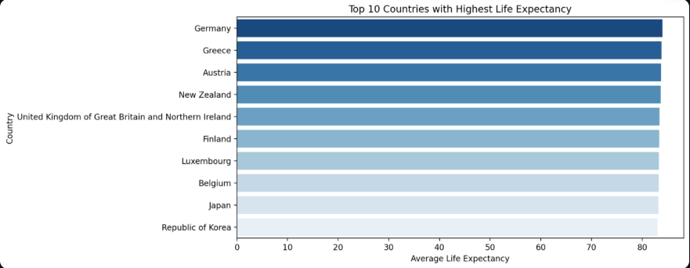
Top 10 Countries with Highest Life Expectancy
This bar chart presents the top 10 countries with the highest average life expectancy between 2019 and 2025. These countries typically have strong healthcare systems, high GDPs, and better access to education and nutrition.

Slide 3
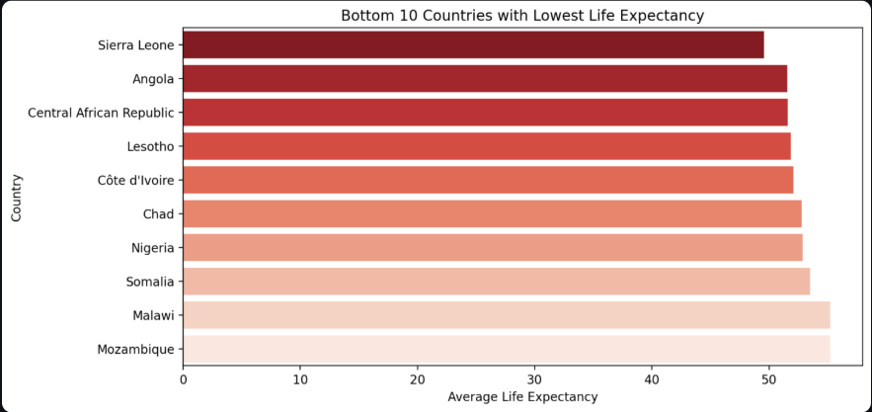
Bottom 10 Countries with Lowest Life Expectancy
This bar chart highlights the 10 countries with the lowest average life expectancy. Common factors include limited healthcare access, high disease burden, and economic challenges.

Slide 4
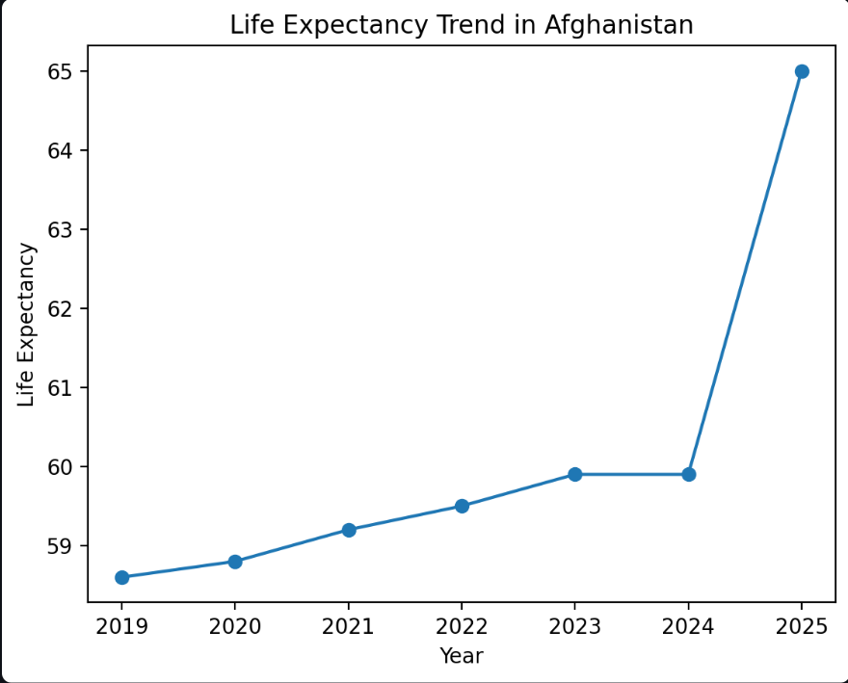
Life Expectancy Trend Over Time
This line plot shows life expectancy changes over time for a selected country. It helps analyze national trends and the effectiveness of public health and economic policies.

Slide 5
Factors Affecting Life Expectancy
Scatter plots illustrate correlations between life expectancy and various factors such as:
- Adult Mortality
- Alcohol Consumption
- Healthcare Expenditure
- HIV/AIDS Prevalence
- Schooling
These help identify which factors most influence longevity.

Slide 6
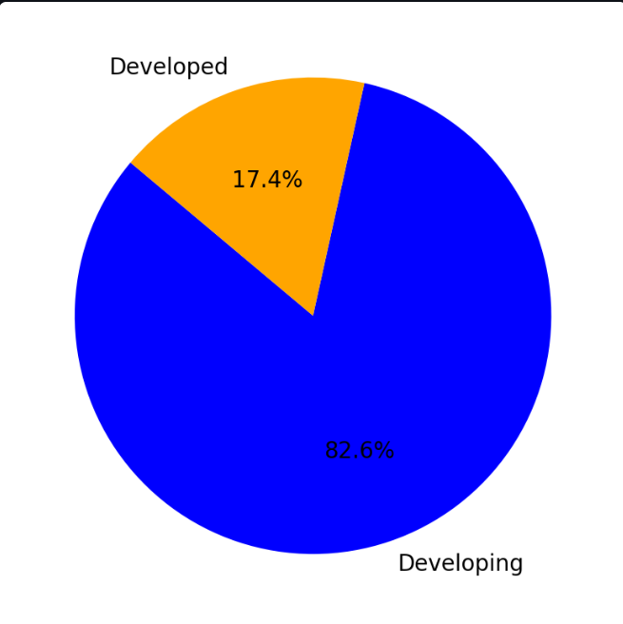
Proportion of Developed vs Developing Countries
This pie chart shows the proportion of observations in the dataset from developed and developing countries. Such classification aids in comparative analysis.

Slide 7
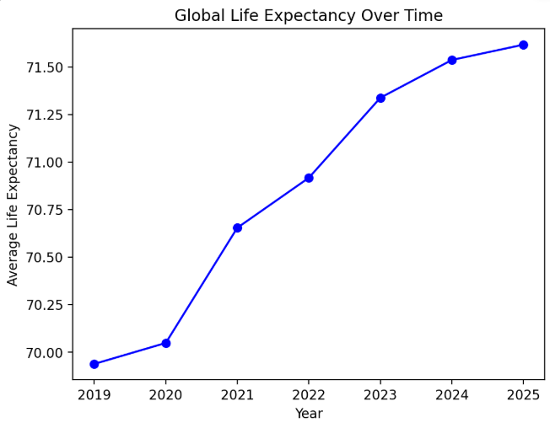
Global Life Expectancy Over Time
This line plot depicts the global average life expectancy from 2019 to 2025. An upward trend would indicate overall improvement in global health outcomes.

Slide 8
Conclusion
- Economic prosperity, healthcare accessibility, and education strongly influence life expectancy.
- High infant mortality and HIV/AIDS prevalence decrease life expectancy.
- Developed countries tend to have better life expectancy indicators.
Policy focus on these areas can enhance national health outcomes.

Slide 9
Prediction Feature Overview
The app provides a predictive tool using Linear Regression or SVR.
Users can select a country and forecast future life expectancy based on the most recent data and a selected year.
This helps in planning and evaluating public health strategies.

Slide 10
Steps to Run the Application Locally
1. Ensure Python is installed on your system (preferably Python 3.8 or newer).
2. Install required packages:
pip install streamlit pandas numpy matplotlib seaborn scikit-learn
3. Save the file as 'app.py' in your working directory.
4. Place the dataset CSV file in the same directory (or upload it via the app UI).
5. Run the Streamlit app:
streamlit run app.py
6. The application will open in your default web browser.
7. Use the sidebar to upload a CSV file and explore visualizations and predictions.

