Slide 1
Parallel Single/Multi-Turn Reinforcement Learning for LLM Agent Training
Team 4
Nikhil Pandey and Pradyumna Raghavendra

Slide 2
Project Overview
PROBLEM
  • Training LLMs with RL is computationally expensive
SOLUTION
  • Parallelize using PyTorch Distributed Data Parallel (DDP)
GOAL
  • Reduce training time while maintaining accuracy
KEY RESULT
  • 51 min → 31 min (1.63× speedup, 81.5% efficiency)

Slide 3
Introduction
RESEARCH PAPER
  • Incentivizing Reasoning Capability in LLMs via Reinforcement Learning- DeepSeek- R1
KEY INNOVATION: A*PO ALGORITHM
  • A* = Advantage-weighted
  • PO = Policy Optimization
THREE COMPONENTS
1. Policy Model (π): Generates actions (text)
2. Reference Model (π_ref): Provides stability via KL divergence
3. Value Function (V*): Estimates expected reward
LOSS FORMULA
Loss = -E[A(s,a) · log π(a|s)] + β · KL(π || π_ref)

Slide 4
System Architecture
MODEL SPECIFICATIONS
  • Base Model: Qwen2.5-3B (3 billion parameters)
  • Size: 12 GB model weights
  • Memory: 35 GB per GPU (with activations)
TRAINING CONFIGURATION
  • Optimizer: 8-bit AdamW (memory-efficient)
  • Batch Size: 4 (baseline) / 2 per GPU (DDP)
  • Gradient Accumulation: 4 steps
  • Effective Batch: 16 (constant)

Slide 5
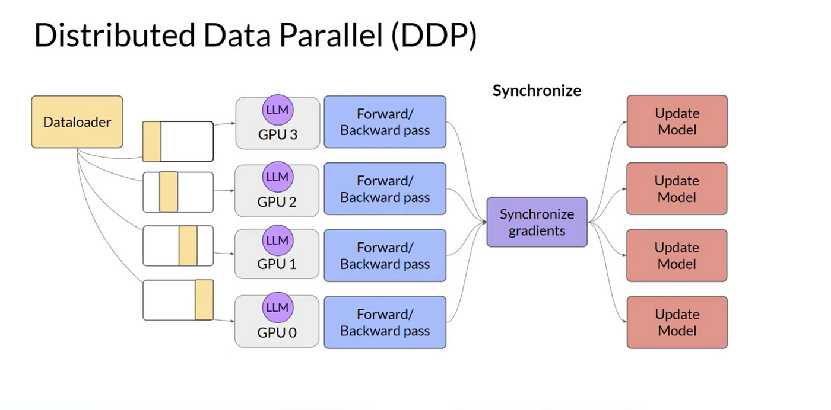
How DDP Works
  • Replicate model on each GPU
  • Split data across GPUs
  • Synchronize gradients after backward pass
  • Policy model: Wrapped with DDP (synchronized)
  • Reference model: NOT wrapped (frozen, independent copies)

Slide 6
Experimental Configuration
Parameter | CPU | 1 GPU | 2 GPUs | 4 GPUs
Hardware | CPU | 1× H100 | 2× H100 | 4× H100
Time | 4 hours | 51 min | 31 min | 20 min
Batch/GPU | N/A | 4 | 2 | 1
Effective Batch | N/A | 16 | 16 | 16
Total Steps | 200 | 200 | 200 | 200
V* Samples | 5 | 5 | 2 | 2
Best Accuracy | - | 84% | 76% | 82%

Slide 7
Training Performance Results
Metric | CPU | 1 GPU | 2 GPUs | 4 GPUs
Time | 240 min | 51 min | 31 min | ~20 min
Speedup | 0.21× | 1.00× | 1.63× | ~2.5×
Efficiency | - | - | 81.5% | ~62.5%
Cost |  | $3.40 | $4.16 | $5.33

Slide 8
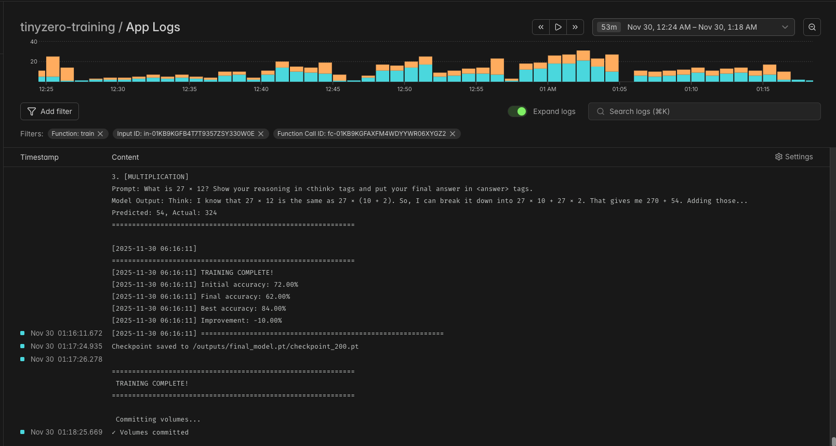
Results- 1 GPU

Slide 9
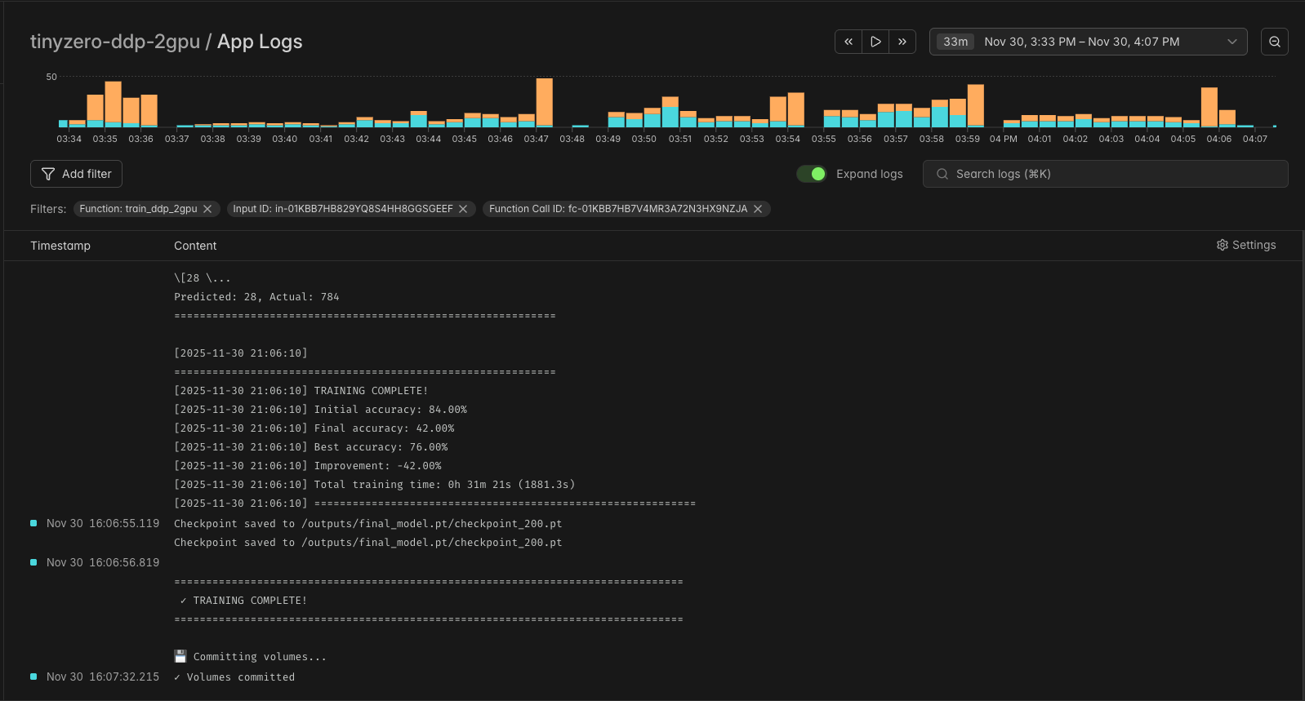
Results- 2 GPUs

Slide 10
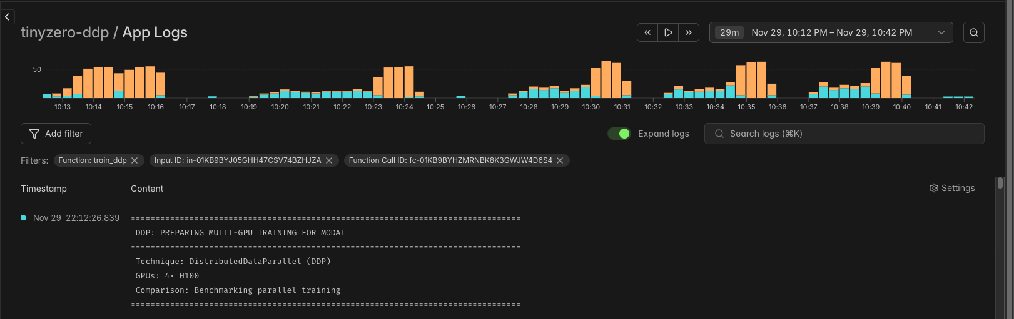
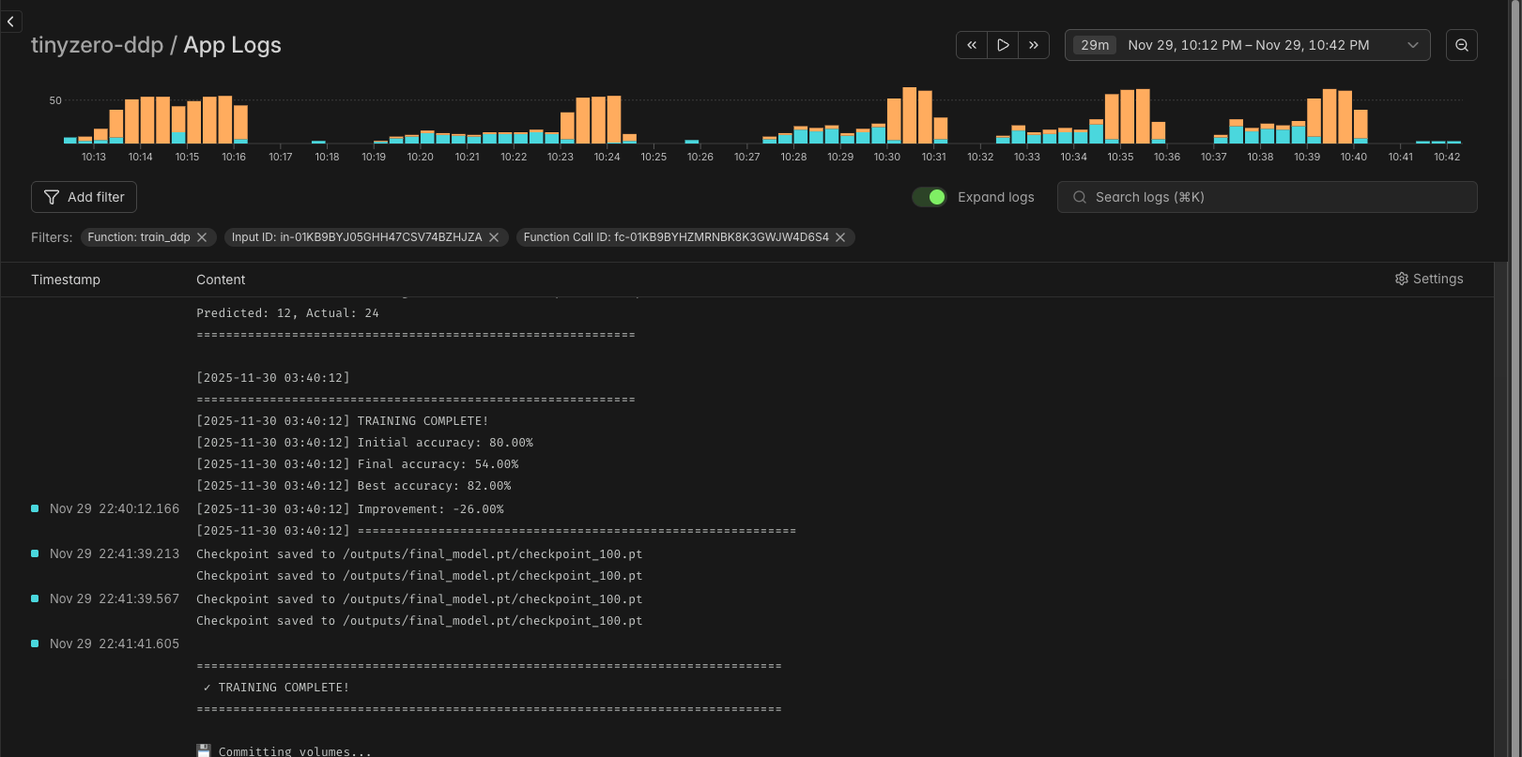
Results- 4 GPUs

Slide 11
Scalability Analysis - Model Size Matters!
Why not DDP with 4 GPUs?
Problem 3: Diminishing Returns → 28% more cost, only 11 min faster, 30% worse accuracy
Problem 4: Communication Overhead → More GPUs = more AllReduce
Problem 1: Model Size → 3.5B params ÷ 4 GPUs = Poor utilization
Problem 2: Reward Degradation → V* sampling needs coherent batches

Slide 12
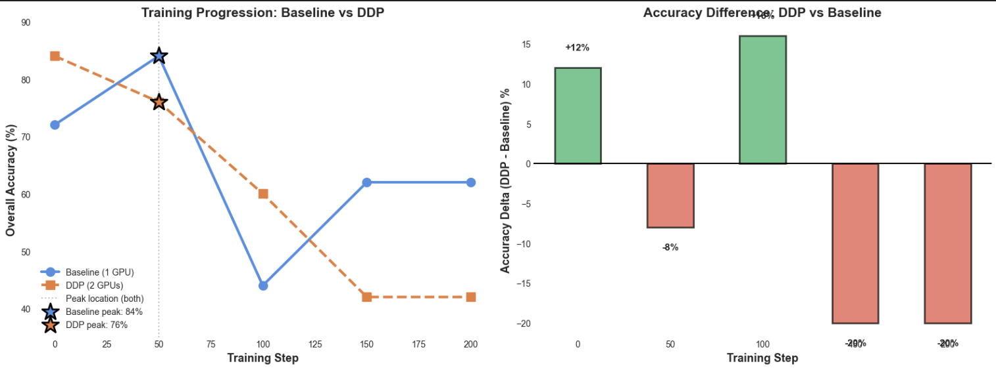
Training Progression and Accuracy difference

Slide 13
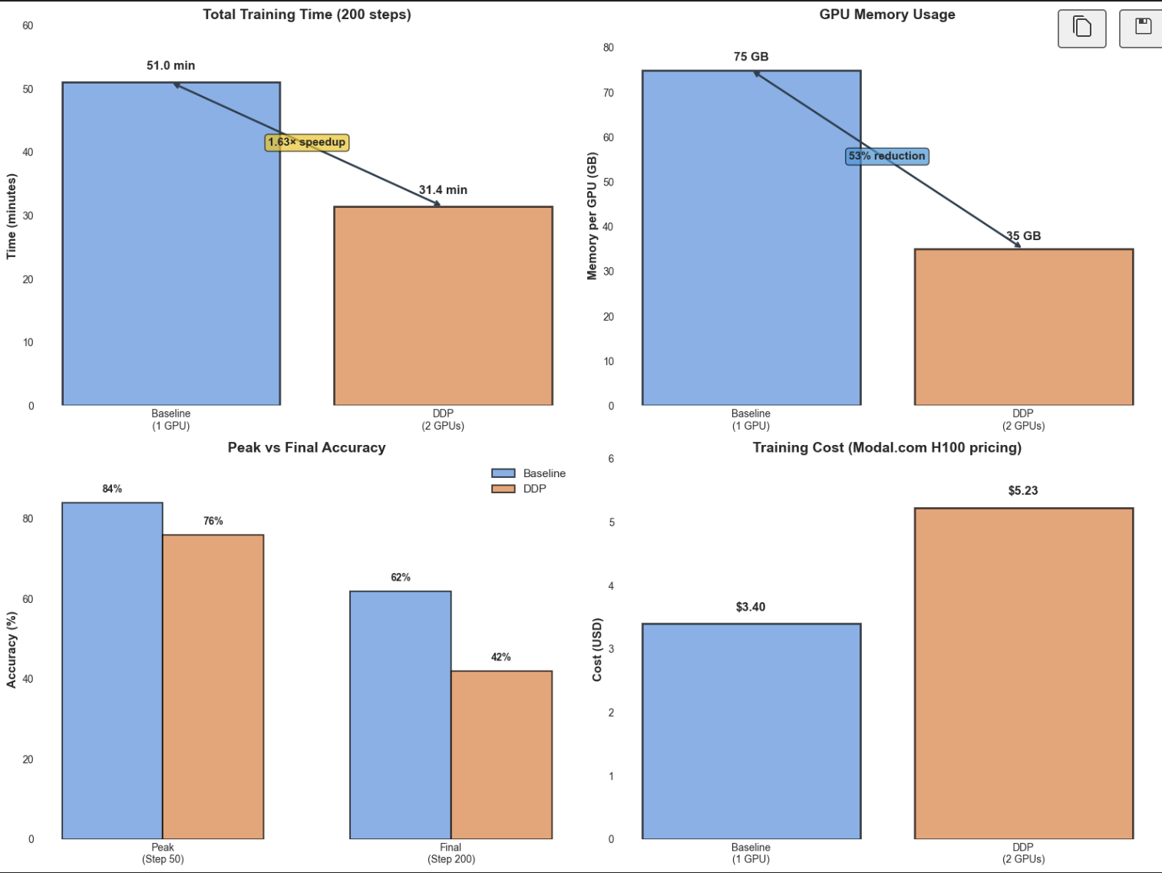
Time, GPU Memory, Accuracy and Costs

Slide 14
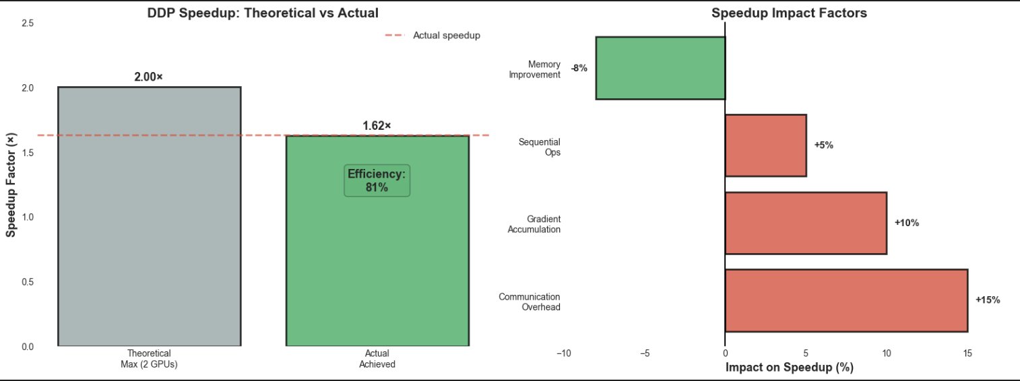
Speedup

Slide 15
Technical Insights
1. DDP IS HIGHLY EFFECTIVE FOR RL TRAINING
• 81.5% efficiency is excellent for 2 GPUs
• NCCL backend minimizes communication overhead
2. MEMORY OPTIMIZATION IS CRITICAL
• Gradient checkpointing essential
• 8-bit optimizers enable larger models
• V* sampling is memory-intensive
3. SELECTIVE PARALLELIZATION
• Policy model: DDP (synchronized)
• Reference model: Independent copies
• Know what to parallelize!
4. CLOUD PLATFORMS ENABLE RAPID EXPERIMENTATION
• Modal: Easy GPU provisioning
• Persistent volumes for checkpoints
• Cost-effective for prototyping

Slide 16
Next Steps & Key Takeaways
KEY LESSON: MODEL SIZE DICTATES GPU COUNT
< 3B params 1-2 GPUs Overhead dominates
3-7B params 2 GPUs Sweet spot
7-13B params 2-4 GPUs Start benefiting
13B+ params 4-8 GPUs FSDP needed
70B+ params 8+ GPUs Pipeline parallel
Proved 2 GPU optimal for 3.5B model (81.5% efficiency)
  • Shared V* Cache across GPUs
  • Mixed Precision (BF16) for memory savings

Slide 17
Detailed Training Progression
Step | Baseline Loss | DDP Loss | Baseline Reward | DDP Reward
0 | 1.9041 | 1.3531 | 0.500 | 1.000
5 | 1.2745 | 0.8982 | 0.550 | 0.700
10 | 0.9745 | 0.4793 | 0.800 | 0.600
20 | 0.6496 | - | 0.850 | -

Slide 18
DDP Communication Overhead
NCCL ALLREDUCE PERFORMANCE
  • Bandwidth: ~200 GB/s (H100 NVLink)
  • Gradient size: 12 GB
  • Expected time: 60 ms per step
MEASURED OVERHEAD
  • Average: 100 ms per step
  • Includes: synchronization + data transfer
  • Percentage: ~3% of total step time
OPTIMIZATION POTENTIAL
  • Gradient compression (FP16): 2× reduction
  • Overlap compute + communication: Hide latency

Slide 19
Summary & Conclusion
CPU (4h) → 1 GPU (51m) = 4.7× speedup
DDP: 1 GPU → 2 GPUs = 1.63× speedup
81.5% parallel efficiency
38.5% reduction in training time
Proved 2 GPU optimal for 3.5B models
Complete A*PO implementation on Modal Cloud

Slide 20
Summary & Conclusion
1. DDP parallelization of A*PO algorithm
2. Memory-optimized training (8-bit AdamW + checkpointing)
3. Empirical analysis: CPU, 1, 2, 4 GPUs tested
4. Key finding: Model size determines optimal GPU count

Slide 21
Summary & Conclusion
KEY TAKEAWAYS
1. GPU acceleration is essential: 4.7× faster than CPU
2. More GPUs ≠ Better: 2 GPUs optimal for 3.5B params
3. 4 GPUs failed: Poor accuracy (54%) due to reward degradation
4. Match GPUs to model size: Critical for RL training

Slide 22


