Slide 1


StudyHub
Venture Viability Analysis
MIT World Peace University, Pune

Slide 2

StudyHub
Study Hub centralizes verified, syllabus-aligned study resources for faster exam preparation.
MIT World Peace University, Pune

Slide 3
Context
More than 60% of students spend excessive time searching for study resources instead of learning
3

Slide 4

Problem Statement
Problem
Students struggle to find reliable, syllabus-specific study materials because resources are scattered across multiple platforms.
Impact
Students waste study time, teachers repeatedly share resources, and institutions lack a centralized academic repository.
4

Slide 5

Problem Statement/Industry
Problem Being Solved
Engineering Students struggle to find reliable, syllabus-relevant study materials because resources are scattered across multiple websites, apps, and messaging groups. This leads to wasted time, information overload, and dependence on outdated or inaccurate content, reducing learning efficiency and exam preparedness.
Supporting Data
More than 60% of students spend excessive time searching for study resources instead of learning
Source: UNESCO Global Education Monitoring Report & AISHE, Ministry of Education, India
Area
Education
Industry
Education & Training
Domain
EdTech

Slide 6



Problem Analysis
Affected Stakeholders
The problem affects college students, educators, educational institutions, and student communities. Students struggle to access quality learning resources, teachers spend time repeatedly sharing materials, and institutions lack a centralized system to organize and distribute academic content.
Impact on Stakeholders
Students lose valuable study time searching for notes, previous-year papers, and reference material, often using unreliable sources. Teachers repeatedly share the same resources with different batches. Institutions face inconsistent learning outcomes due to the absence of a structured and accessible repository.
Root Causes
Academic resources are spread across multiple platforms such as messaging apps, cloud drives, websites, and personal devices. There is no standard format for organizing content, search options are limited, materials become outdated, and many students are unaware of reliable sources relevant to their syllabus.
Personal/Team Connect
As students, we have experienced the frustration of searching through multiple WhatsApp groups, Google Drives, and websites to find notes and previous-year papers before exams. We believe every student should be able to access reliable, organized study resources quickly, regardless of their college or branch.a

Slide 7

Target Customer Segments
Primary
School and college students in India seeking syllabus-relevant study material preparation
Secondary
Educational institutions looking for a centralized resource repository for
students
5

Slide 8

Customer Segment & Persona
Primary Segment
School and college students in India seeking syllabus-relevant study material preparation
Persona
Secondary Segment
Educational institutions looking for a centralized resource repository for students
kamonmi
Age in years: 20 Location: Metropolitan
Organizational Role: {Persona's
primary role}
(if applicable)

Slide 9
Customer Profile
Education: High school pass out
Gender: Female
Occupation: Student
Interests/Hobbies: Sports and Fitness
Primary Source of Information: News Apps
Shopping Preference: Hybrid Comfort with Technology: High Favourite Social Media: X
Favourite Offline Gathering Spots: cafes

Slide 10

Jobs-to-be-Done
Functional JTBD
Find reliable, syllabus-aligned study materials quickly Access notes, previous-year question papers, question banks, and revision resources in one place Verify whether study material is relevant to the current syllabus Organize study resources by subject and upcoming exams Reduce time spent searching across websites, YouTube, WhatsApp, and Telegram
Emotional JTBD
Feel confident that she is studying accurate and relevant material Feel less stressed and overwhelmed during exam preparation Feel in control of her study schedule and resources Feel reassured that she is not missing important topics or questions Feel motivated and prepared rather than anxious about upcoming exams
Social JTBD
Maintain or improve her academic performance compared with peers Gain recognition from classmates for being well-prepared Receive appreciation from teachers and parents for good academic performance Be able to confidently participate in discussions and group study sessions Share useful and reliable resources with friends and classmates

Slide 11


Current Alternatives
Current Alternatives
Searches Google for notes, summaries, and explanations Watches YouTube lectures and revision videos Downloads notes and question papers from different educational websites Uses WhatsApp and Telegram college groups to exchange study material Collects notes from classmates and seniors Uses college-provided study material and learning portals
Gaps in Current Alternatives
Study materials are scattered across multiple websites, apps, and messaging groups It is difficult to determine whether online notes actually match the current syllabus Resources can be outdated, incomplete, duplicated, or inaccurate Searching for the right material takes valuable study time

Slide 12
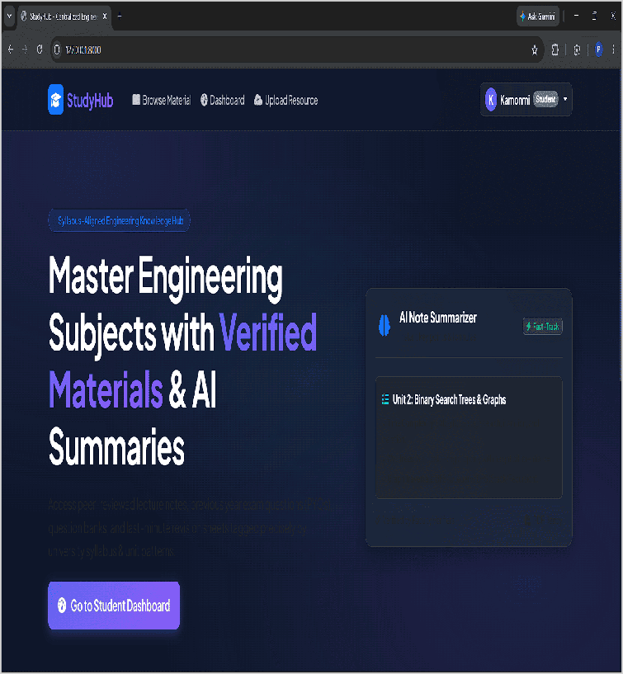
Our Solution
Solution
A website/app where students can find organized and relevant notes, pyqs, and study resources, all verified and categorized by course and subject. (centralized study material platform)
Core Technologies/ Methodologies
React.js, Node.js, PostgreSQL, Firebase, AWS, Elasticsearch and AI for search, categorization, summaries and recommendations.
6

Slide 13

Solution Design
Our Solution
A website/app where students can find organized and relevant notes, pyqs, and study resources, all verified and categorized by course and subject. (centralized study material platform)
Key Features
Verified notes, PYQs and question banks; smart search, filters, personalized dashboard, bookmarks, downloads, AI summaries and resource reporting.
Uniqueness
Syllabus-first organization, resource verification and AI-assisted discovery help students find relevant, trustworthy study material faster.
Solution Format:
Digital web and mobile study platform
Core Technologies/ Methodologies:
React.js, Node.js, PostgreSQL, Firebase, AWS, Elasticsearch and AI for search, categorization, summaries and recommendations.

Slide 14

Solution Benefits
Functional Benefits
Study using resources organized according to their syllabus Access notes, PYQs, question banks, and revision resources in one place Reduce time spent searching across multiple platforms
Emotional Benefits
Feel confident that the material being studied is relevant and reliable Reduce stress caused by searching through scattered resources Feel more organized and in control of exam preparation
Social Benefits
Improve academic performance compared with peers Gain recognition from classmates for being well-prepared Participate more confidently in discussions and group study
Macro Benefits
Study Hub improves learning efficiency by reducing search time, providing organized access to study resources, and enabling students to access and share quality digital materials.

Slide 15


Competitors
Direct
Nexus Notes, Notesgen, Stuvia India, CollegeNotes.in Studocu, Course Hero, OneClass, Docsity
Indirect
Google Drive, WhatsApp, Telegram, College LMS/ERP Portals Khan Academy, Coursera ,Udemy, YouTube, Google Classroom
Our UVP
Find reliable, syllabus-aligned study resources faster, all in one place.
7

Slide 16

Competitors
Direct Competitors
Nexus Notes, Notesgen, Stuvia India, CollegeNotes.in
Indirect Competitors
Google Drive, WhatsApp, Telegram, College LMS/ERP Portals
Direct Competitors Globally
Studocu, Course Hero, OneClass, Docsity
Indirect Competitors Globally
Khan Academy, Coursera
,Udemy, YouTube, Google Classroom

Slide 17
Macro Analysis
Favourable Trends
AREA | DESCRIPTION
Technology | Growing adoption of digital learning increases demand for online study resources.
Technology | AI-powered search enables faster discovery of relevant study materials.
Unfavourable Trends
AREA | DESCRIPTION
Technology | Free AI tools may reduce demand for dedicated study resource platforms.
Other | Growing competition in EdTech makes user acquisition more difficult.
Data Sources:
AISHE (Ministry of Education), UNESCO GEM Report, UGC, Statista, World Economic Forum

Slide 18
Back-of-the-Envelope Financial Projections
Currency: Indian Rupee (INR)
Chosen Business Model: Subscriptions
AREA | YEAR 1 |  | YEAR 2 | YEAR 3
Revenues | 360000 | 630000 | 1108800
Total Expenses | 616000 | 665300 | 833168
Profit | -256000 | -35300 | 275632

Slide 19
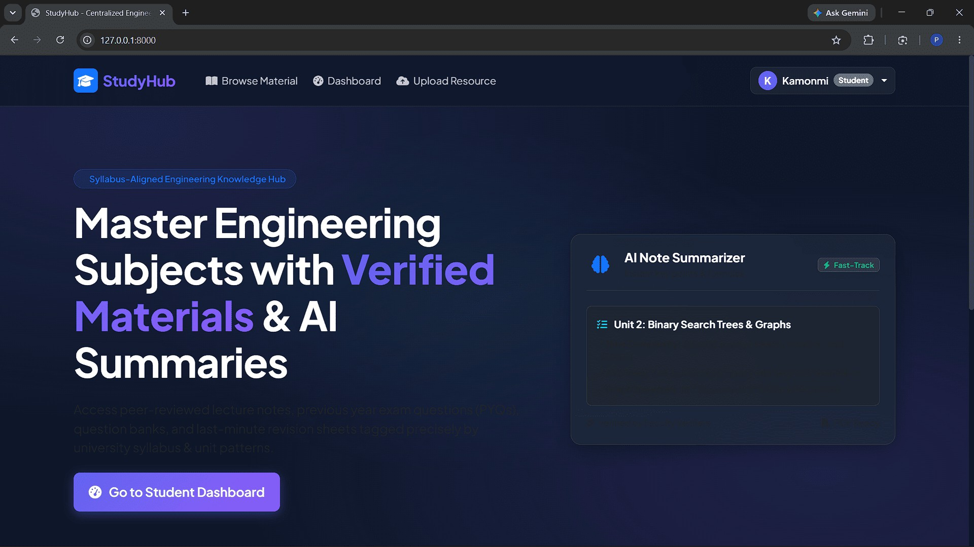
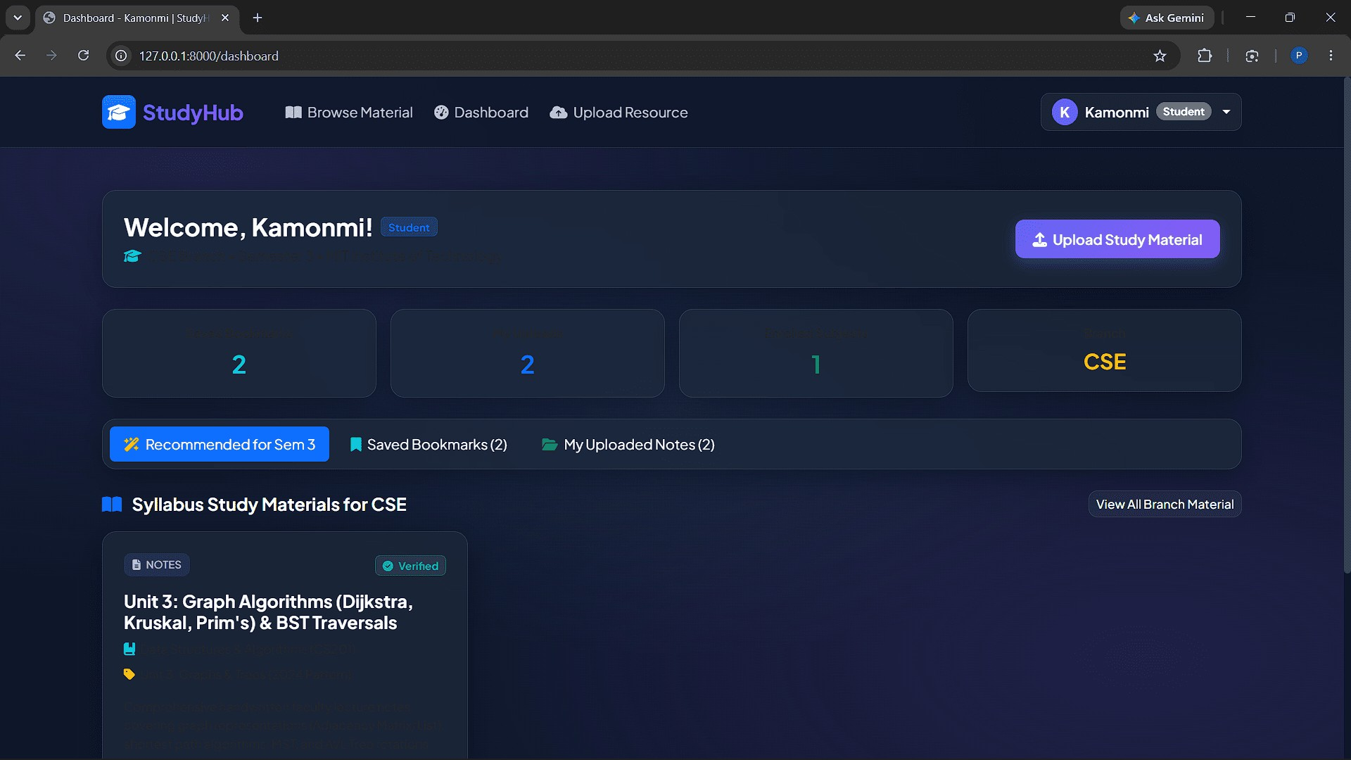
Prototype
Prototype Format
Digital functional prototype — a working web app (Python/FastAPI + HTML/Bootstrap)
Functionality included in the Prototype
Signup/login, course selection, personalized dashboard, resource upload, search/filters, verified badges, bookmarking, and downloads — the full discover-to-access flow.
Functionality NOT included in the Prototype
AI summaries, full moderator workflow, reporting/flagging, semantic search, admin panel, notifications, cloud storage, and payment features

Slide 20
Revenue Models / Pricing
Revenue Model (Primary)
Freemium Model
Revenue Model (Secondary)
Data Monetization model

Slide 21



Lean Canvas
 | Solution A website/app where students |  |  | Unfair Advantage A growing database of syllabus-
Problem Students struggle to find reliable, syllabus- specific study | can find organized and relevant notes, pyqs, and study resources, all verified and categorized by course and subject. (centralized study material platform) | Unique value Proposition Find reliable, syllabus-aligned study resources faster, all in one place. |  | linked resources, student feedback, usage insights, and personalized recommendations can create a data and content advantage that becomes harder to replicate. | Customer Segment School and college students in India seeking syllabus- relevant study material preparation,Educational
materials |  |  |  |  | institutions looking for
because |  |  |  |  | a centralized resource
resources are scattered across multiple platforms. |  |  |  |  | repository for students
 | Key Metric |  |  | Channels
 | User registrations, monthly |  |  | Direct web and mobile
 | active users, retention, searches, |  |  | platforms, college partnerships,
 | resource views/downloads, |  |  | student ambassadors, campus
 | premium conversion, revenue |  |  | outreach, educational
 | per user, engagement, and |  |  | communities, referrals, and
 | customer satisfaction. |  |  | student social-media networks.
Cost Structure |  |  | Revenue Streams
Platform development, cloud hosting and storage, AI/API costs, |  |  | Freemium Model, Data Monetization model
content verification, cybersecurity, customer support, maintenance,
and marketing and user acquisition.

Slide 22
Financials
Revenue Models/Streams
Freemium Model
Data Monetization model
First Year Projections
Revenues: ₹80,92,800
Operating Profits:
₹3,57,120
Pricing
Unit of Sale: Monthly Subscription
Selling price per unit: ₹99 per
month
9

Slide 23
Revenue Models / Pricing
Revenue Model (Primary)
Freemium Model
Unit of Sale
Monthly Subscription
Sale Price per Unit
₹99 per month
Expected units to be sold in Year 1
60 Subscriptions
Expected growth in monthly sales
5% per month

Slide 24
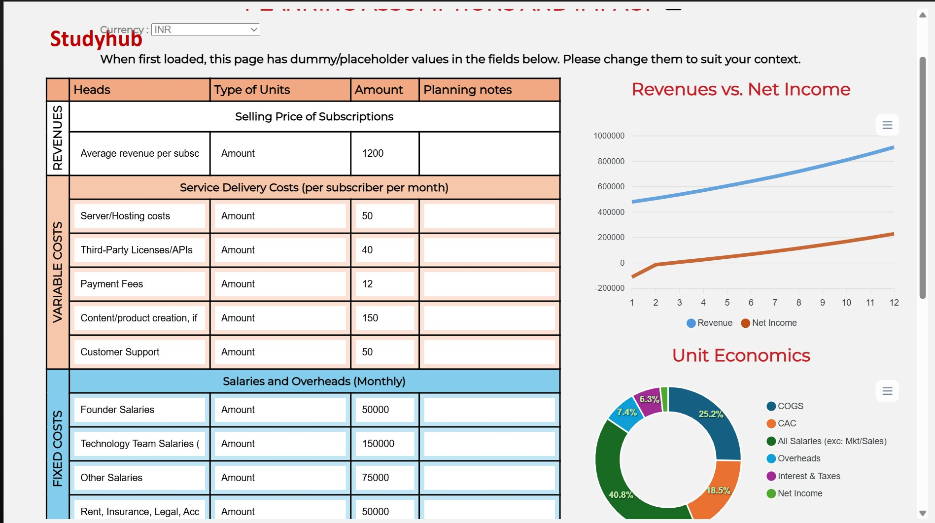
Costs & Revenues: Key Assumptions

Slide 25
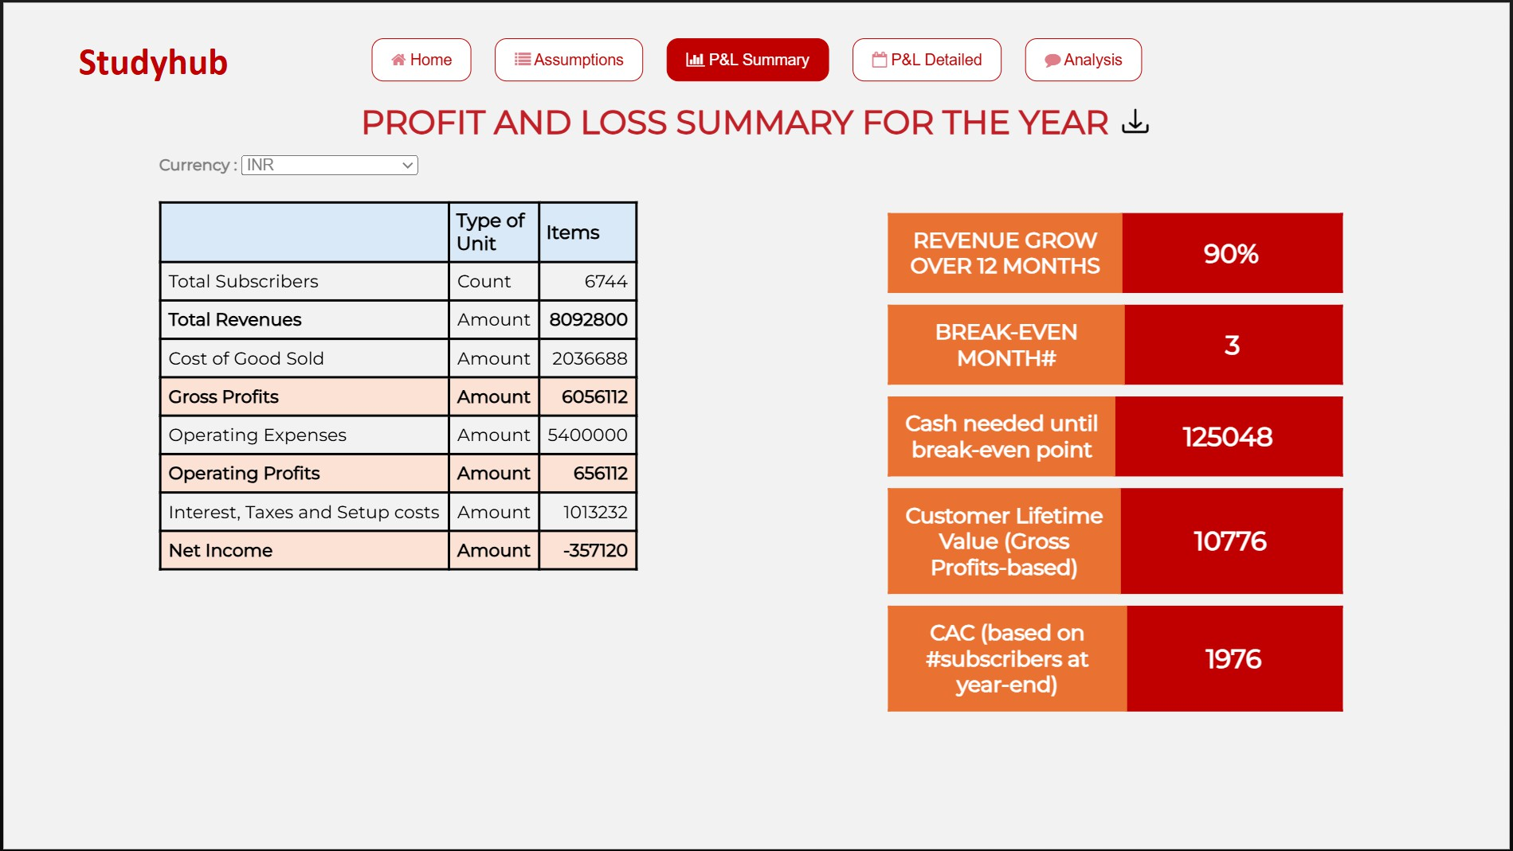
Profit & Loss Projections: Summary

Slide 26
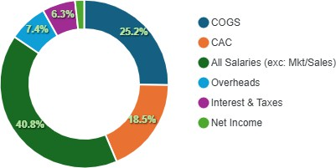
Performance & Break-Even Analysis
Year 1 Revenues ₹80,92,800 | Gross Profits for Year 1 ₹60,56,112
Net Profits for Year 1 ₹3,57,120 | Break-even Month Month 3

Slide 27

Thank You!

