Slide 1
Saint Patrick´s Day
by Richard Stöckl
Notes:
Hello ladies and gentlemen, today im gonna present you the Saint Patrick´s day.

Slide 2
Content
general information
History
locations
Saint Patrick
celebration
Leprechaun
comparison
Notes:
First of all this slide shows you, what the presentation does contain. As you can see it here i m going to tell you something about…
Last but not least

Slide 3
What is Saint Patrick´s Day?
date of death of Saint Patrick
17th March
cultural and religious celebration
official christian feast day
Notes:
In general, Saint Patrick´s Day is the date of death of Saint Patrick but it is not fully unambiguous due to the findings of some historians. It is an christian fest day however also people with another religions celebrate it.

Slide 4
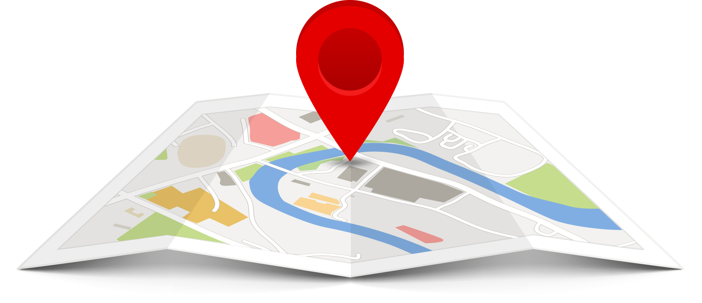
Locations
not only in Ireland
all over the world
irish emigrants
parade also in München
Notes:
Ireland is not the only location where Saint Patrick´s Day is being celebrated. People all over the world celebrate it especially irish emigrants and a couple of people in München where also a parade takes place.

Slide 5
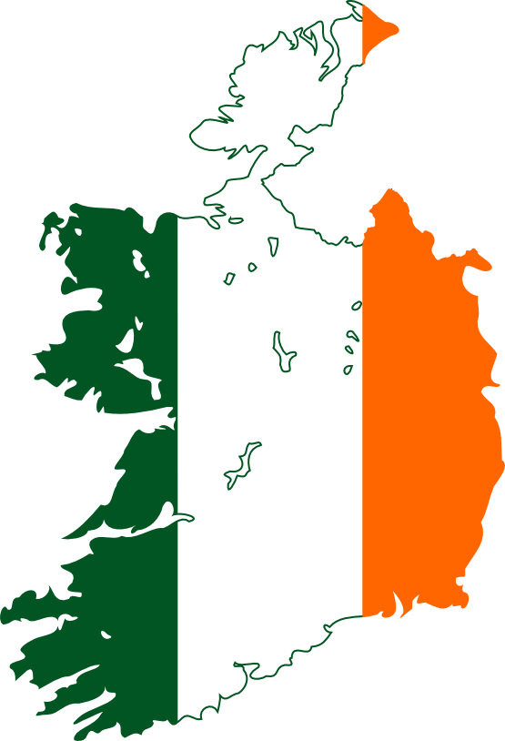
Ireland
since 9th century
public holiday since 1903
parades since 1931
Notes:
The irish population celebrates Saint Patrick´s Day since the 9th century but on the other hand it is a public holiday as of 1903. Also the founding day of the parades is not a long time ago.

Slide 6
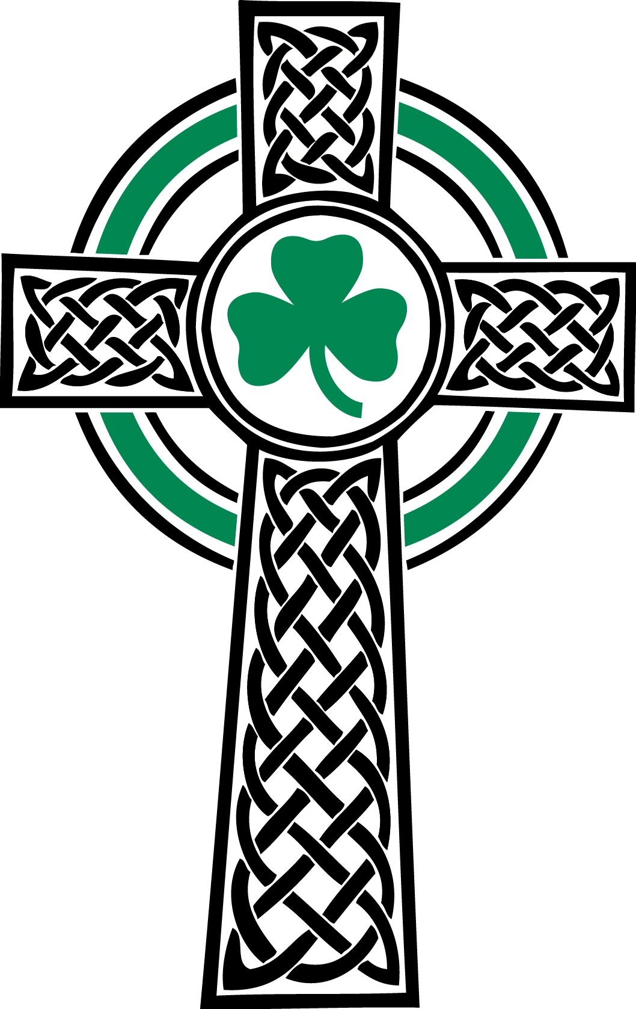
Celebration
„Wearing Green“
wearing the shamrock
wearing the Saint Patrick´s Cross
Leprechaun
Notes:
On Saint Patrick´s Day, the irish population reveal their mood by wearing green the shamrock, the Saint Patrick´s cross and by illustrating the Leprechaun

Slide 7
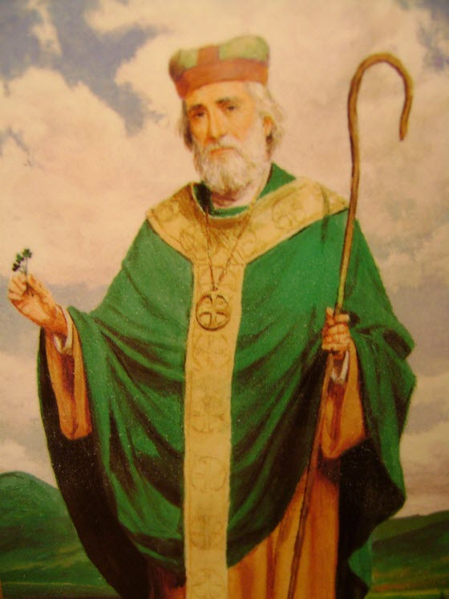
Who is Saint Patrick?
irish bishop
lived in the 5th century
lots of missing information
most details in the 7th century
Notes:
At least 2 persons
Important for catholic church and anglican communion

Slide 8
Life of Saint Patrick
born in Britannia
kidnapped when he was 16
hard work
found consulation by god
fled after 6 years
went back to Ireland
Notes:
Saint Patrick was born in Britannia. Has was kidnapped and brought to Ireland by slavedrivers. In Ireland, Saint Patrick had to do a hard work, so he found consulation by God. After six years he successfully fled to Britannia. A few years later, he had a vision from an angel named victorious who said to him that the irish population needs him, so he went back to Ireland, became a priest, later a bishop and built churches there.All in all most hisorians belive that saint patrick was at least two persons. Because of the findings they made.

Slide 9
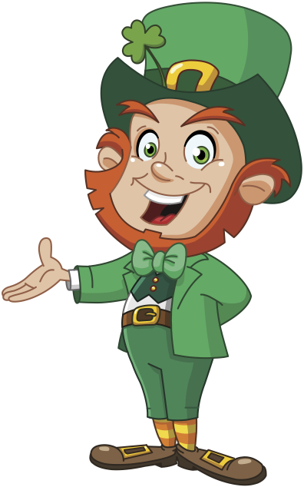
Leprechaun
irish mythology
unique appearance
makes and mends shoes
type of a fairy
can grant wishes

Slide 10
Comparison

Slide 11

Comparison

Slide 12
Comparison

Slide 13
Thank you for your Attention
wikipedia.org
iwin.com
njfamily.com
tekrevue.com
ireland.com
luxuryeyesite.com
www.stpatrick.cdsbeo.on.ca

