Slide 1
CARD STACK-SWIPER

Slide 2
Library
“npm install react-native-card-stack-swiper"
"npm install react-native-gesture-handler“
" npm install react-navigation“
------------------------------------------------------------------------------
Github: https://github.com/Praepilai2626/Object2

Slide 3
Assets
-Data
-Demo_shoe.js
-Shose.js
-รูปรองเท้า.jpg
-Style
-Index.js
Components
-CardItem.js
-Icon.js
Container
-Home.js
-Hshoe.js

Slide 4
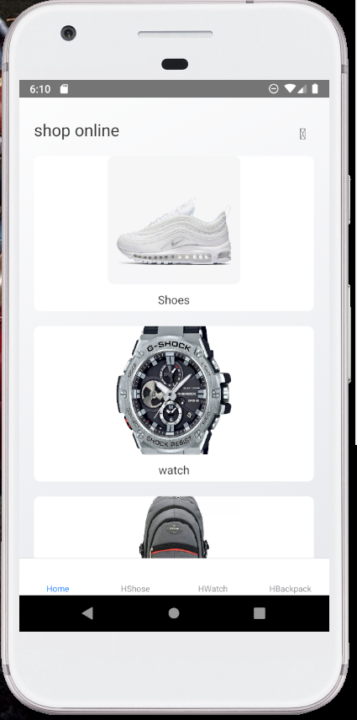
import React from 'react';
import styles from '../assets/styles';
import { ScrollView, View, Text, TouchableOpacity,
ImageBackground, FlatList } from 'react-native';
import CardItem from '../components/CardItem';
import Icon from '../components/Icon';
import demo_shoe from '../assets/data/demo_shoe';
HOME.js

Slide 5
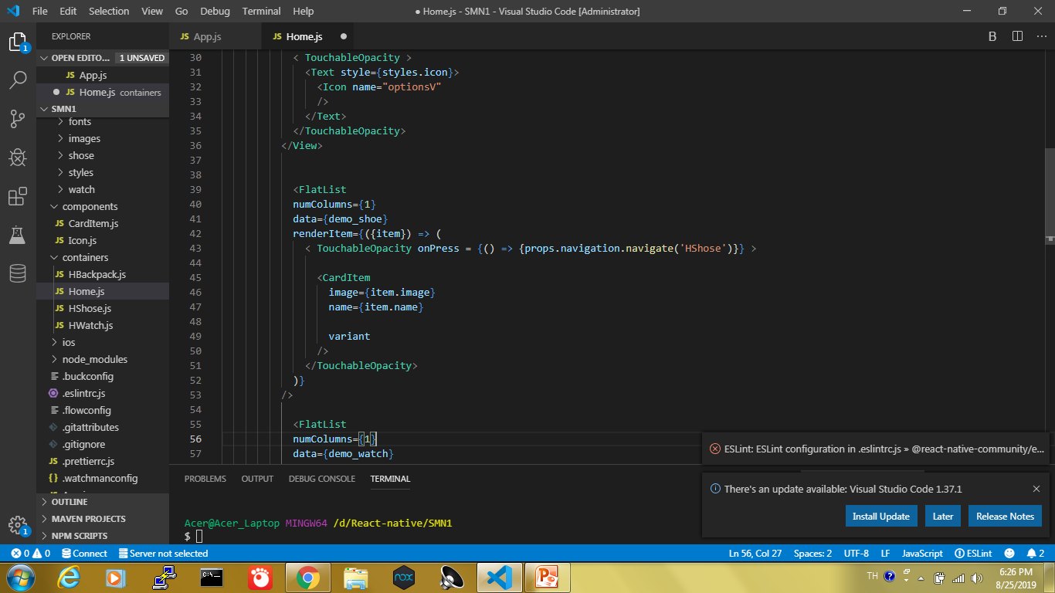

Slide 6

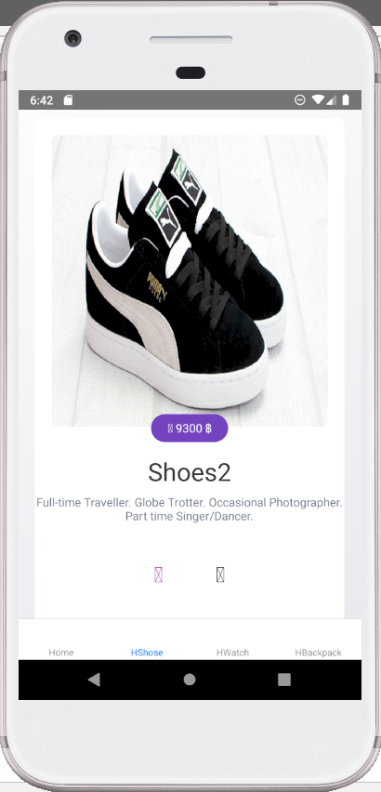
HShose.js
import React from 'react';
import { View,TouchableOpacity, ImageBackground,
Button, Linking } from 'react-native';
import CardStack, {Card} from 'react-native-card-stack- swiper';
import CardItem from '../components/CardItem';
import styles from '../assets/styles';
import shose from '../assets/data/shose';

Slide 7
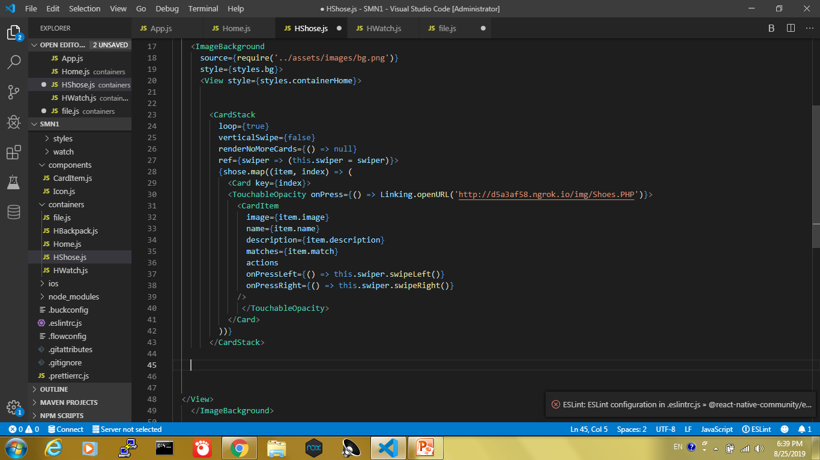

Slide 8
Thanks!

