Slide 1


Learning-
Augmented K-Means:
PCA Integration
A Survey on Improving Clustering for High-Dimensional Data
Presented by:
Praful John
CMPE 255

Slide 2
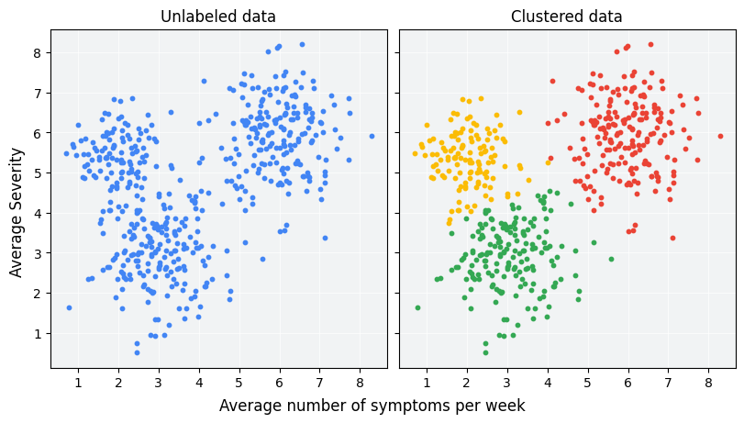
CLUSTERING
What is Clustering?
Grouping similar data points based on shared characteristics.
Widely used in customer segmentation, image analysis, and network analysis.

Slide 3
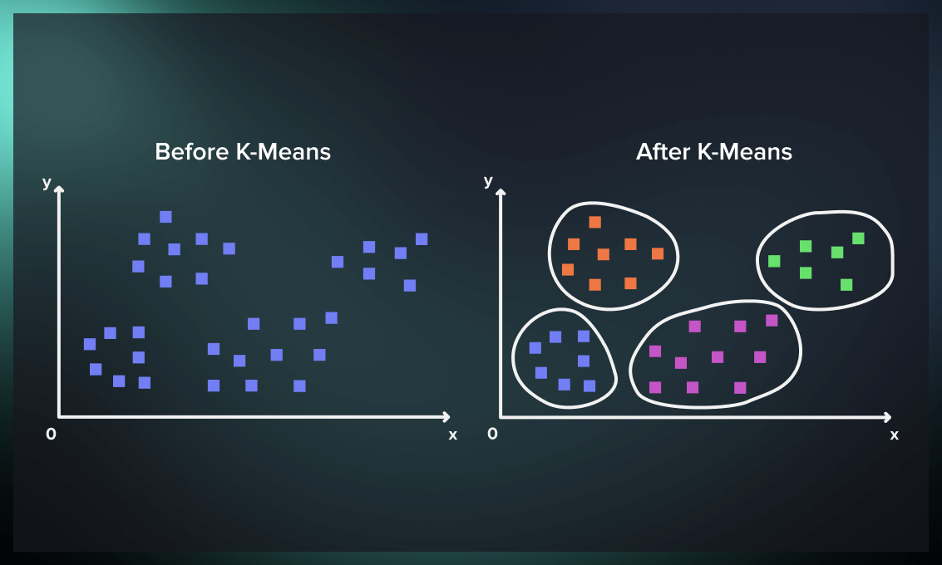
What is K-Means?
A popular clustering algorithm that partitions data into kkk clusters.
Relies on centroids (cluster centers) to assign points iteratively.

Slide 4
DIMENSIONALITY REDUCTION
Simplifying data by reducing the number of features while retaining key information.
Necessary for high-dimensional datasets to avoid inefficiency and noise.
PCA
Example:
Reducing a 1000-feature dataset to 10 meaningful features
LZDA
Principal Component Analysis
Linear Discriminant Analysis

Slide 5
Introduction to the Paper
1
Problem Statement
2
Proposed Solution
K-means faces challenges with high-dimensional data: inefficiency, local minima, and poor interpretability.
Combine PCA for dimensionality reduction with k-means clustering, supported by machine learning predictors.
3
Comparative Study
Tested on three datasets (Oregon Graph, PHY Dataset, CIFAR-10), showing PCA reduces costs, improves stability, and enhances interpretability.

Slide 6
THE PROBLEM
K-means struggles with high-dimensional data due to:
Computational Cost
01
Distance calculations scale poorly with more features.
Local Minima
02
Algorithm may converge to suboptimal solutions.
Poor Interpretability
03
High-dimensional clusters are hard to analyze.

Slide 7
THE SOLUTION
Using PCA with K-Means:
PCA reduces dimensionality, retaining only the most significant information.
Simplifies data for faster and more accurate clustering
· The paper proposes PredictorClustering, combining PCA and machine learning predictors with k-means for enhanced clustering.

Slide 8
CHALLENGES IN K-MEANS
Local
Minima
Computational Complexity
Initialization Sensitivity
Poor Interpretability
K-means often converges to suboptimal solutions, especially with high-dimensional data.
Increased dimensionality leads to more distance calculations, slowing the algorithm.
Random initial centroids impact results, causing variability.
Clusters in high dimensions are hard to visualize and understand.

Slide 9
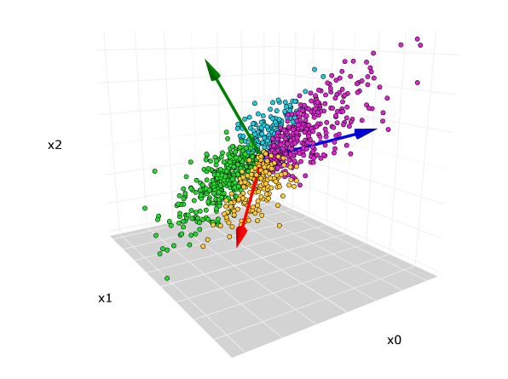

PCA comes for the rescue!
A technique that reduces data dimensionality by extracting principal components

Slide 10
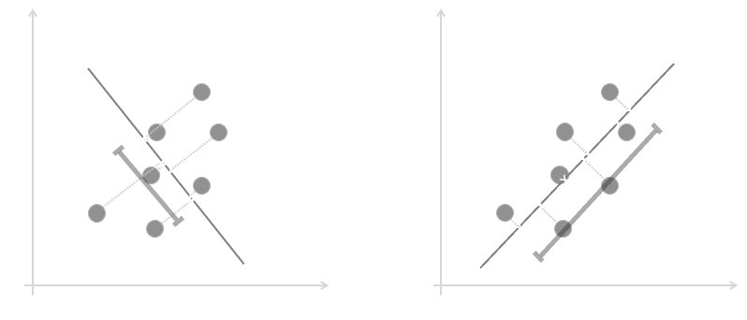
PRINCIPAL COMPONENT ANALYSIS
How it works?
Advantages!
Reduces noise and redundancy
Improves computational efficiency
Enables better visualization (e.g., 2D or 3D plots)
Identify the directions (principal components) with the most variance.
Project data onto these components

Slide 11
PCA BENEFITS
SIMPLIFIES DATA
01
Retains key features while removing noise
02
03
IMPROVES
EFFICIENCY
ENABLES VISUALIZATION
Reduces the number of dimensions, speeding up algorithms like k-means.
High-dimensional data becomes interpretable in 2D or 3D.

Slide 12
PROPOSED SOLUTION
PREDICTOR CLUSTERING
WORKFLOW
PREPROCESSING
Apply PCA to reduce dimensionality
PREDICTOR
Use ML models for initial cluster assignments
CLUSTERING
Apply k-means to refine clusters iteratively.

Slide 13
PREDICTOR CLUSTERING
ADVANTAGES
Reduces clustering costs
01
02
03
Avoids local
minima
Improves scalability for large datasets

Slide 14
DATASETS USED
OREGON GRAPH
PHY Dataset
CIFAR-10
Quantum physics data from the KDD Cup 2004
Image dataset with 60,000 labeled examples across 10 categories.
Network data with node relationships

Slide 15
KEY FINDINGS
Improved clustering costs | Increased stability | Better interpretability
PCA significantly reduced clustering costs across all datasets | Higher kk-values (e.g., k=25k=25) showed consistent and stable clustering | Reduced dimensions allowed for clearer and more meaningful cluster structures

Slide 16
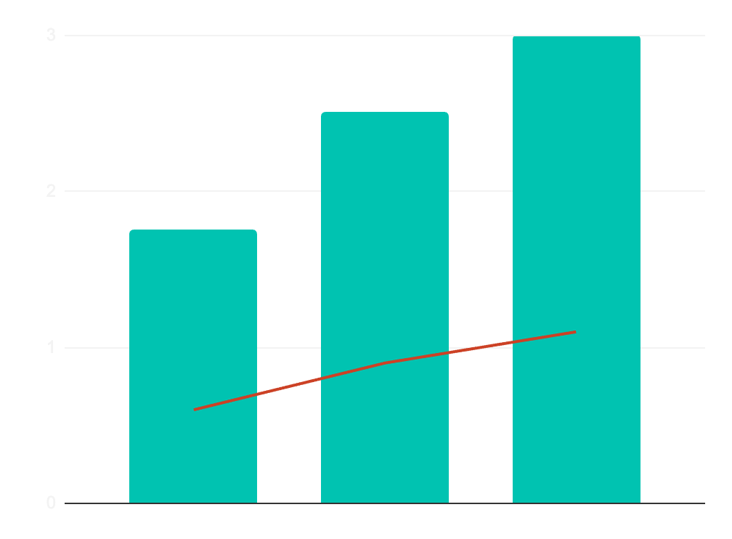
Clustering Cost Comparison
PREDICTED RESULTS
Without PCA
With PCA
Oregon
Dataset
PHY Dataset
CIFAR - 10

Slide 17
CONCLUSION
PCA enhances k-means by reducing dimensionality, clustering costs, and computational complexity.
When to use
o High-dimensional datasets with noise and redundancy.
SUMMARY
It improves interpretability and stabilizes clustering outcomes
Limitation
o May lose information for low-dimensional data.

Slide 18

REFERENCES
1. Jabari, I. K. O., et al. (2024). Learning-Augmented K-Means Clustering Using Dimensional Reduction. arXiv:2401.03198.
MacQueen, J. (1967). Some methods for classification and analysis of multivariate observations. Link to Paper.

