Slide 1


AI/ML Vision club
Yateley Lions and Yateley school

Slide 2
Idea – why, what, where & when
Idea:
Increase the Yateley School students' knowledge about AI/ML
Why:
Yateley & District Lions club would like to provide AI/ML Technology sessions to Yateley school students
What:
Artificial intelligence and Machine learning
Where and When
Yateley School, Friday 3:15pm

Slide 3
What will you do?
Understand
Machine Learning
&
AI models
Code in Python

Slide 4
Tech Requirements
Internet enabled Smart device
Knowledge of python
Google Colab
You

Slide 5


AI/ML Vision
Picture is worth a thousand words
Good analysis is worth millions ☺
How do you analyse a picture?

Slide 6
Image classifications
Where is image classifications used?
Robotics
Remote Sensing
Biomedical imaging
Is Image structured or unstructured?
Image is stored in structured format jpg, png etc. But they don’t contain the relevant information which is of interest to human or computer system.
We will be converting this unstructured image into structured format through image analysis

Slide 7
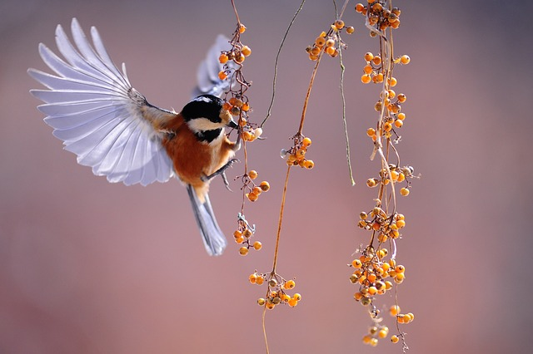
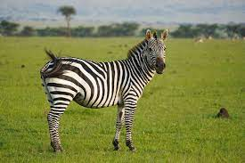
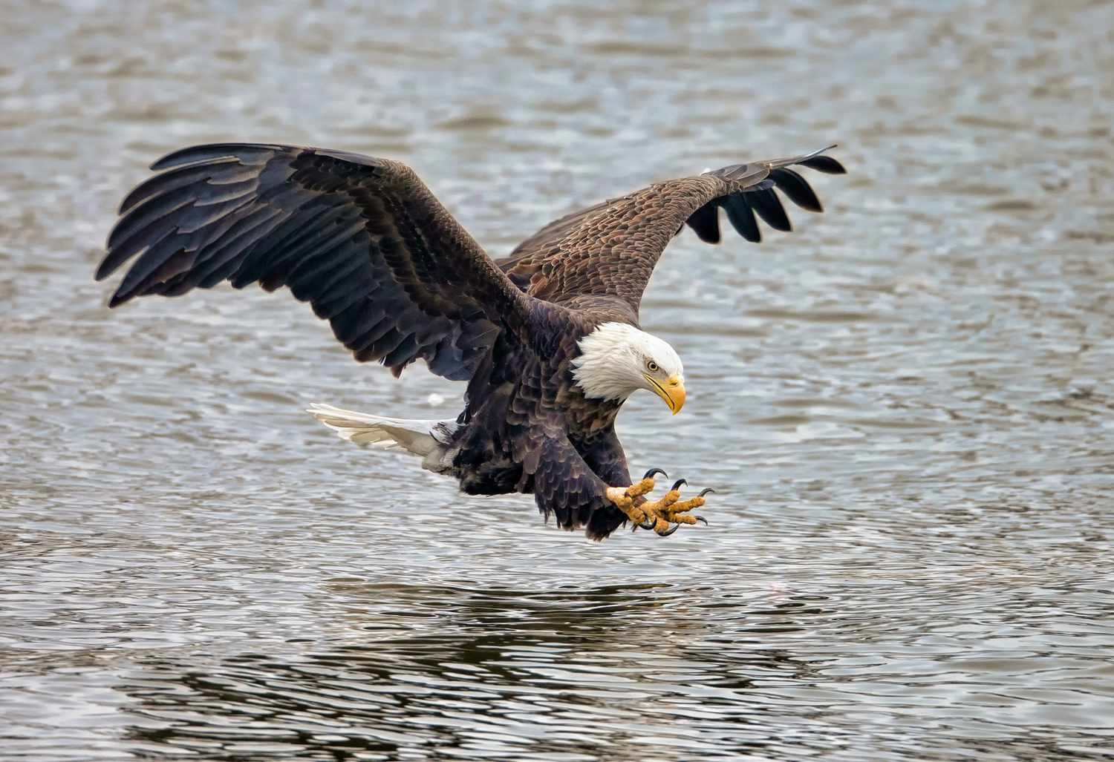
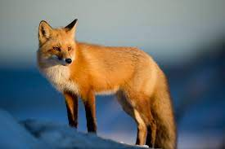
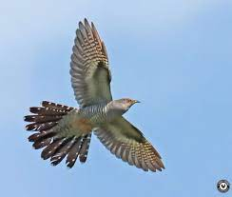
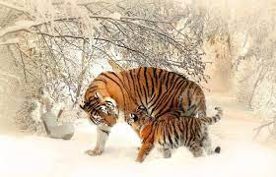
Let’s do Image classifications – Input
Note: Images from Google Search

Slide 8
Let’s do Image classifications – Process
Features, Extractions
Classification 1: Tail, wings, 2 legs, feathers
Classification 2: Tail, head, 4 legs, ?
BIRDS
Animals

Slide 9
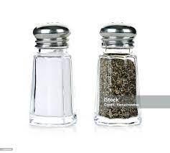
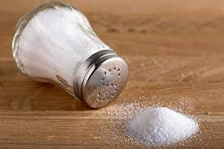
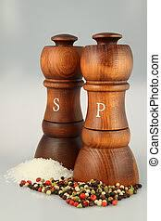
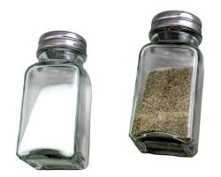
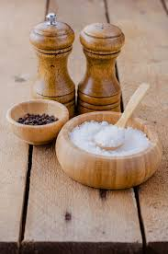
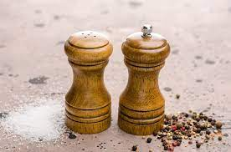
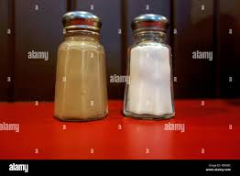
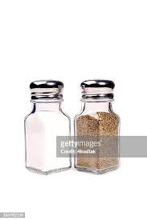
Image classification - Salt
Note: Images from Google Search

Slide 10
Classification process
Get feedback from the students
Which process followed?

Slide 11
Machine learning concepts
How do you learn?
Humans learn from Past Experiences
Computers – Tell to learn from Experiences/data
Analysis and storage happens in your brain
Teach computer (program) to learn to perform tasks from Past Experiences
Someone (including yourself) provides information about object
So what is Past Experience for Computer?
Your eyes (all senses) categories the object and identifies it
Past Experience for Computer is just data
Your Past Experience makes it easier in identification
Let’s teach your program to learn from Past experience

Slide 12
Machine learning concepts
Journey Started!!!

Slide 13
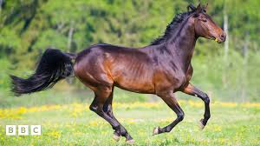
Work this out
Is Horse “acerous”?

Slide 14
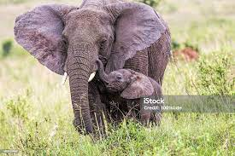
Elephant is “acerous”

Slide 15
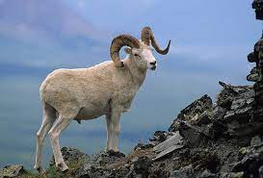
Acerous
Not Acerous
Ram is not “acerous”

Slide 16
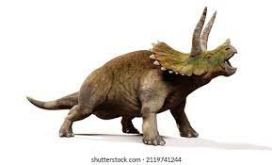
Acerous
Not Acerous
Triceratops is not “acerous”

Slide 17
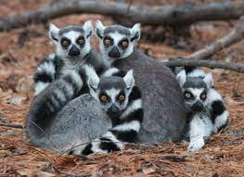
Acerous
Not Acerous
Lemurs are “acerous”

Slide 18
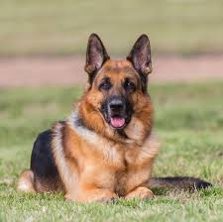
Acerous
Not Acerous
Dog is “acerous”

Slide 19
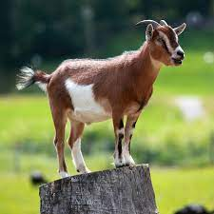
Acerous
Not Acerous
Goat is not “acerous”

Slide 20
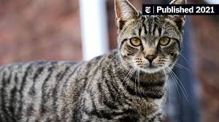
Acerous
Not Acerous
Cat is “acerous”

Slide 21
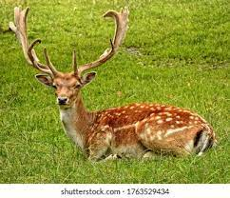
Acerous
Not Acerous
Deer is not “acerous”

Slide 22
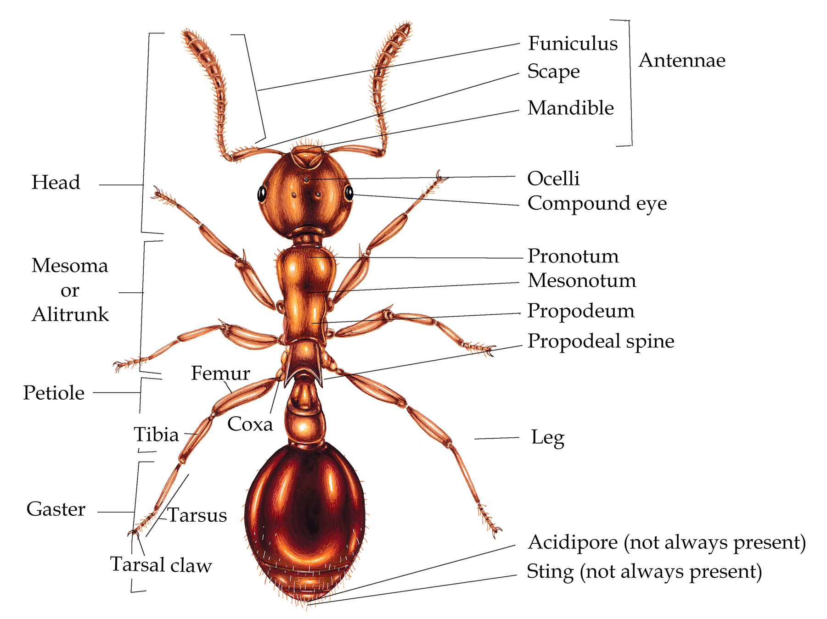
Acerous
Not Acerous
Ant is “acerous”

Slide 23
Acerous
Not Acerous
Now, is Horse “acerous”?

Slide 24
Acerous or Non-Acerous?
If I give you 1000 examples, then your confidence level will increase – Correct?
You will say with higher probability that Horse is ### - Correct?
What features you are extracting – Color, legs, horns, antenna, tentacles etc?
This is what we will be doing in Machine learning
Giving examples, features and attributes

Slide 25
2nd Session
Praful PAsarkar

Slide 26
Supervised learning
Look directly at the words that make-up
Observe and direct the task process and activity
How to Supervise computer?
Create Machine models and teach the model with knowledge (data) to predict the future instances
Model is a program or algorithm
Model enables machine to analyse data, identify patterns and make predictions
Model can adapt to new situations and perform tasks similar to how a human would.
How to teach a Model?
Train the model by providing large dataset
Dataset should have “features”, “attributes” and “observations”
Features
Attributes
Observations

Slide 28

Thank You

