Slide 1
Advantages and limitations of Segmentation methods

Slide 2
1. Segmentation using Reeb graph
The reeb graph extraction from 3D point cloud is a topological method, it is a “mass-driven curve skeleton” that simultaneously presents geometric properties and mass (or density of point cloud) distribution of the 3D mesh into skeleton as a new type of curve skeleton representation for 3D point cloud data. The mathematical tool used to extract the skeleton of any 3D object is Laplacian contraction.
Segmentation approach:
Obtain skeletal structure of the 3D mesh using Laplacian contraction.
Use this skeleton to identify critical points for segmentation such junction points, angle of deviation etc.
Based on these critical points create a segmentation rule (threshold for crucial points)
Segmentate the 3d mesh and feed it to existing knitting algorithm.

Slide 3
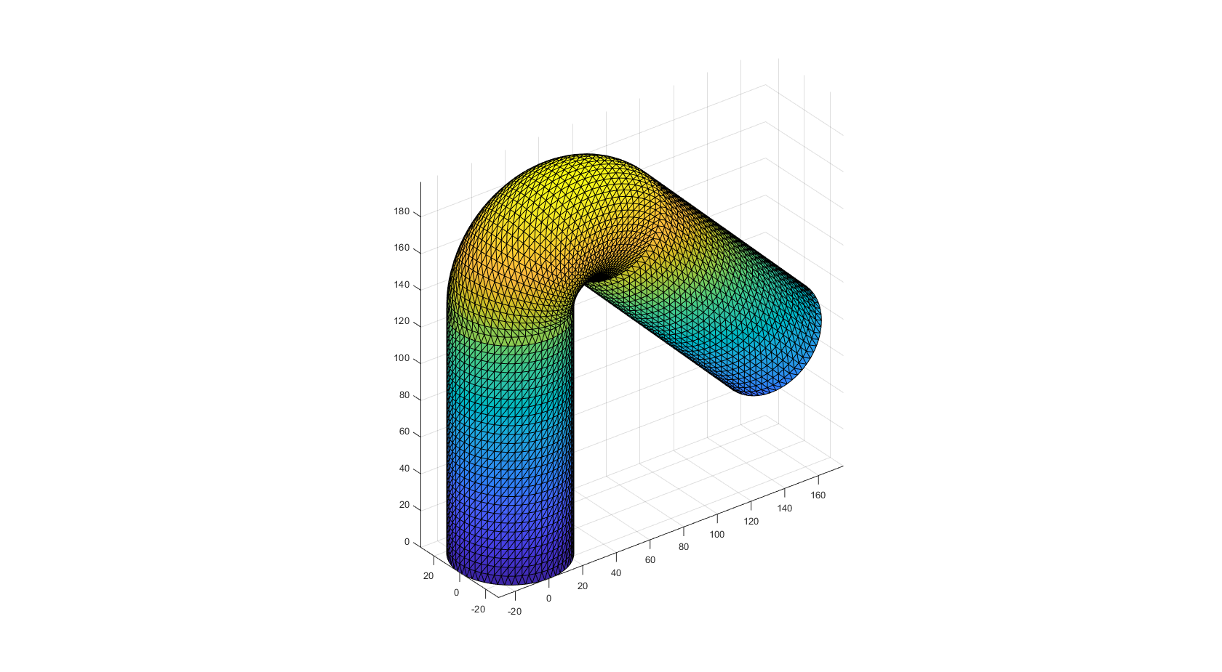
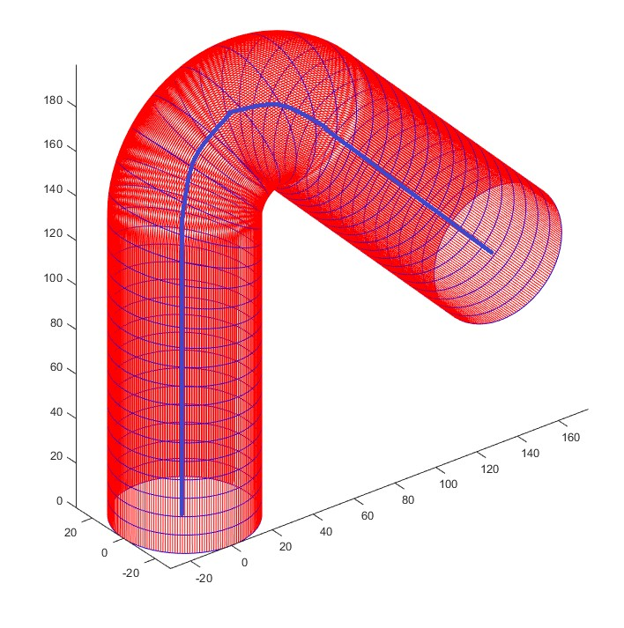
Bent cylinder 3D mesh
Reeb graph extraction from the 3D data

Slide 4
1. Segmentation using Reeb graph
Advantages
The Laplacian contraction process does not alter the connectivity of the original mesh, and the connectivity surgery maintains its connectedness and retains all undulations in the mesh as loops in the resulting skeleton structure. Hence, the final curve-skeleton is guaranteed to be homotopic to the original object.
The Laplacian contraction process is based on an iterative implicit smoothing operation. Thus, the method inherently deals with noise, making it insensitive to noise.
The method works directly on the original geometry rather than on a resampled volumetric representation, making it efficient, rotation invariant, and pose insensitive.
The skeletonization process yields a skeleton-mesh mapping and local thickness, which serve as important information for various applications that require shape analysis.
Limitations
The skeleton extraction only works for closed mesh models, in case of pyramid the skeleton would just be a straight line which doesn’t retain much about the geometry.
Although the method is largely insensitive to the model resolution, it cannot generate fine skeletons for very coarse models.
Since the Laplace contraction is an iterative process, it requires a large computational power.

Slide 5
2. Time values, and distances criterion for segmentation
This segmentation algorithm focuses on the construction of knitting patterns using a set of rules based on point properties such as time values, and distances of points in the 3D object.
Segmentation approach:
Create a full row based on time criterion: if max time value of the previous layer/ row is less than all the time values of the potential current row.
If the time criterion is satisfied, then check for the distance criterion: the distance between all the points in a row and short rows must be less than two times the knitting width.
Short row are created when the time criterion is not met, whereas full rows are obtained if the it is met.

Slide 6
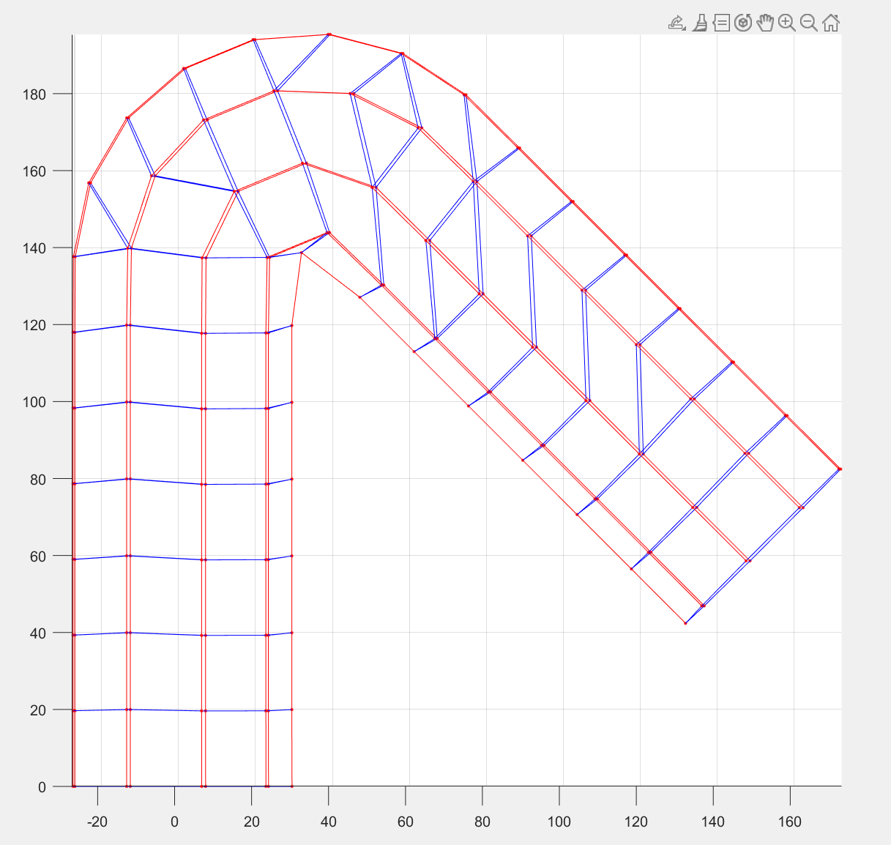
Multipoint connection/ short rows in the second
half of the bent cylinder
Bent cylinder 3D mesh

Slide 7
2. Time values, and distances criterion for segmentation
Advantages
Simple implementation
Layer by layer row building therefore more effective segmentation.
Limitations
Due to truncation error, one node was connecting to multiple points with respect to the nearest distance criterion. That was because there were multiple short rows with the same node.
Can not effectively handle when number of points in a full row keeps changing, for instance in pyramid, the number of points on the start and the end line are lesser than the number of points on the any other lines in between.
Since it is building layer by layer there is a huge computational time is required for complex structure.

Slide 8
3. Time values density and distances criterion for segmentation
This segmentation algorithm focuses on the construction of knitting patterns using a set of rules based on point properties such as time values density, and distances of points in the 3D object.
Segmentation approach:
Cluster the time values based on the number of possible rows, which is calculated by the knitting parameter “h” and the largest length in the 3D mesh.
Implement k-means clustering with initial values initialized using equi-spaced time values from -1 to 1 with number of possible rows.
Using these clusters build the full rows and short rows based on the distance criterions.

Slide 9
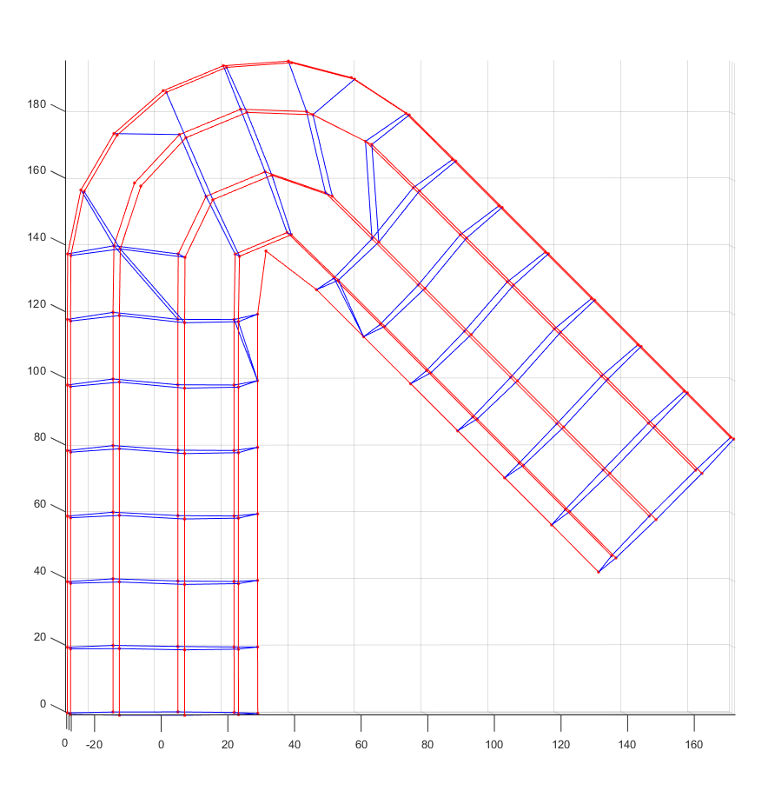
Symmetric connections, multipoint connections/
Unwanted shorts rows
Bent cylinder 3D mesh

Slide 10
3. Time values density and distances criterion for segmentation
Advantages
Clustering helps in initializing the time criterion which simplifies the segmentation based on time.
Simple implementation.
Limitation
Due to non-linearity in the structures the clustering happens between points which are spatially far but time wise near, for instance in the bent cylinder the part where there is bend there is non- linearity and the points in cluster takes multiple points in one cluster leaving fewer points for the next layer, giving rise to undesired short rows.

