Slide 1

Method of Segmentation to aid in effective knitting
Foto: Uli Regenscheit
05/2023

Slide 2
Method - 1
Using Weighted directed graph to segment the reebgraph
Algorithm
Convert the object file into reebgraph
Convert the reebgraph into directed graph by carefully choosing the points such as maxima, minima and saddle points.
Assign weight based on the cross-sectional volume of each quantized unit
Define criterion to perform segmentation.

Slide 3
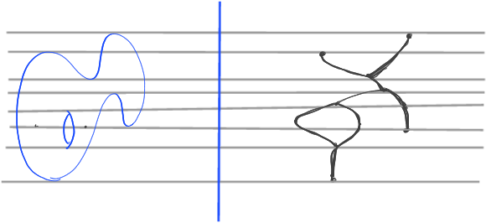
Method - 1
Using Weighted directed graph to segment the reebgraph
Criterion to perform segmentation
Angle of the weighted directed graph.
Change in weight at that point on reebgraph
(exploring TTK i.e Topology toolkit)
Reebgraph from an arbitrary object

Slide 4
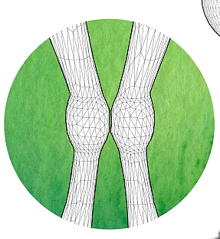
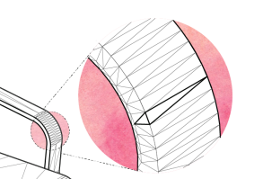
Method-2
Using ML based approch to segment the 3D Object
Method
Mesh pooling by selecting irregular structures at the corners and edges and down sampling
Implementing edge collapse method to eliminate the less informative features such as planer monotonous surfaces.

Slide 5
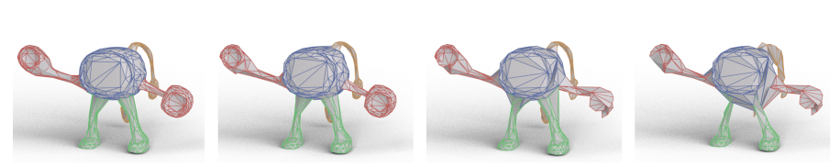
CNN based approach
Semantic segmentation on arbitrary shapes is shown below. The segmentation prediction per edge is shown on the left, followed by the intermediate simplified meshes after each pooling layer. For visualization purposes, the edges in the intermediate meshes are colored with the final segmentation predictions.
CNN uses mesh pooling to learn to collapse edges from the same segments, which are unrolled back to the original input mesh resolution via the mesh unpooling layer.

Slide 6
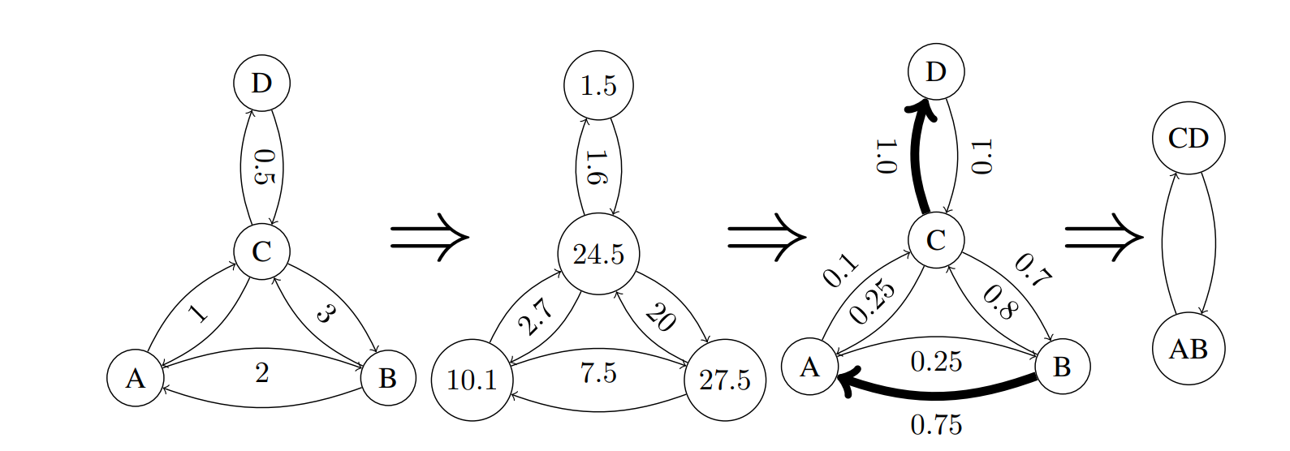
CNN based approach: Mesh pooling

Slide 7
Reference
https://topology-tool-kit.github.io/installation-windows-sources.html
https://arxiv.org/pdf/1809.05910v2.pdf
https://paperswithcode.com/task/3d-part-segmentation

Slide 8
Praful G Aradhyamath
e-mail
prafularadhyamath@gmail.com
phone +49 (0) 15510393730
University Of Stuttgart

