Slide 1

Method of Segmentation to aid in effective knitting
Foto: Uli Regenscheit
05/2023

Slide 2
Agenda
Implementation of the Algorithm
Removal of Dependency of Node Connecting Function on Middle Line

Slide 3
Algorithm
1. Initialization of Data Structures and Variables:
- Data structures like `all_pts`, `all_time`, and `onedge` are created to store information about points and their properties.
- These structures store information such as point coordinates, time values, and whether a point is on the edge or not.
2. Initial 3D Plot:
- The function plots the initial configuration of points and a 3D surface. This step is for visualization or representation purposes.

Slide 4
3. Construction of Knitting Courses and Wales:
- The function is responsible for generating knitting instructions or courses.
- It checks if a point has been visited or not, implying that it keeps track of which points have already been processed.
- Two conditions are checked while visiting points:
a. The time value of the points being joined is greater than the maximum value of the previous layer. This condition likely ensures a certain order or sequence in the knitting process.
b. The distance between the points being joined is less than 2w. This condition might ensure that the points are close enough to be connected in the knitting pattern.

Slide 5
4. Building Knitting Courses:
- The function's main purpose is to build a knitting course from the starting point on a first wale.
- It continues to build and connect knitting courses until all points are visited and connected, indicating that it iteratively constructs the knitting pattern.
Overall, it ensures that points are visited and connected according to specified criteria, resulting in a complete knitting course or pattern.

Slide 6
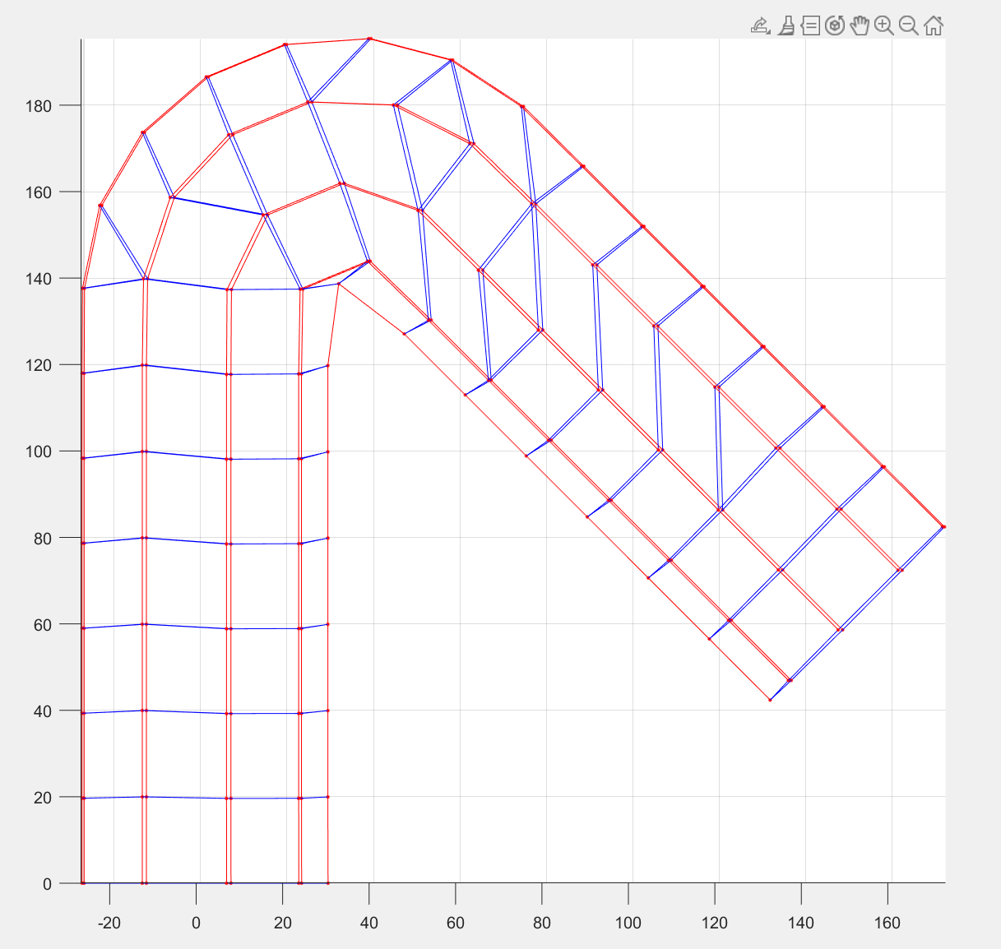
Fig: Implementation of the above-mentioned algorithm
with w=10 and h=5

Slide 7
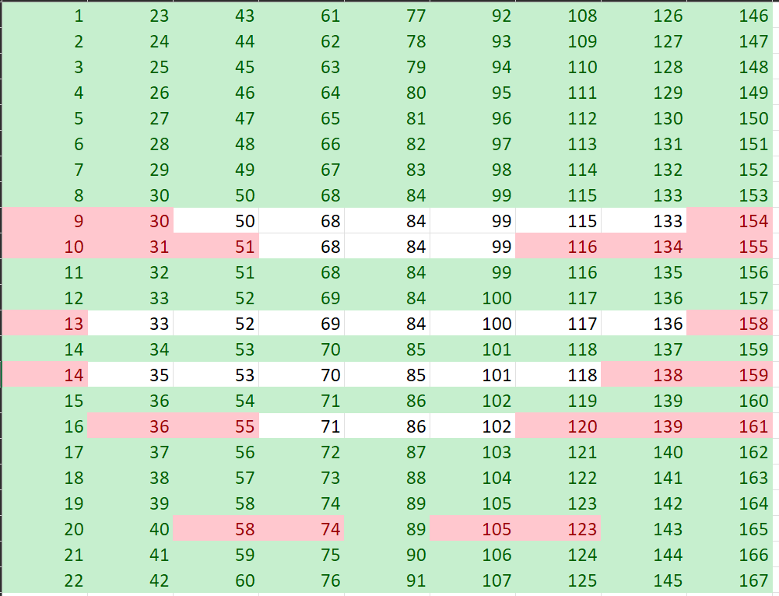

Slide 8
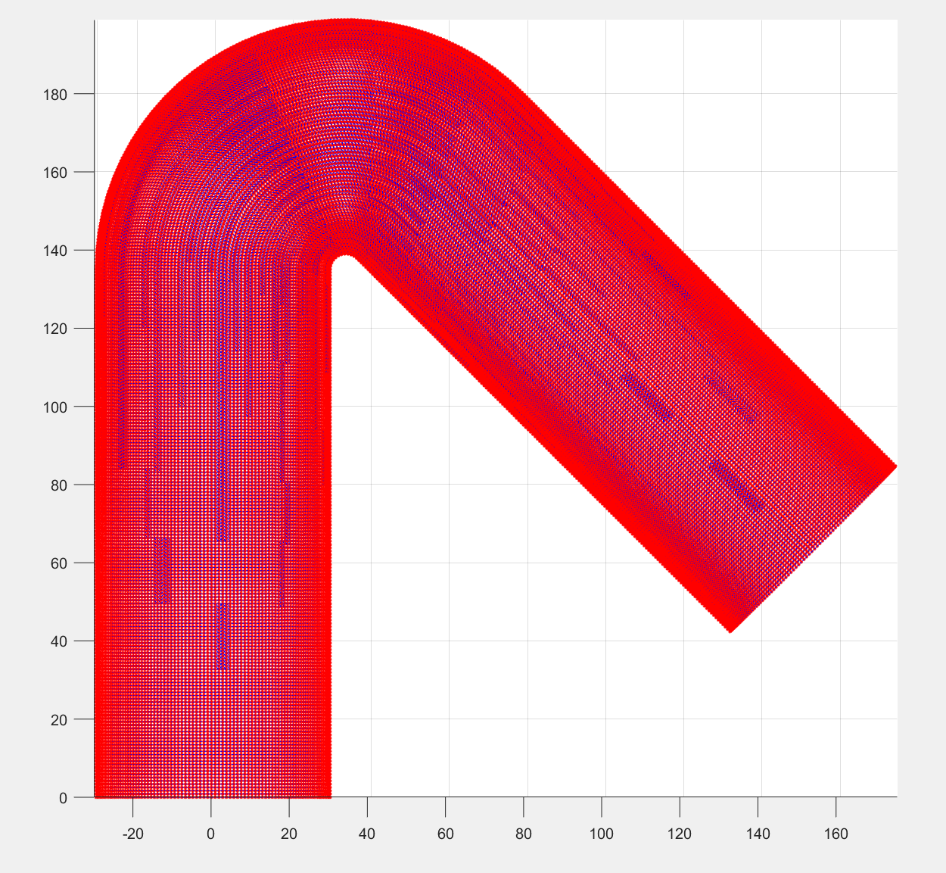
Fig: Implementation of the above-mentioned algorithm
with w=0.96 and h=0.42

Slide 9
Praful G Aradhyamath
e-mail
prafularadhyamath@gmail.com
phone +49 (0) 15510393730
University Of Stuttgart

