Slide 1
EAVESDROPPING ON WEBSITES
Ishan Desai - ijd140030
Karthik Vesireddy – kxv141230
Praful Bhosale – pbb140230
Praveen Kumar Anagi Prabhakar – pxa140230
Raja Shekar Subbaraj - rxs148130

Slide 2
Introduction
WEBSITE FINGERPRINTING:
An idea that aims at identifying the content (i.e., a webpage accessed by a client) of encrypted and anonymized connections by observing patterns of data flows such as packet size and direction.
What’s the need:
Although encryption hides some information it is important to note that it does not hide all information. Few technologies like Tor and other privacy technologies like SSH tunnelling, VPNs and IPSec are vulnerable to website fingerprinting. It becomes easy for eave droppers to collect private data from users.

Slide 3
Introduction continued..
In this project we are trying to,
Fetch real time data using Packet Sniffer and send it to Kafka producer.
Training different models by set of pre-recorded webpage fingerprints to identify or predict the page that is being accessed.
And eventually pass test data to these models, predict the class label for the given test data and report the accuracy for all the models.

Slide 4
System Architecture
Kafka
Data
Packet Sniffing Code
Consumer code
Multiple classifiers
Models using training data
Predict label

Slide 5
Spark Streaming
It is an extension of the core Spark API which enables scalable, fault-tolerant streaming of live data.
An unified engine that supports both batch and streaming workloads.
It’s processing is as follows:
Receive streaming data from data sources (e.g. live logs, system telemetry data etc.) into some data ingestion system like Apache Kafka, Amazon Kinesis, etc.
Process the data in parallel on a cluster. This is what stream processing engines are designed to do, as we will discuss in detail next.
Output the results out to downstream systems like HBase, Cassandra, Kafka, etc.

Slide 6
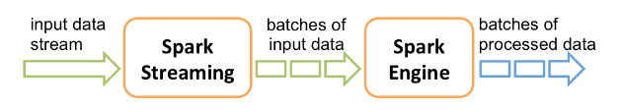
Spark Streaming (contd..)
MLlib provided with Spark-streaming is made use of to help classify the data in all the models being used.

Slide 7
Apache Kafka
It is publish-subscribe messaging rethought as a distributed, partitioned, replicated commit log service.
It provides Java Messaging Services functionality.
Packet Sniffer puts live data into Kafka’s feed name or category which is known as “topics”.
Kafka Consumers can read these topics in a timeframe which can be configured as a window.

Slide 8
Normalized data:
We are normalizing the data that we receive before we train or test the models.
Normalizing data facilitates in scaling the data, which in turn helps in better classification of the data points.
Better accuracy reported by models when using Normalized data.
Features we are considering for classifications are : Burst Size, Surge Period.
Burst Size: It is the interval during which there are packets only in one direction(upstream) but are preceded or followed by packets in opposite(downstream) direction.
Surge Period: It marks the parts of traffic trace where the channel is busy transmitting the packets either upstream or downstream with back to back packages.

Slide 9
Naïve Bayes
Naïve Bayes is a classification technique based on Bayes’ Theorem with an assumption of independence among predictors. In simple terms, a Naive Bayes classifier assumes that the presence of a particular feature in a class is unrelated to the presence of any other feature. For example, a fruit may be considered to be an apple if it is red, round, and about 3 inches in diameter. Even if these features depend on each other or upon the existence of the other features, all of these properties independently contribute to the probability that this fruit is an apple and that is why it is known as ‘Naive’.
Naive Bayes model is easy to build and particularly useful for very large data sets. Along with simplicity, Naive Bayes is known to outperform even highly sophisticated classification methods.

Slide 10
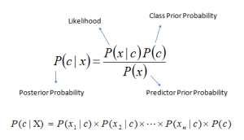
Naïve Bayes continued..
Bayes theorem provides a way of calculating posterior probability P(c|x) from P(c), P(x) and P(x|c). Look at the equation below:
Above,
P(c|x) is the posterior probability of class (c, target) given predictor (x, attributes).
P(c) is the prior probability of class.
P(x|c) is the likelihood which is the probability of predictor given class.
P(x) is the prior probability of predictor.

Slide 11
Decision Tree
Decision tree learning uses a decision tree as a predictive model which maps observations about an item (represented in the branches) to conclusions about the item's target value (represented in the leaves). It is one of the predictive modelling approaches used in statistics, data mining and machine learning.
A tree can be "learned" by splitting the source set into subsets based on an attribute value test. This process is repeated on each derived subset in a recursive manner called recursive partitioning. The recursion is completed when the subset at a node has all the same value of the target variable, or when splitting no longer adds value to the predictions.

Slide 12
Decision Tree continued..
Decision trees used in data mining are of two main types:
Classification tree analysis is when the predicted outcome is the class to which the data belongs.
Regression tree analysis is when the predicted outcome can be considered a real number (e.g. the price of a house, or a patient’s length of stay in a hospital).

Slide 13
Random Forests
Random forests or random decision forests are an ensemble learning method for classification, regression and other tasks, that operate by constructing a multitude of decision trees at training time and outputting the class that is the mode of the classes (classification) or mean prediction (regression) of the individual trees. Random decision forests correct for decision trees' habit of overfitting to their training set
Tree bagging : training algorithm for random forests applies the general technique of bootstrap aggregating, or bagging, to tree learners
This bootstrapping procedure leads to better model performance because it decreases the variance of the model, without increasing the bias. This means that while the predictions of a single tree are highly sensitive to noise in its training set, the average of many trees is not, as long as the trees are not correlated.

Slide 14
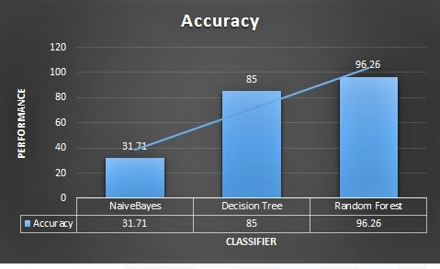
Models and Accuracies:
Naïve Bayes:
Accuracy reported: 31.71%
Decision Tree:
Accuracy reported: 85.00%
Random Forest:
Accuracy reported: 96.26%
Total records :
Training – 60%
Testing – 40%
Features used - 873

Slide 15
Future Scope:
The project can be improved further in the sense that we can broaden the horizon and the kind of packet data that we are sniffing. We can analyze what type of user is sending the packet, where it is originated from, where it is sent to etc.
Currently, we are simulating the streaming of TCP/IP packets and sending it to the Kafka Producer. But we can integrate the simulation to provide real time analysis of packets.

Slide 16
References:
http://spark.apache.org/docs/latest/streaming-programming-guide.html
http://kafka.apache.org/documentation.html
https://databricks.com/blog/2015/07/30/diving-into-apache-spark-streamings-execution-model.html
D. Herrmann, R. Wendolsky and H. Federrath, "Website Fingerprinting: Attacking Popular Privacy Enhancing Technologies with the Multinomial Naive-bayes Classifier," in Proceedings of the 2009 ACM Workshop on Cloud Computing Security, New York, NY, USA, 2009. J. Clerk Maxwell, A Treatise on Electricity and Magnetism, 3rd ed., vol. 2. Oxford: Clarendon, 1892, pp.68–73.
J.-F. Raymond, "Traffic Analysis: Protocols, Attacks, Design Issues and Open Problems," in PROCEEDINGS OF INTERNATIONAL WORKSHOP ON DESIGN ISSUES IN ANONYMITY AND UNOBSERVABILITY, 2001. K. Elissa, “Title of paper if known,” unpublished.
A. Panchenko, L. Niessen, A. Zinnen and T. Engel, "Website Fingerprinting in Onion Routing Based Anonymization Networks," in Proceedings of the 10th Annual ACM Workshop on Privacy in the Electronic Society, New York, NY, USA, 2011. Y. Yorozu, M. Hirano, K. Oka, and Y. Tagawa, “Electron spectroscopy studies on magneto-optical media and plastic substrate interface,” IEEE Transl. J. Magn. Japan, vol. 2, pp. 740–741, August 1987 [Digests 9th Annual Conf. Magnetics Japan, p. 301, 1982].
http://ieeexplore.ieee.org/stamp/stamp.jsp?arnumber=7036866

