Slide 1
Web Traffic Time Series Forecasting
MSCA 31009
Chicago | December 7, 2020
Notes:
I'm happy to kick us off... Possible project outline:
Introduction: Includes problem statement and objective of your project.
Data: Elaborate on the data used in this project with detailed description of all attributes, source of data, missing observations, etc. Describe any steps you followed to prepare the data.
Experimental results and Analysis: Execute algorithm (plots, ACF, PACF, Spectral Analysis, hypothesis testing, ), discuss results with appropriate details.
Model Selection: Select final model based on selection criteria and evaluate forecasting metrics and accuracy.
Conclusion and Future work: Summarize your work and draw specific conclusions from the overall final project. Describe next steps to continue working on this project. (i.e., how the model forecasting can be improved)
The students will be graded based on the following criteria:
Presentation
Problem Statement and Assumptions
Derived Solution
Results
Future Work

Slide 2




Agenda
Proposed Approach
Intervention Analysis
Introduction
Model Selection
Notes:
Introduction
(problem statement/objective/Data ); Shaddy's recommendation to use single time series
Research about Data - RIO Olympics (Interventions)
Walk through different approaches - RIO Olympics
Down-Sampling (weekly)
Different frequency (train 2)
LSTM
Model Selection / Comparison of techniques :Select final model based on selection criteria and evaluate forecasting metrics and accuracy
Future Work
Intervention Analysis
Appendix
Periodogram for stationary data
Stationary Data we started with – ARIMA, ARFIMA, ETS, PEROIDOGRAM, TBATS

Slide 3



Problem Statement - predicting web traffic
This forecasting can help website servers a great deal in effectively handling outages.
The technique we employed by product companies to better understand user behavior as to how a user interacts with their product and improve user experience.
The technique we implemented can be extended to diverse applications in financial markets, weather forecasts, audio and video processing. Not just that, understanding your website’s traffic trajectory can open up business opportunities too!
Notes:
- Used by websites to handle outages
- Understand how user interacts with their product
- Technique itself can be extended to various other areas

Slide 4
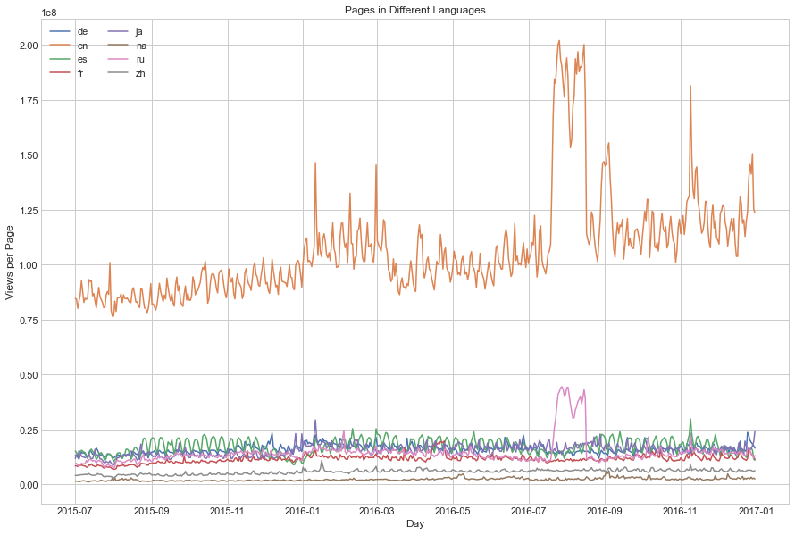
Training Data
Number of Time series: 145k Wikipedia Pages
Frequency : Daily
Span: July 1st, 2015 - December 31st, 2016
Languages: 7
Notes:
- Our dataset is composed of daily views on 145k Wikipedia pages in 7 different languages. These time series spans across July 1st, 2015 – December 31st, 2016.
- On the left you can see an interesting graph on how the Russian and American total views follow the similar trend with similar behavior around August –September 2016 . On further research, we found out that this trend is governed by two external events, first being the RIO olympics and second being the US elections. For our project we would be focusing on the RIO Olympics dataset.

Slide 5
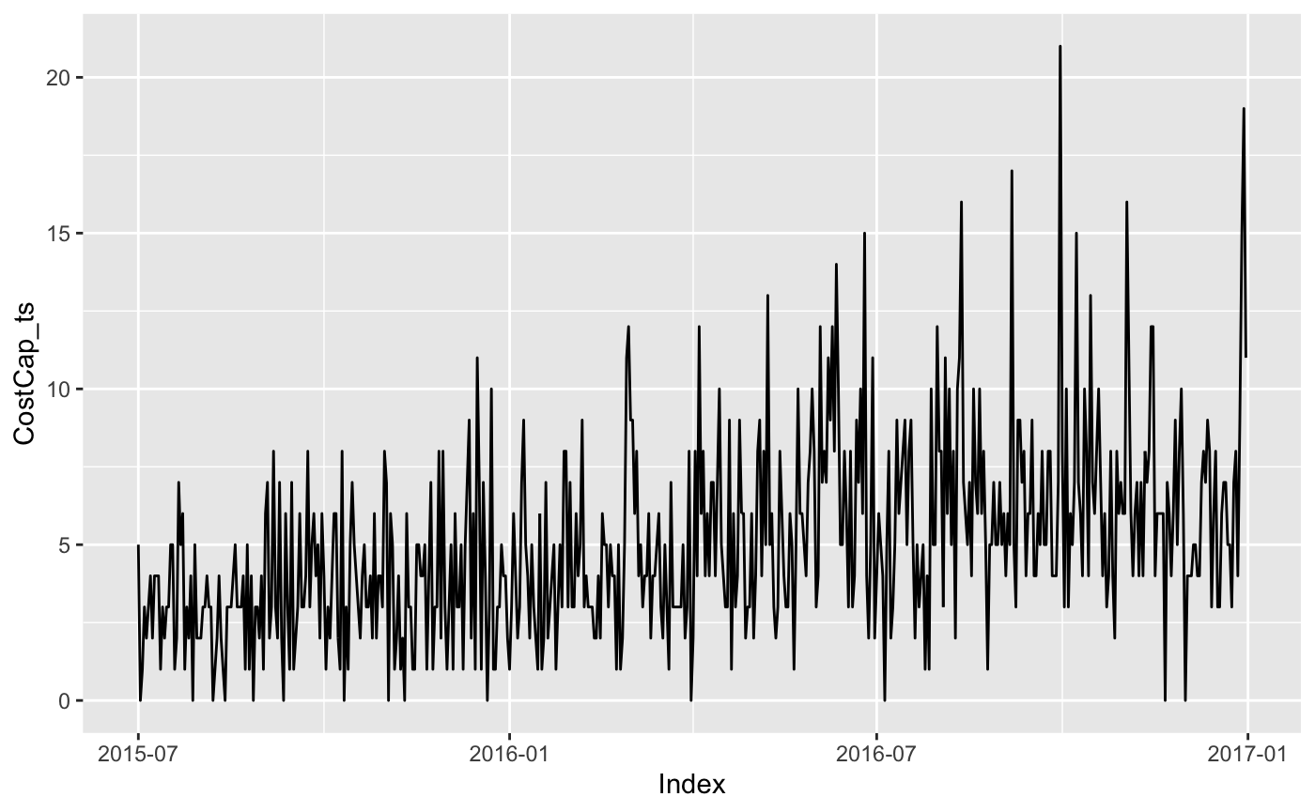
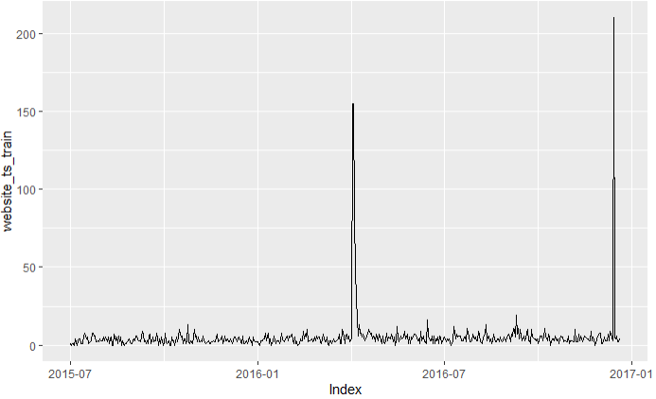
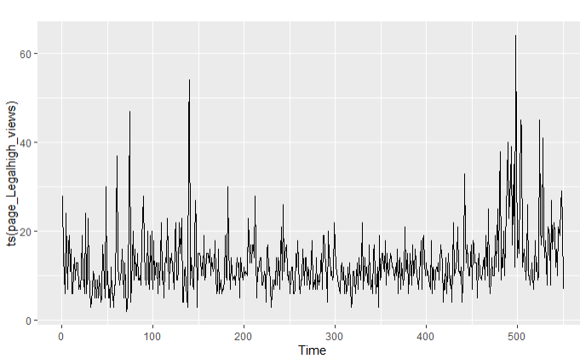
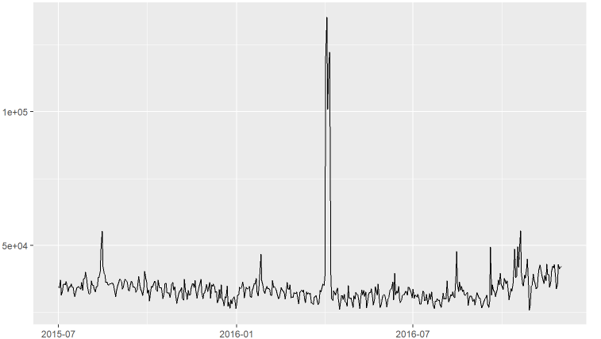
Data
Weighted average cost of capital
3C_zh - Crystal structure of CYP2R1 in complex with vitamin D2
Legal High – Japanese TV Series
India
Notes:
- but before diving deeper into it, we would like to show some time series we worked on which were similar to ones we faced in our homeworks and class which gave us good results. We have added the analysis in our appendix slides.

Slide 6
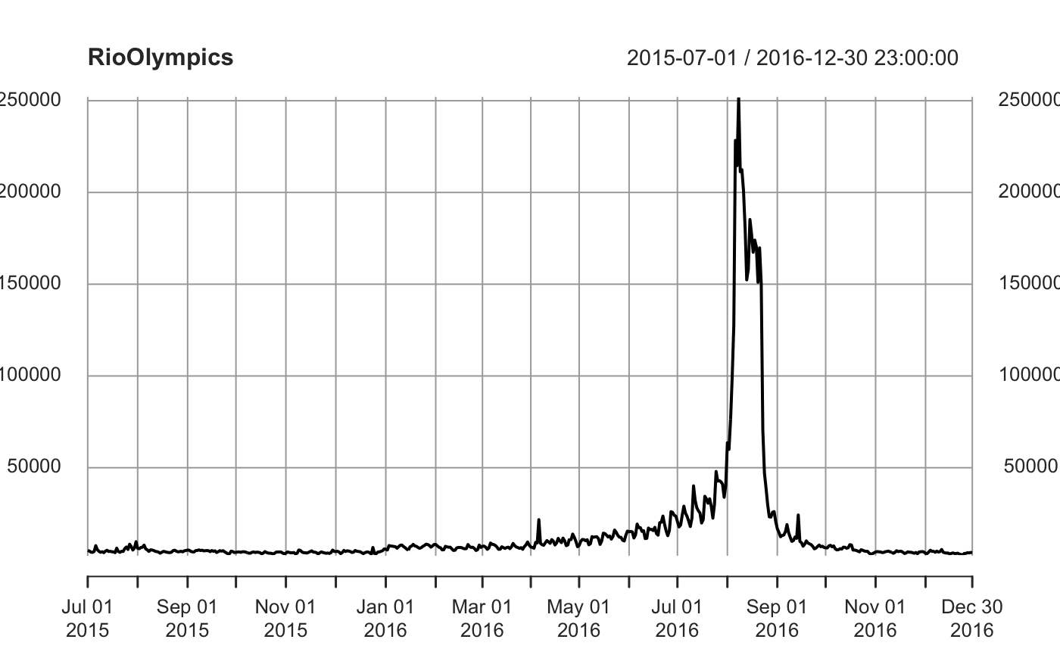
RIO Olympics
Span: 5 to 21 August 2016
Frequency : Daily
Dec 2015: human right violations in Rio
April 2016: Torch Relay

Slide 7
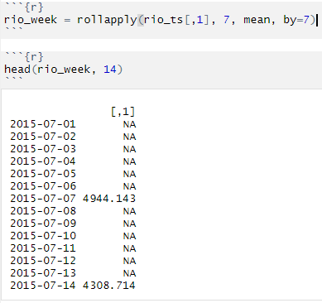
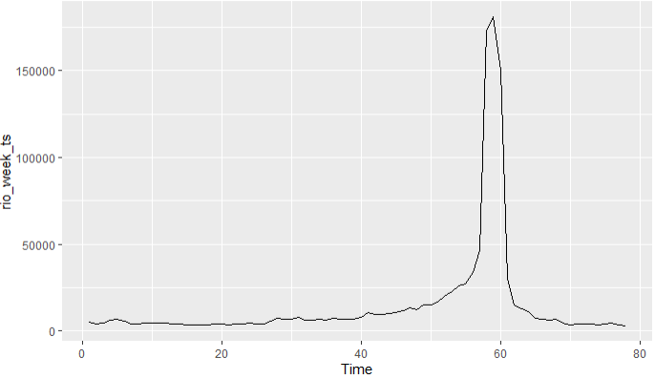
Down Sampling the data from daily to weekly
Code
Output

Slide 8
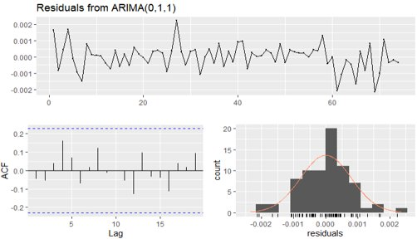
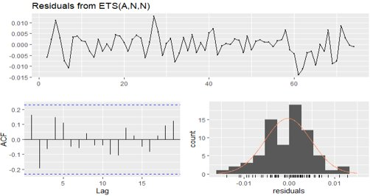
Model Results
Preprocessing Techniques:
Box-Cox Transformation
Differencing
Models Applied:
ARIMA, 'Auto Regressive Integrated Moving Average' explains' a given time series based on its own past values
ETS, (Error, Trend, Seasonal) used to handle the combination of trend, damping and seasonality.

Slide 9
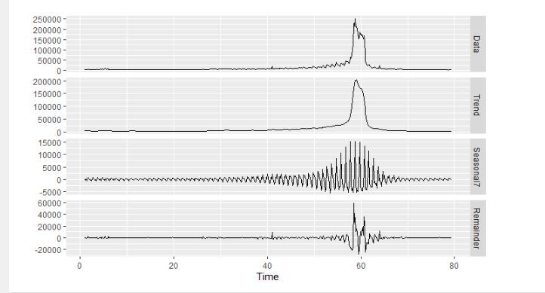
Seasonal Decomposition
Weekly Time Period:
Trend is flexible during the Event Period.
Change in magnitude of the seasonal Component

Slide 10
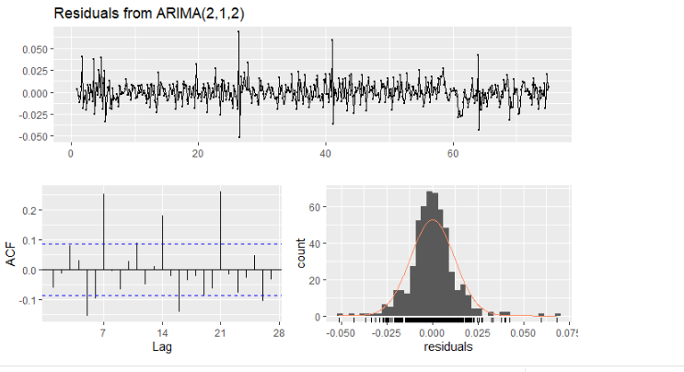
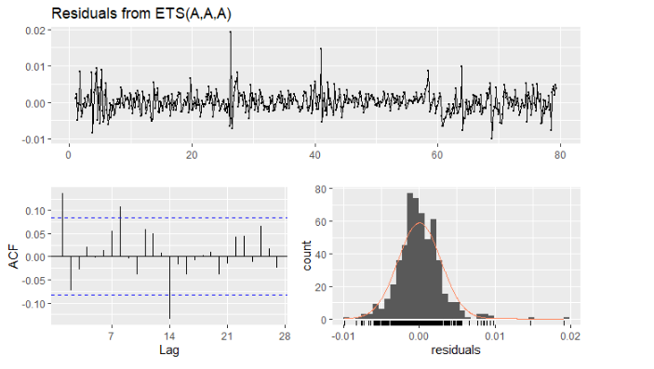
TS Models with Weekly Time Period
Non-Seasonal ARIMA model
ETS model
Notes:
- Residuals are Correlated and significant lag at 7,14,21 showing seasonal component
- Additive Error, Trend and Seasonality

Slide 11
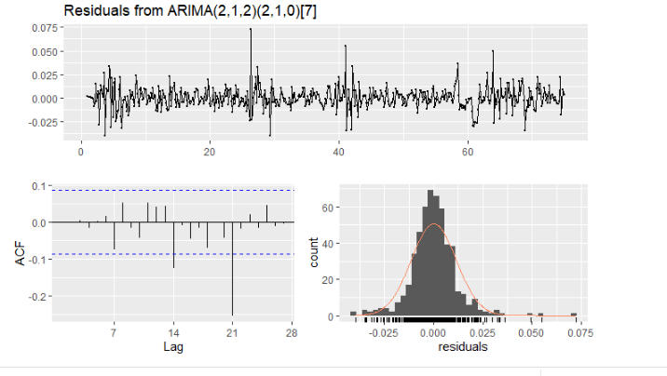
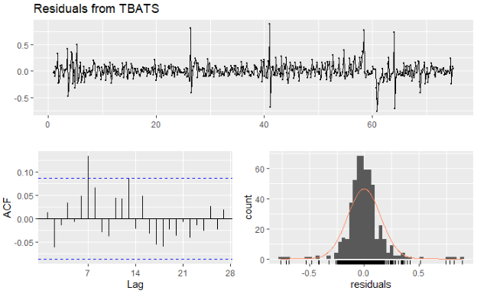
TS Models with Weekly Time Period
Seasonal ARIMA model
TBATS(0, {0,0}, -, {<7,3>})
Notes:
- Residuals are autocorrelated at seasonal time periods(14,21)

Slide 12
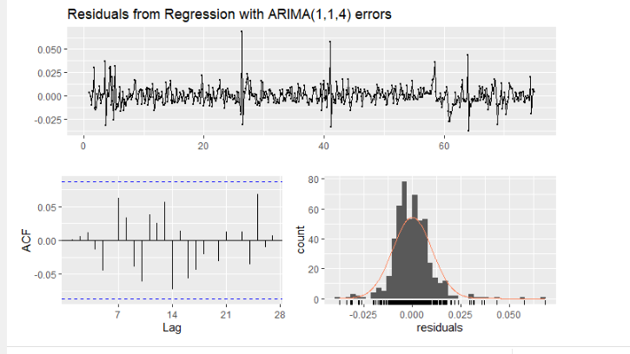
TS Models with Weekly Time Period
Regression with ARIMA Errors
Fourier Transform with K=3
Residuals of ARIMA looks like White Noise
Residuals has outliers due to significant spike during the Olympics event period

Slide 13
LSTM
1
Min Max Scaling
2
Test Train Split
3
Restructure the data
Lookback window
Data Format: samples, time steps, features
4
LSTM Model
5
Invert the predictions
Notes:
- LSTMs are sensitive to the scale of the input data, specifically when the sigmoid (default) or tanh activation functions are used. It can be a good practice to rescale the data to the range of 0-to-1, also called normalizing.
- Test Train Split : With time series data, the sequence of values is important.
- Restructure the data: look_back which is the number of previous time steps to use as input variables to predict the next time period. T -> T+1. 1 input, a hidden layer with 8 LSTM blocks or neurons, and an output layer that makes a single value prediction.
- Invert the predictions: Scaling

Slide 14
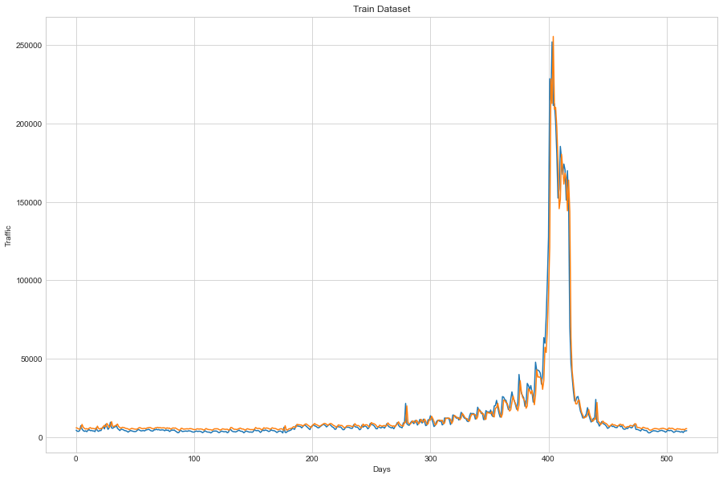
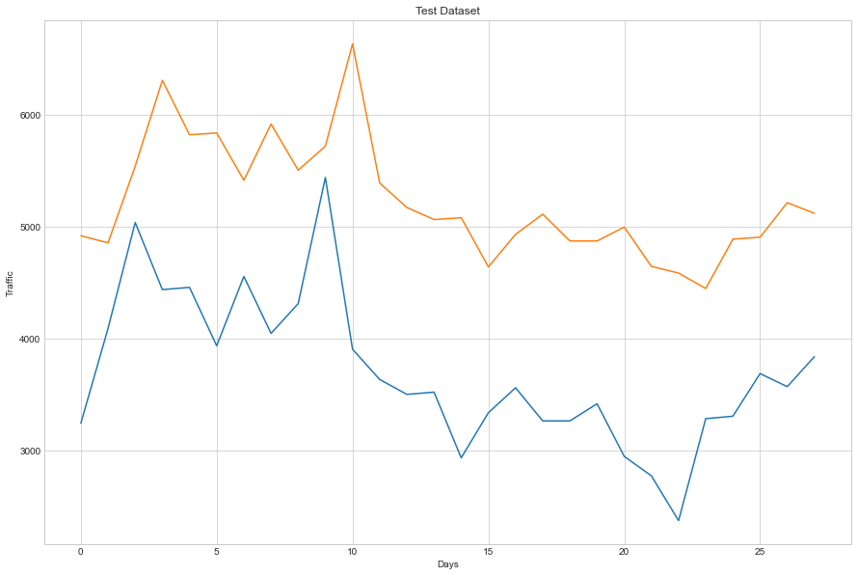
LSTM
Train
Test

Slide 15
Model Comparison
Approach | Down Sampling ARIMA | Regression with ARIMA Error | LSTM
Train RMSE | 30228.8853 | 14911.731 | 7756.18
Test RMSE | 528.3937 | 620.672 | 1610.41
Pros | Smooth variance |  | Lower generalization gap
Cons | Loss of Information | Capture complex seasonality | No long-term dependency in data
Notes:
- All the models underfit but the best model we could get right now was the LSTM model going by lower generalization error
- As Aakash said, The first model allowed us to smoothen the variance but there was a loss in information due to which the model is underfitting.
- The second Model doesn't perform well as it's not able to capture the significant variance change
- LSTM is the best we could come up with but there's a lot of scope for improvement

Slide 16
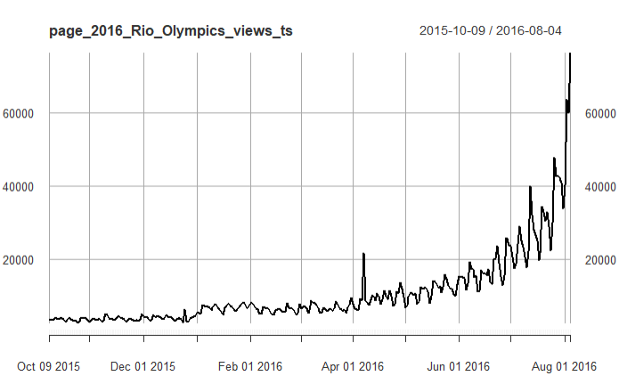
Intervention Analysis
Intervention on 23rd Dec 2015
Dividing to pre- and post-intervention
Taking a subset of observations
Trying to find the underlying process before intervention
Notes:
Took subset of observations – t=100 to t=400 i.e., 9th Oct 2015 to 4th Aug 2016 – to specifically focus the Dec 23rd, 2015 intervention
As mentioned earlier – Intervention – Article in leading newspaper (The Guardian) on 15th Dec 2015 about widespread human rights violation in Rio – people being displaced to create infrastructure for Rio Olympics 2016 – this might have generated curiosity among readers – hence the intervention
There is change in level and trend of the data post Dec 23rd, 2015
We divided the data into pre- and post-intervention
The entire signal is a combination of the underlying process and the intervention and we first try to find what is the underlying process

Slide 17
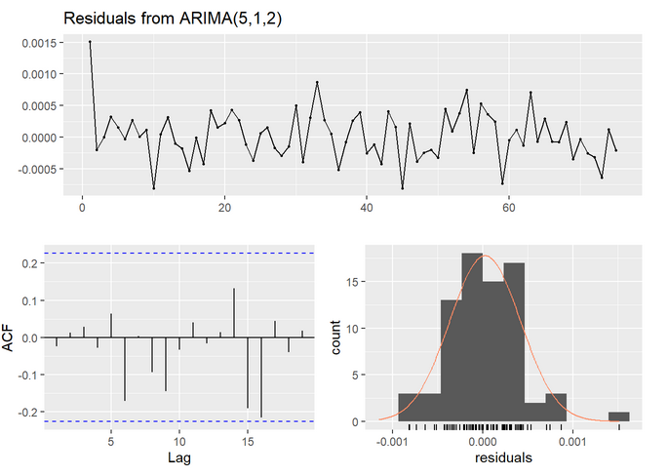
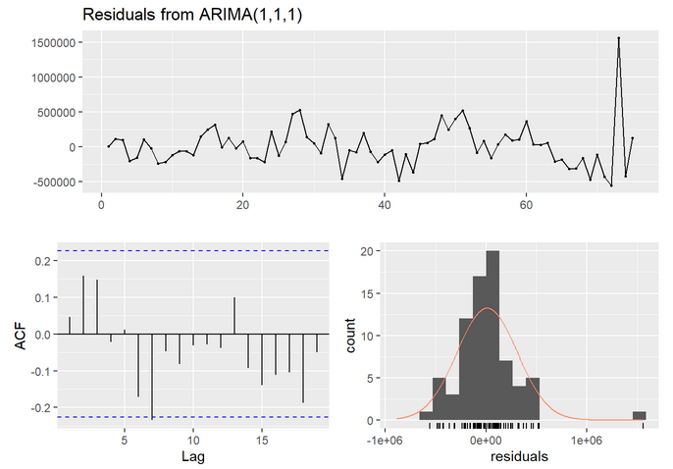
Intervention Analysis
Residuals look good but model complex
Model fitted pre-intervention – ARIMA(5,1,2)
Model fitted after down sampling – ARIMA (1,1,1)
Notes:
First, we try to fit the model for pre-intervention, we do the Box-Cox transformation, seasonal and non-seasonal differencing and we come up with ARIMA(5,1,2) model. This model gives white noise residuals but its too complex
So, we down sample the data and end up with ARIMA(1,1,1) – simple and gives white noise

Slide 18
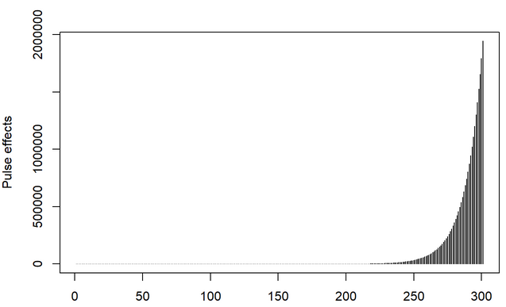
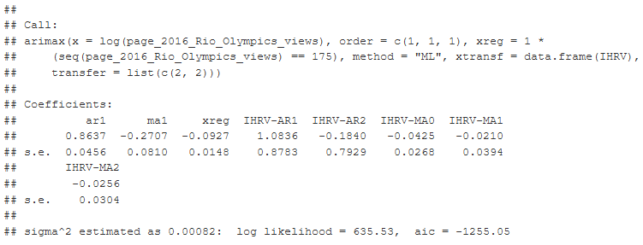
Intervention Analysis
ARIMAX model to capture underlying process and intervention
Assumed that intervention was ARMA(2,2) process
Notes:
For determining the transfer function that represents the intervention, we tried to follow the airmiles example taught in class.
We suspect that the intervention can be described as ARMA(2,2) process. For this, we kind of did trial and error for various processes like AR(1), AR(2), ARMA(1,1) etc. And we saw that the ARMA(2,2) process gave us a shape that was closer to the shape of our intervention.
Here we applied the Regression with ARMA error for capturing the underlying unperturbed process and the intervention. We also included one additive outlier at t= 175. i.e., 1st April 2016. Here additive outlier may be regarded as interventions of unknown nature that have a pulse response function.

Slide 19
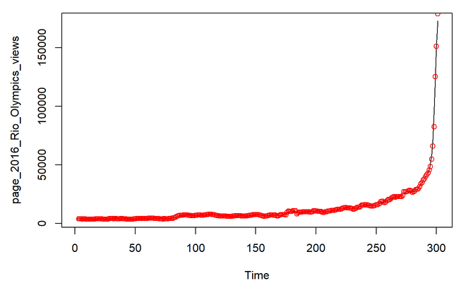
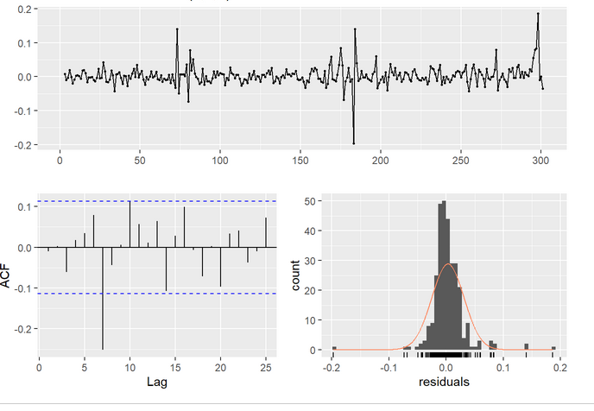
Future Work – Intervention Analysis
Residuals not white noise
Model doing for fitted values and actual values
Model needs improvement
Better estimation of transfer function for the intervention
Notes:
We plot the fitted values out of this model and the actual observations – look pretty good – this is down sampled data
But residuals are still not white noise, and this indicates our model needs improvement
More time must be spent to understand the math and produce a better transfer function that can explain the intervention more appropriately
- Requirement cyclical data: Last 8 years
- Additional covariance: As we have complex seasonality. Some other time series is impacting the current time series

Slide 20





Meet the Team
Aakash Pahuja
Devanshi Verma
Prafulla Ranjan Dash
Surendiran Rangaraj

Slide 21
Appendix

Slide 22
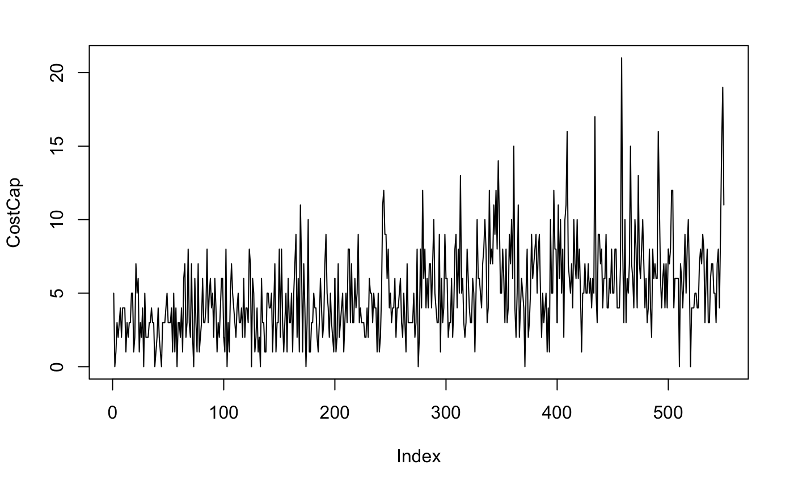
Data
Before delving deep into the data, the web page let's know about its story. It's a Chinese Wikipedia page for Weighted average cost of capital which means measure of the cost of capital of a company. Because financing cost is seen as a logical price tag, it was used by many companies as the discount rate for a financing project in the past. It's not a much-researched topic and the range is usually in the range of 0-20 views per day but an extremely varying number.

Slide 23
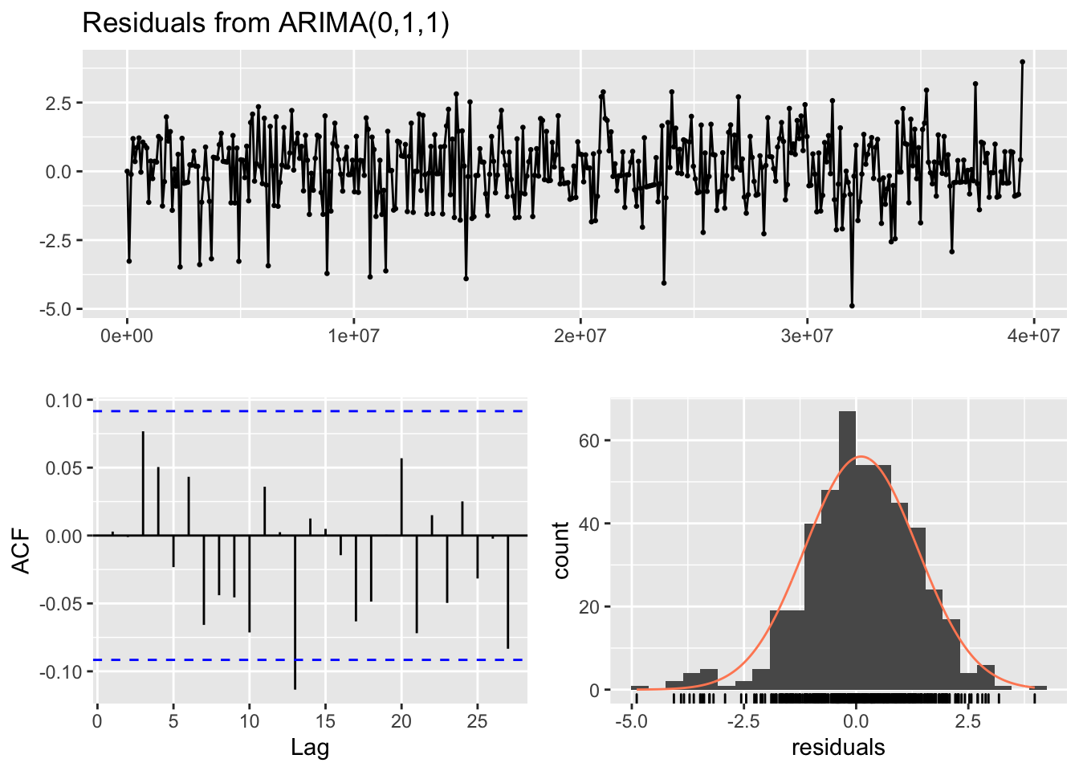
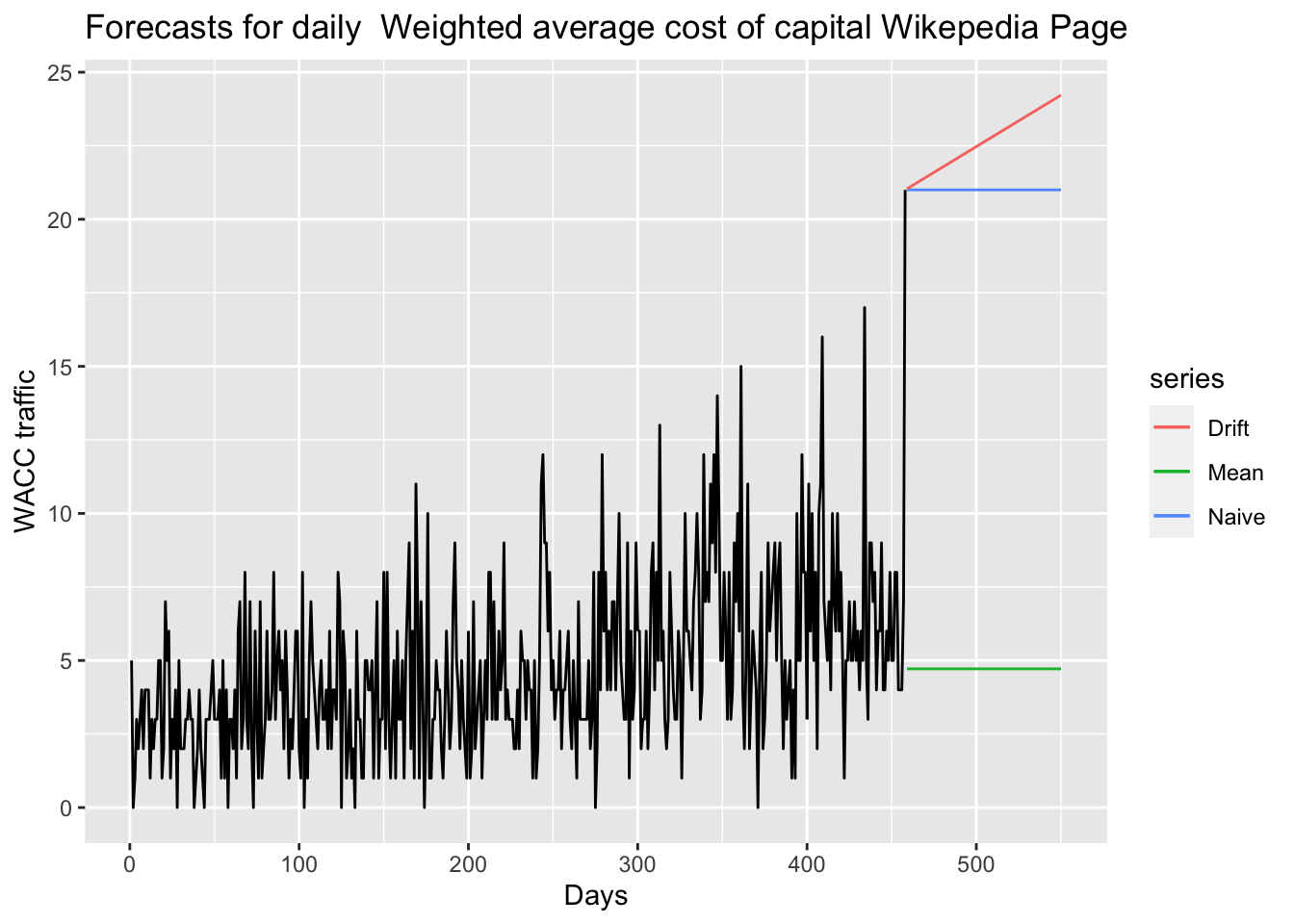
Models and Results
Naive Forecasts
ARIMA
Approach | Mean | Naïve Model | ARIMA
Train RMSE | 2.920003 | 3.540327 | 2.736433
Test RMSE | 3.725011 | 14.720586 | 3.213281

Slide 24
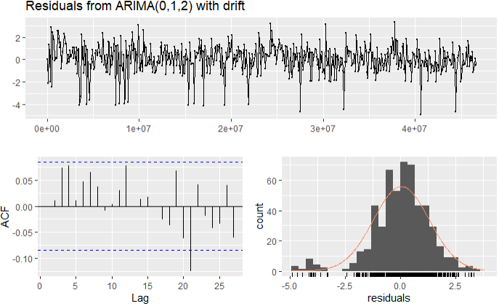
3C_zh Models and Results
Unflitered Time Series
Residuals from ARIMA
Approach | Mean | Naïve Model | ARIMA
Train RMSE | 2.650704 | 1.994064 | 2.675221
Test RMSE | 4.496604 | 2.601935 | 4.460078

Slide 25
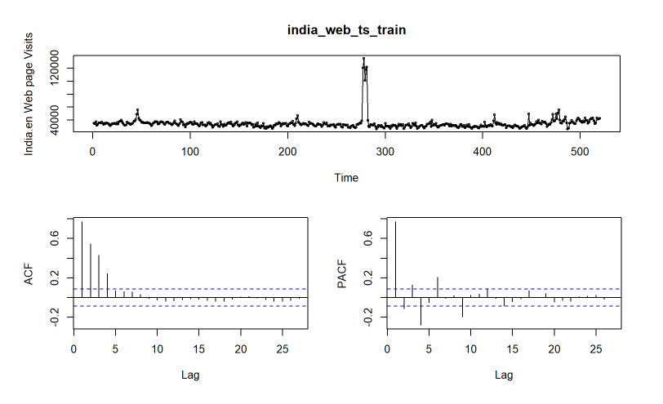
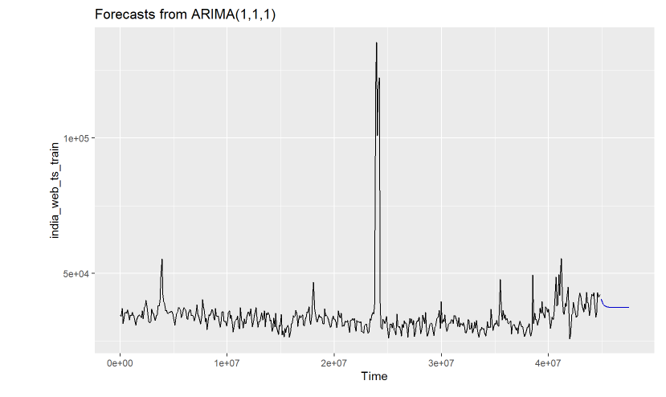
India.en Models and Results
Time Series Display
ARIMA

Slide 26
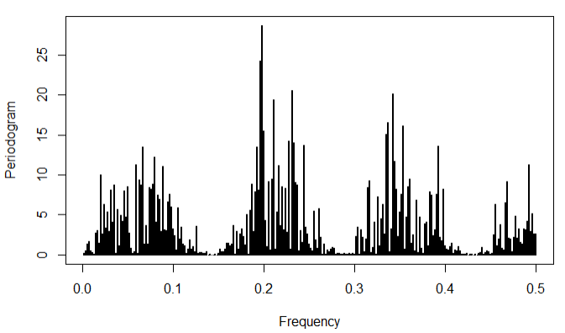
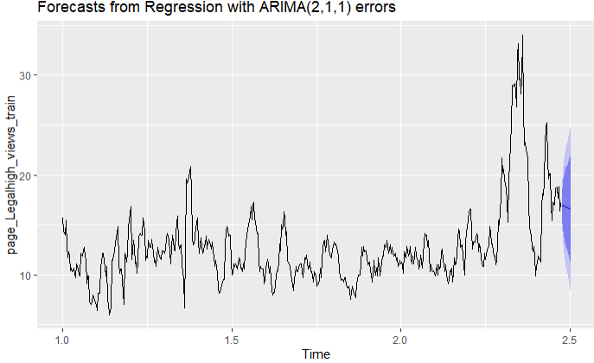
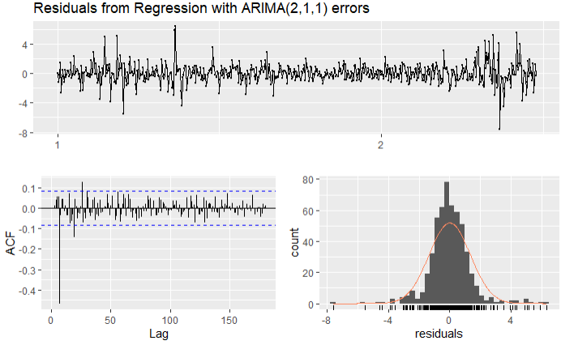
Legal High – Models and Results
Periodogram
Forecasts
Residuals

Slide 27
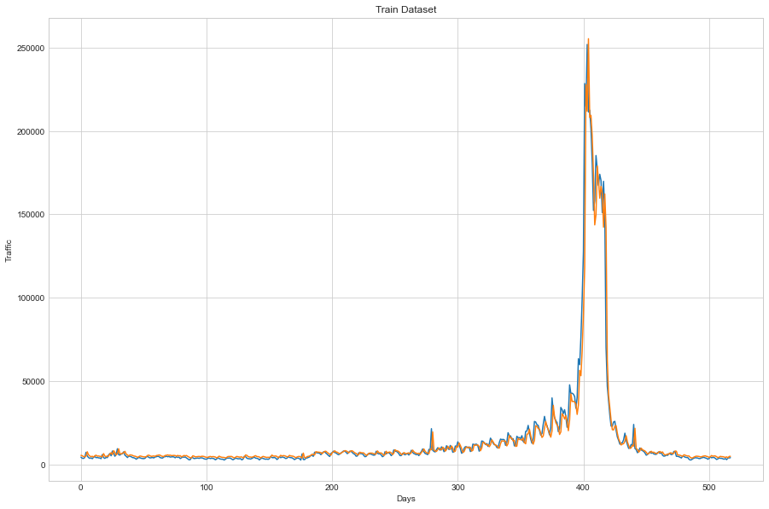
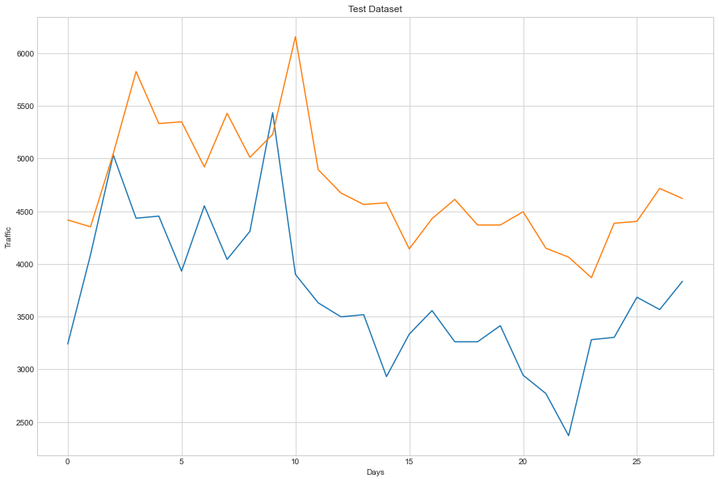
LSTM – Multiple time steps
Train
Test
Notes:
- For example, given the current time (t) we want to predict the value at the next time in the sequence (t+1), we can use the current time (t), as well as the two prior times (t-1 and t-2) as input variables
- Here we have taken lookback range to be 5 previous values

Slide 28
Questions

