Slide 1
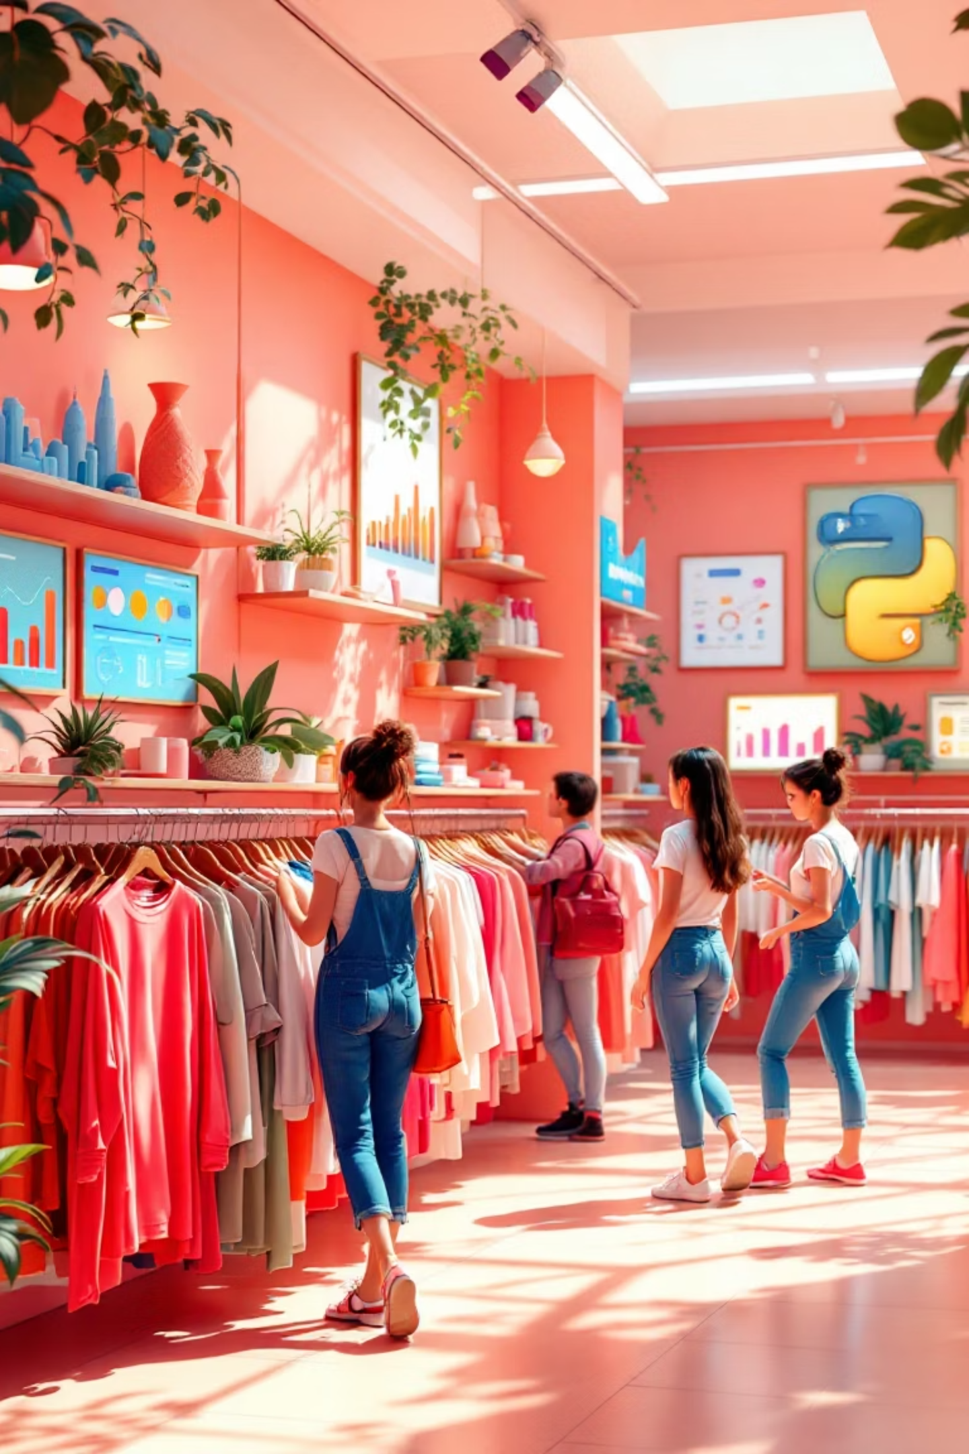
Sales Customer Shopping Behavior Analysis
This project analyzes transactional data from 3,900 purchases to uncover insights into spending patterns, customer segments, and product preferences.

Slide 2

Dataset Profile
Structure
Key Features
Data Quality
3,900 rows and 18 columns covering demographics, purchase details, and shopping behavior.
Includes Age, Gender, Location, Item Purchased, Season, Review Rating, and Subscription Status.
Generally clean dataset with only 37 missing values found in the Review Rating column.

Slide 3

Python Data Preparation
01
02
Exploration & Cleaning
Feature Engineering
Loaded data via pandas, checked summary statistics, and imputed missing review ratings using category medians.
Created "age_group" bins and "purchase_frequency_days" columns while standardizing names to snake_case.
03
Integration
Verified data consistency, dropped redundant columns, and loaded the cleaned DataFrame into PostgreSQL.

Slide 4
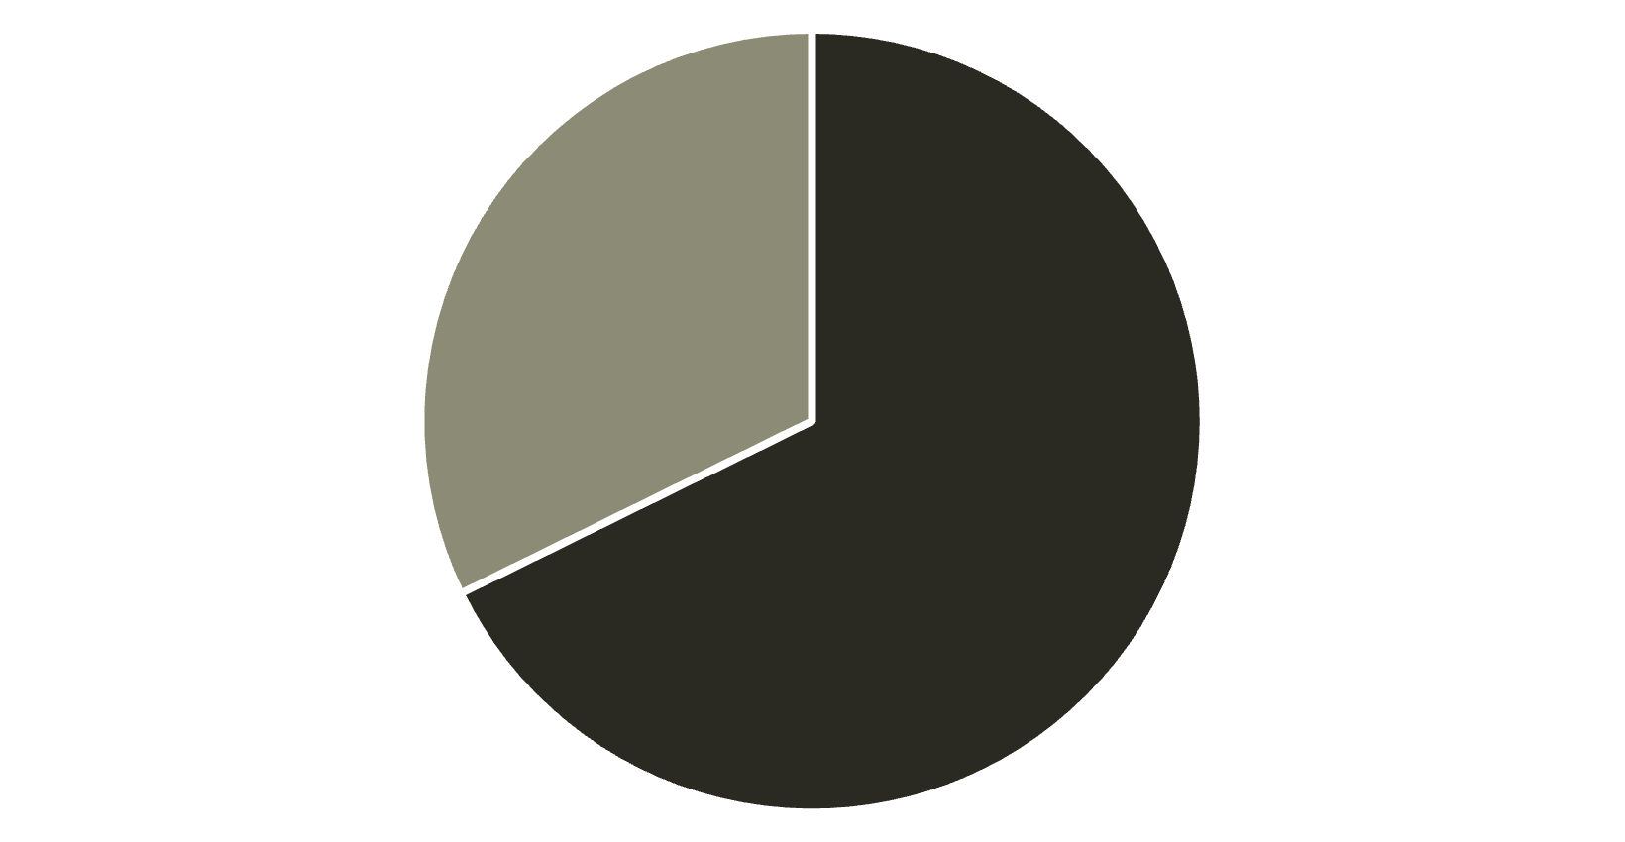
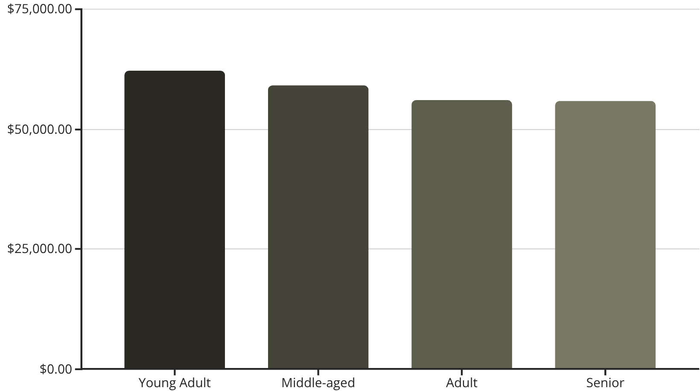
Revenue Demographics
Revenue by Gender
Revenue by Age Group
Male
Female
Male customers generate significantly higher total revenue compared to female customers.
Young Adults contribute the most revenue, though spending is relatively balanced across groups.

Slide 5

Product Performance
Top Rated Items
Clothing Leaders
Gloves (3.86), Sandals (3.84), and Boots (3.82) hold the highest average customer ratings.
Blouses and Pants are the top-selling items within the Clothing category, with 171 orders each.
Accessories Leaders
Jewelry leads the accessories category with 171 orders, followed closely by Sunglasses.

Slide 6
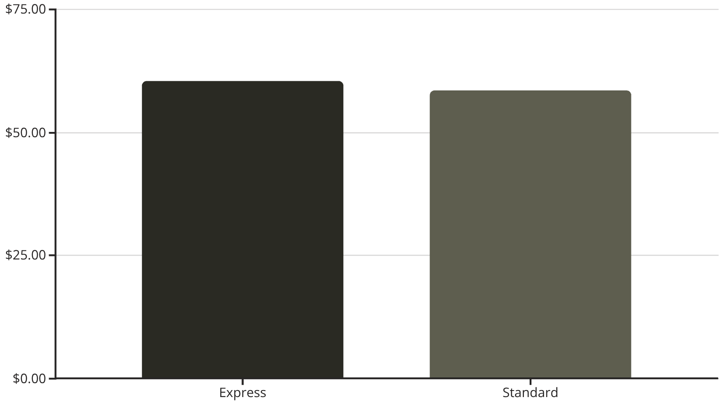
Shipping & Discount Behavior
Shipping Type Spend
Discount Dependency
Certain products rely heavily on discounts to drive sales. The top items with the highest percentage of discounted purchases include:
Hat: 50.00%
Sneakers: 49.66%
Coat: 49.07%
Sweater: 48.17%
Customers choosing Express shipping have a slightly higher average purchase amount.

Slide 7
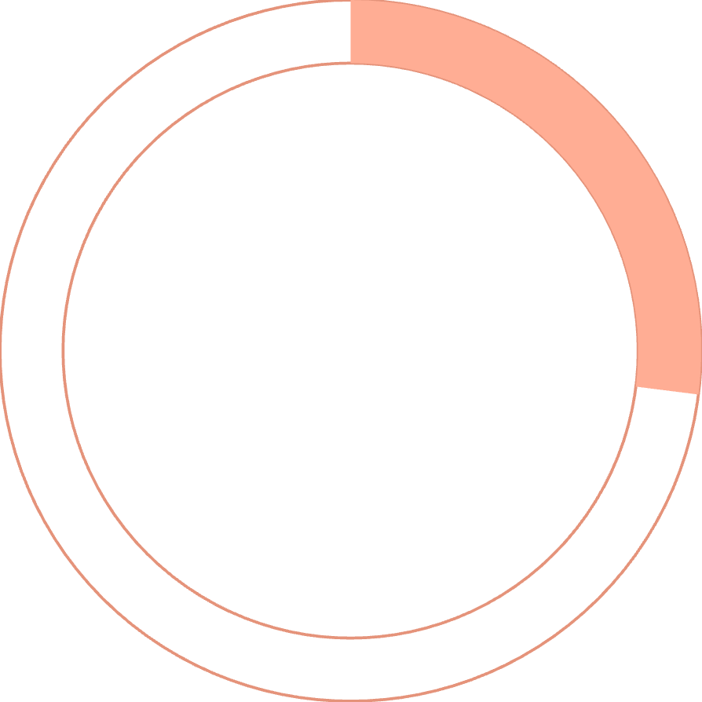

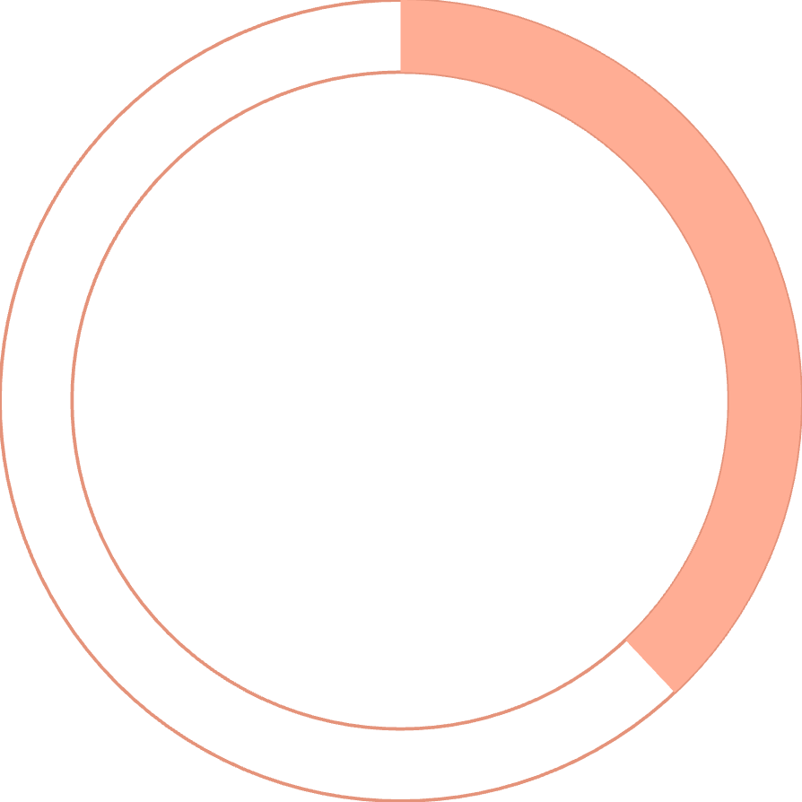
Subscription Insights
27%
$59
38%
Subscriber Base
Average Spend
Repeat Buyers
Only 1,053 customers are subscribers, compared to 2,847 non-subscribers.
Spending is nearly identical between subscribers ($59.49) and non-subscribers ($59.87).
Of repeat buyers with >5 purchases, only 958 are subscribed, leaving 2,518 non-subscribed.

Slide 8



Customer Segmentation
We classified customers based on purchase history. The vast majority of the customer base falls into the "Loyal" segment.
New Customers
1
83 Customers
Returning Customers
2
701 Customers
Loyal Customers
3
3,116 Customers

Slide 9
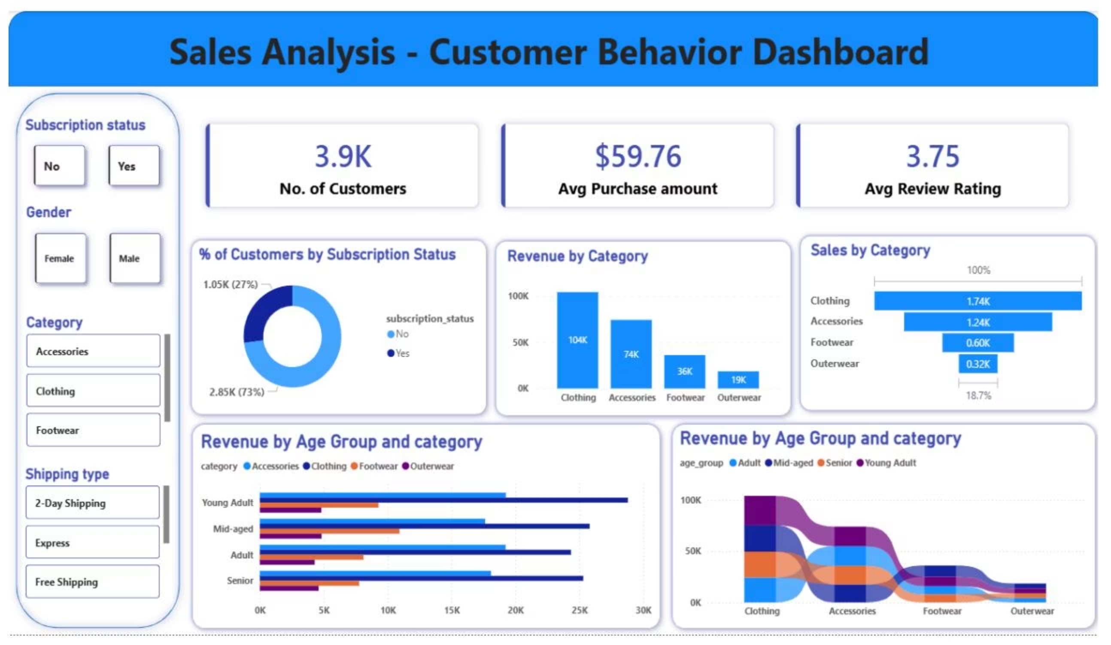
Power BI Dashboard
An interactive view of the insights, visualizing demographics, product performance, and revenue metrics.

Slide 10
Strategic Recommendations
Boost Subscriptions
Loyalty Programs
Promote exclusive benefits to convert the large non-subscriber base.
Reward repeat buyers to solidify the "Loyal" segment and encourage retention.
Review Discounts
Targeted Marketing
Balance sales boosts with margin control, especially for high-discount items like Hats.
Focus efforts on high-revenue age groups (Young Adults) and express-shipping users.

