Slide 1
Project 9: Haplotype Assembly (Difficulty Level: Medium)
Pragadheeshwaran thirumurthi
UCLA ID: 904-000-582

Slide 2
Biological Introduction - Haplotype
Genomes of 2 humans - Identical at 99% of positions
SNPs - The positions of variations.
Only two of four nucleotides are observed in most SNPs
So Chromosomes can be viewed as Binary Strings
These binary strings are called Haplotype
Set of SNPs on a single chromosome
Particular combination of alleles along a chromosome
For diploid organisms - 2 haplotypes per individual

Slide 3
Problem Motivation – Haplotype Assembly
The HapMap project
Study of DNA variation
Haplotype has all SNP information
The haplotype information
Association between certain diseases and genetic variations
More information content than individual SNPs or genotype in disease association studies
Easy to construct genotype from haplotype information
Notes:
The haplotype information is very important to many genomic analyses such as the analysis of potential association between certain diseases and genetic variations
Haplotype information is centric to the study of DNA variation.

Slide 4
Problem Definition – Haplotype Assembly
Finding the pair of haplotypes from a number of their aligned SNP fragments (Reads)
Given the collection of reads/fragments
Location of reads/fragments by mapping it to a reference genome
SNP fragments with error and missing data
Also called Single Individual Haplotyping (SIH)

Slide 5
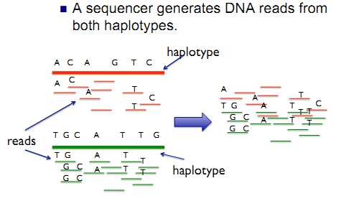
Problem Understanding – Haplotype Assembly (From Project Slide)

Slide 6
Computational Problem
Input
Reads generated from Haplotype fragment
Reference Genome to find SNP positions
Read matrix R _{m x n}
m - to denote the number of reads
n - length of the Haplotype
Output
A pair of haplotypes H = (h₀, h₁)
How the output is measured
Minimize the error function

Slide 7
Generating Reads
1 0 0 1 1 0 1 1 0
Random Position Chooser
00110
Flip Bits
Or
Delete Bits
01110
Notes:
Length of Reads not greater than 2 * (Size of Haplotype / Number of Reads)

Slide 8
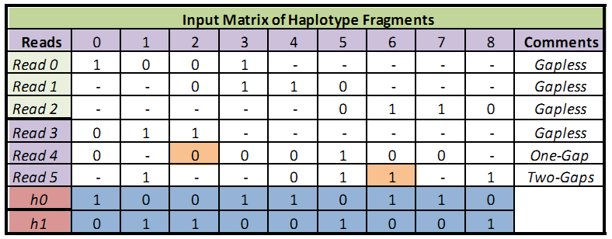
Read Matrix

Slide 9
Benchmarks
Speed / Computational time
Accuracy
Read matrix
Length of haplotype
Number of Reads
Reads
Error rate
Gaps in Reads

Slide 10
Baseline Method – Brute Force Approach
Generate all possible combinations of Haplotype (h₀)
Find Complementary Haplotype sequence (h₁)
Choose the haplotypes (h₀, h₁) with minimum error
Complexity O(m * 2^{n})
m – Number of Reads
n – Length of the Haplotype
Number of positions where it does not contain a hole

Slide 11
My Approach – Complimentary Subsets
Split the matrix into two
Distance between reads - O(m²)
Divide ‘m’ reads into two subsets
Divide Matrix M into M₁ and M₂ such that rows are non conflicting
Find possible haplotypes and see minimum error
Notes:
Perform minimum error correction in the matrix itself which needs minimum no. of flips
Find corresponding haplotypes

Slide 12
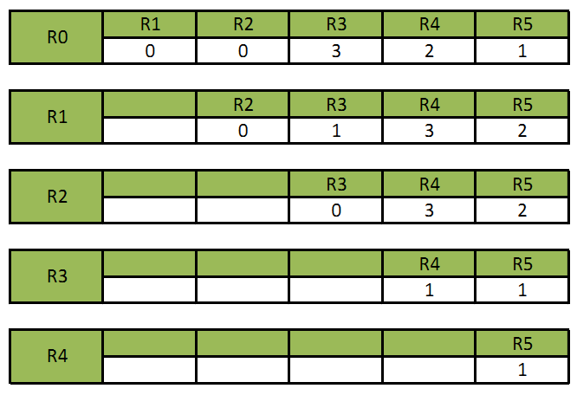
My Approach – Read Distance

Slide 13
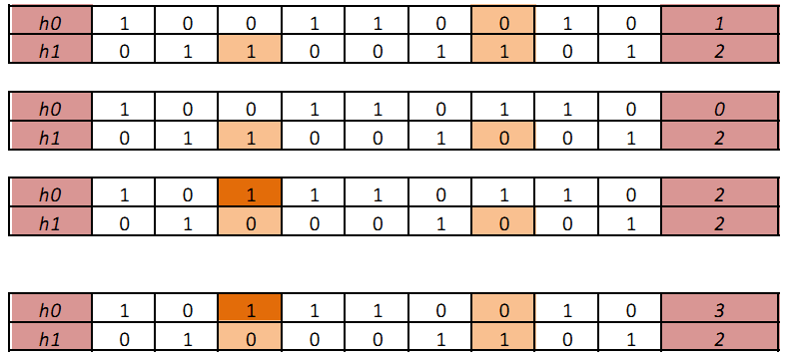
My Approach – Haplotype Generation

Slide 14
Results
Tradeoff between Accuracy and time
Parallelize code by using multiple threads through OpenMP
Lot of condition checks which increases computation cost
Read Matrix size = 50 * 500
50 Reads
Length of Haplotype is 500

Slide 15
Performance Measurement
Haplotype Length vs Computational Time
Read error rate vs Haplotype accuracy
Gaps is Reads vs Haplotype accuracy
Improvement after Parallelization
Baseline method vs My approach

Slide 16
Other approaches
MEC model
Low error rate and Low missing values
Dynamic Programming
O(m * 2^{k} * n)
m - Number of Reads
n - Total number of SNPs / fragment Reads
k – Length of longest Read
All existing exact algorithms are NP Hard (including Dynamic Programming)
Explore Heuristic Approach
Haplotype fragments are treated as Markov Process
Constructing haplotypes having genotype information

Slide 17
Future Work – Room for Improvement
Performance Improvement and Better Parallelization
Greater error rate in the read matrix
Larger size of the Haplotype string

Slide 18
References
Russell Schwartz, "Theory And Algorithms For The Haplotype Assembly Problem“
Dan He, Arthur Choi, Knot Pipatsrisawat, Adnan Darwiche, Eleazar Eskin "Optimal algorithms for haplotype assembly from whole-genome sequence data"
Seung-Ho Kang, In-Seon Jeong, Hwan-Gue Cho, Hyeong-Seok Lim, "HapAssembler: A web server for haplotype assembly from SNP fragments using genetic algorithm"
R Lippert, R Schwartz, G Lancia, "Algorithmic strategies for the single nucleotide polymorphism haplotype assembly problem"

