Slide 1

QuickRes — Agentic AI-Based Ticket Resolution
Autonomous AI that investigates, resolves, and verifies support tickets while escalating high-risk actions to human agents. Built for evidence-first decisions, transparent reasoning, and controlled automation.
Team Members:
Karthik C ( 231501073 )
Pragadeesh Kumar L D ( 231501117 )
Lovisha Karol C ( 231501088 )

Slide 2
Problem & Motivation
Volume & Repetition
Fragmented Evidence
Limits of Chatbots
High throughput of repetitive tickets consumes agent capacity and increases mean time to resolution.
Relevant data scattered across knowledge bases, past cases, and customer systems — manual correlation is slow and error-prone.
Conventional bots generate responses but rarely perform investigation, verification, or policy-driven actions safely.
Human Control Required
Sensitive actions (refunds, cancellations, account changes) must preserve human oversight and auditability.

Slide 3
QuickRes — Solution Overview
QuickRes acts as an AI support agent — not just a chatbot. It autonomously: understands tickets, plans investigations, retrieves evidence, reasons with multi-agent collaboration, executes low-risk actions, and escalates high-risk decisions to humans.
Primary Users
Key Capabilities
Customer Support Agents • Support Managers
Multi-agent collaboration, Agentic RAG, enterprise tool usage, stateful ticket memory, reflection & self-correction, risk-based escalation.

Slide 4
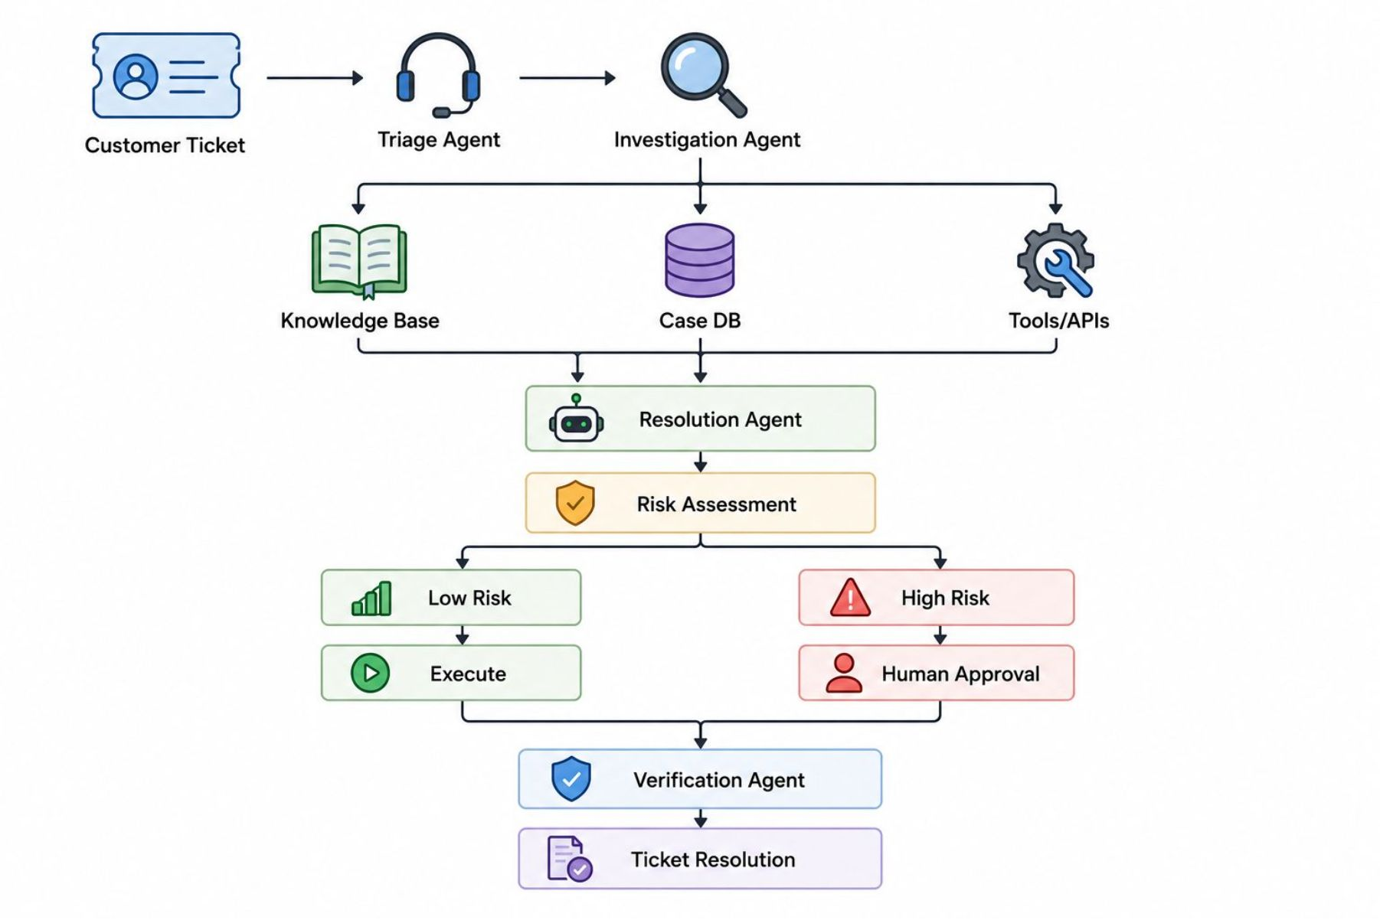

Agentic Architecture — System Overview
Core Workflow
Intake: receive the ticket.
Routing: send tasks to the right agents.
Knowledge: pull from docs, tickets, and context.
Decision: assess confidence and risk.
Action: execute approved steps or escalate.
High-risk or unclear cases go to a human.

Slide 5

Agentic RAG & Authorized Tool Usage
Conventional RAG
Ticket → Vector search → Top-K documents → LLM
Conventional RAG
QuickRes Agentic RAG
Ticket → Agent decides required info → Selects source → Retrieves evidence → Evaluates relevance → Refines retrieval → Uses evidence for resolution
Ticket → Vector search → Top-K documents → LLM
Agentic RAG
Ticket → Agent decides required info
Source & Retrieval
Selects source → Retrieves evidence
Evaluate & Resolve
Sources: Knowledge base, historical cases, customer records, orders, subscriptions
Authorized tools: get_customer(), get_order(), check_payment(), check_subscription(), create_refund(), update_ticket()
Evaluates relevance → Refines retrieval → Uses evidence

Slide 6
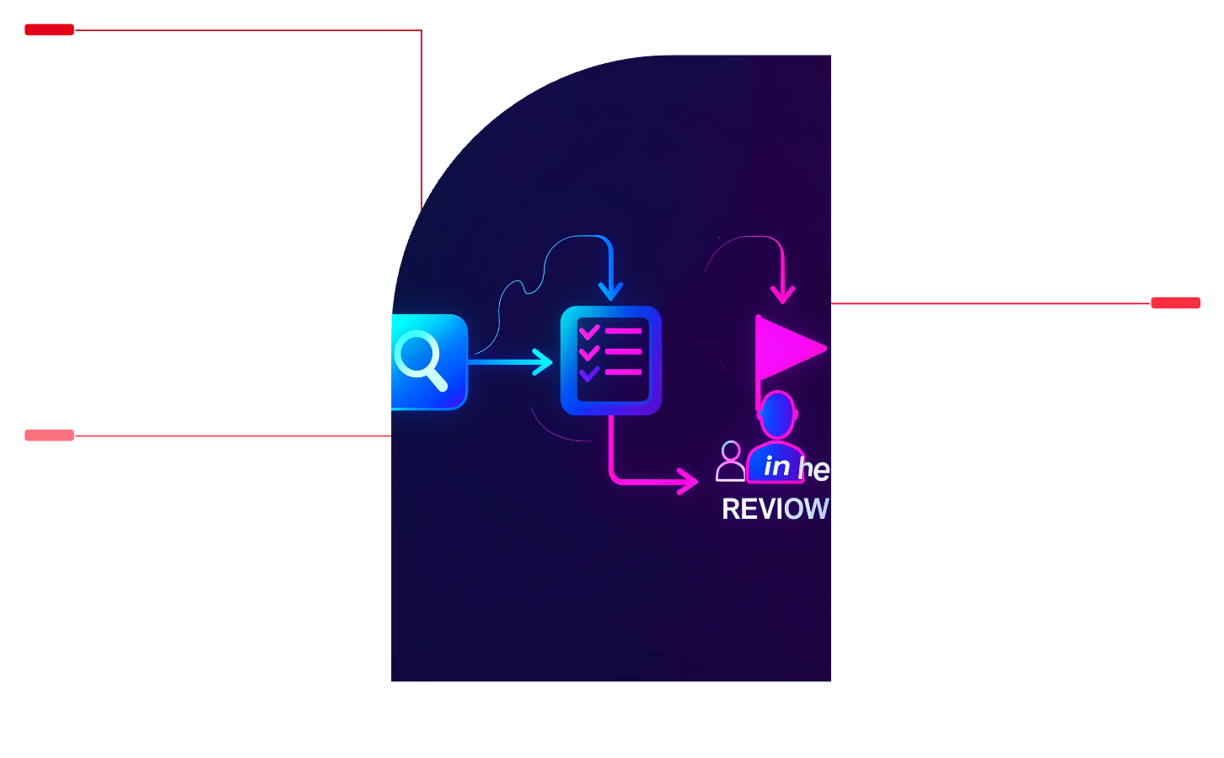

Reflection & Human-in-the-Loop
Reflection / Self-Correction
Retrieve
Assess evidence relevance and sufficiency
Cross-check conflicting sources
Revise retrieval and reasoning when confidence is low
Fetch relevant sources and prior outputs.
Evaluate Evidence
Assess relevance, sufficiency, and conflicts.
Human-in-the-Loop Policy
Decide
Choose action or flag for human review.
Goal: maximize safe automation while preserving control and auditability.
Autonomous
Human Approval Required
Update ticket classification, send routine responses, execute low-risk updates
Issue refunds, modify account details, cancel subscriptions — actions gated by approval workflow

Slide 7
Implementation & Evaluation Plan
Implementation Stack
Evaluation Baselines
LangGraph orchestration • Multi-LLM experiments • Vector DB knowledge store • Mock/authorized enterprise APIs • Stateful ticket memory • Support-agent dashboard
1) No-RAG + LLM • 2) Conventional RAG • 3) Agentic RAG + Multi-Agent System
Metrics
Experiment
Resolution accuracy, retrieval quality, hallucination rate, policy compliance, escalation accuracy, response consistency, latency, cost
Compare multiple LLMs and orchestration strategies under identical test suites and adversarial edge cases.

Slide 8
Expected Outcomes & Next Steps
Outcomes
Next Steps
Higher resolution accuracy, evidence-grounded responses, fewer hallucinations, reduced manual investigation effort, safe automation of eligible actions, reliable escalation for high-risk decisions.
Integrate with CRM/helpdesk platforms, incorporate agent feedback loops, expand enterprise tool coverage, continuous monitoring, adaptive risk policies and periodic audits.
Conclusion: QuickRes converts support from response generation into autonomous, evidence-driven investigation and resolution — combining Agentic RAG, multi-agent reasoning, tool use, reflection, stateful memory, and controlled human oversight.

