Slide 2
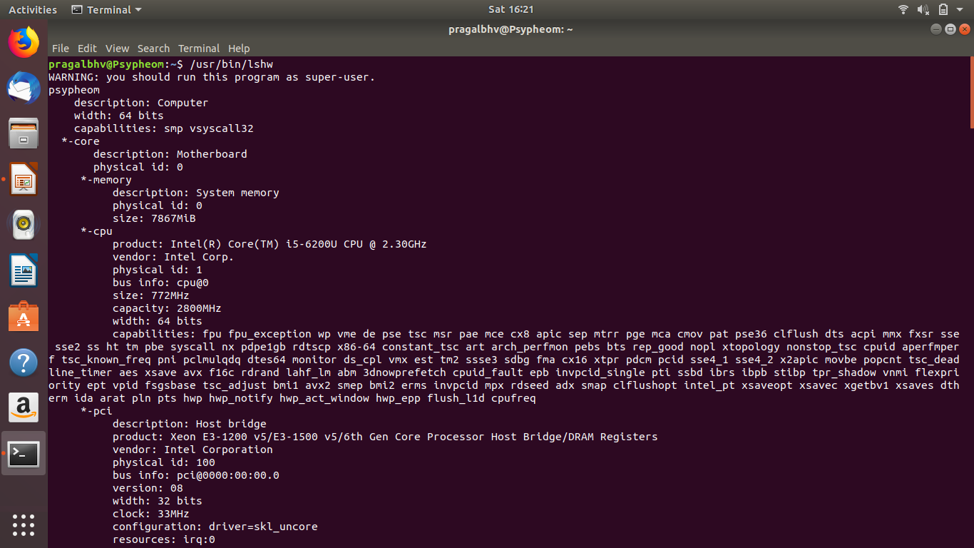
Make a listing of harware in your laptop
Using command “/usr/sbin/hwinfo” a comprehensive list can be obtained, however i used “/usr/bin/lshw” fo a brief listing of hardware components.

Slide 3
Intsall Packages and explore what they do
command | description
fortune | Fortune prints a one-line aphorism chosen at random
ocatve | Octave is used interactively by running the program ‘octave’ without any arguments.
pdftk | pdftk − A handy tool for manipulating PDF
unison | unison − a file-synchronization tool for Unix and Windows
wget | Wget − The non−interactive network downloader
curl | curl is a tool to transfer data from or to a server, using one of the supported protocols
gftp | gFTP is a file transfer client for *NIX based machines. It currently has a text interface
xfig | Xfig is a menu-driven tool that allows the user to draw and manipulate objects interactively under the X Window System
vlc | It opens vlc media player

Slide 4
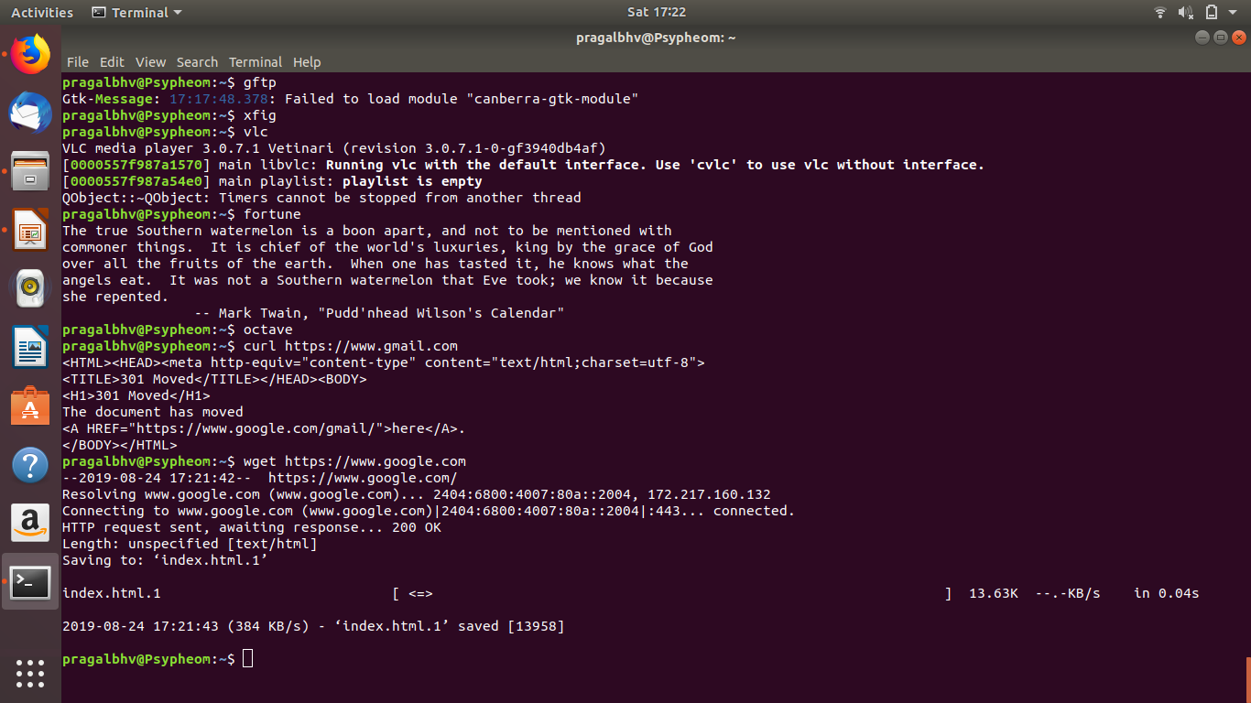
Previous screenshots of fortune -vlc

Slide 5
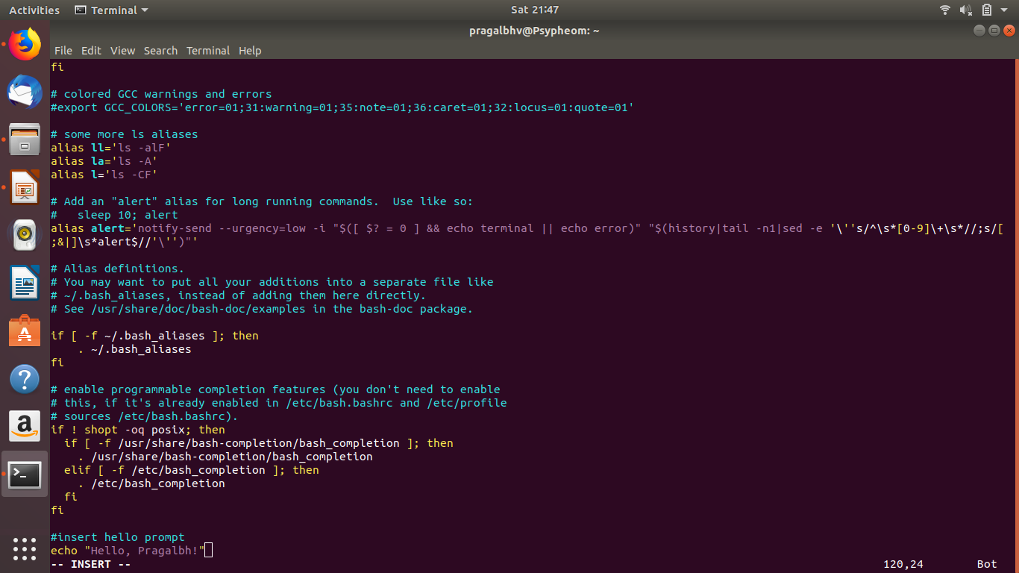
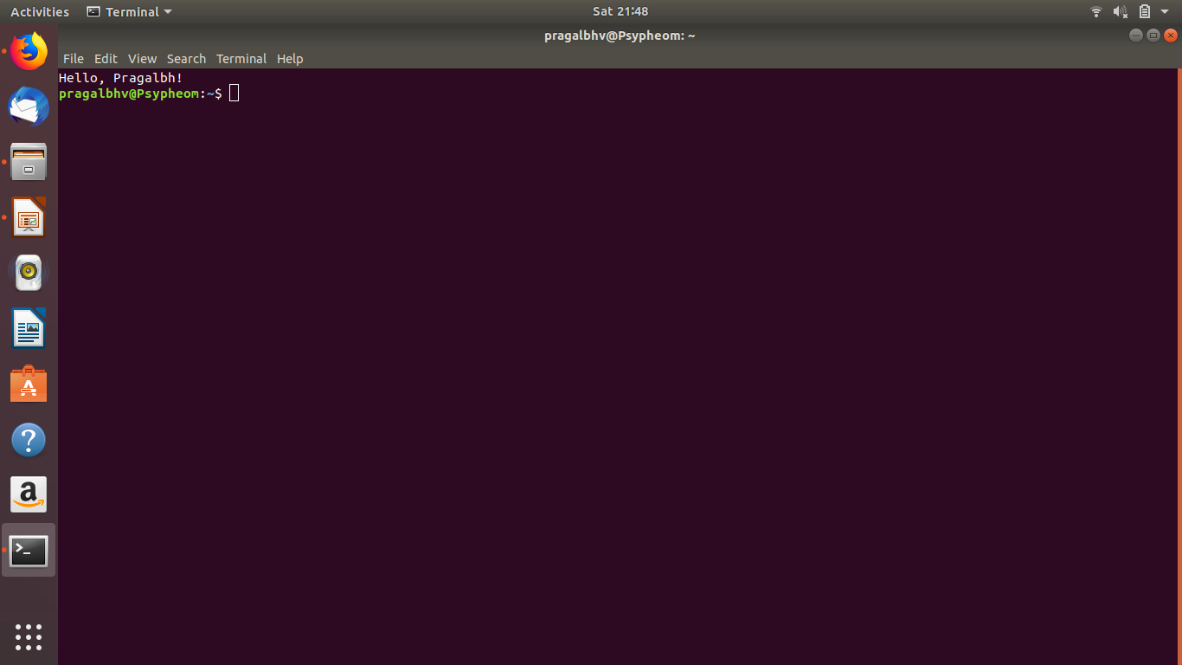
Add command to your bashrc
By using
“vi $HOME/.bashrc” bashrc file can be edited and made to display text at opening of terminal
I used echo “Hello, Pragalbh!”

Slide 6
Code Name of Linux
Version and Code name
4.10 Warty Warthog
5.04 Hoary Hedgehog
5.10 Breezy Badger
6.06 LTS Dapper Drake
6.10 Edgy Eft
7.04 Feisty Fawn
7.10 Gutsy Gibbon
8.04 LTS Hardy Heron
8.10 Intrepid Ibex
9.04 Jaunty Jackalope
9.10 Karmic Koala
10.04 LTS Lucid Lynx
10.10 Maverick Meerkat
11.04 Natty Narwhal
11.10 Oneiric Ocelot
12.04 LTS Precise Pangolin
12.10 Quantal Quetzal
13.04 Raring Ringtail
13.10 Saucy Salamander
14.04 LTS Trusty Tahr
14.10 Utopic Unicorn
15.04 Vivid Vervet
15.10 Wily Werewolf
16.04 LTS Xenial Xerus
16.10 Yakkety Yak
17.04 Zesty Zapus
17.10 Artful Aardvark
18.04 LTS Bionic Beaver
18.10 Cosmic Cuttlefish
19.04 Disco Dingo
19.10 Eoan Ermine

Slide 7
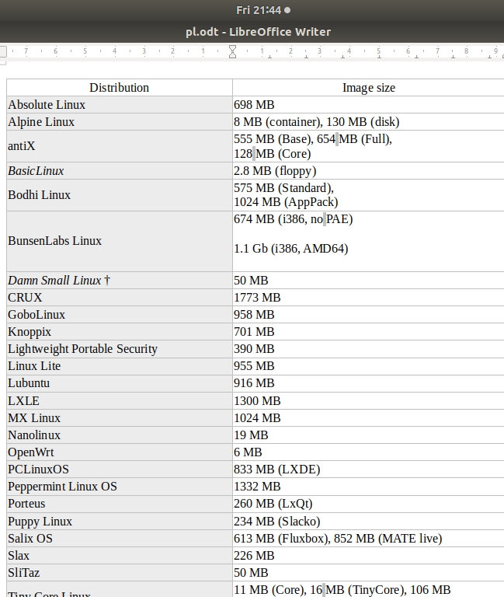
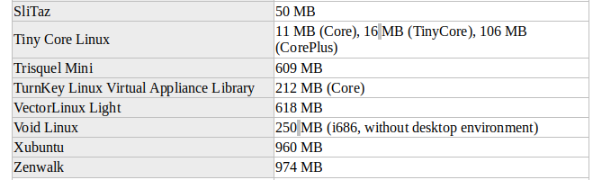
Lightwieght flavours of Linux

Slide 8
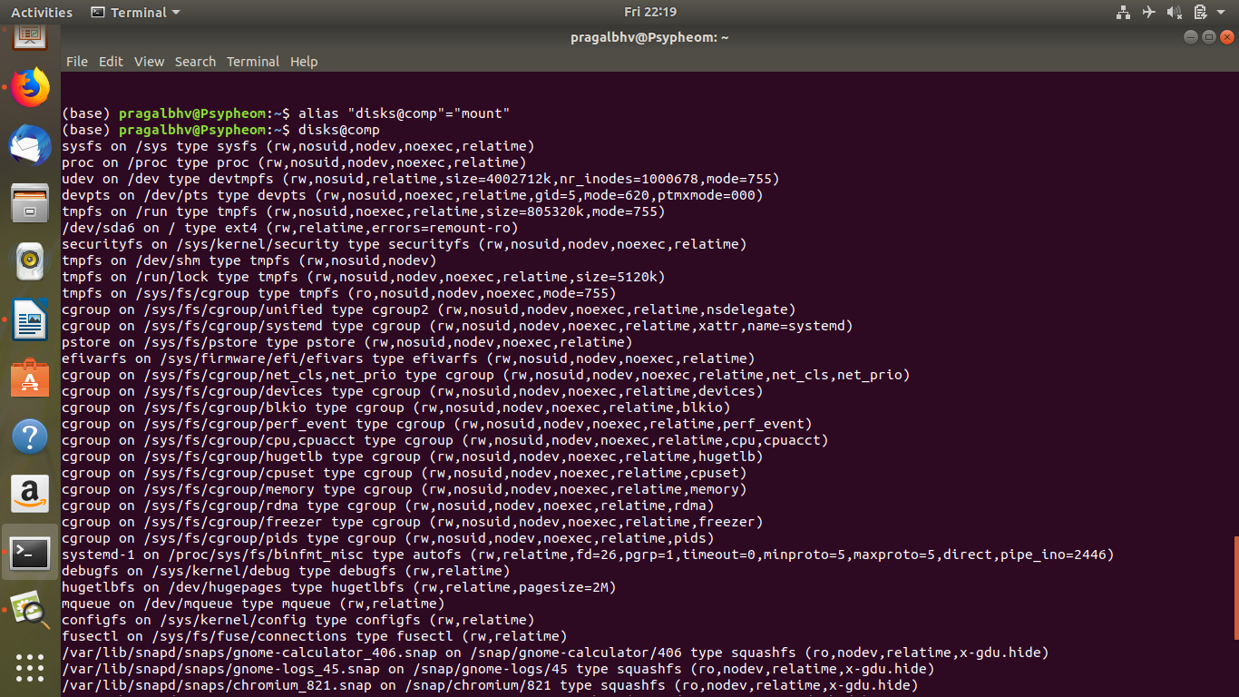
Create an alias that displays the hard discs currently mounted in the system.

Slide 9
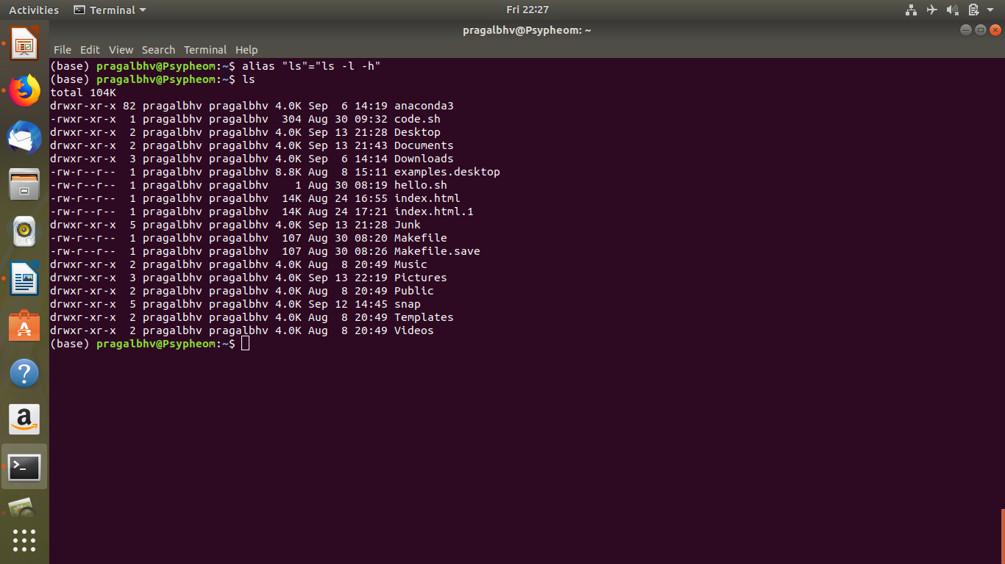
Create an alias for a command your favorite options

Slide 10
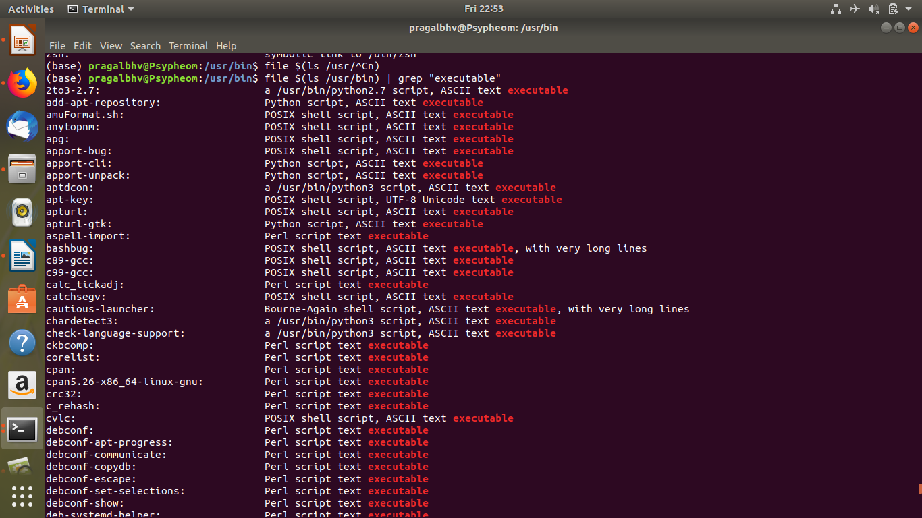
Use “file” command in the /bin directory and see what type of executables are out there.
Output is assed as input by | and also by arguement $()

Slide 11
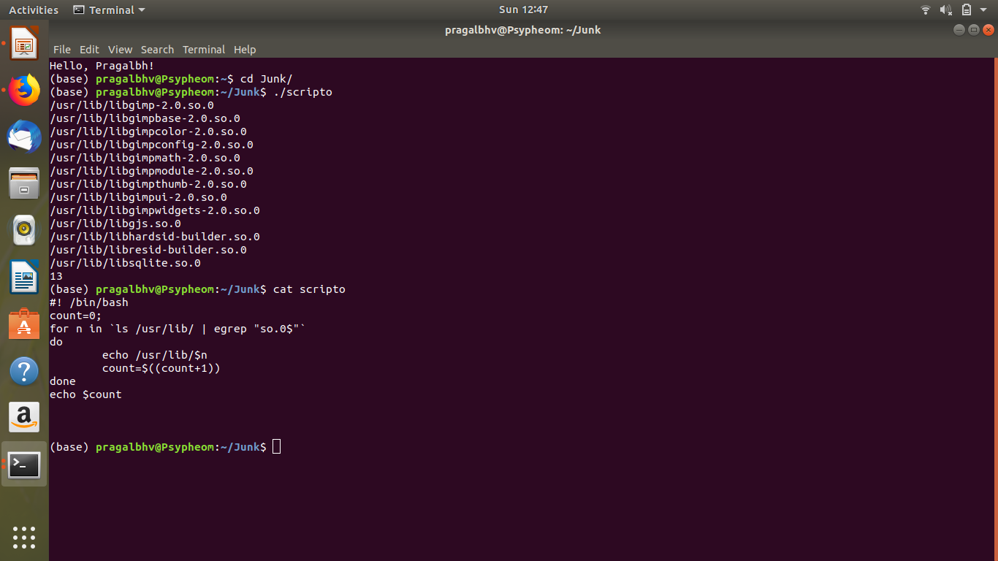
Count the number of library files that have their names ending with “.so.0” in /usr/lib directory.

Slide 12
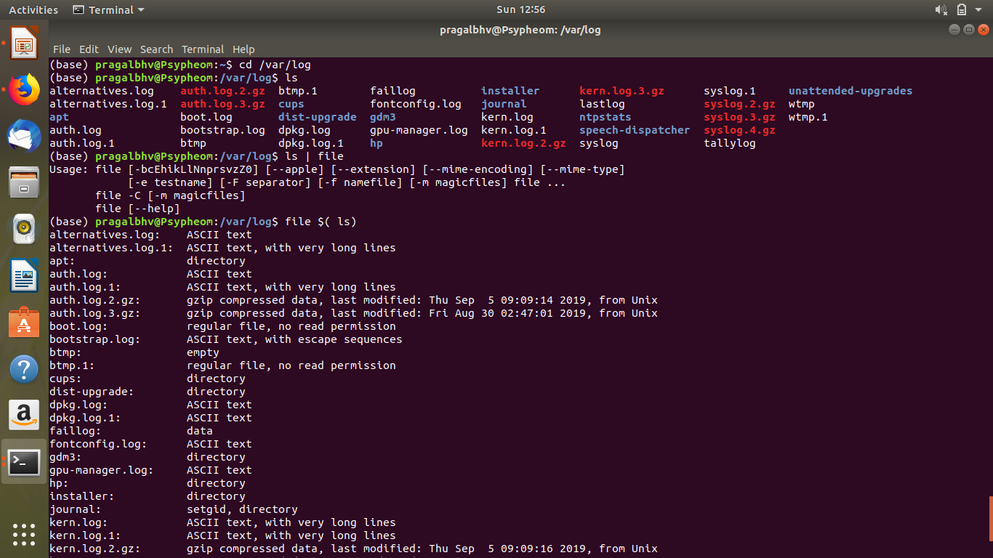
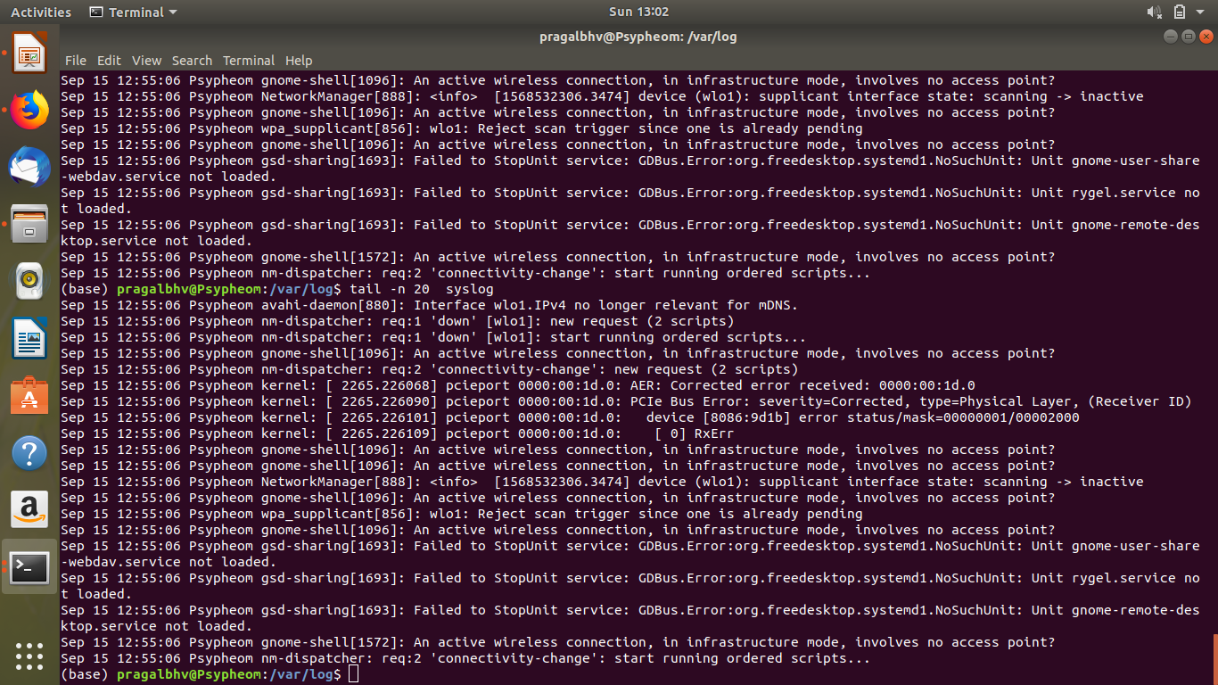
Explore /var/log folder and see which file is for what purpose. Look at the latest 20 lines of “syslog”

Slide 13
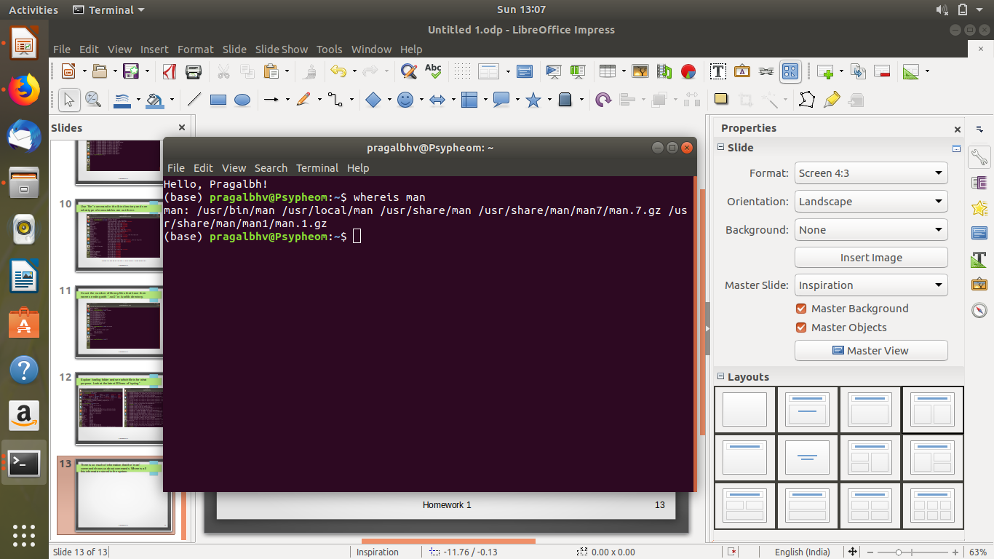
There is so much of information that the “man” command shows us about commands. Where is all this information stored in the system
The standard location is /usr/share/man according to Filesystem Hierarchy Standard, and /usr/man is usually a link to that directory
Source:-superuser.com

Slide 14
The file “/dev/null” is a special file. What does it contain?
dev/null is a blackhole like dump file which contains nothing
It is used to dispose unwanted files, output etc
You write to /dev/null every time you use it in a command such as touch file 2> /dev/null. You read from /dev/null every time you empty an existing file using a command such as cat /dev/null > bigfile or just > bigfile. Because of the file's nature, you can't change it in any way; you can only use it
The null device is typically used for disposing of unwanted output streams of a process
The /dev/null device is a special file, not a directory, so one cannot move a whole file or directory into it with the Unix mv command.
It is also known as balckhole

