Slide 1
Homework 2
Session 4 5 6
Mm19b012

Slide 2
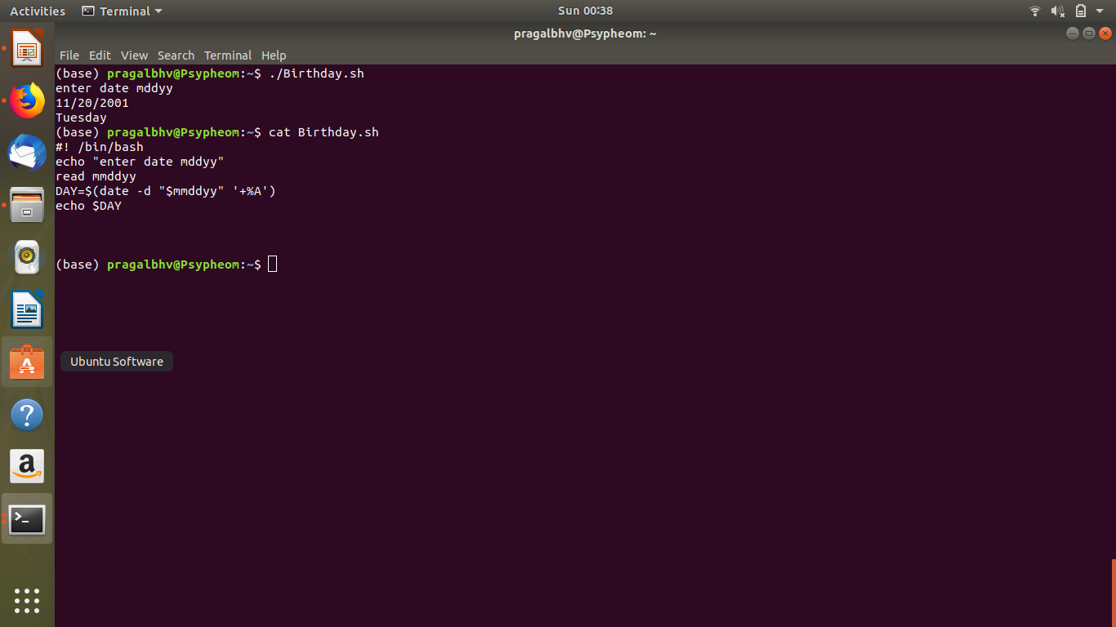
Write a command that displays the weekday

Slide 3
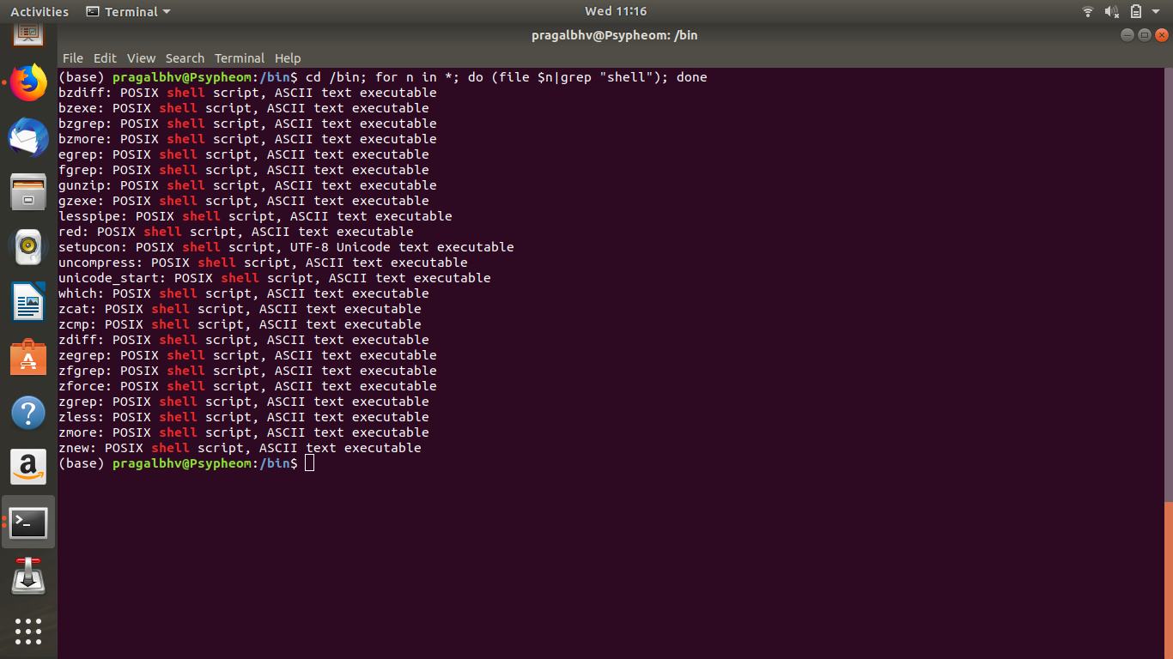
Create a command that lists all the shell scripts in the directory “/bin”

Slide 4
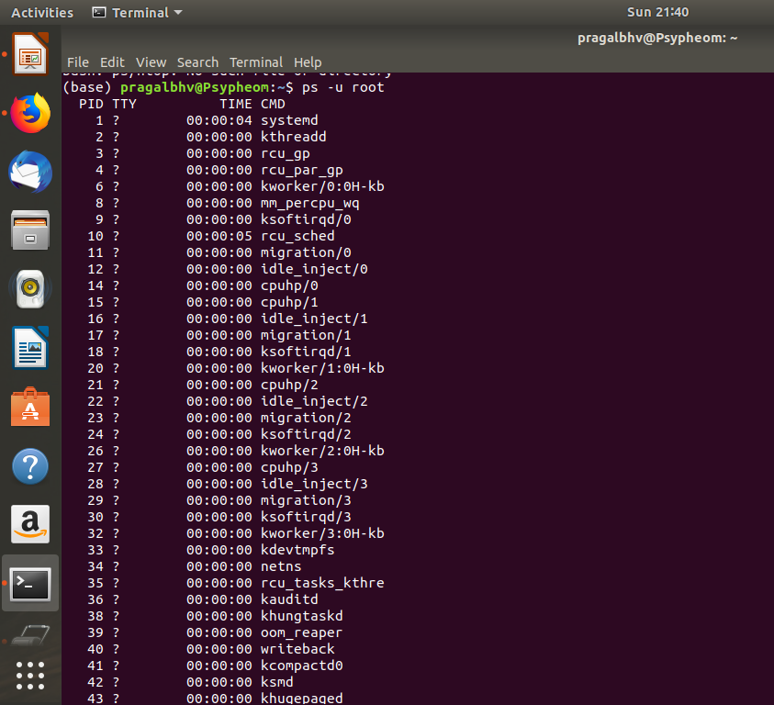
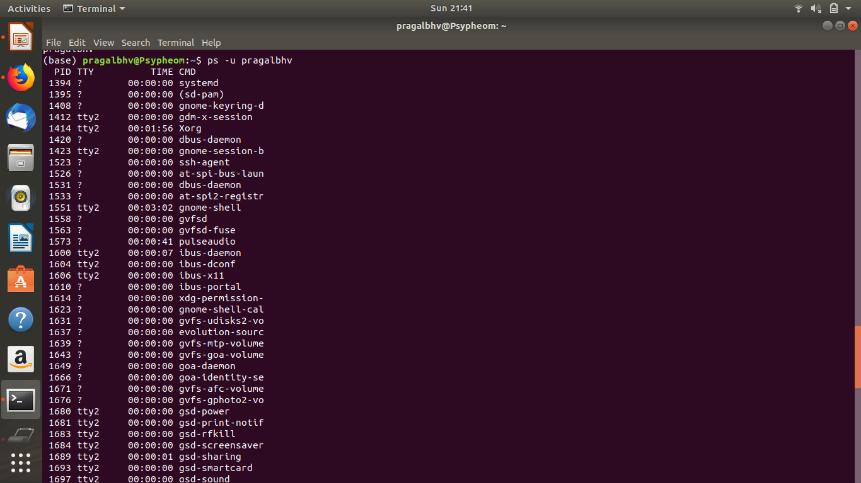
List processes that are being run by root or logged-in user

Slide 5
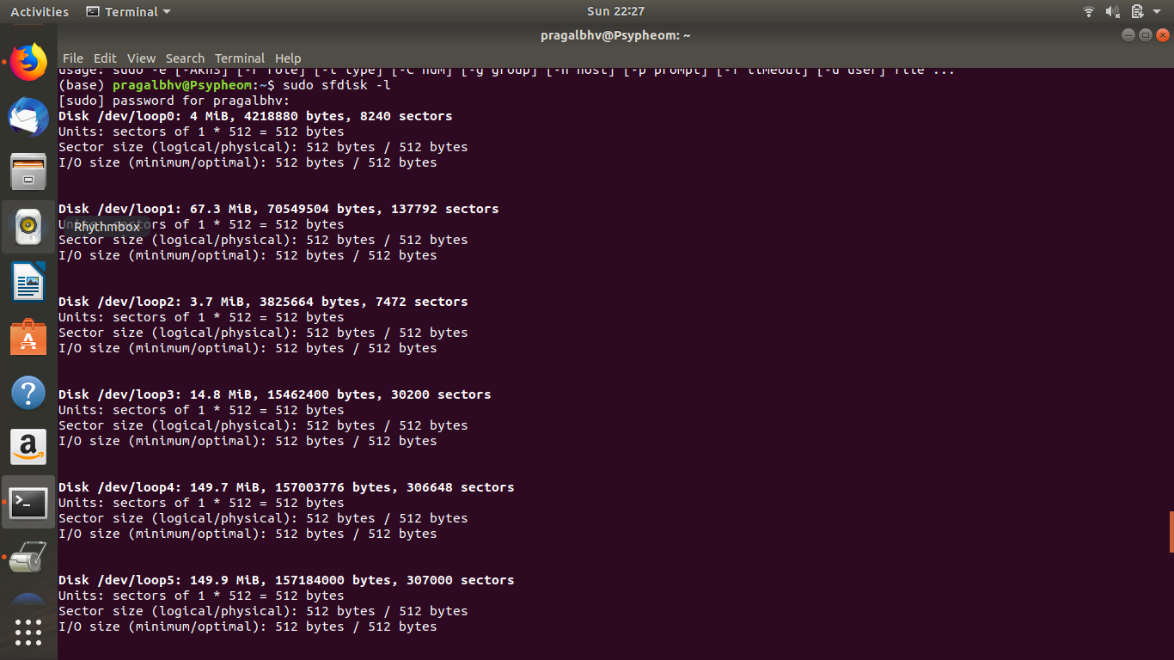
List used space for only mounted hard disk partitions
Sfdisk command is used

Slide 6
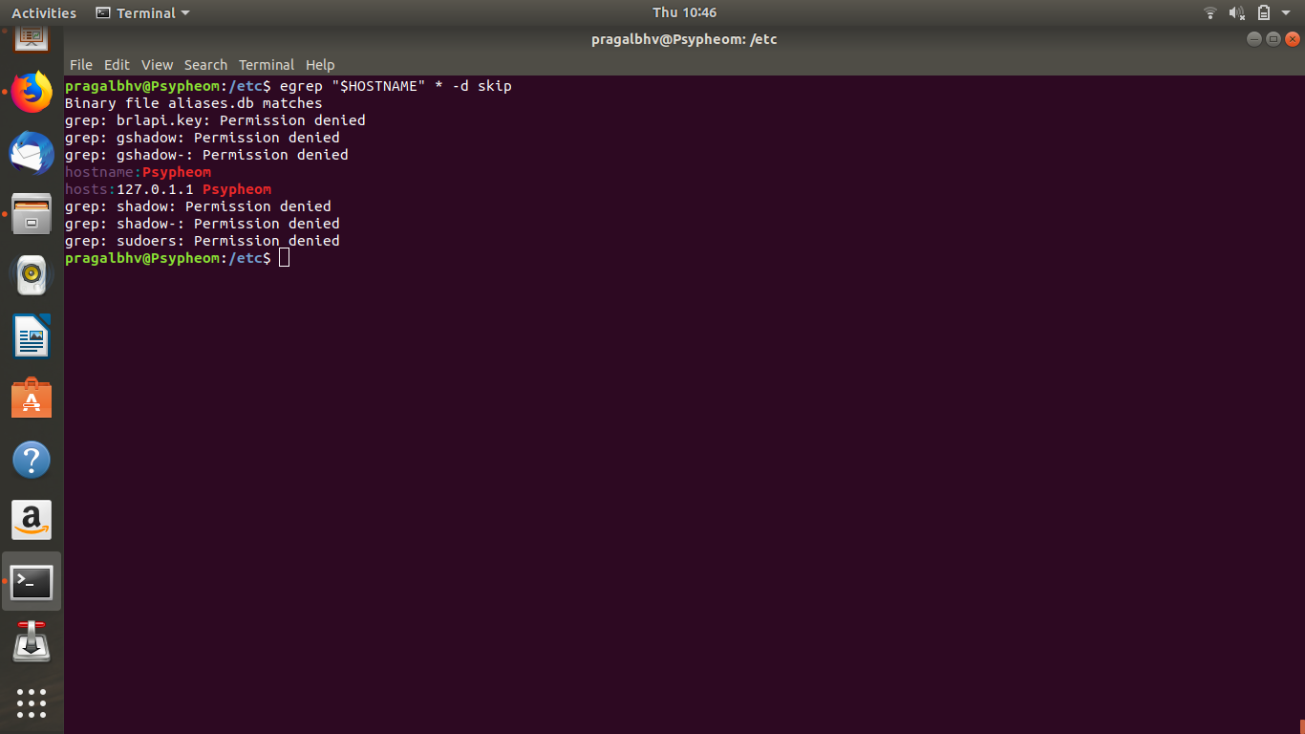
Find out which files in the /etc directory use the name of your machine

Slide 7
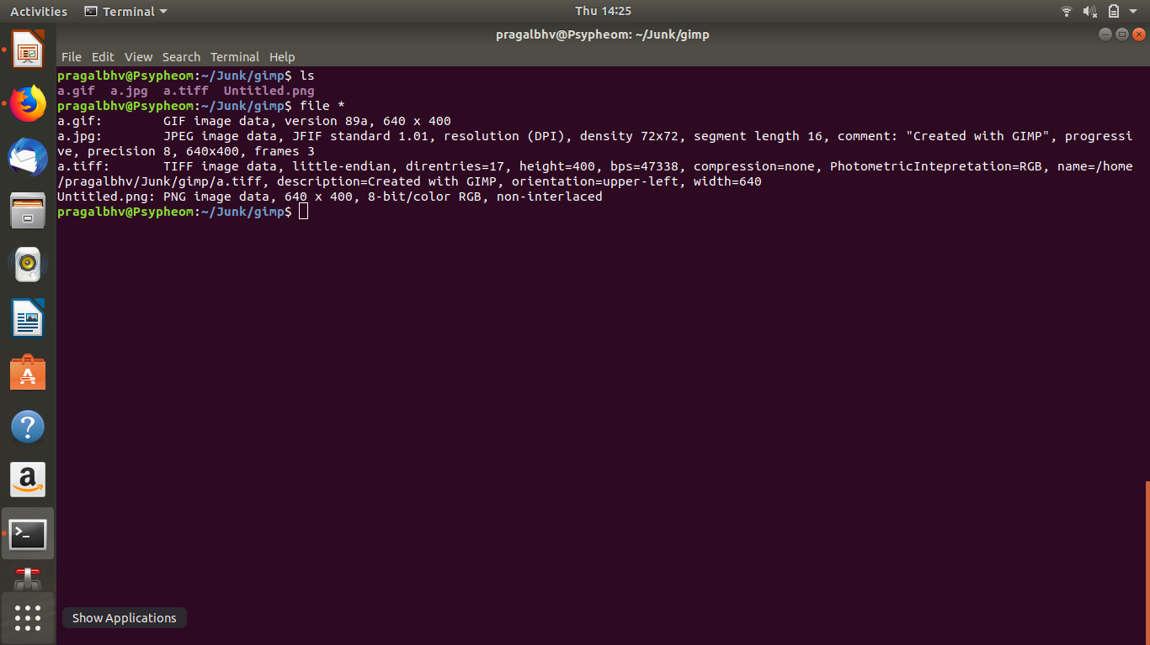
Create images using the tool “gimp” and export to different formats like png, tiff, jpg, gif and bmp. Use the “file” command to see what the system knows about these formats.

