Slide 2
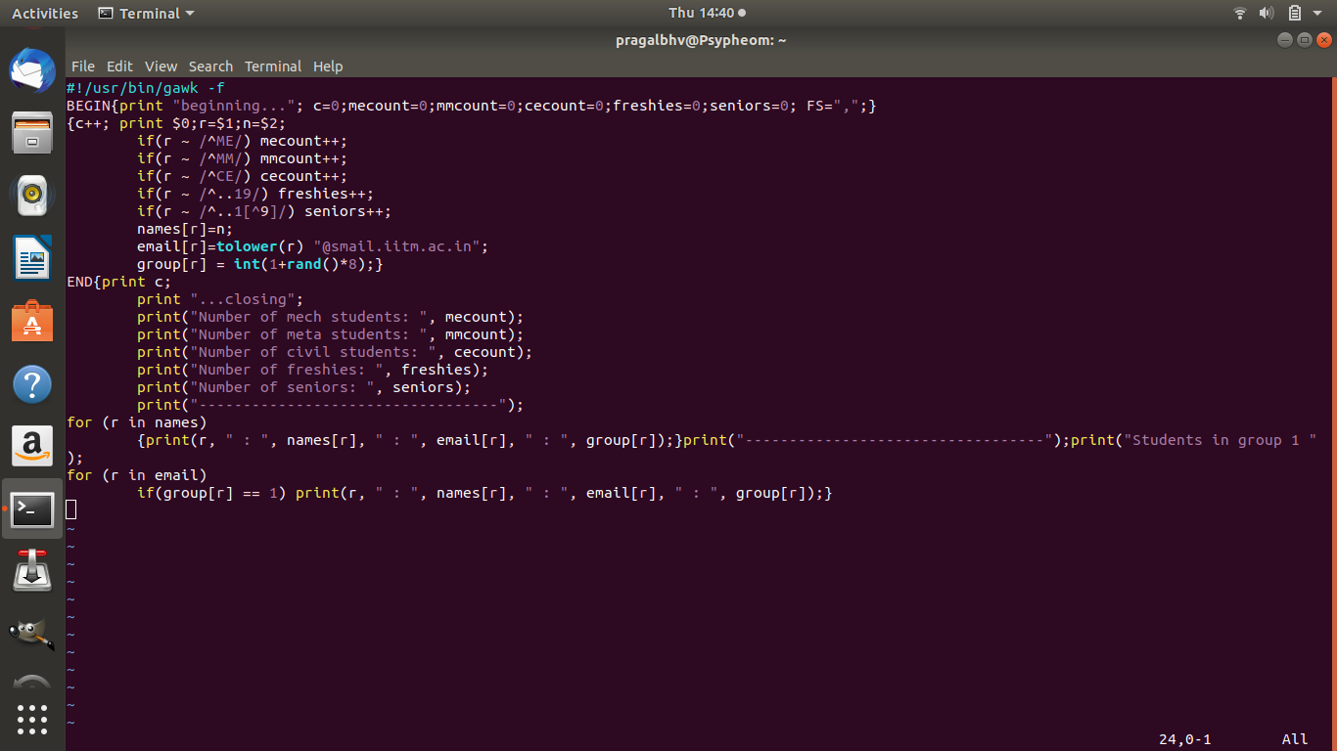
Script and output

Slide 3
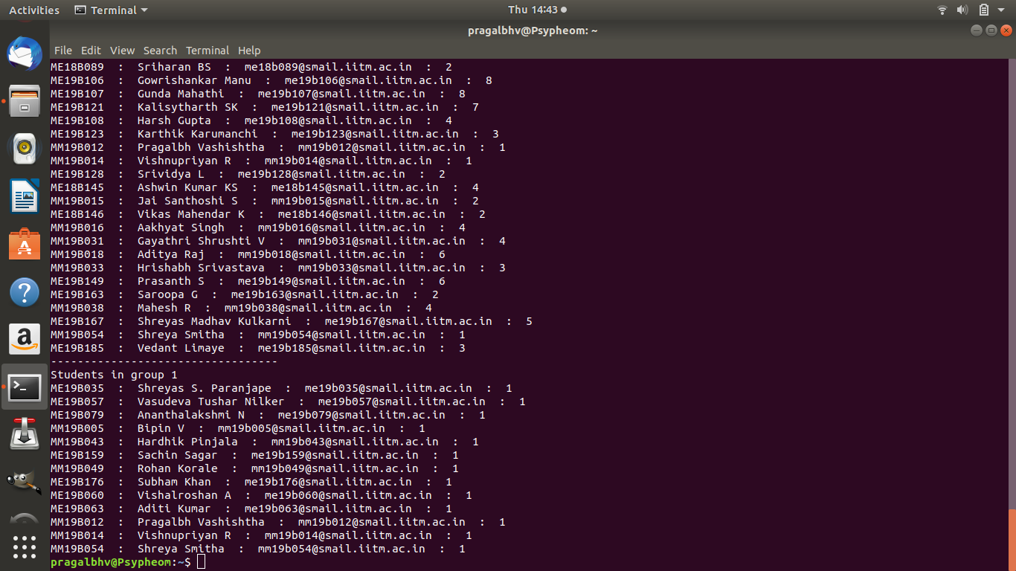
Output

Slide 4
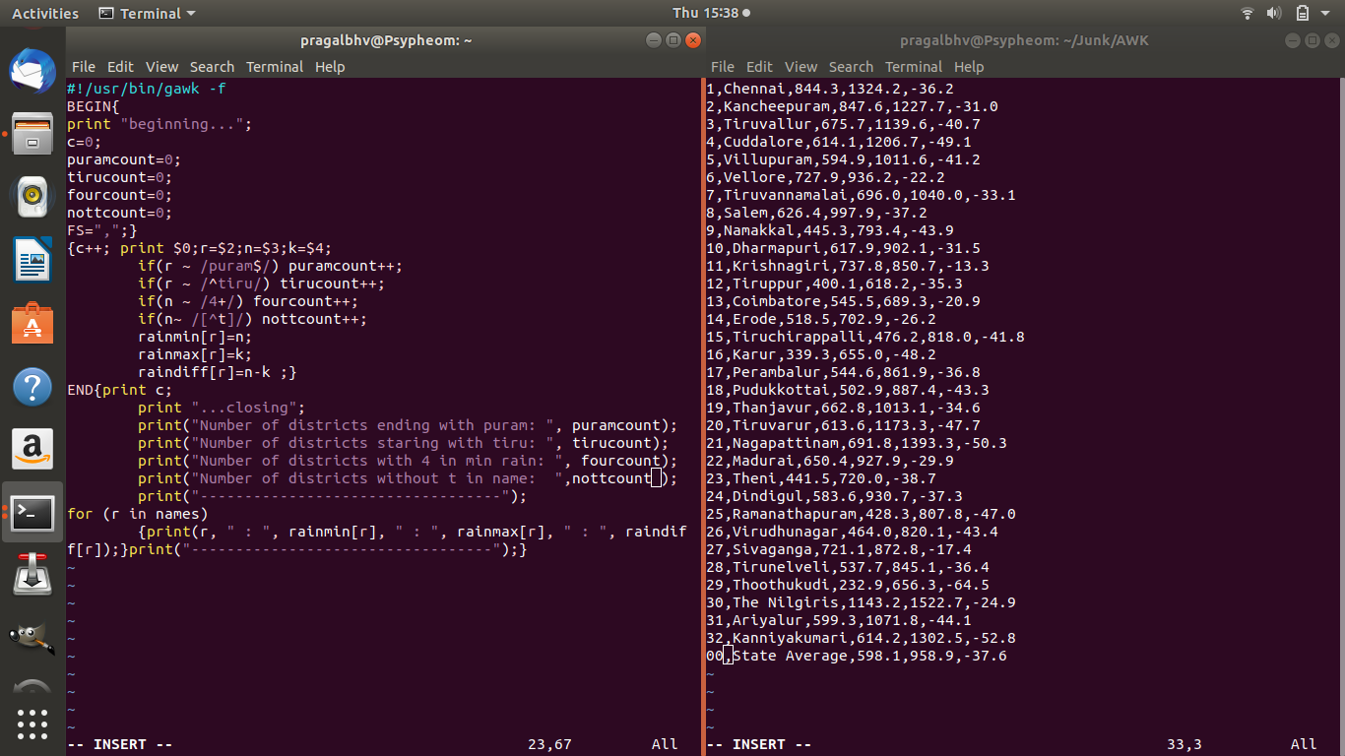
Modify it to try out your understanding of the regex and code capabilities of awk.

Slide 5
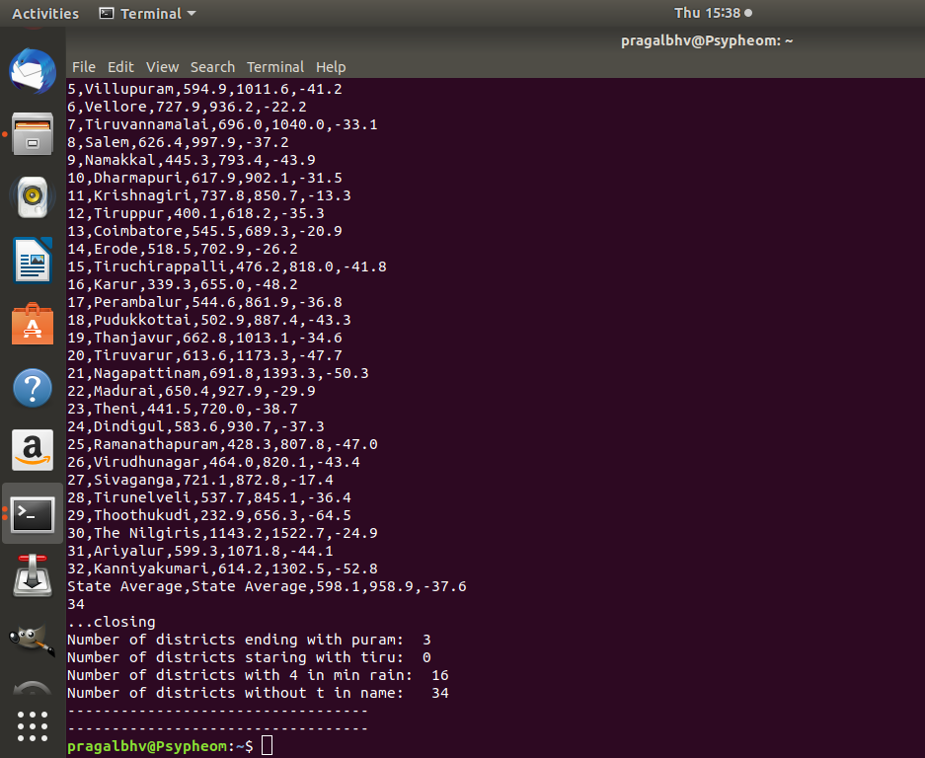
Output of code and data in prev. slide

Slide 6
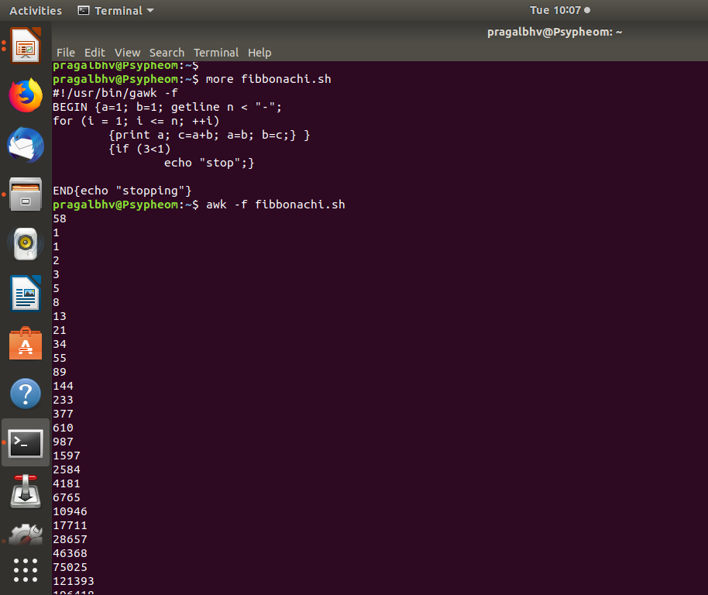
Fibbonachi seq

