Slide 1
HOMEWORK 5
Makefile

Slide 2
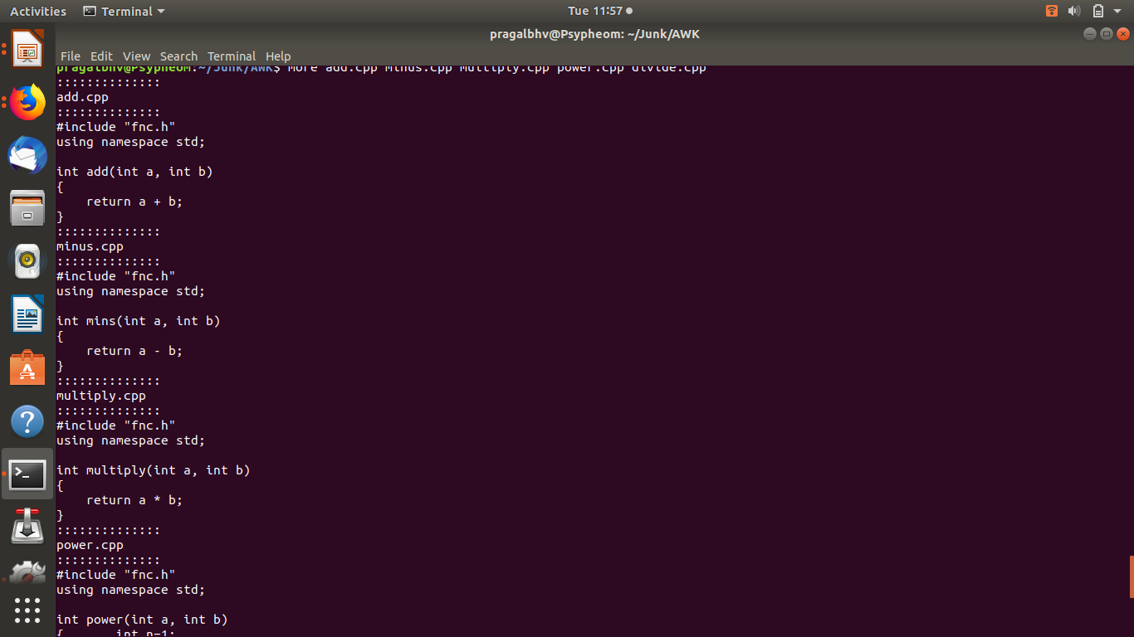
Take one of your old codes, split the code into separate files, one for each function. Create a makefile and test the recompilation

Slide 3
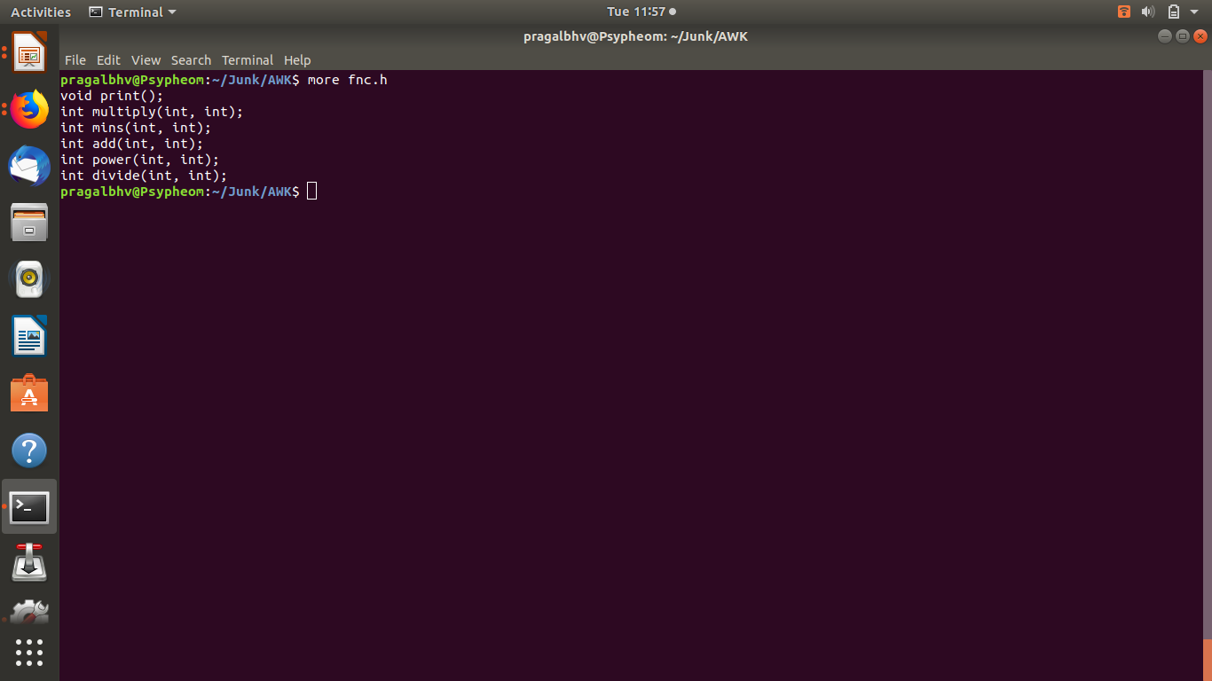
Fnc.h

Slide 4
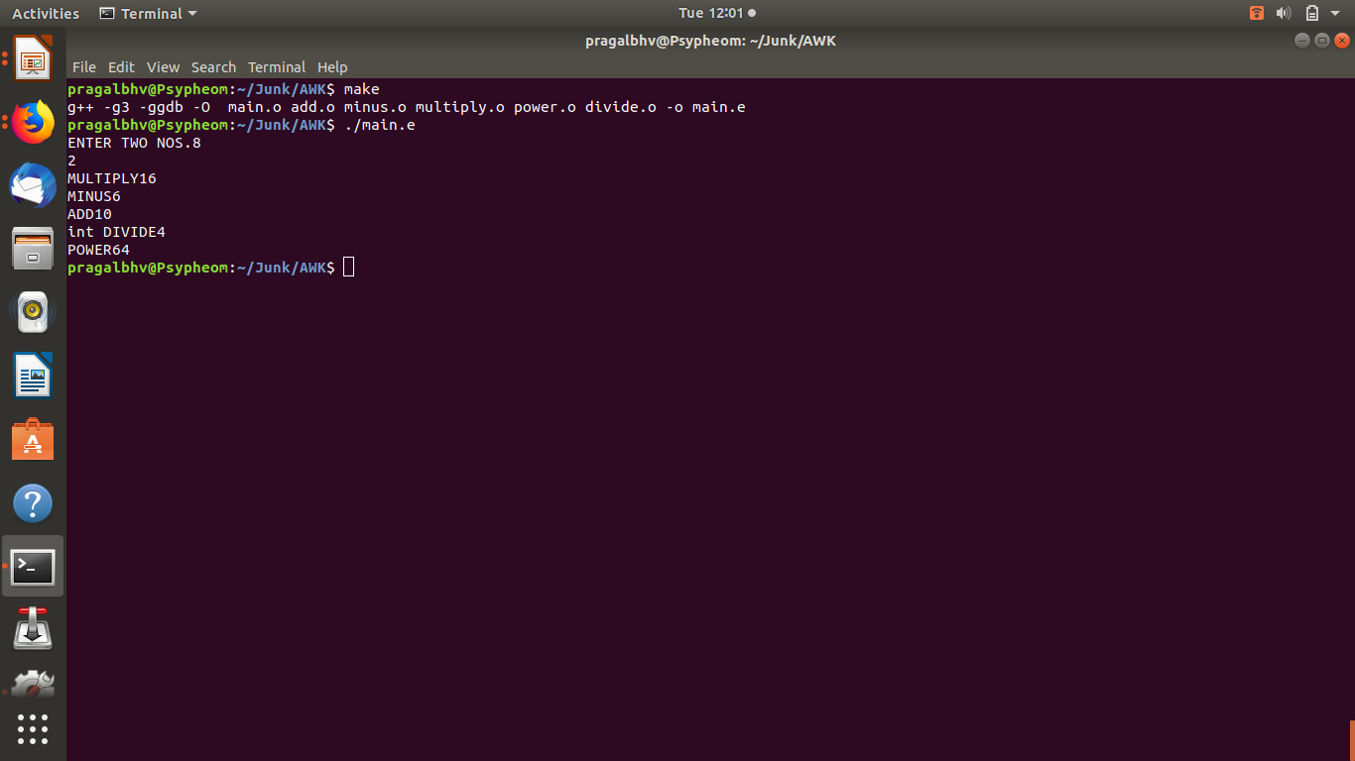

Slide 5
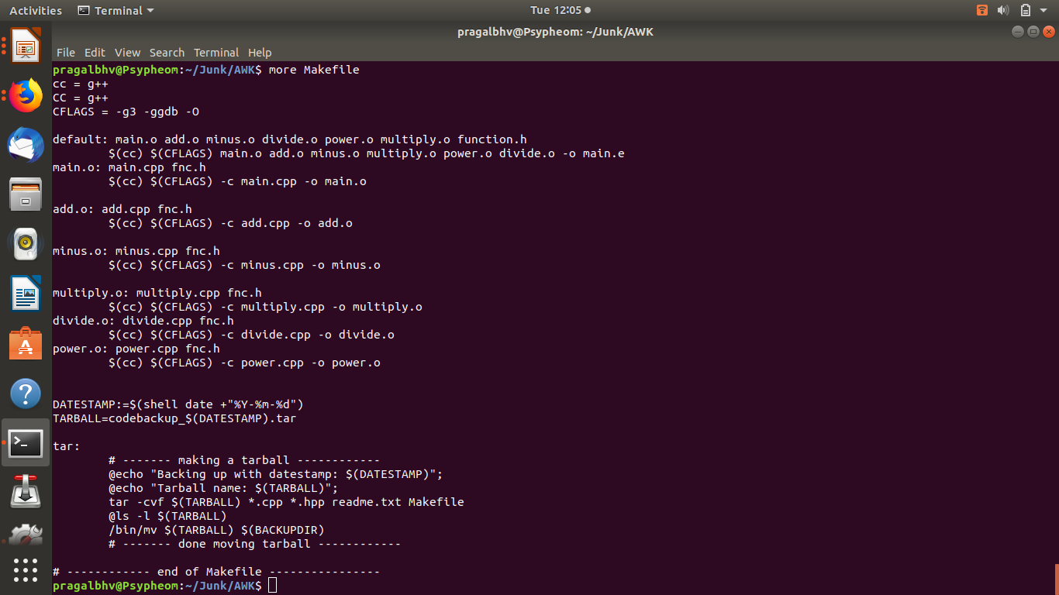

Slide 6
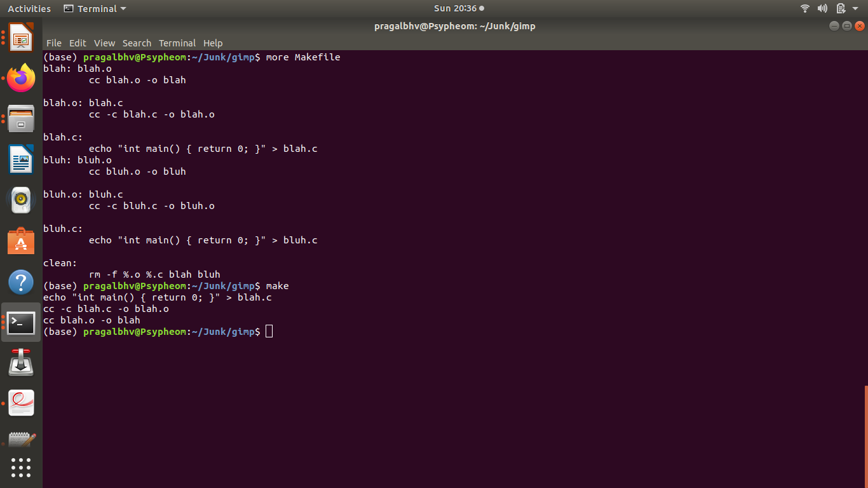
Create a makefile that uses a pattern for files rather than explicit listing of each of the files.

