Slide 1
HOMEWORK 5
Makefile

Slide 2
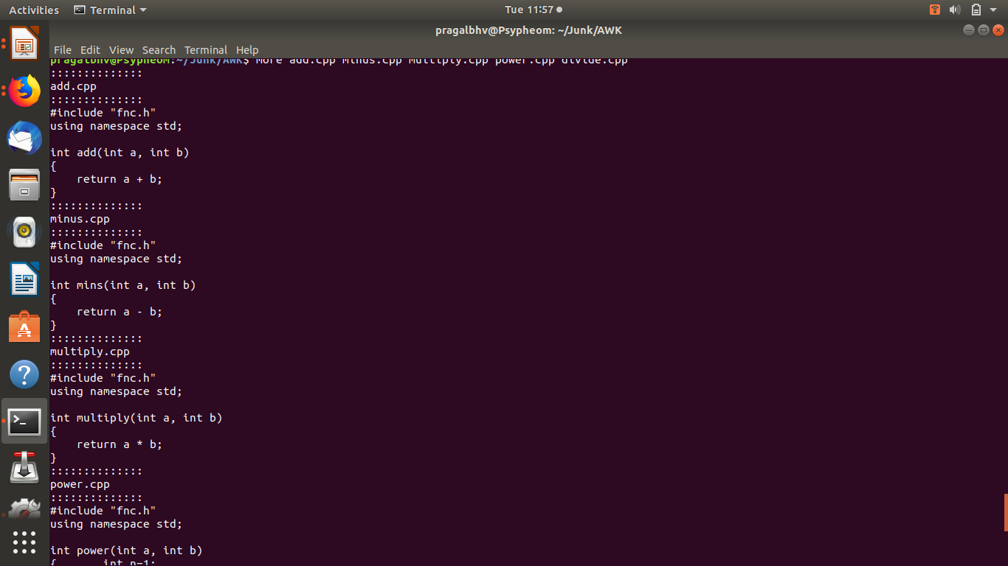
Take one of your old codes, split the code into separate files, one for each function. Create a makefile and test the recompilation

Slide 3
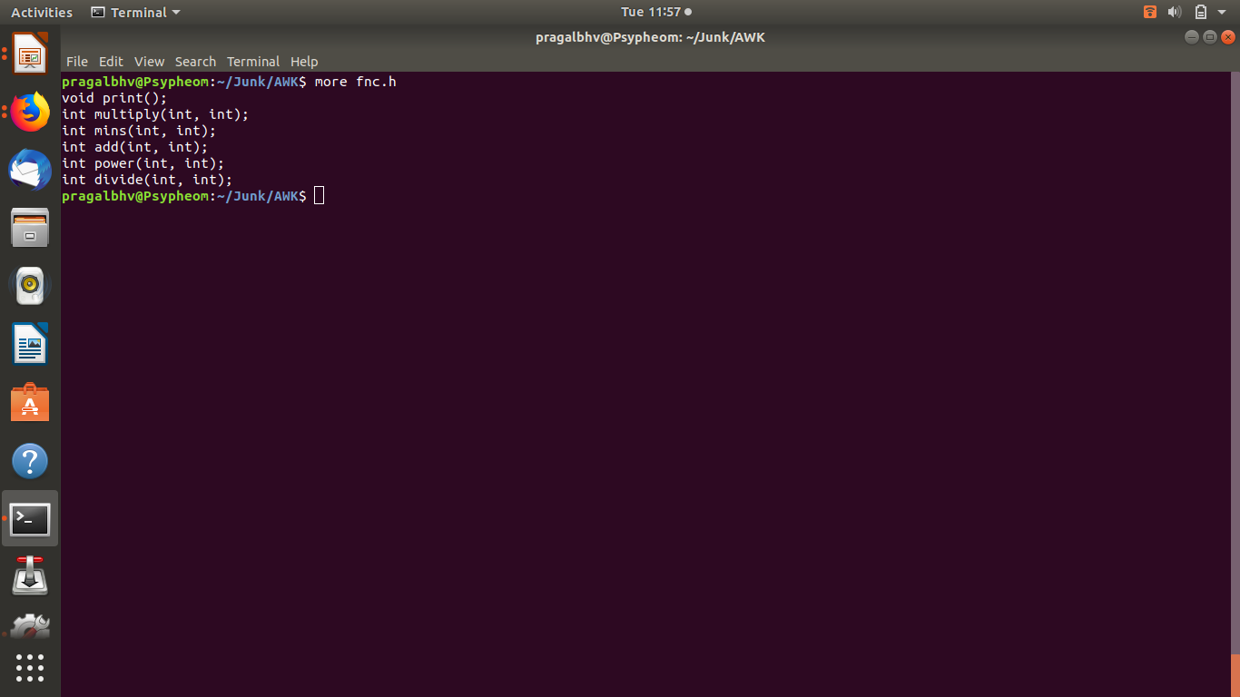
Fnc.h

Slide 4
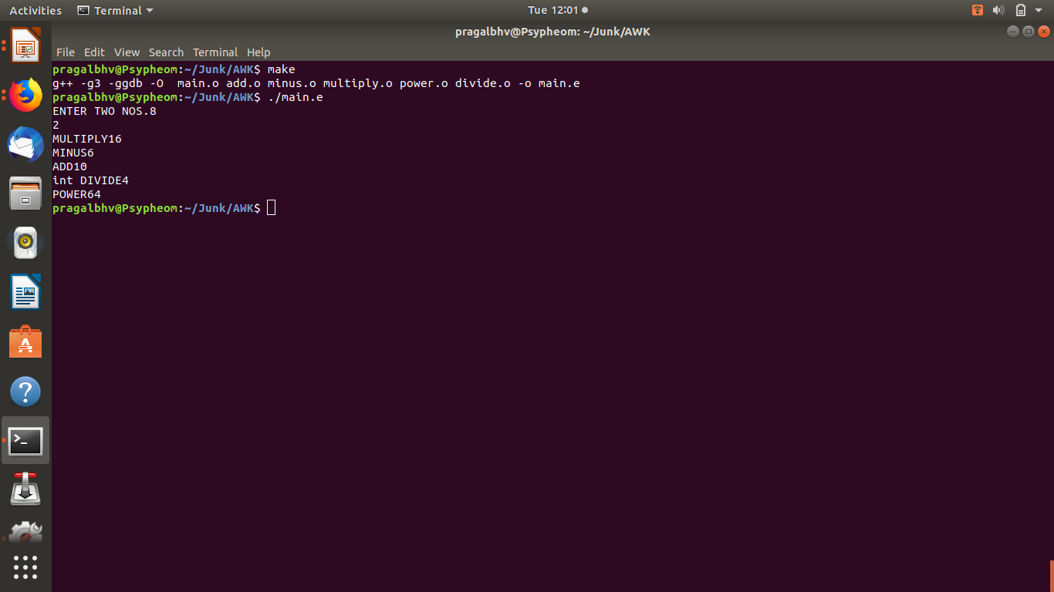

Slide 5
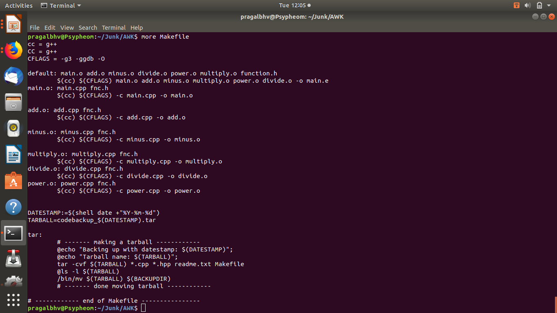

Slide 6
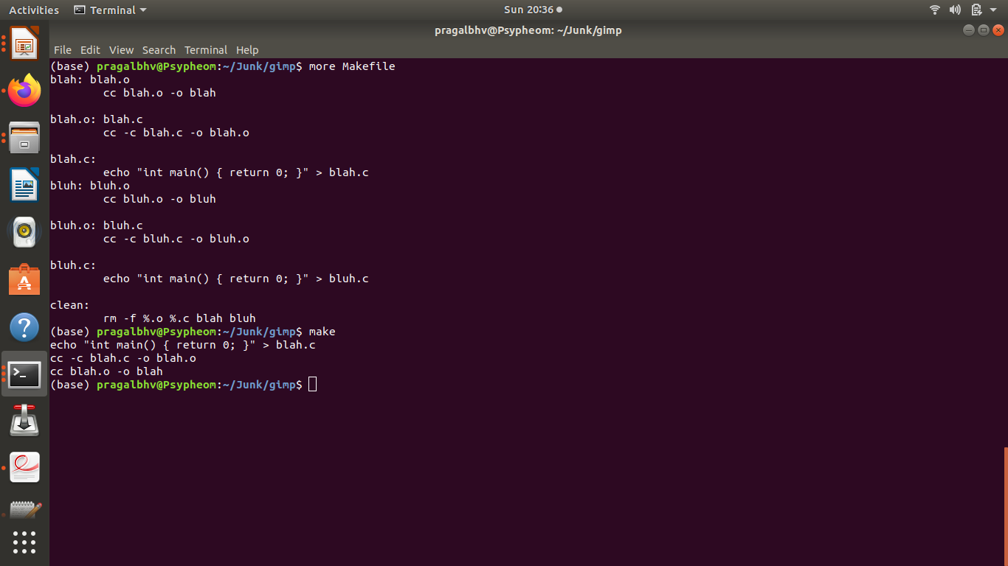
Create a makefile that uses a pattern for files rather than explicit listing of each of the files.

Slide 7
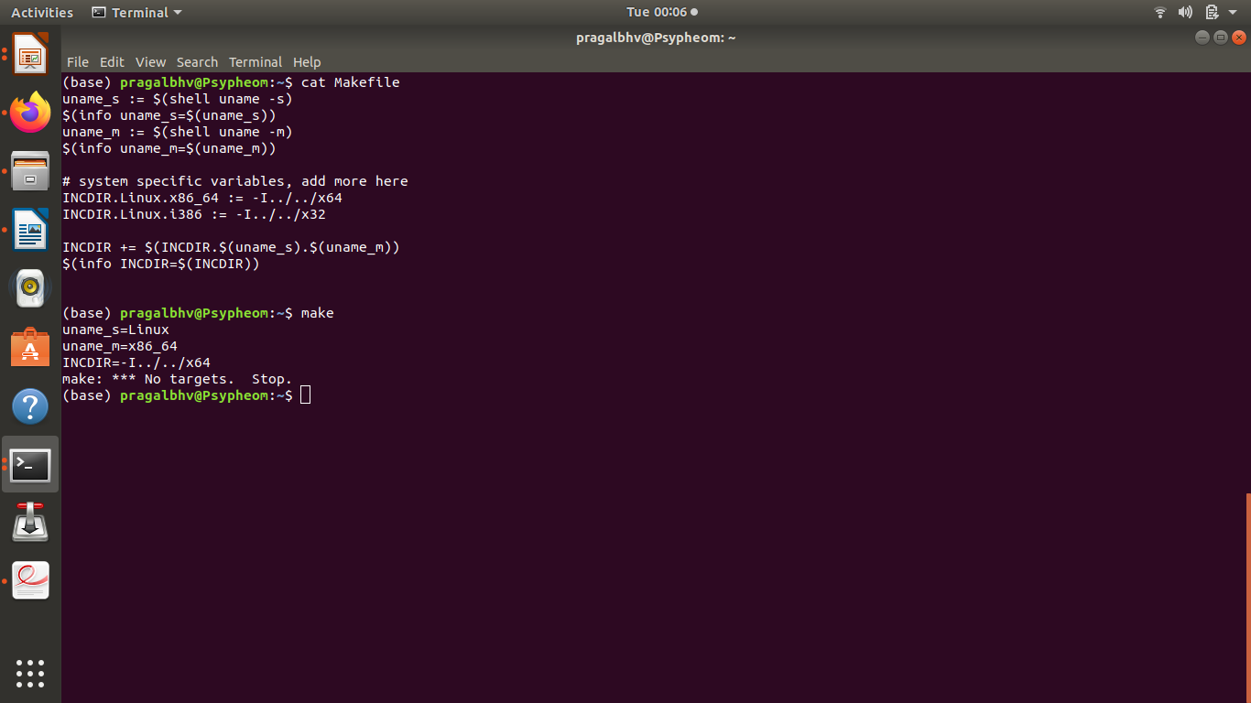
Prepare a Makefile that performs conditional compilation depending on the architecture of the machine.

Slide 8
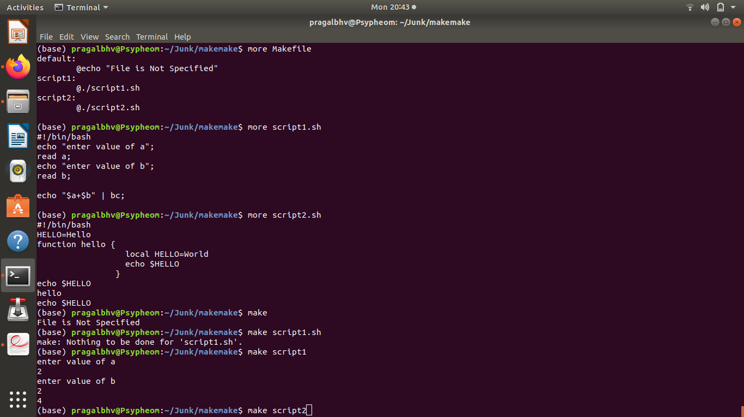
Create a Makefile that uses your own bash shell scripts in each recipe.

Slide 10
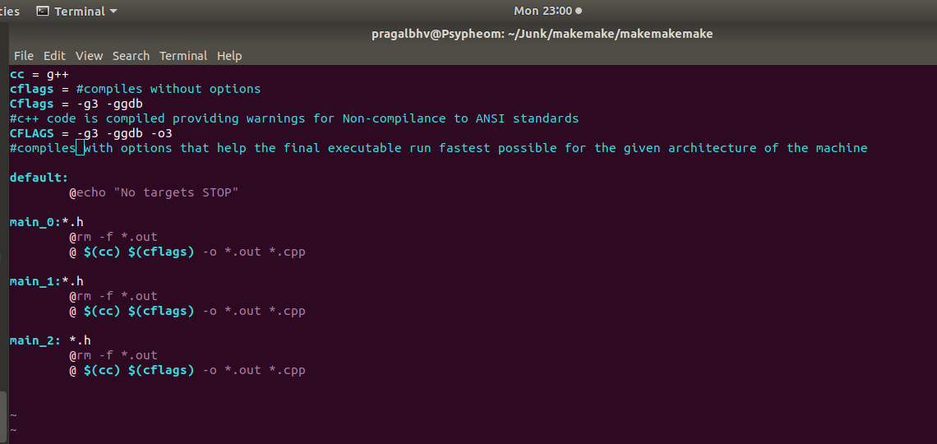
Create a Makefile that can compile a code in three different ways namely (a) without any options, (b) with all options to provide warnings for non-compliance to ANSI standards etc., and (c)with options that help the final executable run fastest possible for the given architecture of the machin

