Slide 1
Homework 6

Slide 2
List out all the built-in data types of C and C++ language, the space they consume in the memory and their ability to represent information
char: For characters. Size 1 byte
int: For integers. Size 4 bytes.
float: For single precision floating point. Size 4 bytes.
double: For double precision floating point. Size 8 bytes.
bool: For booleans, true or false. Size 1 byte
wchar_t: Wide Character. It is generally 2 or 4 bytes long.
Also there are data type modifiers:-
Signed
Unsigned
Short
Long

Slide 3
Are there built in data types in Fortran that are not in C? Check out the complex number, for example and write about that.
Complex Type
This is used for storing complex numbers. A complex number has two parts, the real part and the imaginary part. Two consecutive numeric storage units store these two parts.
For example, the complex number (3.0, -5.0) is equal to 3.0 – 5.0i.
Logical Type
There are only two logical values: .true. and .false.

Slide 4
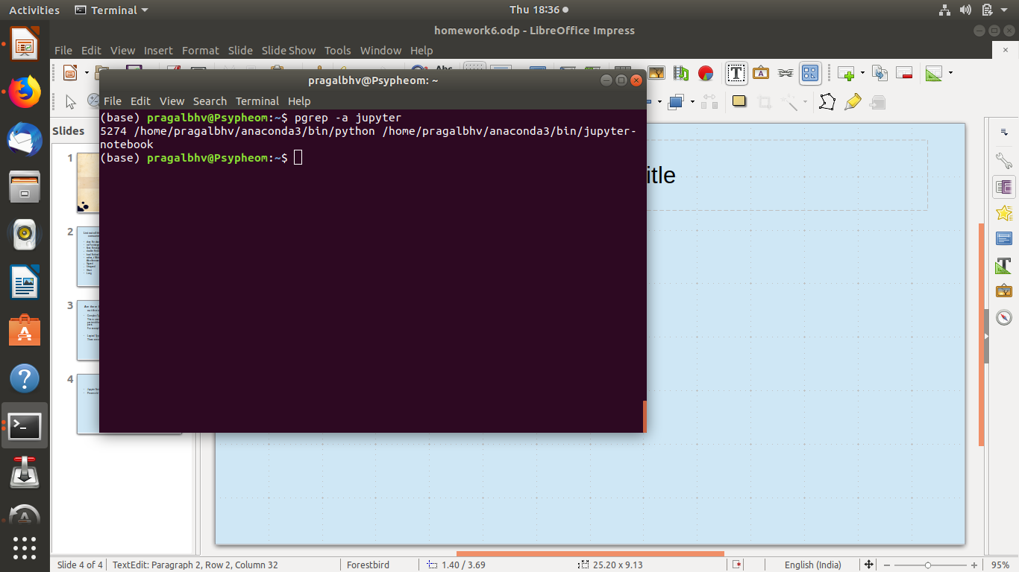
Launch the notebook and watch out whichport number the notebook server is running on. Can you also find out the process ID of this notebook server while it is running?
Jupyter Notebook runs on port number 8888
Process Id is 5274 found using
pgrep

Slide 5
Python uses five numeric types: Booleans, integers, long integers, floating-point numbers, and complex numbers
Other standard types are list, tuple, set, dict, str.
All versions of Octave include a number of built-in data types, including real and complex scalars and matrices, character strings, a data structure type, and an array that can contain all data types.
Sage has all the built in data types of python and adds many other types. E.g., vector spaces

Slide 6
Figure out what data types are available in python that are not readily available from C
Python provides various standard data types that define the storage method on each of them. The data types defined in Python are given below.
Numbers, String, List, Tuple, Dictionary
Lists:-
Lists,Tuples and Dictionary are different datatypes which are not available in c
Lists are similar to arrays in C. However; the list can contain data of different types. The items stored in the list are separated with a comma (,) and enclosed within square brackets [].
We can use slice [:] operators to access the data of the list. The concatenation operator (+) and repetition operator (*) works with the list in the same way as they were working with the strings.

Slide 7
Figure out what data types are available in python that are not readily available from C contd.
Tuple
A tuple is similar to the list in many ways. Like lists, tuples also contain the collection of the items of different data types. The items of the tuple are separated with a comma (,) and enclosed in parentheses ().
A tuple is a read-only data structure as we can't modify the size and value of the items of a tuple.
Dictionary
Dictionary is an ordered set of a key-value pair of items. It is like an associative array or a hash table where each key stores a specific value. Key can hold any primitive data type whereas value is an arbitrary Python object.
he items in the dictionary are separated with the comma and enclosed in the curly braces {}.

