Slide 1
Homework 9

Slide 2
Q1

Slide 3
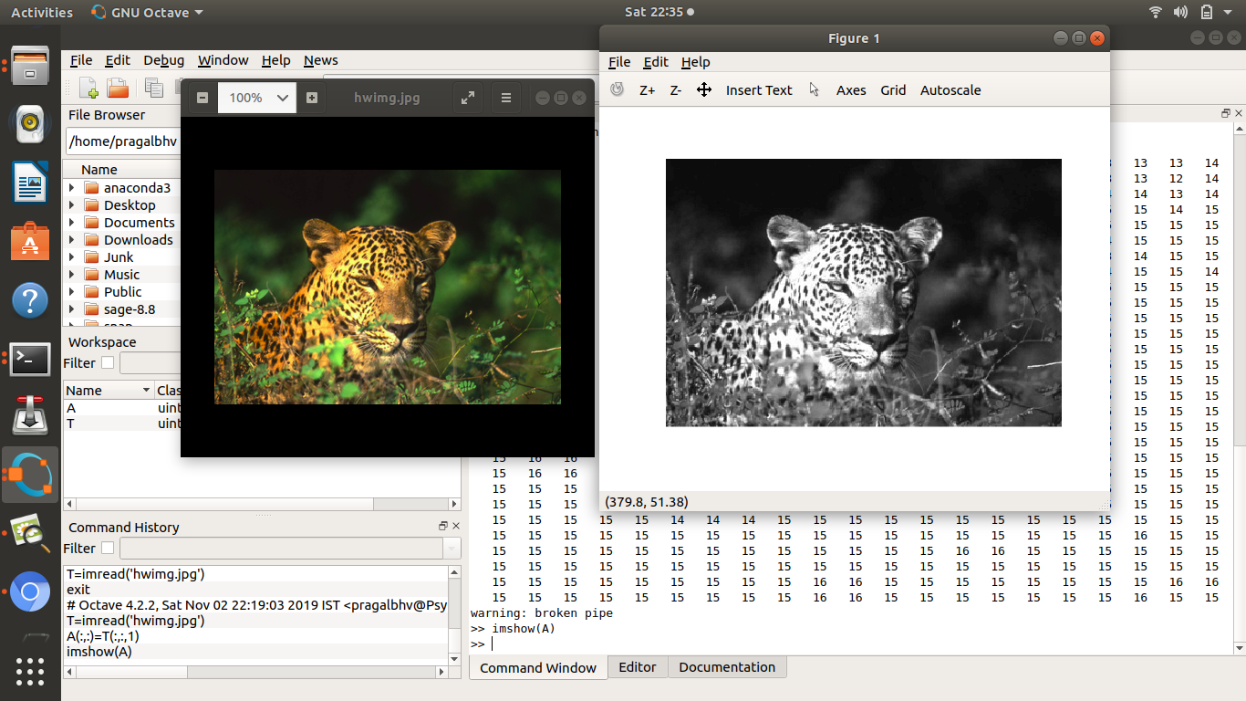
[Q1] Pick an image and convert it to gray scale using a tool such as gimp(i shall use octave itself). Load it in octave as a matrix.

Slide 4
Description of steps to make into grayscale using octave itself
By using imread and imshow, images are loaded to and from octave variables in the form of matrices
To convert a coloured img stored in T to black and white the rgb dimension of the matrix is discarded and the 2-D matrix is stored in A
Imshow of a gives greyscaled image

Slide 5
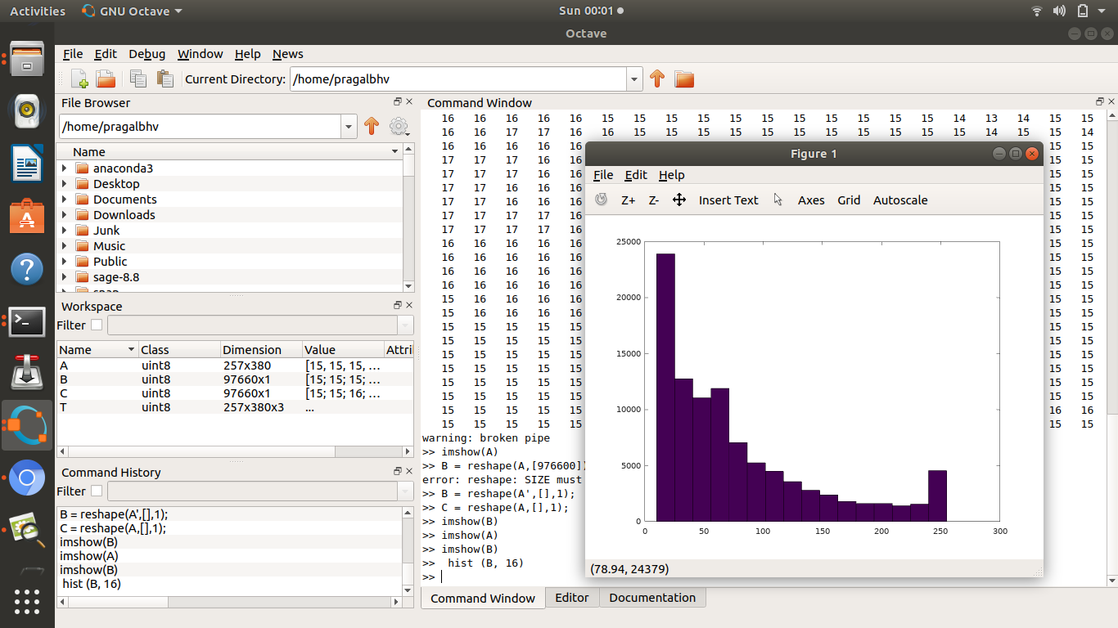
Reshape the matrix to a 1 D array. Make a histogram of this image using 16 bins that span over the 256 levels of gray scale.

Slide 6
Reshape the matrix to a 1 D array. Make a histogram of this image using 16 bins that span over the 256 levels of gray scale.
>> B = reshape(A',[],1);
>> imshow(B)
>> hist (B, 16)
Reshaping 2D matrix a into B a 1D matrix/array; imshow returns nothing visible
Plotting a histogram with 16 bins, 97660 data points (i*j of A 2-D image matrix)
Min value of 10 and max value of 255 for the Grayscale, 16 bins (permissible values of grayscale 0-255)

Slide 7
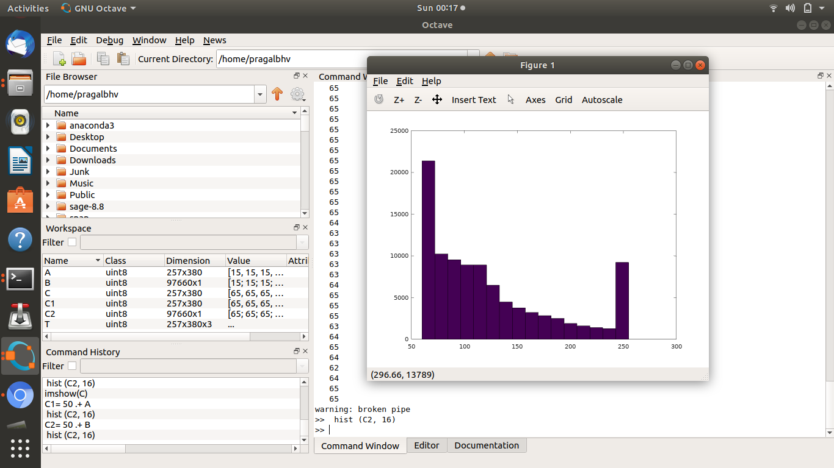
Add a constant integer such as 50 to every element of this matrix. Make the histogram again and also visualize the image using imshow.

Slide 8
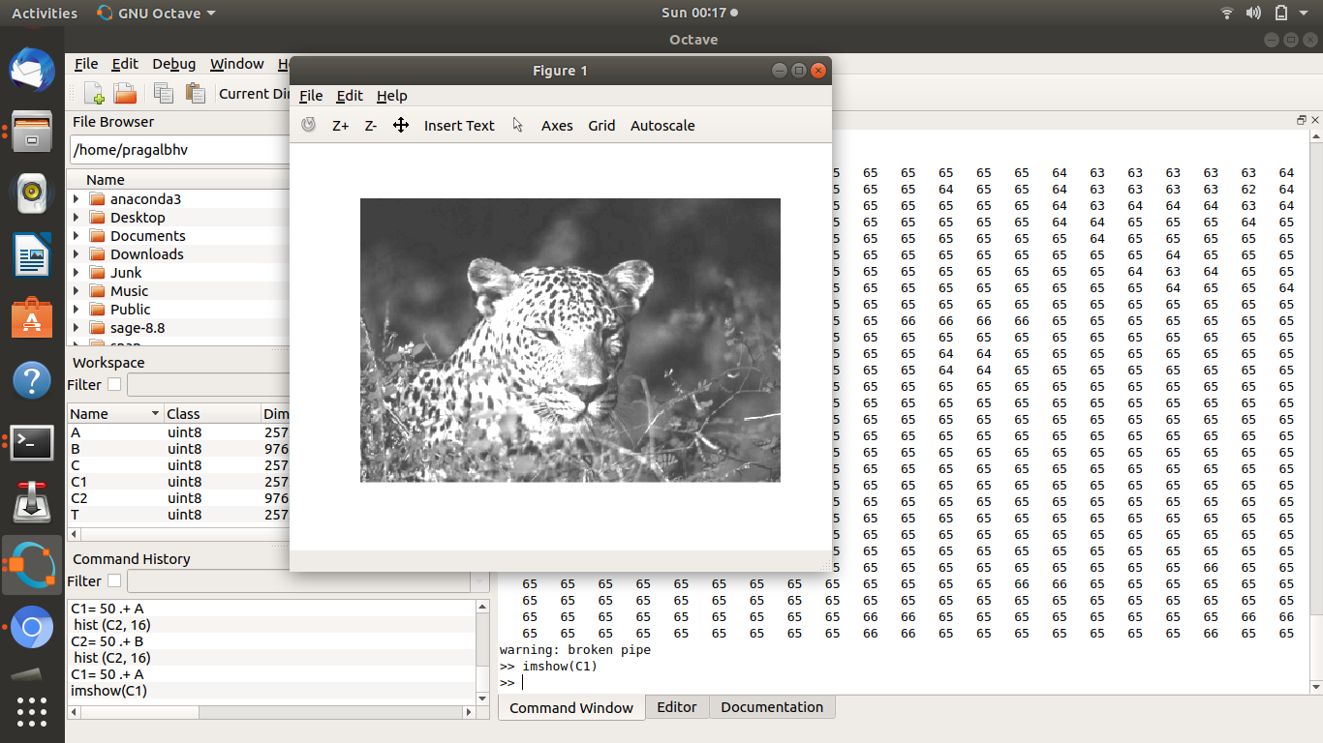
Add a constant integer such as 50 to every element of this matrix. Make the histogram again and also visualize the image using imshow.

Slide 9
Compare the original matrix before (a) with the matrix in case (b) and comment on what an increase oof brightness control does to an image
>> C1= 50 .+ A
>> C2= 50 .+ B
>> hist (C2, 16)
>> imshow(C1)
Min value of 60 and max value of 255 for the Grayscale, 16 bins
Permissible values of grayscale 0-255 hence brightness doesn’t increse past 255
No of pixels with Grayscale value 255 increases compared to previous case( all pixels 205-255 in G.S. value end up here)
Picture becomes Brighter in duller parts while the brightest parts relatively stayed the same

Slide 10
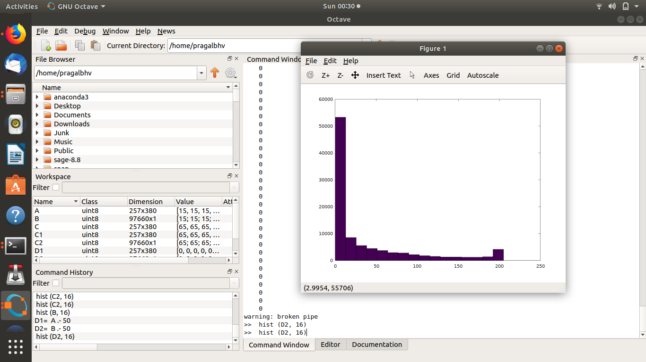
Subtract 50 from every element of this matrix. Make the histogram again and view it using imshow

Slide 11
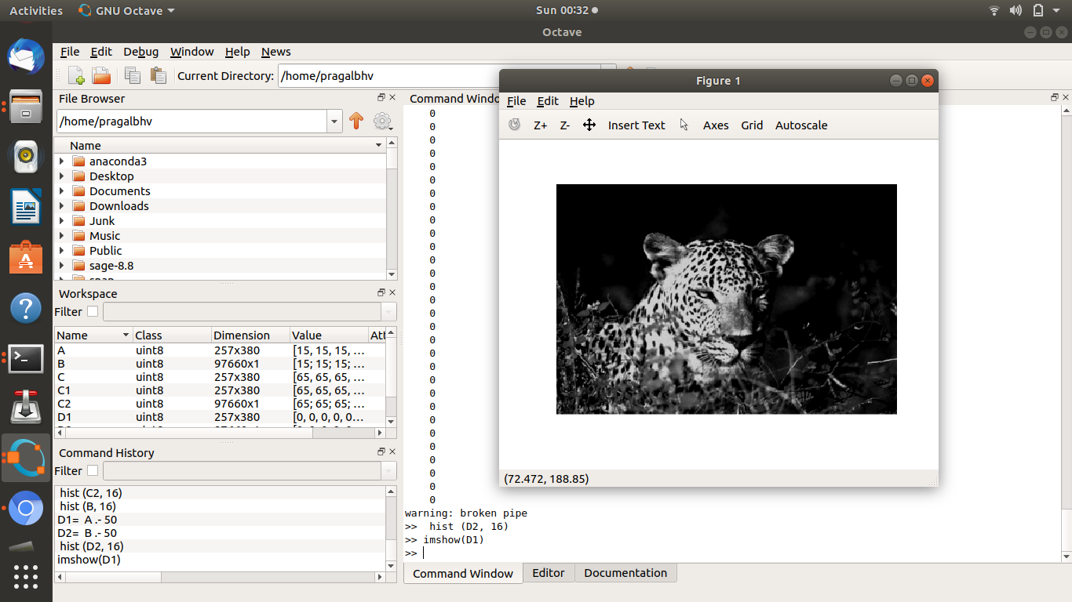
Subtract 50 from every element of this matrix. Make the histogram again and view it using imshow.

Slide 12
Compare the original matrix before (a) with the matrix in case (c) and comment on what an decrease of brightness control does to an image
>> D1= A .- 50
>> D2= B .- 50
>> hist (D2, 16)
>> imshow(D1)
Min value of 0 and max value of 205 for the Grayscale, 16 bins
Permissible values of grayscale 0-205 hence brightness doesn’t decrese past 255
No of pixels with Grayscale value 0 increases compared to previous case( all pixels 0-50 in G.S. value end up here)
Picture becomes duller while the blackest parts show no change

Slide 13
What are the other histogram operations you could think of – eg., what is contrast enhancement or gamma correction?
The adaptive gamma correction, which is used to correct each pixel value in the local image, is obtained by incorporating a cumulative histogram or a cumulative sub-histogram into the weighting distribution.
Image enhancement techniques primarily improve the contrast of an image to lend it a better appearance. One of the popular enhancement methods is histogram equalization (HE) because of its simplicity and effectiveness.

Slide 14
What are the other histogram operations you could think of – eg., what is contrast enhancement or gamma correction? Contd.
Histogram Equalization
The process of adjusting intensity values can be done automatically using histogram equalization. Histogram equalization involves transforming the intensity values so that the histogram of the output image approximately matches a specified histogram. By default, the histogram equalization function, histeq, tries to match a flat histogram with 64 bins, but you can specify a different histogram instead.

