Slide 1
Canada’s economic challenge: a trilemma
Consider the so-called “trilemma” shown in Figure 1a, which highlights three contemporary challenges facing the Canadian economy, and Figure 1b, which shows plausible pathways to achieve each of the desirable outcomes.
  The creator of these figures claims that we can’t solve for all three challenges concurrently – there are tradeoffs. We can, at best, only solve for two. And so we have to choose our poison. Imagine yourself trying to explain the logic of this trilemma to someone who knows something about Canada, but who hasn’t had your exposure to economics. In maximum 300 words, explain the argument. Hint: it might be helpful to work around the triangle and consider for example, why stable population growth and housing affordability might come at the cost of productivity growth (i.e., we get 1+2, but not 3). 30 marks
  If the author is correct, which 2 outcomes would you choose for Canada and why? (Maximum 200 words). 10 marks
  Can you see any pathways out of the trilemma? To answer this, imagine you are hired by the Prime Minister of Canada to bring forward some ideas to defeat the trilemma, ie.., to achieve all 3 desirable simultaneously. What would you propose? Give us your best policy proposal (just one). Be clear and concise in your recommendation and be sure to explain how it helps to resolve the tradeoff implied by the trilemma. (Maximum 200 words). 10 marks

Slide 2
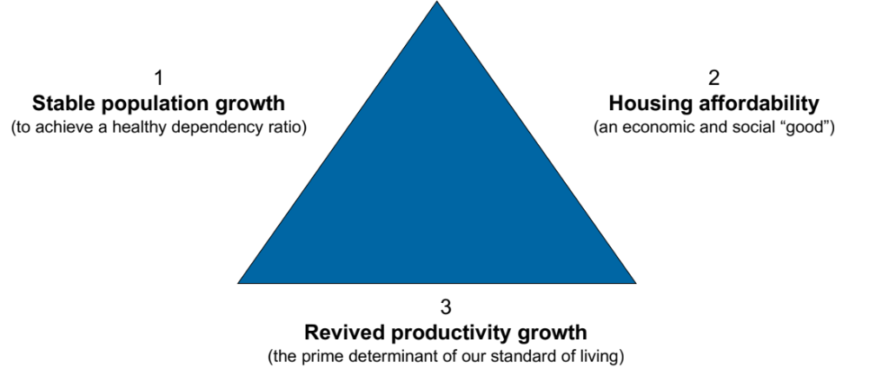
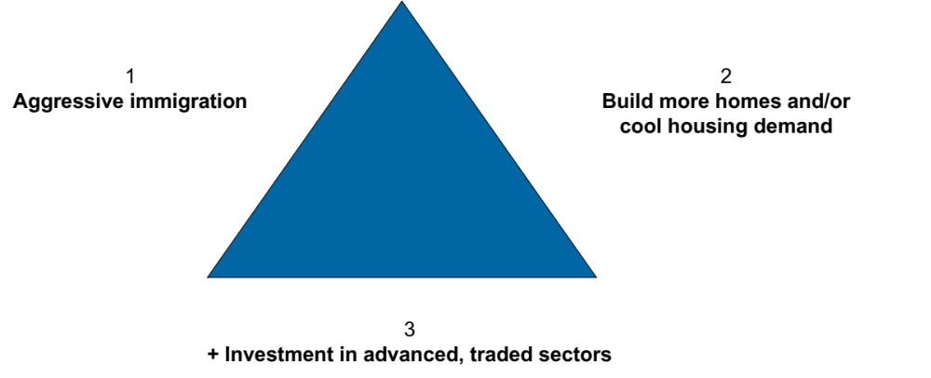
Canada’s economic challenge: a trilemma
What if it’s the case that we want three outcomes for our economy, but we can only have two?
Figure 1a
Three desirable outcomes
Figure 1b
Pathways to achieve outcomes

Slide 3
You’ve got mail! (from a close family member)
To: Sweetness
Subject: I know you are taking Economics right now
Hi Sweetness, (Prof note: yeah, that’s your family nickname, sorry.)
I heard this amazing interview the other day with an economist -- Paul Krugman. HE WON THE NOBEL PRIZE! He was talking about the US economy, but I didn’t really understand everything he said. I know you are taking economics right now and I thought “hey, I bet Sweetness knows!” Here’s the transcript from the part I found confusing:
“If you look at a chart of U.S. potential GDP growth over the past 50 years — we had some pretty big political swings in there, big changes in tax policy, trade deals, etc. If you didn't know that there had been big changes in politics and policy, you would never guess. It's pretty much just a flat line. The reason is that economic growth is largely driven by innovation – inventing new things and new ways of doing things. And who really knows what levers to pull to make that happen?
If someone says, ‘I have a policy that could raise potential GDP growth by a quarter of a percentage point,’ I'd say, ‘okay, I could possibly believe that, show me the details.’ If somebody says they could raise it by one percentage point, I think that's crazy. Nobody knows how to do that. We really just don't know very much about why countries have different rates of economic growth.
It feels like we've had a lot of technological change over the last two decades, and yet, if we believe our numbers, total factor productivity growth has been really pretty lousy for that whole period.”
I wrote down the main questions I had while listening to the interview:
First off, what does Krugman mean by “potential GDP growth”? Why not just say “GDP growth?” (100 words max). 5 marks
Is Canada in the same situation? I thought our economy was growing – I read that our GDP is quite a bit bigger now than it was before the pandemic. (150 words max). 10 marks
Assuming Krugman is right to be so pessimistic about growth (NOBEL PRIZE!), I was thinking “Wow, this is really bad for the poor countries of the world – you know, in Africa, parts of Asia and LatAm.” Is Krugman really saying we don’t have any non-crazy ideas for boosting growth by one percentage point for these countries?!!! Are they destined to stay poor forever? ☹ (300 words max) 15 marks

