Slide 1
Canada’s economic challenge: a trilemma
Consider the so-called “trilemma” shown in Figure 1a, which highlights three contemporary challenges facing the Canadian economy, and Figure 1b, which shows plausible pathways to achieve each of the desirable outcomes.
  The creator of these figures claims that we can’t solve for all three challenges concurrently – there are tradeoffs. We can, at best, only solve for two. And so we have to choose our poison. Imagine yourself trying to explain the logic of this trilemma to someone who knows something about Canada, but who hasn’t had your exposure to economics. In maximum 300 words, explain the argument. Hint: it might be helpful to work around the triangle and consider for example, why stable population growth and housing affordability might come at the cost of productivity growth (i.e., we get 1+2, but not 3). 30 marks
  If the author is correct, which 2 outcomes would you choose for Canada and why? (Maximum 200 words). 10 marks
  Can you see any pathways out of the trilemma? To answer this, imagine you are hired by the Prime Minister of Canada to bring forward some ideas to defeat the trilemma, ie.., to achieve all 3 desirable simultaneously. What would you propose? Give us your best policy proposal (just one). Be clear and concise in your recommendation and be sure to explain how it helps to resolve the tradeoff implied by the trilemma. (Maximum 200 words). 10 marks

Slide 2
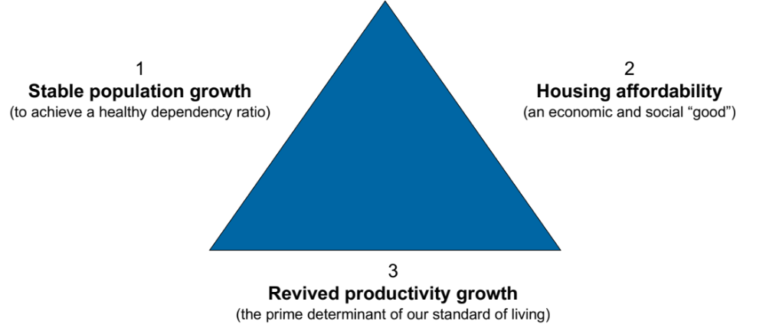
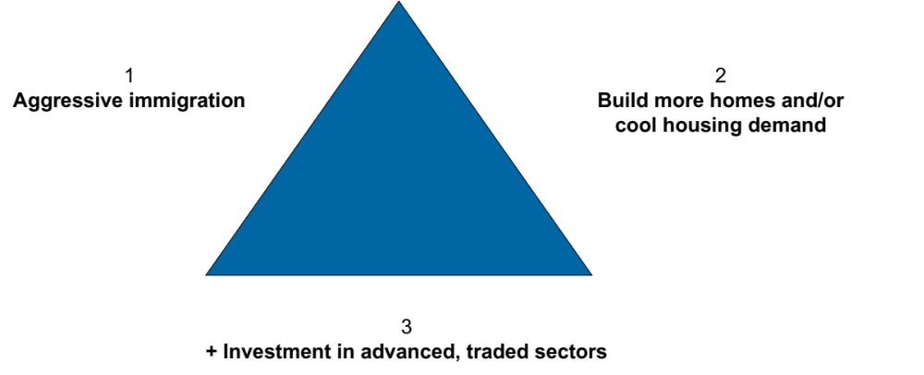
Canada’s economic challenge: a trilemma
What if it’s the case that we want three outcomes for our economy, but we can only have two?
Figure 1a
Three desirable outcomes
Figure 1b
Pathways to achieve outcomes

Slide 3
1a) Explain the argument
Stable Population Growth + Housing Affordability (1 + 2, without 3): Canada can use aggressive immigration to maintain stable population growth, which is essential to support an aging population. However, high immigration rates increase demand for housing, driving up prices and making housing less affordable. Trying to achieve housing affordability alongside population growth would likely require substantial housing investment, and the key point here is that residential investment (housing construction) is well known to be a chronically low (and declining!) productivity sector. Solving the housing problem likely means diverting resources (capital and talent) from productivity-enhancing investments in more advanced sectors limiting productivity growth. (10 marks)
Stable Population Growth + Productivity Growth (1 + 3, without 2): Prioritizing population growth and productivity would mean focusing on immigration alongside investments in advanced industries to improve Canada’s economic output per worker. In addition, combining immigration with a focus on productivity likely means prioritizing immigrants with advanced education and skills, not the kinds of new Canadians who would typically have backgrounds in trades and other construction-essential skills. Aggressive immigration and fewer people with construction skills would likely drive-up housing demand without a corresponding increase in housing supply, worsening affordability. Productivity growth often benefits high-income earners more directly, leaving housing even less accessible for average Canadians. (10 marks)
Housing Affordability + Productivity Growth (2 + 3, without 1): Canada could focus on affordable housing and productivity growth by limiting immigration, which would reduce housing demand and keep prices more manageable. With fewer resources needing to be channeled into the chronically low productivity construction sector, Canada could also invest in advanced sectors to raise productivity. However, with limited population growth, Canada’s workforce would age faster, creating a high dependency ratio (fewer working people paying taxes that are needed to support a growing number of older people) and putting pressure on social services, and potentially creating deep inter-generational divisions within our economy that could undermine political and economic stability. (10 marks)

Slide 4
1b) If the author is correct, which 2 outcomes would you choose for Canada and why? (Maximum 200 words). 10 marks
Students are basically free to choose their preferred outcome and so grading should pay attention to the following:
  Answers should not fight the trilemma. The point here is to take the tradeoffs as real and binding – and then make a decision about which one you prefer.
  The quality of the argument is the key here. Answers should clearly indicate they understand the tradeoff and that they have reasons for deprioritizing the one “desirable” that they have left out. The next 3 pages outline such arguments.

Slide 5
Example: Option 1 is the best because…
Option 1 (1+2, without 3)—prioritizing stable population growth and housing affordability—supports social stability and quality of life, making it a strong choice for Canada.
By focusing on stable population growth through controlled immigration, Canada can achieve a balanced age structure, essential for a sustainable dependency ratio. This approach ensures that enough working-age people support the growing elderly population without overwhelming the social infrastructure. Meanwhile, prioritizing housing affordability addresses one of the most pressing issues facing Canadians. Affordable housing enhances economic security for families and promotes equitable access to homeownership, which has far-reaching benefits for mental health, community stability, and intergenerational wealth.
While forgoing aggressive productivity growth may mean slower wage gains and less economic dynamism, a stable population and affordable housing provide a secure foundation for Canadians’ well-being. This strategy fosters a more inclusive society, where more citizens can meet basic needs without extreme economic pressures, building a Canada that prioritizes equitable growth and quality of life over high productivity.

Slide 6
Example: Option 2 is the best because…
Choosing Option 2 (1+3, without 2)—prioritizing stable population growth and productivity—offers Canada the best path for long-term economic resilience and prosperity. By encouraging stable population growth through immigration and investing in productivity-enhancing sectors, Canada can build a more robust and dynamic economy that competes globally.
A growing population provides a young, diverse workforce, essential for supporting an aging demographic and sustaining social programs. Meanwhile, focusing on productivity growth through advanced industries boosts the standard of living by increasing output per worker, which ultimately drives wages and economic prosperity. As a likely bonus, new immigrants have the potential to spur innovation in Canada by allowing people who are not risk averse (the decision to leave one’s home country is something of a signal of that) and who will bring new ideas and a long runway (immigrants are typically younger than average) to make their home in Canada
Although housing affordability may suffer, Canada can address this challenge through targeted policies, such as increasing housing supply over time or offering subsidies for lower-income households. Accepting higher housing costs in exchange for economic dynamism may be necessary to ensure Canada remains competitive and can adapt to future economic shifts. In short, by emphasizing population and productivity growth, Canada strengthens its economic foundation, creating opportunities that can later support more accessible housing.

Slide 7
Example: Option 3 is the best because…
Option 3 (2+3, without 1)—prioritizing housing affordability and productivity growth—creates a balanced approach to economic and social well-being.
By emphasizing housing affordability, Canada can address one of its most pressing social challenges, making homeownership and stable housing more accessible to Canadians across income levels. This approach reduces economic inequality and strengthens social stability, as affordable housing is foundational to health, security, and community cohesion. Addressing housing costs also makes Canada a more attractive place to live, retaining talent and reducing emigration.
Coupled with productivity growth through investments in advanced sectors, Canada can boost economic output and increase wages. This productivity focus supports a higher standard of living, enabling Canada to remain competitive on the global stage and create more high-quality jobs. Although limiting population growth may lead to a higher dependency ratio, this approach allows Canada to strengthen its economy without overburdening housing demand. In the long run, stable housing costs and enhanced productivity can attract skilled talent and improve the quality of life, achieving sustainable growth while addressing core economic challenges.

Slide 8
1 c) Can you see any pathways out of the trilemma? To answer this, imagine you are hired by the Prime Minister of Canada to bring forward some ideas to defeat the trilemma, ie.., to achieve all 3 desirable simultaneously. What would you propose? Give us your best policy proposal (just one). Be clear and concise in your recommendation and be sure to explain how it helps to resolve the tradeoff implied by the trilemma. (Maximum 200 words). 10 marks
Again, we should be fairly non-judgmental (i.e., inclusive) about what policies are proposed and focus more on the quality of the ideas and argument contained within. “Quality” can be defined as:
  Resolves trilemma. Proposals should offer a clear story about how their ideas actually solve the trilemma. The pathway provided should have good potential to actually work *and* be feasible. Both matter.
  Consistent with our growth model. The policy proposal is consistent with – and underpinned by – the two main elements of our growth model, labour force growth and productivity growth. Likely the focus will be on productivity growth here, meaning there should be references to factors such as capital investment, skilling and innovation, all supported by “institutions” (policies, rules and regulations, etc) that facilitate these proximate drivers.
  Clear, thorough. Reward clarity and thoroughness within the bounds of the word limit. Ideally, the proposal creates a clear vision of how the ideas presented would be implemented, i.e., what the solution actually looks like. And, ideally, there is enough detail that we can visualize the plan.
  Actionable. Reward proposals that are more than ”study” or “research”. There should be some clear suggestions for what the PM should do: invest, establish, create, etc.
  Creative. We should reward creative ideas that solve the problem and are feasible and actionable, including legal(!)
To me, the most plausible way out of the trilemma is to focus attention on boosting productivity in the residential construction sector, both by influencing the supply side (how we build, and the rules that govern building such as zoning, development fees, etc. Emphasis here could usefully be on anti-NIMBY policies that restrict the volume of building that is allowed to take place and the type of building, e.g., “only single family residences”). In addition, some answers might focus on the demand side (what kinds of housing units we prioritize building) and trying to get home buyers to move away from traditional notions of what a “house” needs to be (quarter acre, low density, etc).
Below are two examples of policy proposals that would meet the above criteria at a very high level. These would clearly be “A” answers and don’t be disappointed if you don’t see any that quite hit this standard. But this is what excellent looks like. There are probably many more examples like this and you should be receptive to these. When grading, you should be mostly concerned with whether and to what extent the proposal provided meets the evaluation criteria above.

Slide 9
Example 1: Construction productivity focus
To address Canada’s trilemma—balancing stable population growth, housing affordability, and productivity growth—I propose a National Construction Productivity Initiative. The NCPI would drive innovation and efficiency in Canada’s construction sector, allowing the industry to build more affordable housing faster and at lower costs, all while boosting productivity across the economy. The initiative would focus on three main areas:
Incentivize Adoption of Advanced Construction Technologies:
  Provide tax incentives, grants, and low-interest loans to construction firms that adopt technologies like modular construction, 3D printing, and prefabricated materials. These methods can reduce on-site labor needs and construction timelines, increasing productivity and lowering costs.
  Establish partnerships with technology firms and universities to bring emerging construction technologies to market faster and train workers in new skills.
Streamline Regulatory Processes and Standardize Building Codes:
  Collaborate with provinces and municipalities to harmonize and streamline building codes and zoning laws across Canada, especially in high-growth areas. By reducing red tape, construction projects can move more quickly from approval to completion, addressing housing shortages faster.
  Introduce digital permitting systems to reduce approval times and increase transparency in the construction process.
Develop a Skilled Workforce for High-Productivity Construction:
  Fund specialized training programs for construction workers in new technologies, materials, and project management techniques, ensuring the industry has the skills needed to improve productivity.
  Create targeted immigration pathways for skilled workers in construction technology and management, addressing labor shortages and supporting stable population growth.
How It Solves the Trilemma:
  Housing Affordability: By improving construction efficiency, the NCPI can lower the costs of building homes, making housing more affordable and available.
  Productivity Growth: Increased productivity in construction supports overall economic growth, making Canada more competitive and raising the standard of living.
  Stable Population Growth: As construction capacity increases, housing supply can better meet the needs of a growing population, making it feasible to maintain immigration levels without worsening the housing crisis.

Slide 10
Example 2: Smart housing focus
To tackle Canada’s economic trilemma—achieving stable population growth, housing affordability, and productivity growth simultaneously—I would recommend a smart housing initiative, which I’ll call the National Housing and Innovation Corridor Initiative.
Proposal: National Housing and Innovation Corridors
  Establish designated Housing and Innovation Corridors across Canada. These corridors would combine high-density, affordable housing development with targeted investments in advanced industries (like green technology, digital services, and advanced manufacturing). By strategically locating these corridors in underutilized urban and suburban areas, this policy can address housing supply constraints, stimulate productivity growth, and manage population distribution.
Key Components:
  Federal-Provincial Partnership for Zoning and Development: The federal government, in partnership with provincial and municipal governments, would streamline zoning and provide incentives for high-density, affordable housing construction in these corridors. The focus would be on creating diverse housing options, with price controls or subsidies to maintain affordability. This expansion in supply would help stabilize housing prices without sacrificing urban density.
  Investment in Advanced Sectors: Alongside housing, these corridors would receive federal investment in productivity-enhancing sectors like technology, clean energy, and skilled trades training. By clustering housing and job opportunities, the initiative would create self-sustaining, high-value economic hubs that boost productivity.
  Targeted Immigration for Skilled Workers: Within these corridors, prioritize immigration for skilled workers in high-demand fields, aligning with productivity growth goals. This managed approach would support stable population growth without overwhelming housing markets in other regions.
How It Solves the Trilemma:
  Stable Population Growth: By targeting immigration within designated corridors, Canada can manage population growth where housing and job opportunities are concentrated, maintaining a healthy dependency ratio.
  Housing Affordability: High-density, affordable housing in the corridors directly addresses Canada’s housing shortage, easing pressure on existing urban centers and reducing housing costs.
  Productivity Growth: Concentrating advanced industries in these hubs enhances productivity by creating innovation ecosystems, increasing wages, and supporting economic competitiveness.

Slide 11
You’ve got mail! (from a close family member)
To: Sweetness
Subject: I know you are taking Economics right now
Hi Sweetness, (Prof note: yeah, that’s your family nickname, sorry.)
I heard this amazing interview the other day with an economist -- Paul Krugman. HE WON THE NOBEL PRIZE! He was talking about the US economy, but I didn’t really understand everything he said. I know you are taking economics right now and I thought “hey, I bet Sweetness knows!” Here’s the transcript from the part I found confusing:
“If you look at a chart of U.S. potential GDP growth over the past 50 years — we had some pretty big political swings in there, big changes in tax policy, trade deals, etc. If you didn't know that there had been big changes in politics and policy, you would never guess. It's pretty much just a flat line. The reason is that economic growth is largely driven by innovation – inventing new things and new ways of doing things. And who really knows what levers to pull to make that happen?
If someone says, ‘I have a policy that could raise potential GDP growth by a quarter of a percentage point,’ I'd say, ‘okay, I could possibly believe that, show me the details.’ If somebody says they could raise it by one percentage point, I think that's crazy. Nobody knows how to do that. We really just don't know very much about why countries have different rates of economic growth.
It feels like we've had a lot of technological change over the last two decades, and yet, if we believe our numbers, total factor productivity growth has been really pretty lousy for that whole period.”
I wrote down the main questions I had while listening to the interview:
First off, what does Krugman mean by “potential GDP growth”? Why not just say “GDP growth?” (100 words max). 5 marks
Is Canada in the same situation? I thought our economy was growing – I read that our GDP is quite a bit bigger now than it was before the pandemic. (150 words max). 10 marks
Assuming Krugman is right to be so pessimistic about growth (NOBEL PRIZE!), I was thinking “Wow, this is really bad for the poor countries of the world – you know, in Africa, parts of Asia and LatAm.” Is Krugman really saying we don’t have any non-crazy ideas for boosting growth by one percentage point for these countries?!!! Are they destined to stay poor forever? ☹ (300 words max) 15 marks

Slide 12
Q2, Part a)
First off, what does Krugman mean by “potential GDP growth”? Why not just say “GDP growth?” (100 words max). 5 marks
2 points for defining potential GDP. The answer should include some concept of “capacity” and/or “long-run sustainability”. (e.g. “Potential GDP is what we could produce over a long period of time if we were using our resources effectively and sustainably. It represents the underlying productive capacity of the economy, which may or may not be realized at any moment in time.”).
2 points for explaining how actual GDP may differ from potential. This should include both an explanation of what it looks like when actual GDP is less than potential (e.g. “Our actual GDP is below potential GDP if we are in a period of high unemployment, when we aren’t using all of our workers”) as well as an explanation of what it looks like when GDP is above potential (e.g. “Our actual GDP is above potential when we are in a boom. Workers may be working a lot of overtime, and we may be running our machines all the time without stopping to service them. We can be above capacity for a while, but we can’t keep up this pace forever.”)
1 point for addressing the “why” question, i.e., why did Krugman focus on potential. Krugman is focused on the fundamental trend in GDP, knowing that in any given year GDP can fluctuate – a lot. This is the essence of the long run focus of the question, i.e., why do we see advancement in living standards across generations, not just year over year.

Slide 13
Q2, Part b)
Is Canada in the same situation? I thought our economy was growing – I read that our GDP is quite a bit bigger now than it was before the pandemic. (150 words max). 10 marks
2 points for answering the family member’s question properly, namely “Yes” our economy has been growing quite rapidly over the last couple of years,
3 points for the “but”: growth since the pandemic has been driven almost completely by labour force growth. Answers should note that while this still “counts” as GDP growth, it is productivity growth that more strongly affects economic well-being (i.e. GDP per capita).
2 point for noting that Canada’s productivity growth has been extremely poor over the past couple of decades, worse than the U.S. record on this.
3 points for explanations of Canada’s poor productivity growth. These could include:
  Over-exposure to the natural resource industry, which is high productivity but has low productivity growth.
  Lack of competition
  Small market size, which means a lack of returns to scale – particularly in some highly productive industries like tech
  An under-developed innovation ecosystem (partly as a result of the first three factors)
  Proximity to the U.S., which makes it hard to compete for investment and top talent
  Higher taxes vis-à-vis the U.S.

Slide 14
Q2, Part b)
Assuming Krugman is right to be so pessimistic about growth (NOBEL PRIZE!), I was thinking “Wow, this is really bad for the poor countries of the world – you know, in Africa, parts of Asia and LatAm.” Is Krugman really saying we don’t have any non-crazy ideas for boosting growth by one percentage point for these countries?!!! Are they destined to stay poor forever? ☹ (300 words max) 15 marks
2 marks for answering the question posed here, which is “no”, that is not what Krugman is saying. His argument is very much oriented toward the growth dilemmas of advanced economies like the US. The growth challenges facing poor and middle-income countries are different and this should be acknowledged in the answer.
3 marks for making reference to, and use of, our growth model in the answer, which brings in both productivity growth and labour force growth to the GDP growth trajectories of developing countries.
5 marks for explaining that basic processes of capital deepening are fundamental to the growth trajectories of poor countries and that process for most of the regions highlighted in the question are still very much alive. The difference to rich countries centers on the concept of “diminishing returns to capital”, a concept that should be referenced in the question. Ideally, the explanation should include a concrete example. For example, we discussed in class how purchasing water buffalo (a form of “capital”) can have a huge return for subsistence rice farmers, but that buying an expensive tractor makes only a marginal difference to productivity in Canadian wheat fields.
5 marks for explaining how institutional factors are crucial in realizing the potentially-high returns to investment in poor countries. Examples of how institutions matter could include the introduction of contract law and property rights, which are necessary for investment; government investment in transport and energy infrastructure, which allow for production and trade; government investment in health and education, which raise human capital; etc.

Slide 15
Appendix: Our Long-Run Growth Model
Labour
Force
Growth
Demographics (birth/death rate; pop pyramid)
Immigration
Economic policies, eg. tax
Social policies (e.g., child care)
Social & cultural norms (e.g., women in LF)
Economic
Growth
(∆ GDP_{r} = ∆ Y)
“Institutional Environment”
Capital deepening (quantity & quality of K)
Labour quality (skill, effort)
“Innovation”
Political
Legal
Macroeconomic
Trade
Microeconomic
Productivity
Growth

