Slide 1
Midterm Exam and Answer Key
Global Macroeconomics for Managers (HBA 4505)
Professor Tony Frost
October 15, 2025
Notes:
I

Slide 2
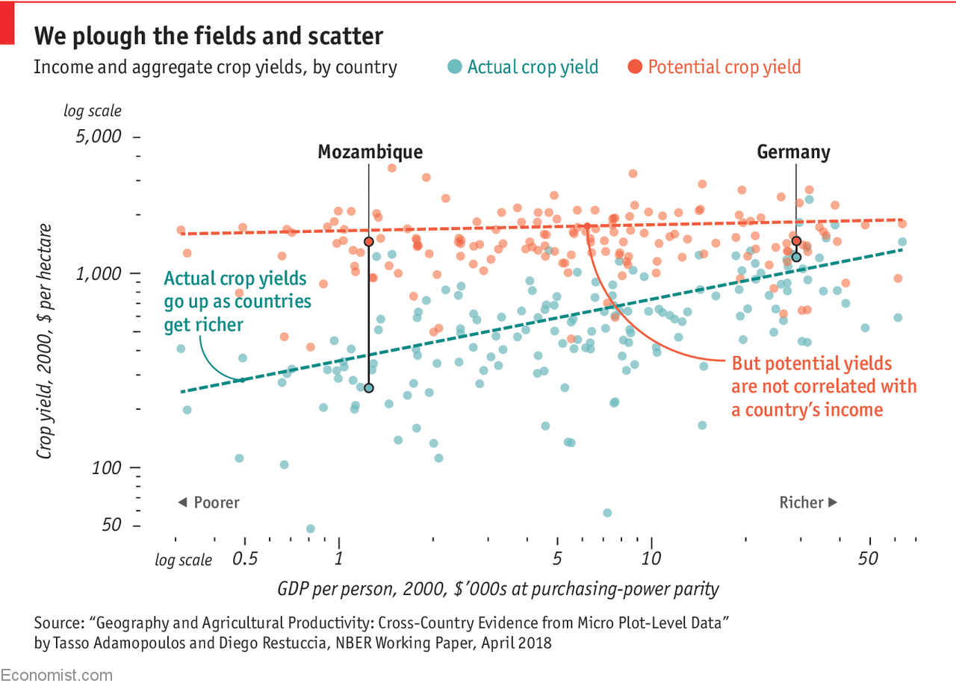
Rich country, poor country
Consider this chart on agricultural productivity across nations, focusing on Germany and Mozambique*.
*Mozambique is extremely poor country in southeast Africa, bordering the Indian Ocean. After gaining independence from Portugal in 1975, it endured a 15-year civil war (1977-1992) that ended with the Rome Peace Accords. The war left lasting challenges, including political instability, corruption, and weak rule of law. In 2023, over 70% of Mozambique’s population was estimated to be living below the World Bank’s $3.00/day extreme poverty standard. Mozambique is about double the size of Germany in total land area, and nearly six times the size of Germany in terms of land per person.

Slide 3
1. Natural Resources and Prosperity: Question
Many explanations for why some countries are rich and others are poor emphasize natural resource endowments (e.g., oil, minerals, forests). Canada is often cited as an example. Canada, the argument goes, is a high-income country because it has abundant natural resources, including vast tracts of fertile farmland that make it an agricultural superpower (Top 10 in the world for agricultural exports).
Question: Based on the evidence in the chart, does this view seem to be mostly supported or mostly contradicted? Explain why, using specific features of the chart to support your reasoning.
(8 points) Maximum 100 words

Slide 4
2. Role of Institutions: Question
A key idea in our GMM growth framework is the role and value of good institutions in driving long-run economic progress. The chart provided does not mention institutions at all.
Question: Build an explanation that incorporates our “good institutions” story into your interpretation of the data in the chart. Specifically: How might “good institutions” be the hidden driver of the patterns we observe in the chart? Be explicit and specific about which types of institutions might matter and how they influence the relationship between GDP per person and crop yields. Remember: well established contract law doesn’t cause corn to grow! Make sure you connect the dots from institutions to crop yields, and be sure to connect your answer directly to the data shown in the chart.
(12 points) Maximum 200 words

Slide 5
3. Future Uncertain: Question
A key question motivated by the chart is: Going forward, will we see convergence in crop yields between Mozambique and Germany? While the outcome no doubt depends on many factors, consider the following information as you form your answer:
  In Mozambique, agriculture accounts for over 70% of employment but only about 25% of GDP. In Germany, agriculture represents approximately 1% of both employment and GDP.
  Mozambique has a debt-to-GDP ratio of 76.9% and a CCC+ credit rating (very high default risk), compared to Germany’s 62.5% debt-to-GDP and AAA rating.
Question: Address the convergence question in 2 short paragraphs, each no more than 100 words. The first paragraph is Reasons to Expect Convergence; the second paragraph is Reasons to be Skeptical of Convergence. Make sure to use both pieces of information provided above to support your reasoning.
(12 points) Maximum 200 words

Slide 6
4. Future Perfect: Question
Imagine the following scenario: in 2026, Mozambique elects a new government that pledges to “swallow the good institutions pill”. Assume that is exactly what happens, and the country (almost magically) implements a wide range of best-practice economic and governance reforms, e.g., secure property rights, contract enforcement, open trade/logistics, finance/credit reform, infrastructure investment. Assume no major external shocks such as wars or pandemics; global ag prices evolve normally; climate trends remain unchanged.
Question: It is now 2037, 10 years after the sweeping reforms were successfully implemented. What do you think has happened to Mozambique’s economy? Consider these 4 measures:
  Agricultural output (total real value, level)
  Agriculture’s share of total employment
  Poverty: number of people living below the extreme poverty threshold
  Inequality: distribution of income within the country or, more simply, the rich-poor gap
For each indicator, provide a simple “up a lot / up a little / down a little / down a lot / ambiguous” forecast for 2037. Be sure to provide a very short explanation supporting your forecast for each indicator using course concepts and ideas (~ 30 words each)
(8 points) Maximum 120 words, total

