Slide 1
Midterm Exam and Answer Key
Global Macroeconomics for Managers (HBA 4505)
Professor Tony Frost
October 15, 2025
Notes:
I

Slide 2
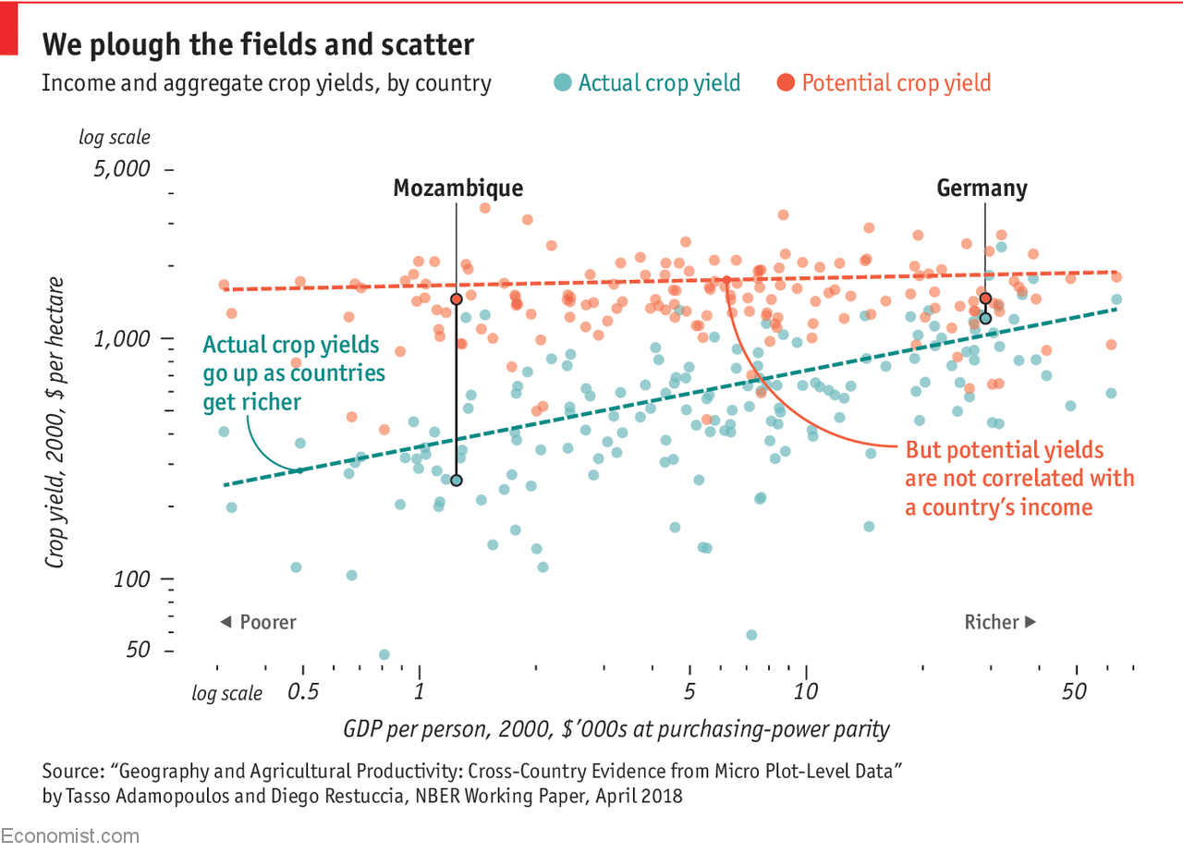
Rich country, poor country
Consider this chart on agricultural productivity across nations, focusing on Germany and Mozambique*.
*Mozambique is extremely poor country in southeast Africa, bordering the Indian Ocean. After gaining independence from Portugal in 1975, it endured a 15-year civil war (1977-1992) that ended with the Rome Peace Accords. The war left lasting challenges, including political instability, corruption, and weak rule of law. In 2023, over 70% of Mozambique’s population was estimated to be living below the World Bank’s $3.00/day extreme poverty standard. Mozambique is about double the size of Germany in total land area, and nearly six times the size of Germany in terms of land per person.

Slide 3
1. Natural Resources and Prosperity: Question
Many explanations for why some countries are rich and others are poor emphasize natural resource endowments (e.g., oil, minerals, forests). Canada is often cited as an example. Canada, the argument goes, is a high-income country because it has abundant natural resources, including vast tracts of fertile farmland that make it an agricultural superpower (Top 10 in the world for agricultural exports).
Question: Based on the evidence in the chart, does this view seem to be mostly supported or mostly contradicted? Explain why, using specific features of the chart to support your reasoning.
(8 points) Maximum 100 words

Slide 4
1. Natural Resources and Prosperity: Model Answer
The chart contradicts the idea that natural resource endowments explain prosperity. The orange line is almost flat, showing that there is no intrinsic difference in potential crop yields between poor and rich countries. The chart shows that Mozambique’s potential crop yields are slightly higher than Germany’s and amongst the highest of all, suggesting it has very fertile land. Yet Mozambique’s actual yields are far lower, while Germany’s are close to potential. This indicates that having natural resources is not sufficient for wealth; what matters more is the ability to translate potential into actual productivity, likely capital, know how, and strong institutions that support investment and entrepreneurial activity.
108 words

Slide 5
2. Role of Institutions: Question
A key idea in our GMM growth framework is the role and value of good institutions in driving long-run economic progress. The chart provided does not mention institutions at all.
Question: Build an explanation that incorporates our “good institutions” story into your interpretation of the data in the chart. Specifically: How might “good institutions” be the hidden driver of the patterns we observe in the chart? Be explicit and specific about which types of institutions might matter and how they influence the relationship between GDP per person and crop yields. Remember: well established contract law doesn’t cause corn to grow! Make sure you connect the dots from institutions to crop yields, and be sure to connect your answer directly to the data shown in the chart.
(12 points) Maximum 200 words

Slide 6
2. Role of Institutions: Model Answer
Good institutions create the environment for farmers and firms to use land and technology effectively. In Germany, strong rule of law, reliable property rights, well-functioning finance/capital markets, and a relatively open set of trade relations are key success factors that reduce uncertainty, encouraging investment in modern capital equipment such as tractors, irrigation systems, and storage facilities. These institutions also support well-functioning markets and infrastructure, enabling farms to combine plots into larger, scale efficient operations, which lowers costs and raises productivity. Together, these factors help Germany achieve actual yields close to potential yields.
In Mozambique, weak rule of law, corruption, and political instability discourage investment and limit secure land ownership. In all likelihood, Mozambique also has weak credit institutions for funding capital investment, meaning that farmers remain stuck with outdated tools and small, fragmented plots, preventing them from reaching efficiency or adopting advanced technologies. Even though Mozambique’s land has very high potential yields, the absence of supportive institutions means much of this potential is lost.
Thus, the patterns in the chart reflect institutional differences: Germany’s good institutions foster capital accumulation and efficient farm sizes, translating potential into realized productivity, while Mozambique’s weak institutions leave it far below its potential.
Word Count: 198

Slide 7
3. Future Uncertain: Question
A key question motivated by the chart is: Going forward, will we see convergence in crop yields between Mozambique and Germany? While the outcome no doubt depends on many factors, consider the following information as you form your answer:
  In Mozambique, agriculture accounts for over 70% of employment but only about 25% of GDP. In Germany, agriculture represents approximately 1% of both employment and GDP.
  Mozambique has a debt-to-GDP ratio of 76.9% and a CCC+ credit rating (very high default risk), compared to Germany’s 62.5% debt-to-GDP and AAA rating.
Question: Address the convergence question in 2 short paragraphs, each no more than 100 words. The first paragraph is Reasons to Expect Convergence; the second paragraph is Reasons to be Skeptical of Convergence. Make sure to use both pieces of information provided above to support your reasoning.
(12 points) Maximum 200 words

Slide 8
3. Future Uncertain: Model Answer
Reasons to Expect Convergence:
  Mozambique has substantial room to improve agricultural productivity because agriculture employs over 70% of workers but produces only about 25% of GDP. This large productivity gap means that even modest gains in capital investment, farm size, and technology adoption could generate big percentage increases in output. Germany, by contrast, already operates near the efficiency frontier: only 1% of its workforce is in agriculture, and its farms are highly mechanized. Diminishing returns to further capital deepening suggest Germany’s crop yields will rise only slowly.
Reasons to Be Skeptical of Convergence:
  Mozambique’s high debt-to-GDP ratio (76.9%) and CCC+ credit rating severely limit its ability to finance the investments needed for modern agriculture. High borrowing costs and scarce credit make it difficult for farmers and the government to fund irrigation, machinery, and infrastructure such as roads and storage. Germany’s AAA rating and stronger fiscal capacity, meanwhile, ensure continued access to low-cost capital and innovation. Without major institutional reform or external support, Mozambique’s financial constraints will keep productivity growth below that of high-income countries.
Word Count: 174

Slide 9
4. Future Perfect: Question
Imagine the following scenario: in 2026, Mozambique elects a new government that pledges to “swallow the good institutions pill”. Assume that is exactly what happens, and the country (almost magically) implements a wide range of best-practice economic and governance reforms, e.g., secure property rights, contract enforcement, open trade/logistics, finance/credit reform, infrastructure investment. Assume no major external shocks such as wars or pandemics; global ag prices evolve normally; climate trends remain unchanged.
Question: It is now 2037, 10 years after the sweeping reforms were successfully implemented. What do you think has happened to Mozambique’s economy? Consider these 4 measures:
  Agricultural output (total real value, level)
  Agriculture’s share of total employment
  Poverty: number of people living below the extreme poverty threshold
  Inequality: distribution of income within the country or, more simply, the rich-poor gap
For each indicator, provide a simple “up a lot / up a little / down a little / down a lot / ambiguous” forecast for 2037. Be sure to provide a very short explanation supporting your forecast for each indicator using course concepts and ideas (~ 30 words each)
(8 points) Maximum 120 words, total

Slide 10
4. Future Perfect: Model Answer
Agricultural output (real value-added): Up a lot. Secure property rights, credit access, and infrastructure spur capital investment and technology adoption, sharply raising productivity and total farm output. (27 words)
Agriculture’s share of total employment: Down a lot. Rapid urbanization and job growth in industry and services pull workers out of agriculture, shrinking its employment share dramatically. Full marks should mention “structural transformation”. (27 words)
Poverty: Down a lot. Rapid productivity and job growth in agriculture, manufacturing, and services lift incomes broadly, sharply reducing extreme poverty rates. (22 words)
Inequality: Up for sure, but hard to know little or a lot. Early gains accrue mainly to urban, skilled, and capital-owning groups; rural incomes rise later as diffusion and migration spread benefits. This is known as the Kuznets curve, but exams don’t have to mention it to score full points. (32 words)
  One contextual nuance: in some poor countries – and this actually is true for Mozambique – there exists today a high degree of inequality (large Gini coefficient). So, with that context, it is possible that inequality in Mozambique could go DOWN as the new (modernizing) agricultural and industrial classes begin to catch up to the extractive elite. So, in marking this question we should prepare for that alternative and reward it (fully) if they get the reasoning correct.

