Slide 1
ViT (Vision Transformers)

Slide 2
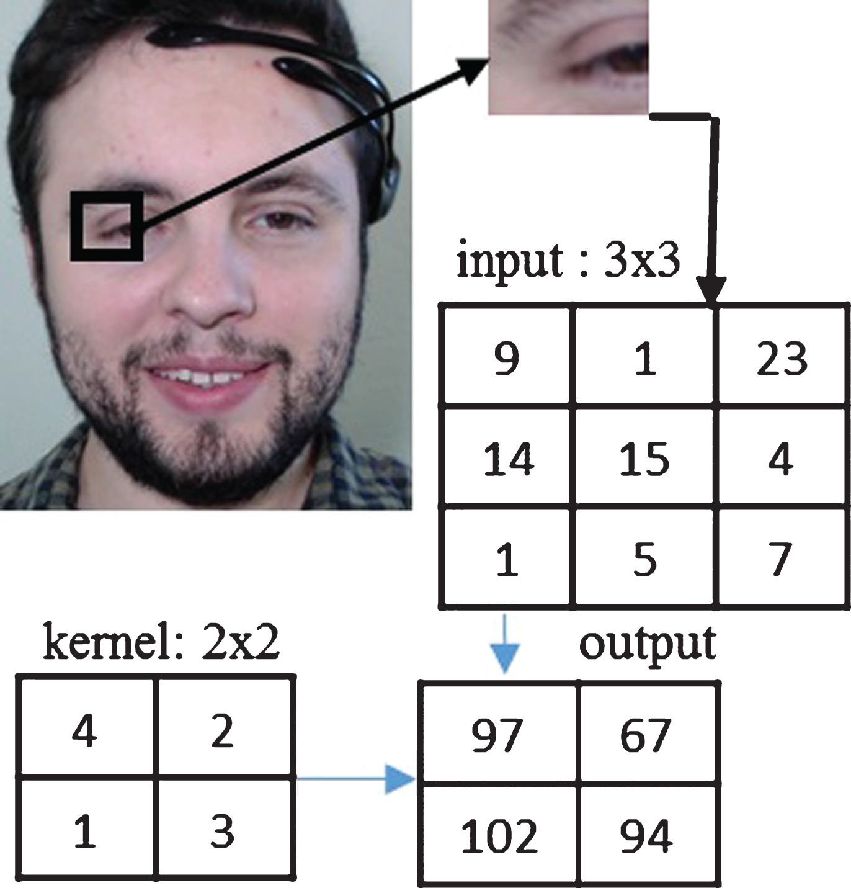
Why ATTENTION instead of CNN?
CNNs only look at local regions using small filters (e.g., 3×3, 5×5).
Long-range dependencies are hard to capture.
Deep CNNs are slow & costly!

Slide 3
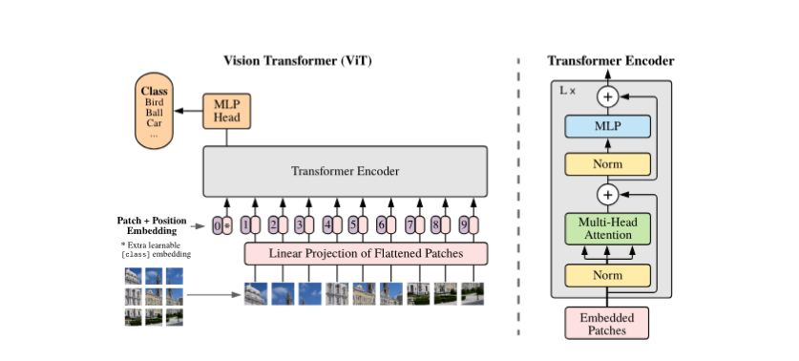

Slide 4
Encoder Vs Decoder
The key reason why BERT behaves like an encoder and GPT behaves like a decoder is the attention mask used in the self-attention mechanism.

Slide 5
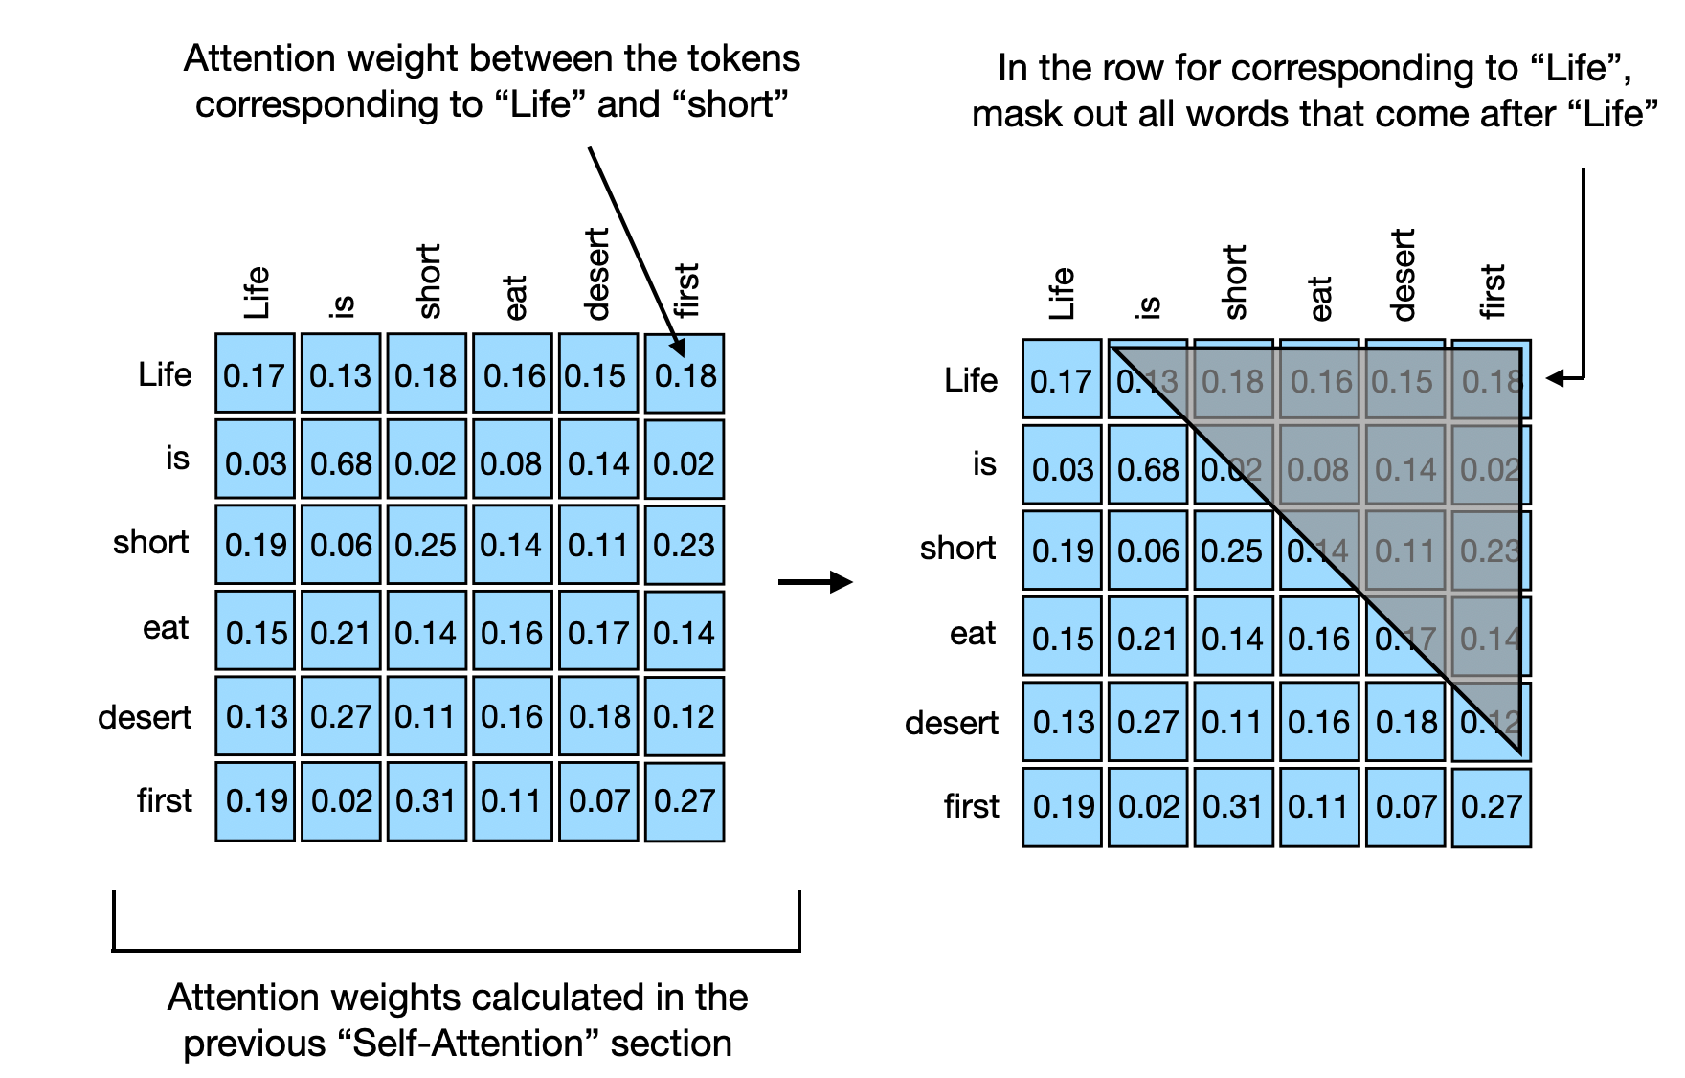
Decoder

Slide 6
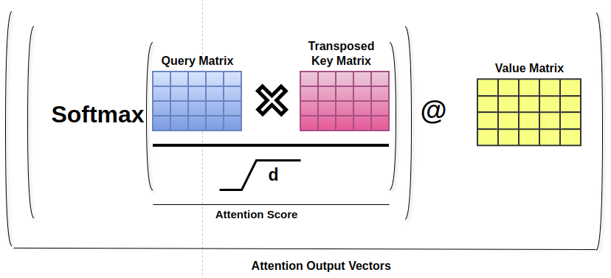
Encoder

Slide 7
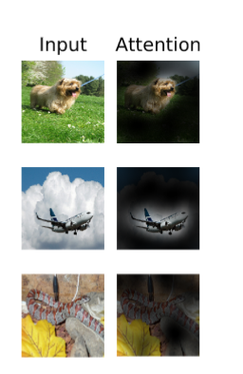
How attention Works with image?

Slide 8
Processing Image

Slide 9

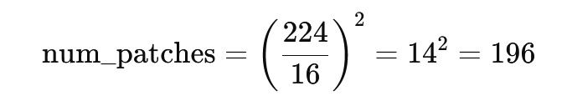
Patches

Slide 10
Tokens

Slide 11

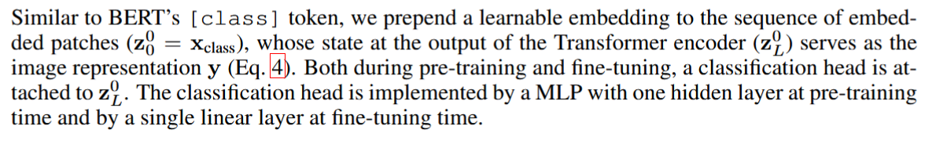
Tokens

Slide 12
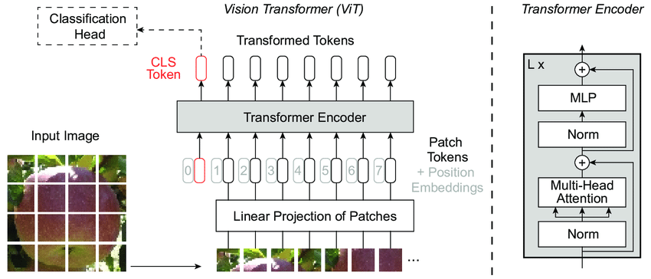

Slide 13
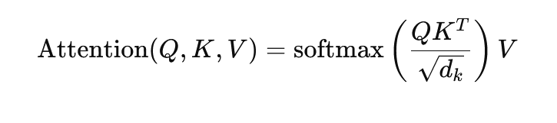
ATTENTION

Slide 14
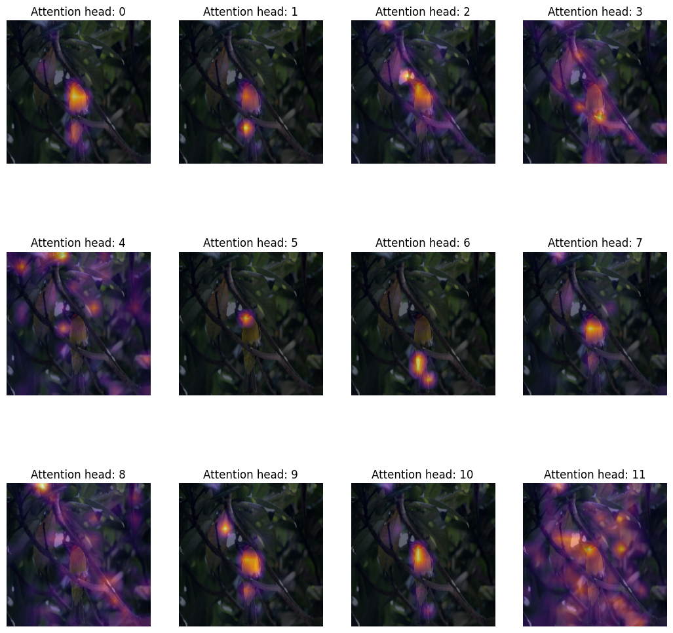
MHA

Slide 15
MHA in Images:
Input => [Batch, num_patches, Embed_dim]
MHA Format => [Batch, num_patches, Number_of_head, New_embed]

Slide 16
Residual Connection
The attention output alone is not enough. That’s why we add the original input (skip connection) to the attention output in transformers
Adding the input ensures no important details are lost.

Slide 17
MLP
Used to transform vector and directs to the particular latent space

Slide 18
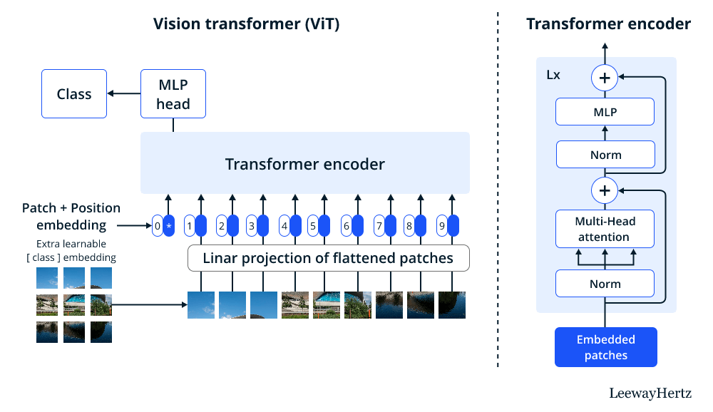
[CLS] token:
The [CLS] token contains a summary of the entire image, which is projected using a linear layer and used for the classification task.

Slide 19
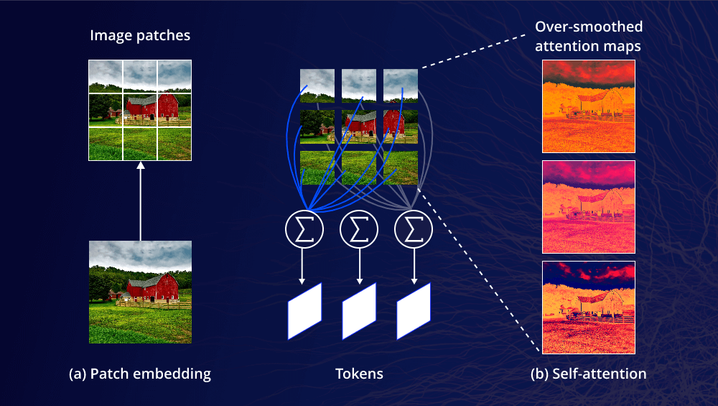
ViT perspective

Slide 20
Applications
Medical Imaging 🏥
Disease Diagnosis: Used in MRI, CT scans, and X-rays for detecting anomalies like tumors and lesions.
Pathology Analysis: Helps in analyzing histopathology slides for cancer detection.
Retinal Disease Detection: Applied in ophthalmology for detecting diabetic retinopathy and other eye diseases.

Slide 21
Applications
Autonomous Vehicles & Traffic Systems 🚗🚦
Object Detection: Identifies pedestrians, vehicles, and traffic signs more efficiently than CNNs.
Traffic Flow Analysis: Analyzes road congestion and optimizes traffic management systems.
Accident Detection: Helps in real-time monitoring of road conditions to detect accidents

Slide 22
Applications
Security & Surveillance 🔍
Face Recognition: Used in identity verification and surveillance systems.
Anomaly Detection: Detects suspicious activities in real-time using CCTV footage.

Slide 23
Applications
Remote Sensing & Satellite Imaging 🛰️
Land Cover Classification: Helps in analyzing forests, water bodies, and urbanization.
Disaster Monitoring: Detects wildfires, floods, and earthquakes from satellite images.

Slide 24
Applications
Industrial Automation & Quality Control 🏭
Defect Detection: Used in manufacturing to detect defects in products.
Predictive Maintenance: Analyzes machinery conditions to prevent failures

