Slide 1
FIFA 21 Player Data Analysis
Does Age Impact a Player's Performance Rating?
Pragathi M Porawakara Arachchige
DSC530-T301 Data Exploration and Analysis (2251-1)

Slide 2
Statistical Question & Hypothesis
Research Question -
Does a player's age impact their overall performance
ratings in FIFA 21?
Hypothesis -
Age has a statistically significant
impact on player
ratings.

Slide 3
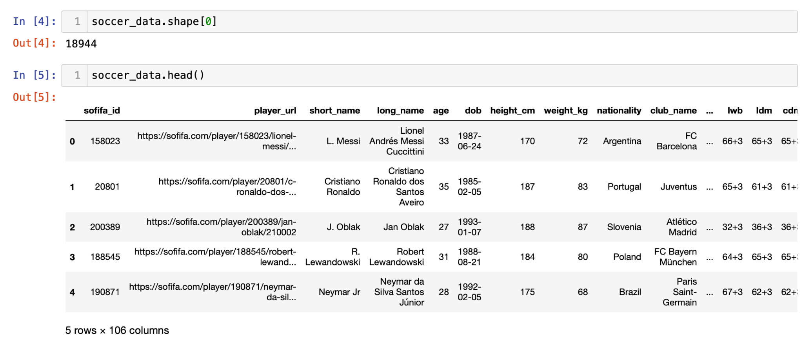
Dataset Overview
﻿﻿Dataset: FIFA 21 dataset with player attributes and skill ratings
﻿﻿Observations: Contains 18,944 entries and 106 columns detailing player data

Slide 4
Selected Variables (Chapter 1)
Variables:
Age: Player age in years.
Overall Rating: Composite performance score (47-93).
Shooting: Player's shooting ability.
Passing: Player’s passing skill.
Dribbling: Player’s dribbling skill.
Relevance: All these variables may contribute to performance.

Slide 5
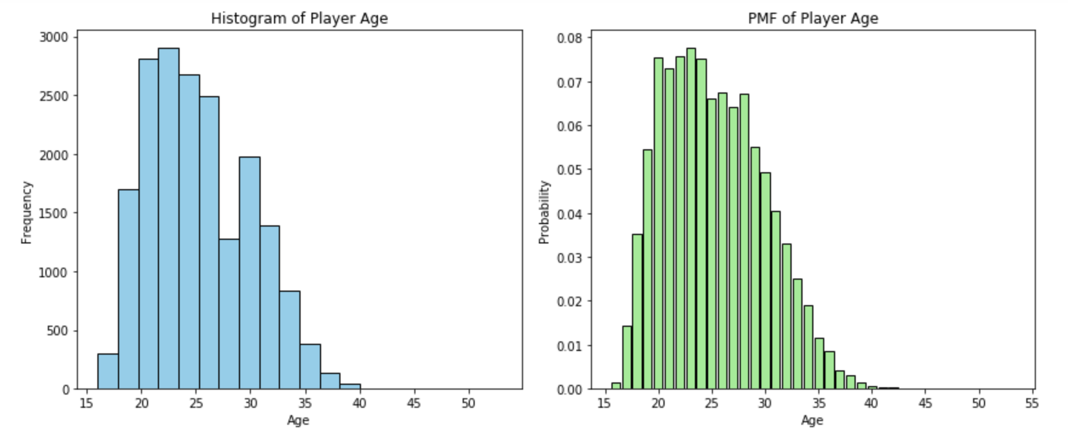
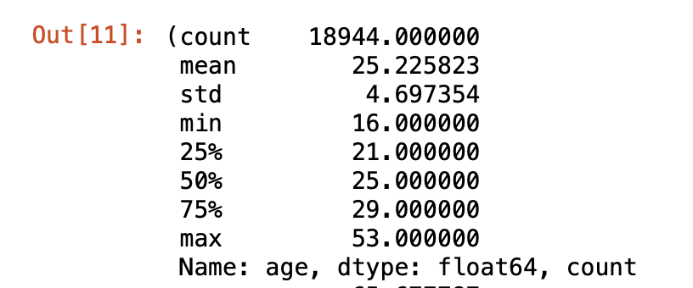
Histogram and Outliers (Chapter 2)
Age:
Mean: ~25.23 years
Outliers: Older players (40+)
Handling: Retain outliers (veteran professionals)

Slide 6
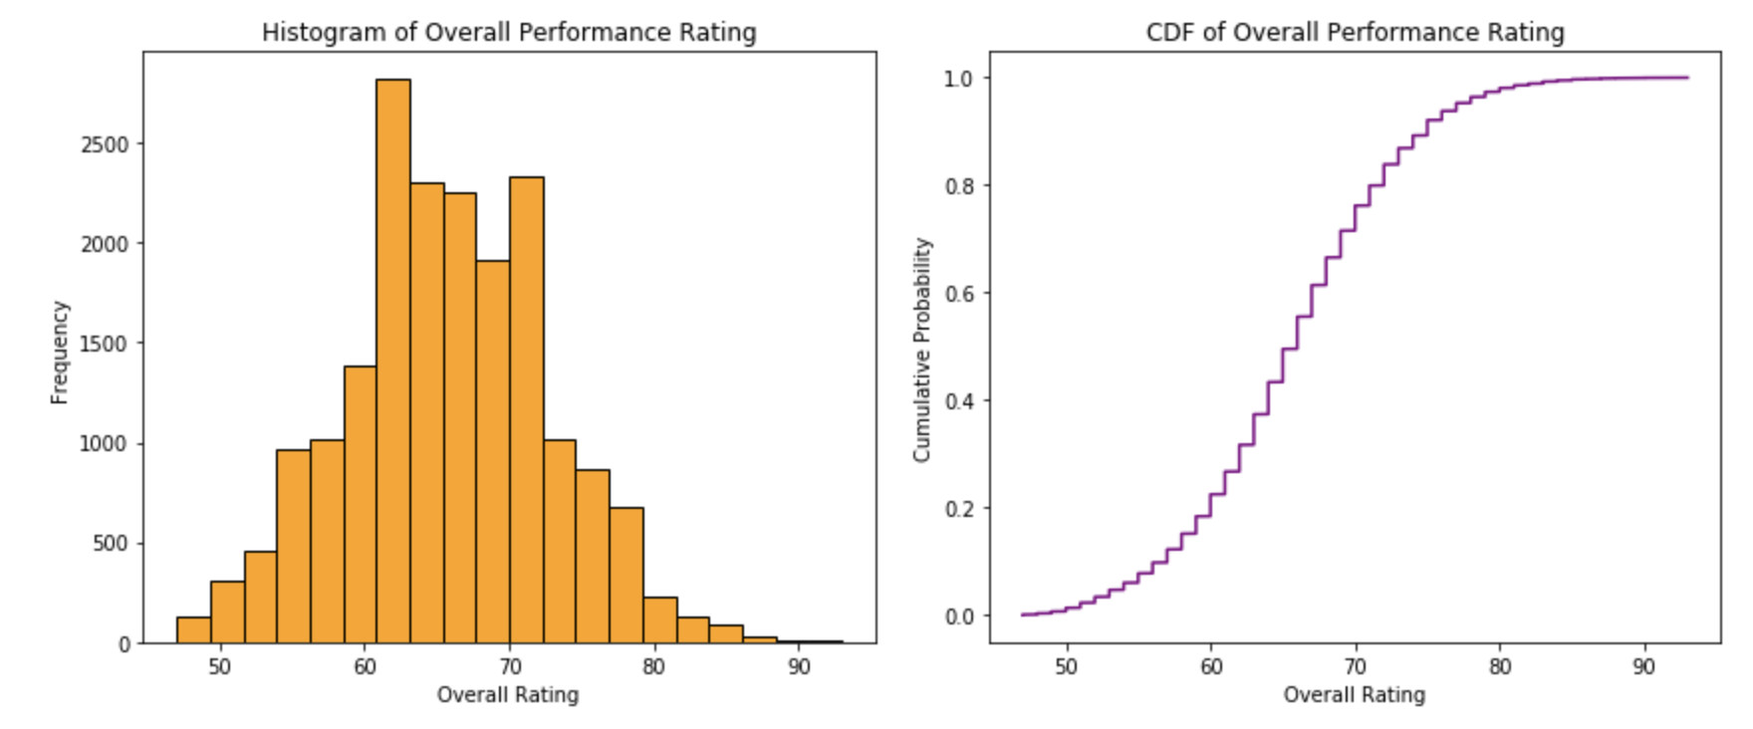
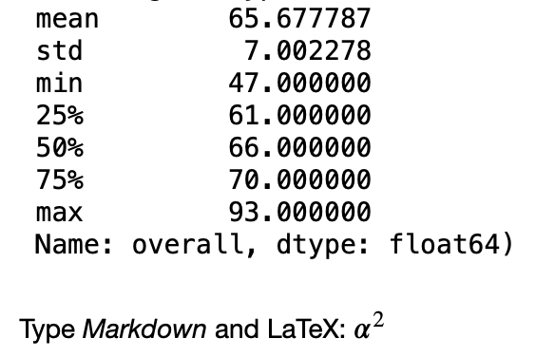
Overall Rating
Overall Rating:
Mean: ~65.68
Outliers: Ratings 90+ (star players)
Handling: Retain outliers (reflect top players)

Slide 7
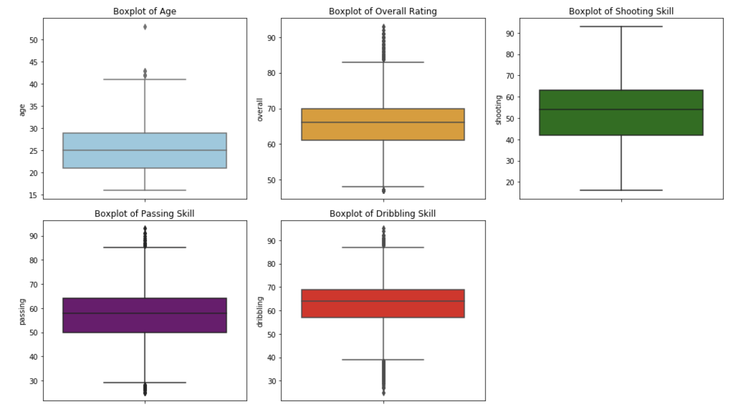
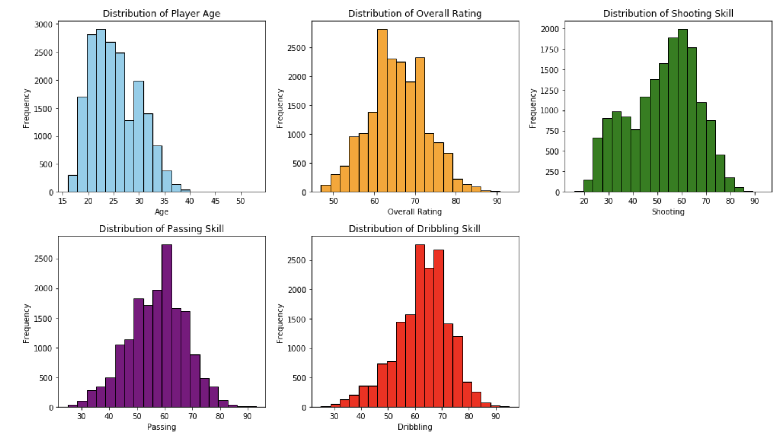
Shooting, Passing, Dribbling
Shooting, Passing, Dribbling:
Mean: Around 50-70 for each.
Handling: Retain as skill variability is meaningful.

Slide 8
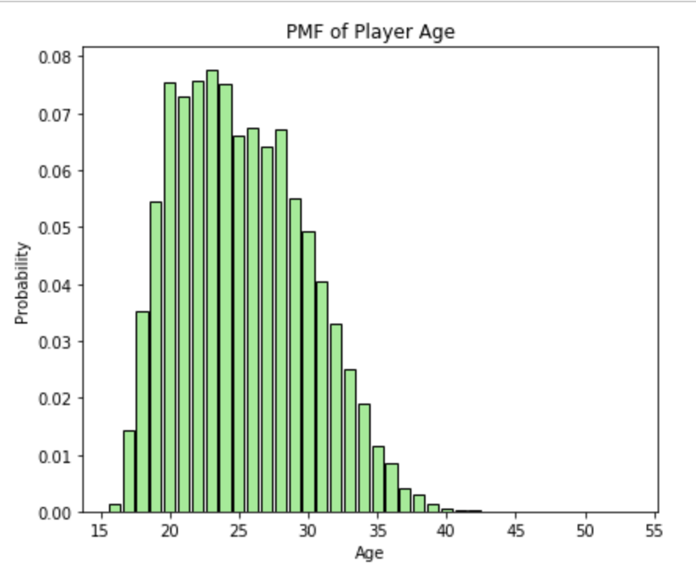
PMF Comparison (Chapter 3)
PMF Comparison:
Scenario: Compare players under 25 and over 25.
PMF Results:
Higher likelihood of moderate ratings in younger players, more high ratings in players 25+.

Slide 9
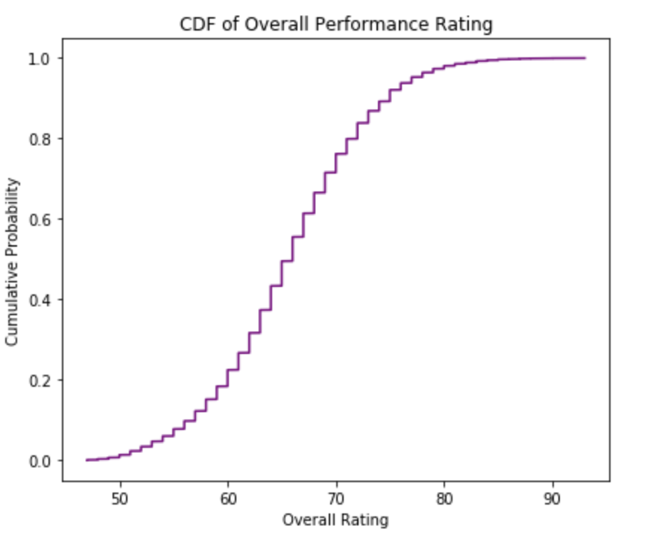
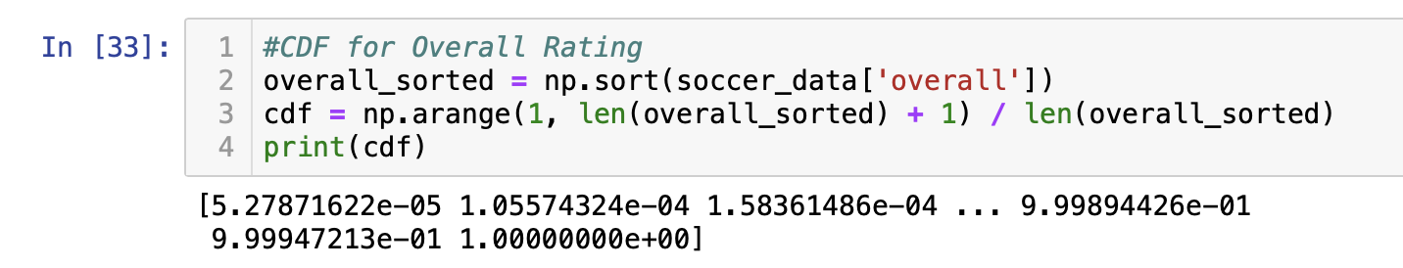
CDF Analysis (Chapter 4)
CDF for Overall Rating:
Shows cumulative probability for ratings.
Interpretation: Shows that the majority of players fall between 60-70, aligning with typical skill levels.

Slide 10
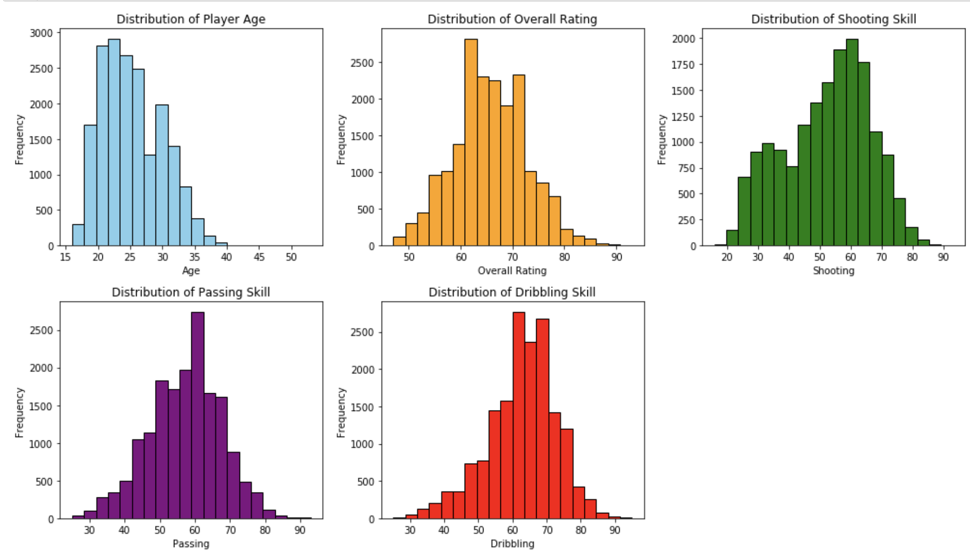
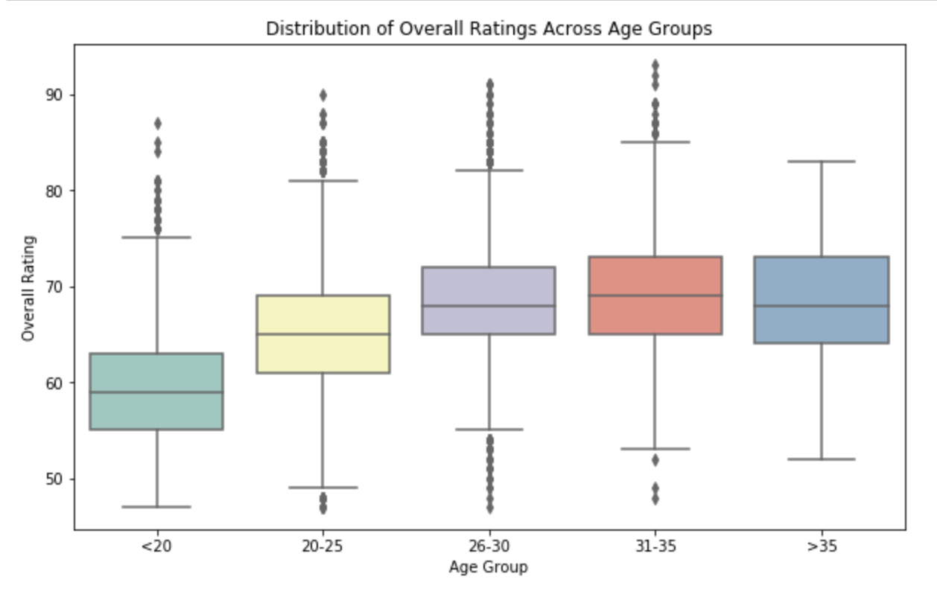
Analytical Distribution (Chapter 5)
Analytical Distribution
Analytical Fit: Normal distribution fitted to overall rating.
Insights: Rating distribution mostly fits a normal curve, though star player ratings it will create a slight right skew.

Slide 11
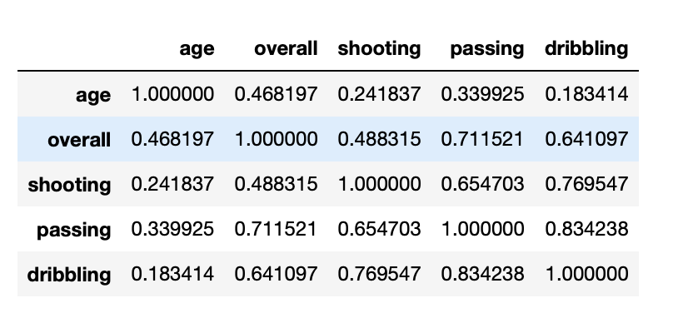
Scatter Plots and Correlation Analysis (Chapter 7)
Scatter Plots:
Age vs. Overall Rating: Shows a moderate positive correlation (~0.47).
Age vs. Passing: Displays similar positive correlation (~0.3).
Correlation Analysis:
Covariance and Pearson’s: Positive correlation coefficients suggest higher skills with age.

Slide 12
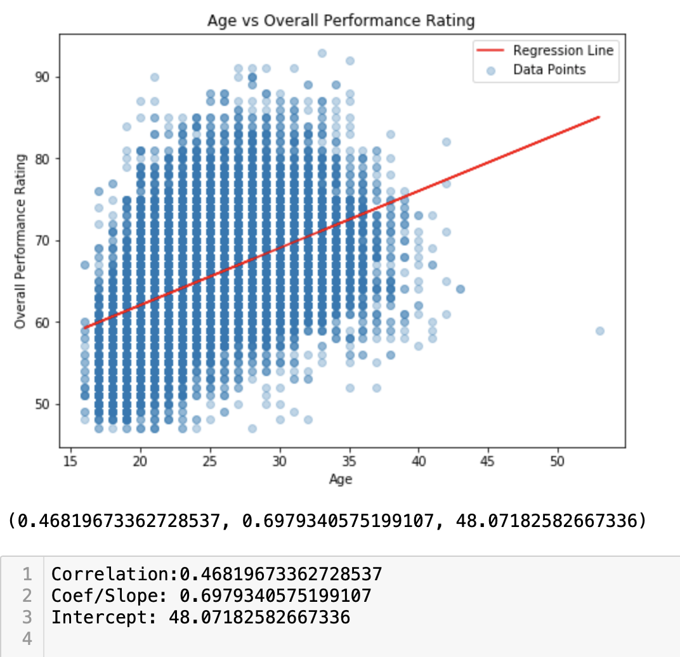
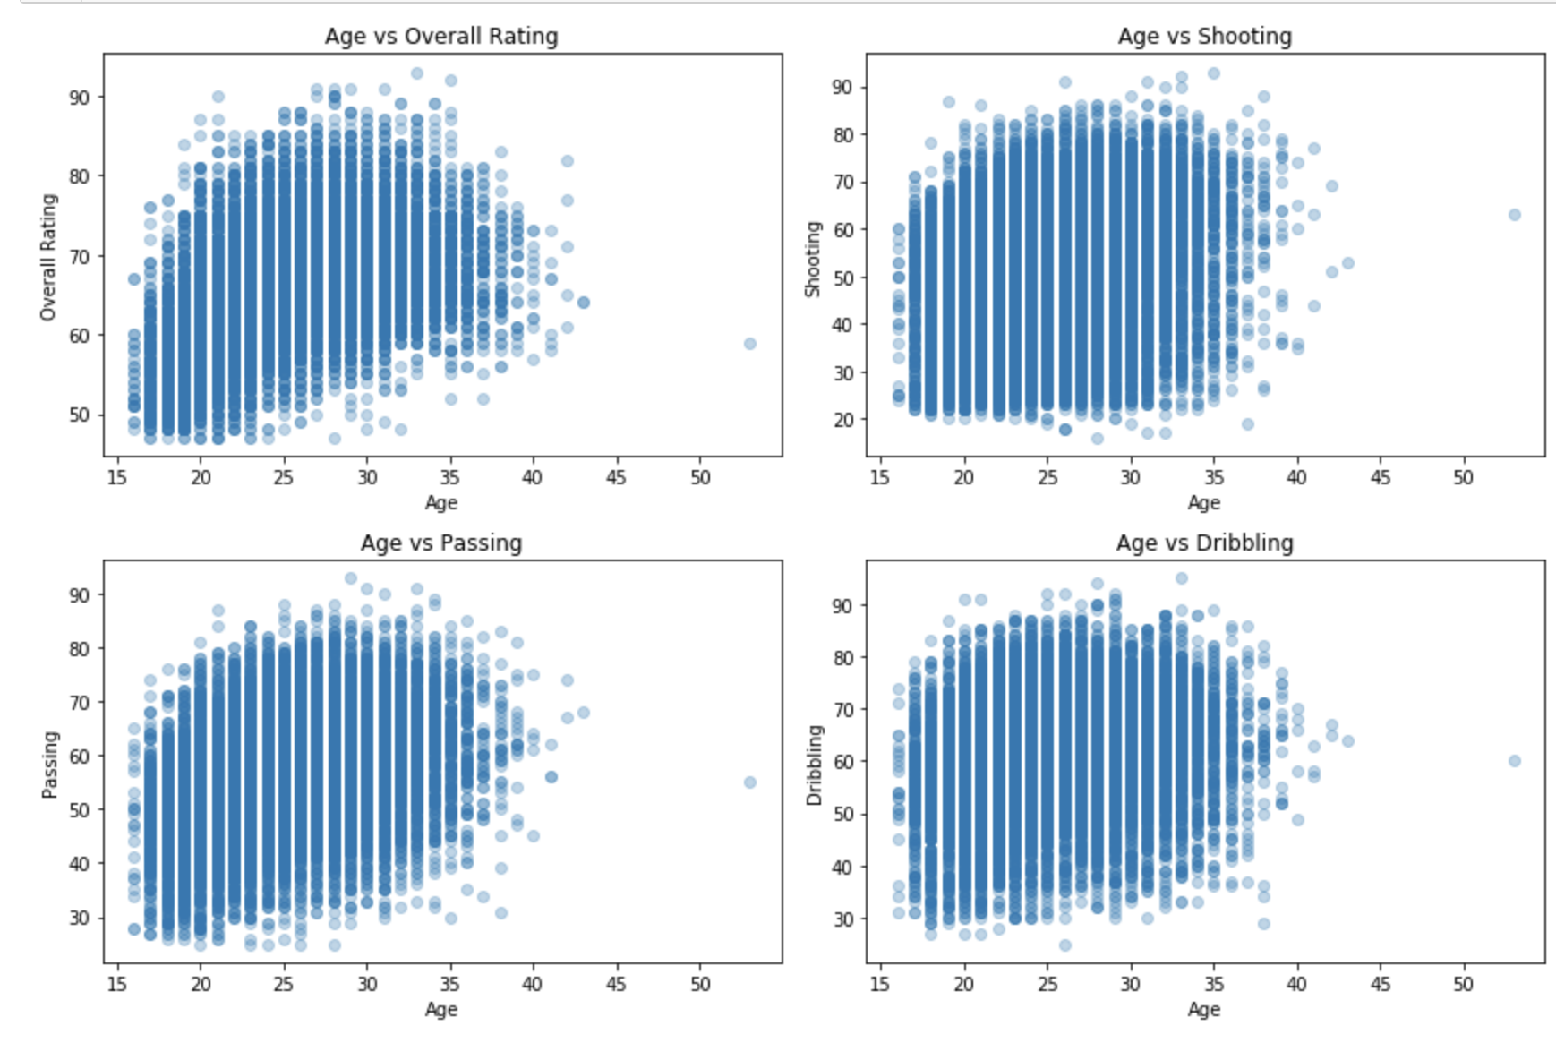
Scatter Plots and Correlation Analysis (Chapter 7) Cont

Slide 13
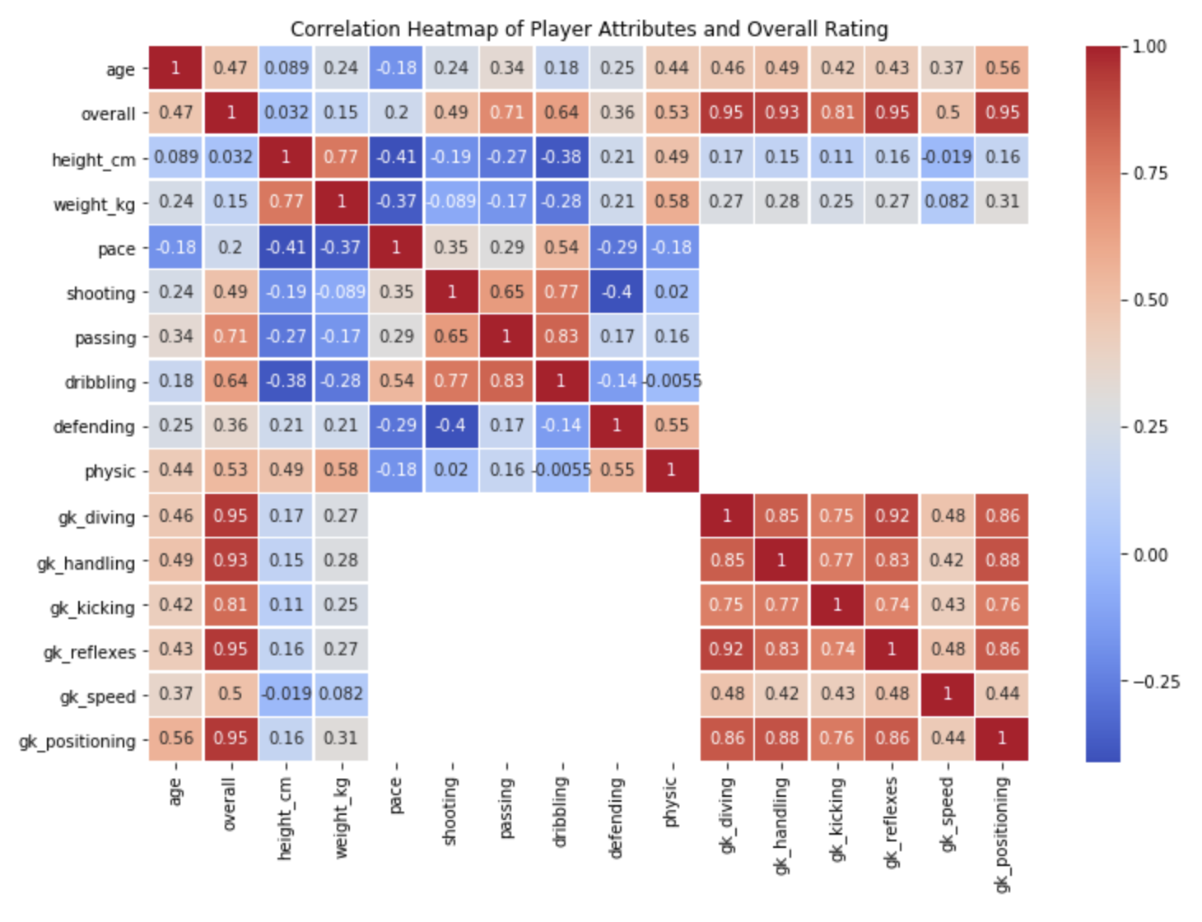
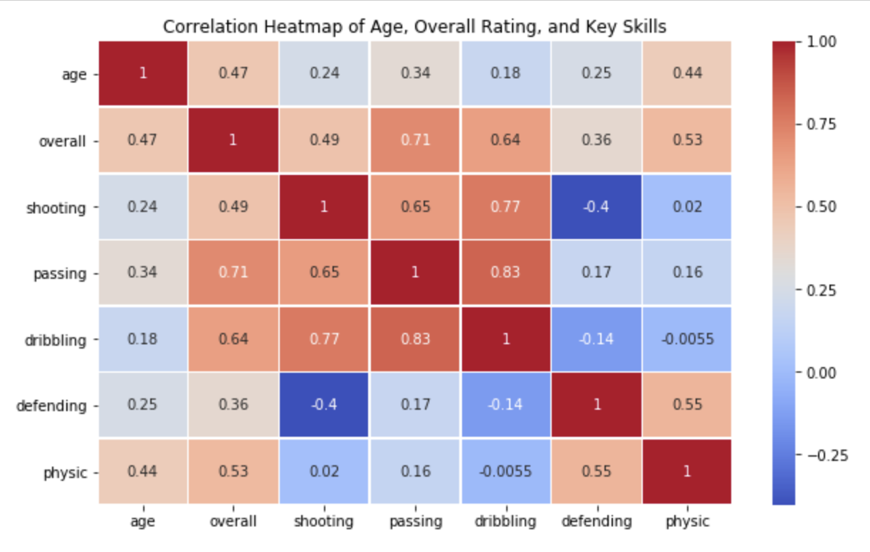
Scatter Plots and Correlation Analysis (Chapter 7) Cont

Slide 14
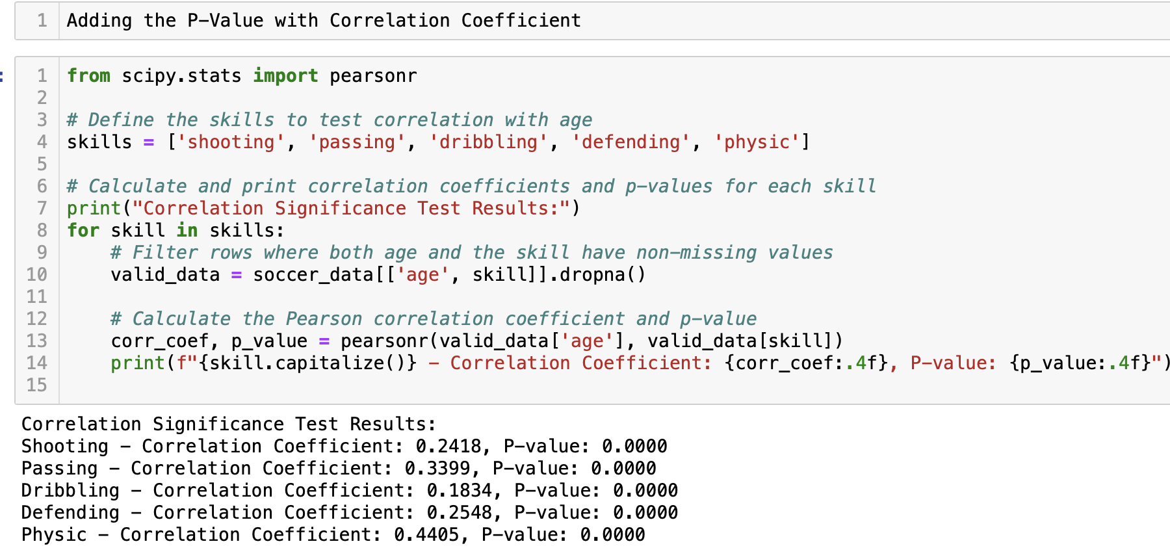
Hypothesis Testing (Chapter 9)
T-Test Results: Statistically significant p-value (p < 0.05), supporting that age impacts overall rating.

Slide 15
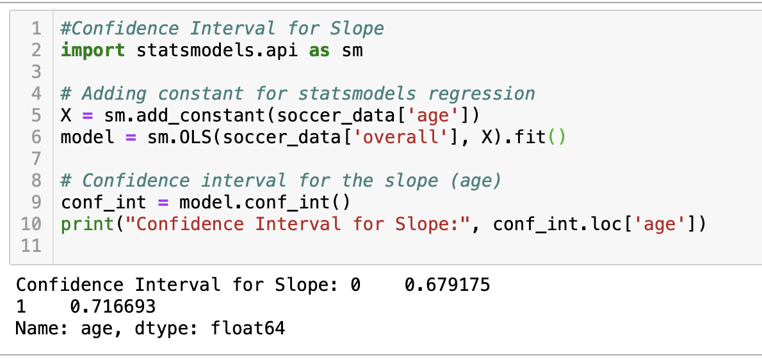
Regression Analysis (Chapters 10 & 11)
Regression Analysis
Regression Model: Linear regression with slope ~0.7 (for each additional year of age, a ~0.7 increase in rating).
R-squared: Moderate explanatory power of age for rating variability.
Interpretation: Age positively impacts performance ratings but is not the sole factor.
Confidence Interval for Slope: [0.679715, 0.716693]
The confidence interval for the slope in the regression model indicates that for every additional year of age, a player's overall rating is expected to increase by 0.68 to 0.72 points. Since the confidence interval does not include 0, this slope is statistically significant.

Slide 16
Conclusion
Summary: Age influences overall rating; players’ skills improve with age, but other factors also contribute.
Limitations: FIFA data may not fully represent all player demographics.

Slide 17
THANK YOU

