Slide 1
Soccer Transfer Market Player Value Prediction
Can Machine Learning Accurately Predict a Soccer Player’s Market Value?
Pragathi M Porawakara Arachchige
DSC680-T301 Applied Data Science

Slide 2
Business Problem
Clubs invest billions in transfers.
Current valuation methods are subjective.
Goal: Can ML predict player value objectively?

Slide 3
Background & Motivation
Transfermarkt uses crowd-sourced data
Rise of analytics in sports
FIFA/FBref data makes modeling possible

Slide 4
Dataset Description
7,000+ players
400+ features
Key variables: age, position, minutes, goals
Data cleaning, encoding, standardization

Slide 5
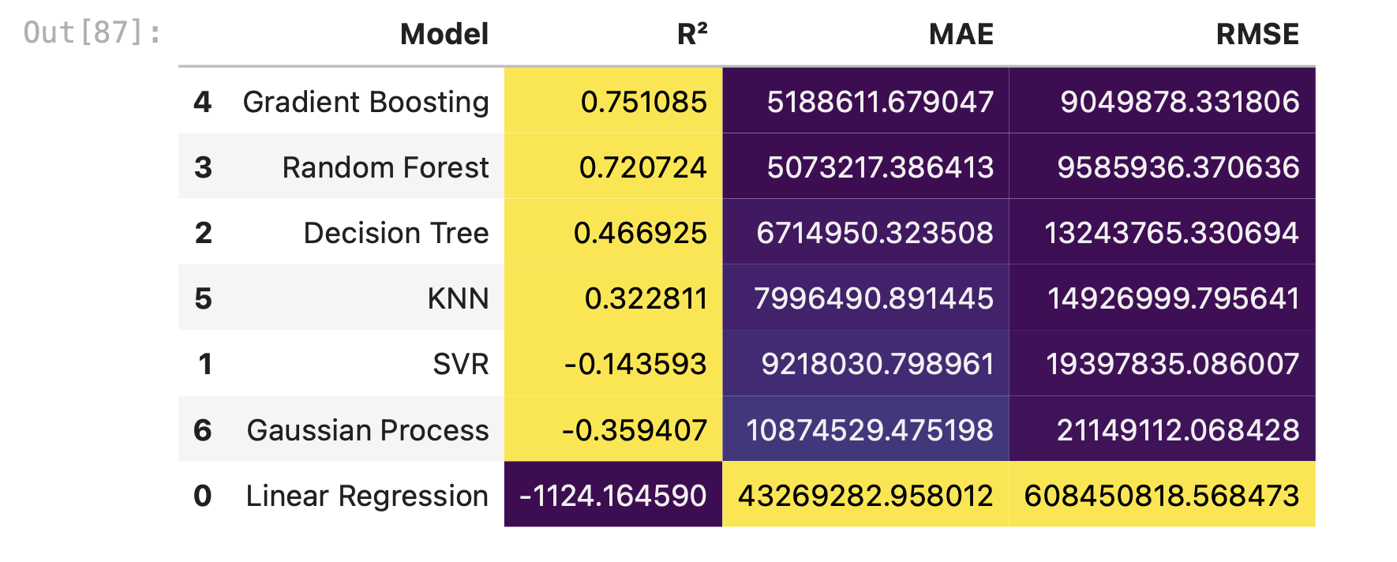
Methods & Models Tested
Tried: Linear, Tree, Ensemble, SVR, Gaussian
Evaluation: R², RMSE, MAE
Gradient Boosting performed best
Hyperparameter tuning with RandomizedSearchCV

Slide 6
Model Comparison
Gradient Boosting Regressor – R² = 0.789, MAE ≈ €5.19 M, RMSE ≈ €9.05 M (Best performer)
Random Forest Regressor – R² = 0.721, MAE ≈ €5.07 M, RMSE ≈ €9.59 M
Decision Tree Regressor – R² = 0.467, MAE ≈ €6.71 M, RMSE ≈ €13.24 M
K-Nearest Neighbors Regressor – R² = 0.323, MAE ≈ €7.99 M, RMSE ≈ €14.93 M
Support Vector Regressor – R² = –0.144, MAE ≈ €9.22 M, RMSE ≈ €19.40 M
Gaussian Process Regressor – R² = –0.359, MAE ≈ €10.87 M, RMSE ≈ €21.15 M
Linear Regression – R² = –1124.16, MAE ≈ €43.27 M, RMSE ≈ €608.45 M (Failed due to outliers)
Gradient Boosting is clearly the strongest model in terms of both prediction accuracy and error measures, making it the best candidate for final deployment.

Slide 7
Analysis & Results
Gradient Boosting R²: 0.789
RMSE: 9.05M
MAE: 5.19M
Best features: minutes, goals, age, position

Slide 8
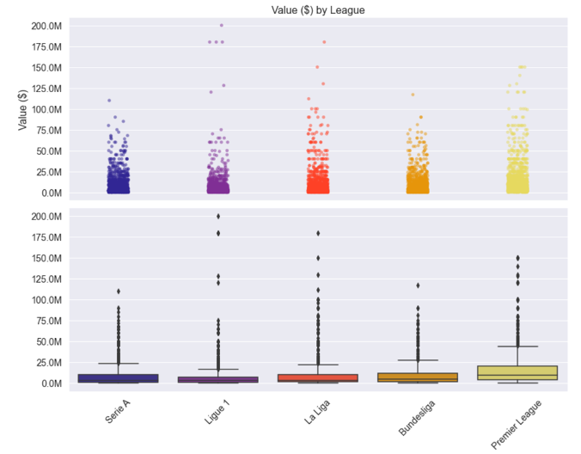
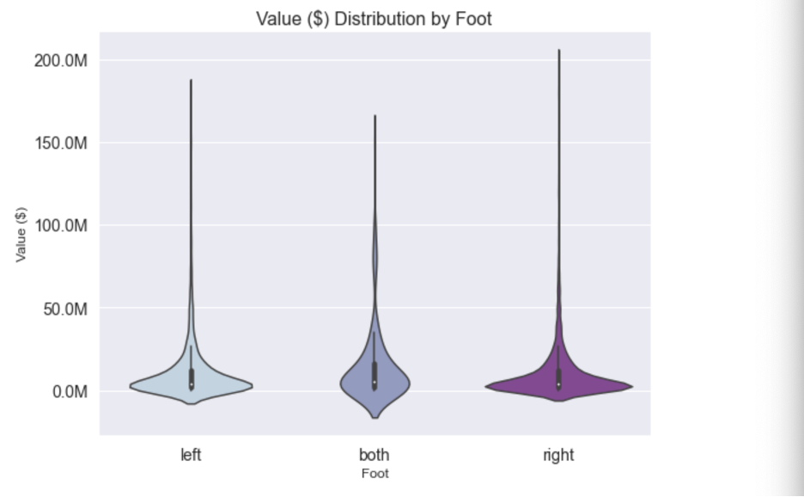
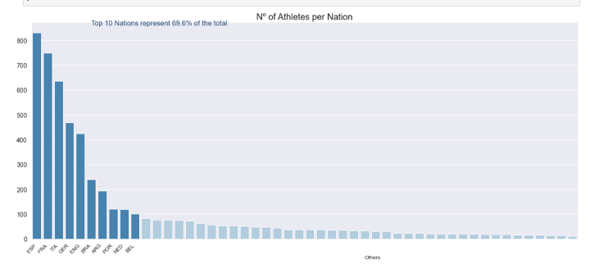
Visualizations
Violin plots
Scatter plots
Residual plots for model diagnostics
Feature importance bar charts

Slide 9
Ethical Considerations
Risk of bias (e.g., nationality)
Model must be explainable (SHAP/LIME)
Should support , not replace , human decisions

Slide 10
Future Uses & Recommendations
Dynamic tools for scouts/agents
Dashboard or API integration
Use in fantasy leagues
Retrain annually with new data

Slide 11
Conclusion
Machine learning offers a powerful tool for data-driven player valuation, reducing subjectivity in the soccer transfer market.
Gradient Boosting Regressor provided the most accurate and consistent performance across metrics.
While the model isn’t perfect specially for high-value players it establishes a strong foundation for club scouting, negotiations, and financial planning.
With further improvements (e.g., real-time updates, more external variables like injuries/media sentiment), the model can be scaled into a full analytical decision-support system for sports management.

Slide 12
THANK YOU

