Slide 1
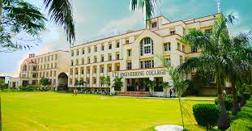
Fake Product Identification System
In guidance of :- Mr Kuldeep Kumar
Represented By:–
Nisha kumari (1902220100096)
Rakshit tyagi (1902220100121)
Pragati kumari (1902220100106)

Slide 2
Blockchain
A blockchain is a distributed database or ledger that is shared among the nodes of a computer network. As a database, a blockchain stores information electronically in digital format. The goal of blockchain is to allow digital information to be recorded and distributed, but not edited. In this way, a blockchain is the foundation for immutable ledgers, or records of transactions that cannot be altered, deleted, or destroyed. This is why blockchains are also known as a distributed ledger technology (DLT).
Bitcoin and Ethereum are popular examples of blockchains. Everyone is allowed to connect to the blockchain and transact on them.

Slide 3
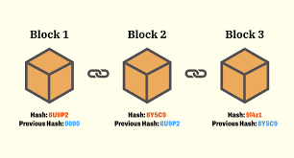
Blockchain technology's data structures have inherent security qualities because they are based on consensus, cryptography, and decentralization principles. Each new block of information connects to all the previous blocks in a way that it's nearly impossible to tamper with. In addition, all transactions in a block get validated and agreed on by a consensus mechanism (authorized users), guaranteeing that each transaction is true and accurate. Thus, there is no point of failure, and a user can’t change transaction records.

Slide 4
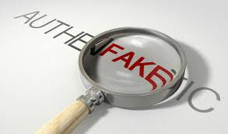
Abstract:
Counterfeit goods have become a global problem as consumers are being deceived into buying unauthentic goods with no way to validate the authenticity. Recently, blockchain has become more popular as it fosters trust between untrusting participants. This paper uses blockchain technology to combat the sale of counterfeit products. We use blockchain to allow manufacturers to add authentic product serial numbers onto the ledger; consumers can then use the serial number to verify the authenticity of a product before purchasing it. Blockchain plays a pivotal role in ensuring that data was not tampered with - creating a trusted environment.

Slide 5
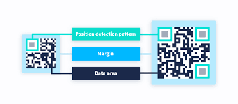
OBJECTIVE
The idea of this project came into existence because of the increase in the counterfeit products. The objectives of this project are:
To Design Anti Counterfeit System using Blockchain.
To secure product details using a QR code.
Provide security to the clients by offering data to client.

Slide 6
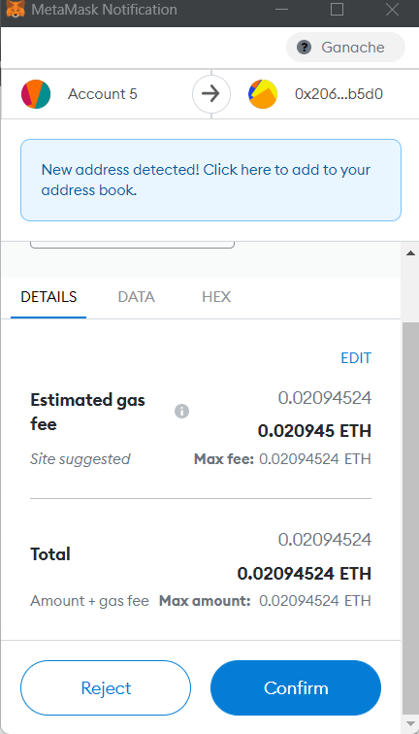

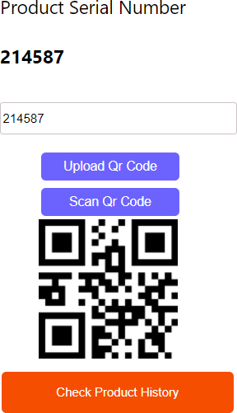
Problem Statement
The overall improvement of a thing or development reliably goes with danger factors, for instance, producing and duplication. Manufacturing things can impact the association's name and the customer's prosperity. As of now days revelation of fake thing is the best test. Counterfeit things are causing a critical effect on the association and the customer's prosperity. Consequently, thing makers are defying tremendous adversity.
India and various countries are doing combating such phony and phony things. In the proposed structure, the system produces secret key codes using Blockchain advancement. This advancement stores trade records in blocks. These squares are secure and hard to access and change the information from it. By using a secret key code, we can perceive the phony thing.
.

Slide 7
Steps Involved
The manufacturer uses the SHA-256 algorithm to generate a QR code in blockchain technology. The generated QR code is scanned by the user to check given product is fake or real. Counterfeit products are growing exponentially with the enormous amount online.
As the input will always be not a perfect multiple of 512 bits, So, some part of input will be left.
To this left input we do a padding concatenate the input with 10 bits before it. Now our input is perfect multiple, so we can proceed further.
Now 512-bit input is added with 256 bits IV to get total of 768 bit. These 768 bits is passed through compression function ‘c’ to get an output of 256 bit only. This output 256 bit is again merged with 512 bits input from block B2.
Again, the total is passed through the compression function to yield a 256-bit output. This loop goes on fill the last block (block n).
Again, a compressing function starts and gives final 256-bits output, what we call it as hash of input

Slide 8
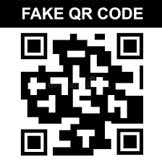
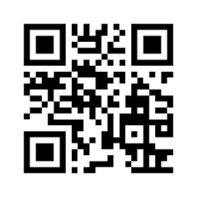
RESULT
The continuous framework can be executed to check the product is a fake product or unique product. The producer utilizes the SHA-1 calculation to create a public key code in blockchain innovation. The created secret key code is examined by the customer to check given product is phony or genuine.
REAL QR CODE

Slide 9
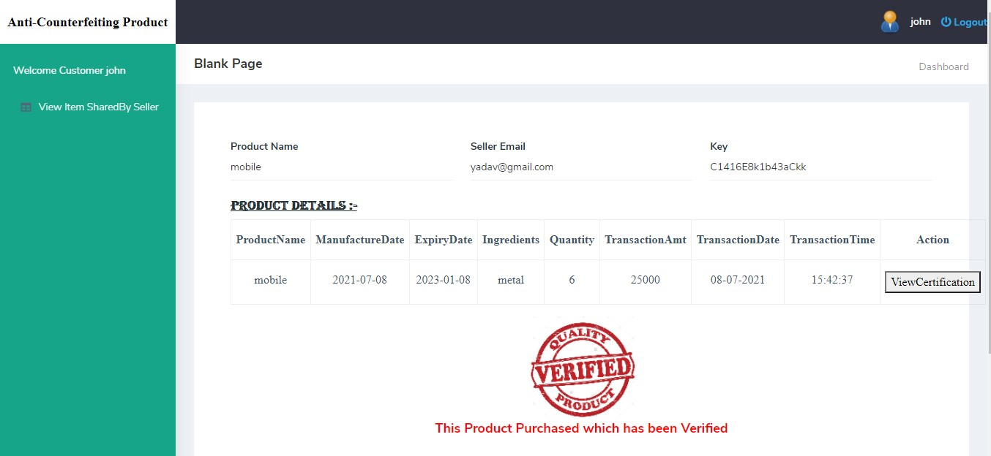
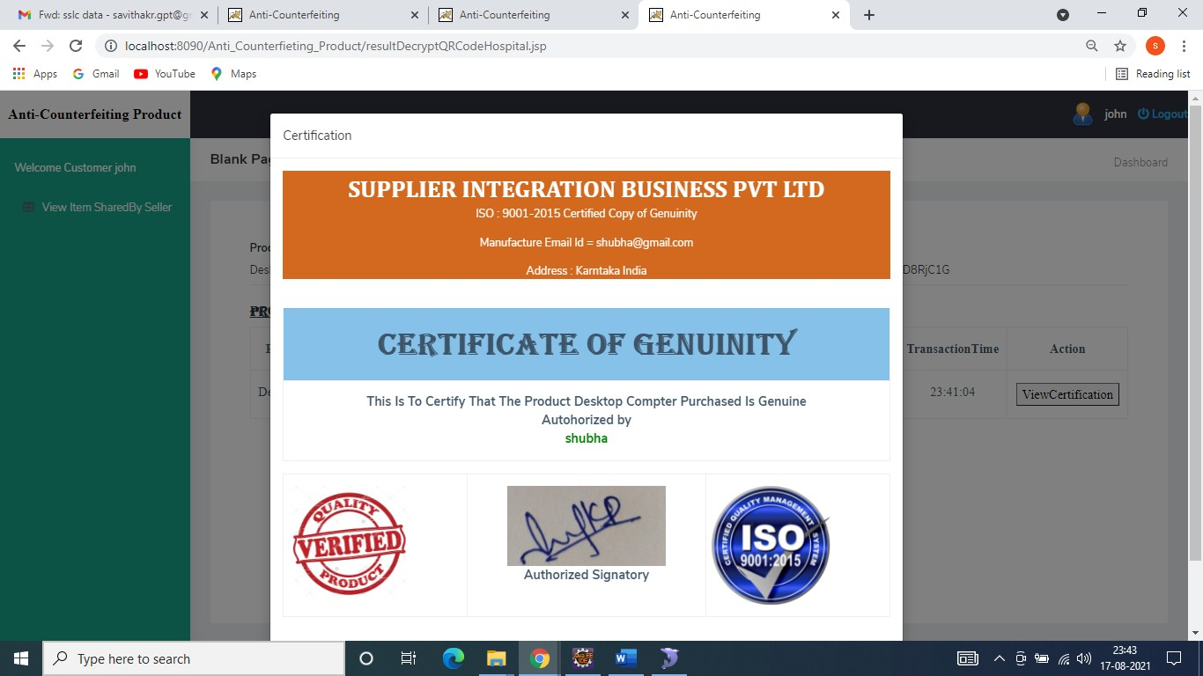

Slide 10
CONCLUSION:
Counterfeit products are growing exponentially with the enormous amount online. So, there is a strong need to detecting counterfeit products and blockchain technology is used to detect fake products. Furthermore, the information is encoded into a QR code. Customers or users scan the QR code and then they can detect the fake product. Digital information of products can be stored in the form of blocks in blockchain technology. The data can be stored in the firebase cloud. Thus, the proposed system is useful for the customer to detect fake products in the supply chain. Customers can scan QR codes assigned to a product and can get all the information like transaction history, current owner based on which end-user can check whether the product is genuine or not.

Slide 11
FUTURE SCOPE:
In future, we plan from one hand to explore and research more about using faster machine learning algorithms to classify marks and logos and detect text with the help of OCR. from the other hand, we need to extend our web crawler to have the possibility to gather more web information, especially from the eCommerce world to find fake products with help of detecting logo, marks and text. This would combine three state-of-the-art technologies, machine learning, Text recognition and web searching in one application. That will bring great convenience and a better experience for users. However, we trust that using machine learning-based technology will change the role and empower the consumer to drive the market for more transparency and safety.

Slide 12



