Slide 1

Data Analytics with Tableau
Course Code: 23BTDSL211
B. Tech – MD II Semester: IV
Prepared by:
Prof. Pragati Agrawal
Designation : Assistant Professor
Department of Data Science
G.H. Raisoni College of Engineering and Management, Nagpur

Slide 2
Teaching and Evaluation Scheme
Course Title: Data Analytics with Tableau (23BTDSL211) – Multi Disciplinary Minor - II
Semester | IV | Teaching Scheme |  |  |  | Evaluation Scheme
 |  |  |  |  |  | Theory |  |  | Practical
Term | EVEN | Th | Tu | Pr | Credits | TAE | CAE | ESE | INT | EXT
Course Category | MD-II | 2 | - | - | 2 | 10 | 15 | 50 | - | -
Course Code | 23BTDSL211
Teaching Mode | Offline | 2 |  |  | Total | 75 |  |  | -
Duration of ESE | 3 hrs |  |  |  |  | 75

Slide 3
Course Objectives and Outcomes
Course Objectives | To introduce students the basics of Tableau, including the user interface and key features.
 | To provide students with the knowledge of blending and joining data from multiple sources.
 | To encourage students to explore advanced analytics features and create interactive dashboards by combining multiple visualizations.
Course Outcomes | CO1: Understand the representation of tableau and its fields.
 | CO2: Analyze various data organization that are present in tableau.
 | CO3: Apply visualization tips in tableau.
 | CO4: Apply the various charts and maps used for data visualization.
 | CO5: Design the Database connection with tableau and forecast the predictions.

Slide 4
Mapping of Course Outcomes with Program Outcomes and Program Specific Outcomes:
Course Out comes | Program Outcomes and Program Specific Outcomes
 | PO1 | PO2 | PO3 | PO4 | PO5 | PO6 | PO7 | PO8 | PO 9 | PO 10 | PO11 | PSO1 | PSO2
CO1 | 2 | 2 | 2 | 2 | 1 | - | - | - | - | - | - | 1 | 2
CO2 | 3 | 3 | 3 | 3 | 3 | - | - | - | - | - | - | 1 | 2
CO3 | 2 | 2 | 3 | 3 | 3 | - | - | - | - | - | 1 | 1 | 1
CO4 | 2 | 3 | 3 | 2 | 3 | - | - | - | - | - | 2 | 2 | 3
CO5 | 2 | 2 | 3 | 3 | 3 | - | - | - | - | - | 2 | 2 | 3

Slide 5
Syllabus
UNIT | CONTENTS
I | Introduction What is Tableau? Terminology, Tableau v/s Excel, Applications and key factors, Data-types, views of data and records, Measure, Dimension, Discrete and Continuous.
II | Organizing and Simplifying Data Drill down and hierarchies, Sorting, Grouping, Parameters, Combine, Sets, Title, Caption, Exporting, Granularity, Worksheet Interface, Managing Metadata, Dashboard, Tableau bins: fixed and variable.
III | Data Connections in Tableau Connecting to tableau server, Join and types of join, Data Blending, Joining v/s Blending, Filters, size, color, label, tooltip, shapes, detail, font, alignment, shading, borders, calculations, Number and String functions, Logical function, conditional formatting, Rank.

Slide 6
Syllabus
UNIT | CONTENTS
IV | Charts and Maps Introduction to Chart, Scatter charts, Line charts, Reference lines, Bubble chart, Bar chart, Stacked chart, Pie chart, Bump chart, Funnel chart, Waterfall chart, Chart Linking Techniques. Introduction to Maps, Map options, Map layers, Word maps, Tree maps.
V | Use Cases Custom Territories, Custom Geocoding, Religion Wise population, National Park, Highlighting and Actions, Publishing Reports, Dashboard Designing, Interacting with Tableau online.

Slide 7
Study Material
Text Books | 1. Tableau 10 for beginners, version: 10.x, Chandraish Sinha
Online TL Material | http://www.udemy.com/big-data-hadoop-the-complete-course/
 | https://www.datacamp.com/courses/introduction-to-tableau/

Slide 8
Unit 1

Slide 9
Learning Objectives
Understand today's turbulent business environment and describe how organizations survive and even excel in such an environment (solving problems and exploiting opportunities)
Understand the need for computerized support of managerial decision making
Describe the business intelligence (BI) methodology and concepts and relate them to decision support systems (DSS)
Understand the issues in implementing BI

Slide 10
The Business Environment
The environment in which organizations operate today is becoming more and more complex, creating:
opportunities, and
problems.
Example: globalization.
Business environment factors:
markets, consumer demands, technology, and societal.

Slide 11
Business Environment Factors
FACTOR DESCRIPTION
Markets Strong competition
Expanding global markets
Blooming electronic markets on the Internet
Innovative marketing methods
Opportunities for outsourcing with IT support
Need for real-time, on-demand transactions
Consumer Desire for customization
demand Desire for quality, diversity of products, and speed of delivery
Customers getting powerful and less loyal
Technology More innovations, new products, and new services
Increasing obsolescence rate
Increasing information overload
Social networking, Web 2.0 and beyond
Societal Growing government regulations and deregulation
Workforce more diversified, older, and composed of more women Prime concerns of homeland security and terrorist attacks
Necessity of Sarbanes-Oxley Act and other reporting-related legislation Increasing social responsibility of companies
Greater emphasis on sustainability

Slide 12
Unit 2

Slide 13
Unit 3

Slide 14
Introduction to Basic Charts
Bar and Column Charts
• Description:
Bar and column charts are used to compare values across different categories. Bar charts display data horizontally, while column charts display data vertically.
• Use Cases:
Ideal for comparing sales figures across different regions, product performance, or website traffic by source.

Slide 15
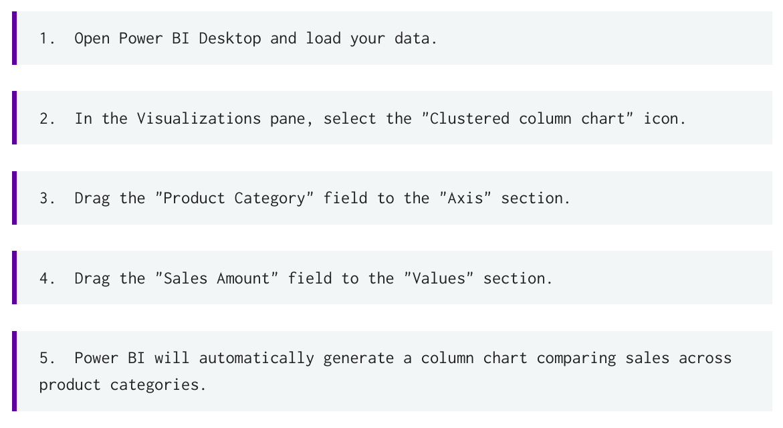
Introduction to Basic Charts

Slide 16
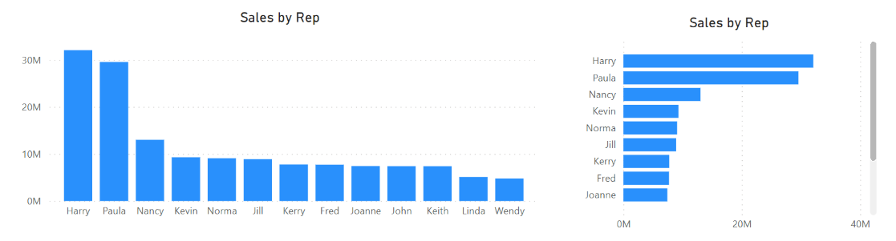
Introduction to Basic Charts

Slide 17
Introduction to Basic Charts
2. Line Charts
• Description:
Line charts display data points connected by lines, showing trends over time or other continuous variables.
• Use Cases:
Best for visualizing changes in data over time, such as stock prices, temperature fluctuations, or website visits over a period.
• Example:
To visualize the monthly sales trend over the past year, you would use a line chart with months on the x-axis and sales amount on the y-axis

Slide 18
Introduction to Basic Charts
6. Ribbon Chart
Usage Scenarios:
• Market Share Analysis: Tracking the changing market share of different companies over time.
• Product Category Performance: Visualizing the sales performance of different product categories over months or years.
• Website Traffic Sources: Showing how the proportion of traffic from different sources (e.g., organic search, social media) changes over time. • Budget Allocation: Displaying how budget allocations for different departments change across fiscal years

Slide 19
Introduction to Basic Charts
6. Ribbon Chart
Example Let's consider a market share analysis example. We want to visualize the market share of different companies over several years:
• Company A: Market Share in 2020: 40%, 2021: 45%, 2022: 50%, 2023: 55%
• Company B: Market Share in 2020: 30%, 2021: 25%, 2022: 20%, 2023: 15%
• Company C: Market Share in 2020: 20%, 2021: 22%, 2022: 23%, 2023: 25%
• Company D: Market Share in 2020: 10%, 2021: 8%, 2022: 7%, 2023: 5%

Slide 20
Introduction to Basic Charts
6. Ribbon Chart
Steps to create a Ribbon Chart in Power BI:
Load Data: Import the data into Power BI.
2. Select Ribbon Chart: In the Visualizations pane, select the Ribbon chart icon.
3. Add Fields: Drag the "Year" field to the "Axis" well, the "Company" field to the "Legend" well, and the "Market Share" field to the "Value" well.
4. Format (Optional): Customize the chart's appearance, such as colors, data labels, and titles, in the Format pane. You can also adjust the "Ribbon Style" to control the appearance of the ribbons.

Slide 21
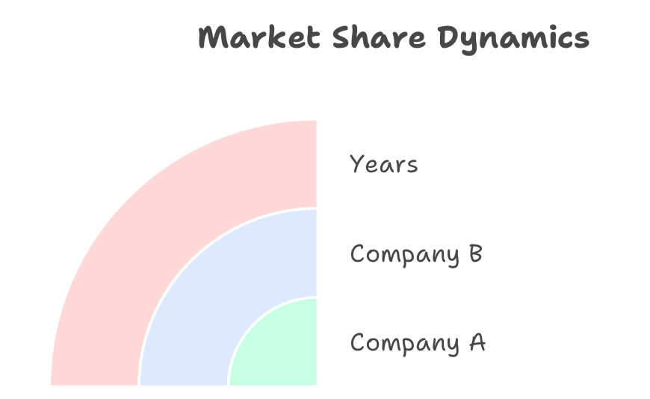
Introduction to Basic Charts

Slide 22
Introduction to Basic Charts
7. Tree Map
Description:
Tree maps display hierarchical data as a set of nested rectangles. The size of each rectangle is proportional to its value.
• Use Cases:
Useful for visualizing hierarchical data, such as sales by region and product category, or website traffic by source and page.
• Example:
To visualize sales by region and product category, you would use a treemap with regions as the main categories and product categories nested within each region

Slide 23
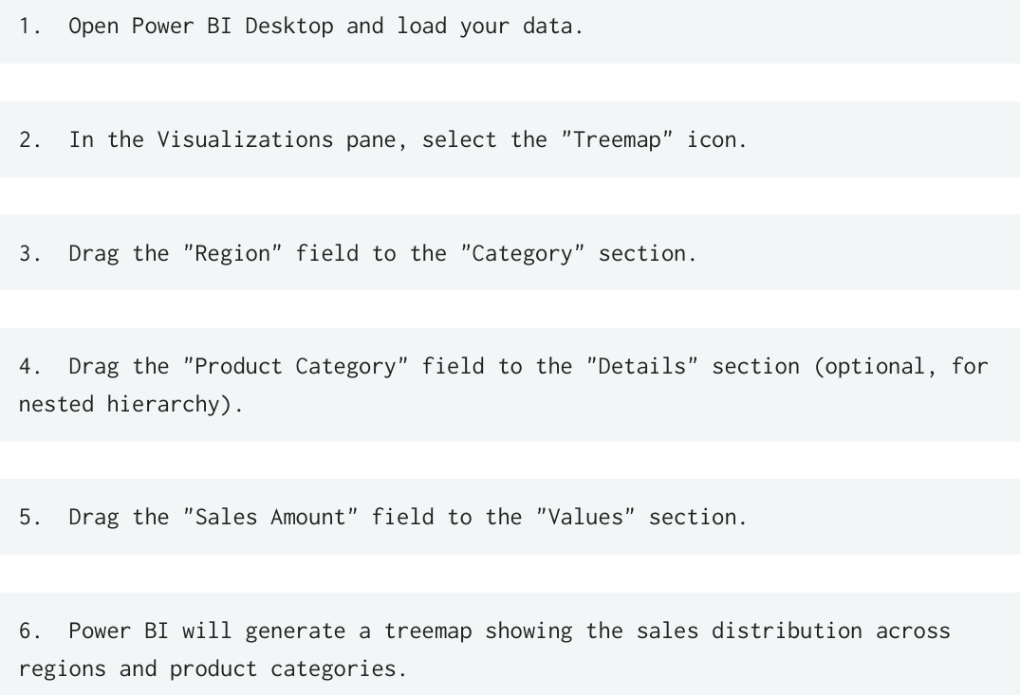
Introduction to Basic Charts

Slide 24
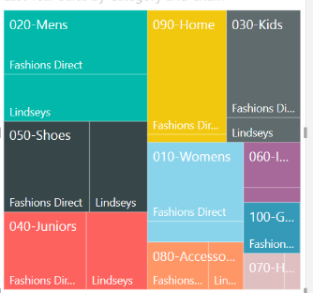
Introduction to Basic Charts

Slide 25
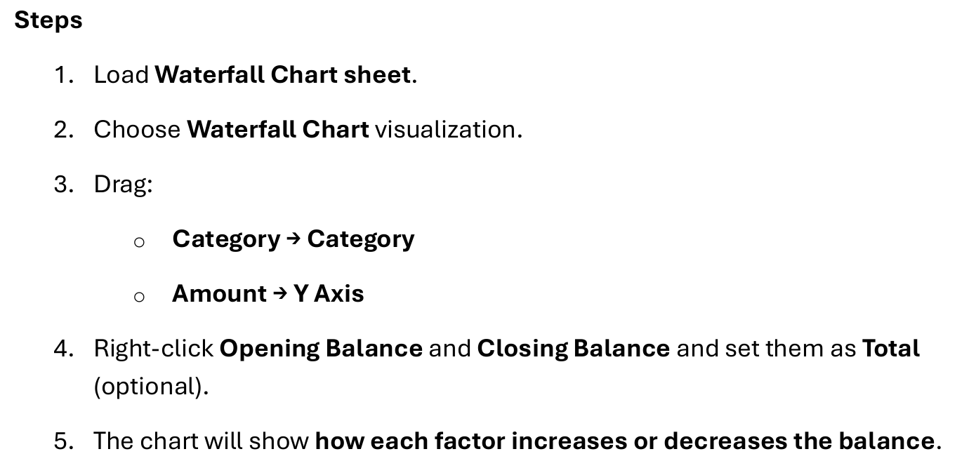
Introduction to Basic Charts
8. Waterfall Chart

Slide 26
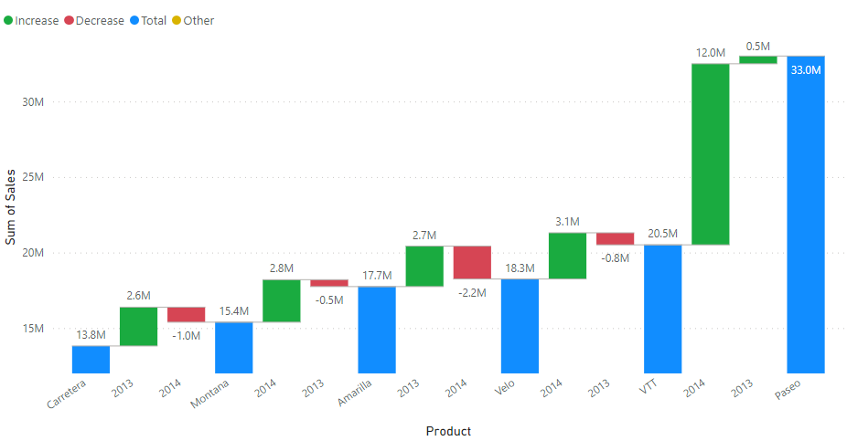
Introduction to Basic Charts
8. Waterfall Chart

Slide 27
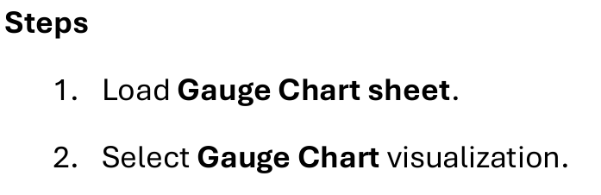
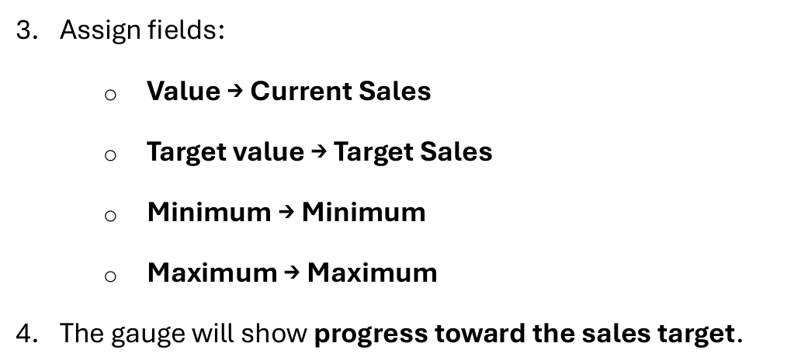
Introduction to Basic Charts
9. Gauge Chart

Slide 28
Unit 4

Slide 29
Slicers in Power BI
Slicers are interactive visual filters that allow users to dynamically filter data within a report.
Unlike filters in the "Filters" pane, slicers are placed directly on the report canvas, providing a more intuitive and user-friendly filtering experience.
Slicers are particularly useful for exploring data and allowing report consumers to customize their view of the data.

Slide 30
Slicers in Power BI
Types of Slicers:
Power BI offers different types of slicers to suit various data types and user preferences:
• List slicer: Displays a list of values to choose from.
• Dropdown slicer: Presents values in a dropdown menu, saving space on the report canvas.
• Date slicer: Allows users to select a date range.
• Relative date slicer: Provides options for filtering data based on relative date ranges (e.g., "last week," "this month").
• Numeric range slicer: Enables users to select a range of numeric values.

Slide 31
Slicers in Power BI
Example of Using Slicers:
Continuing with the sales data example, let's add slicers to the report:
1. Add a slicer for "Product Category": From the "Visualizations" pane, select the "Slicer" visual. Drag the "Product Category" field to the slicer. The slicer will display a list of product categories, allowing users to select one or more categories to filter the data.
2. Add a slicer for "Region": Add another slicer and drag the "Region" field to it. This slicer will allow users to filter the data by region.
3. Add a date slicer: Add a slicer and drag the "Date" field to it. Configure the slicer to display a date range, allowing users to filter the data by a specific time period. Now, users can interact with the slicers to dynamically filter the data and explore different subsets of the sales data.

Slide 32
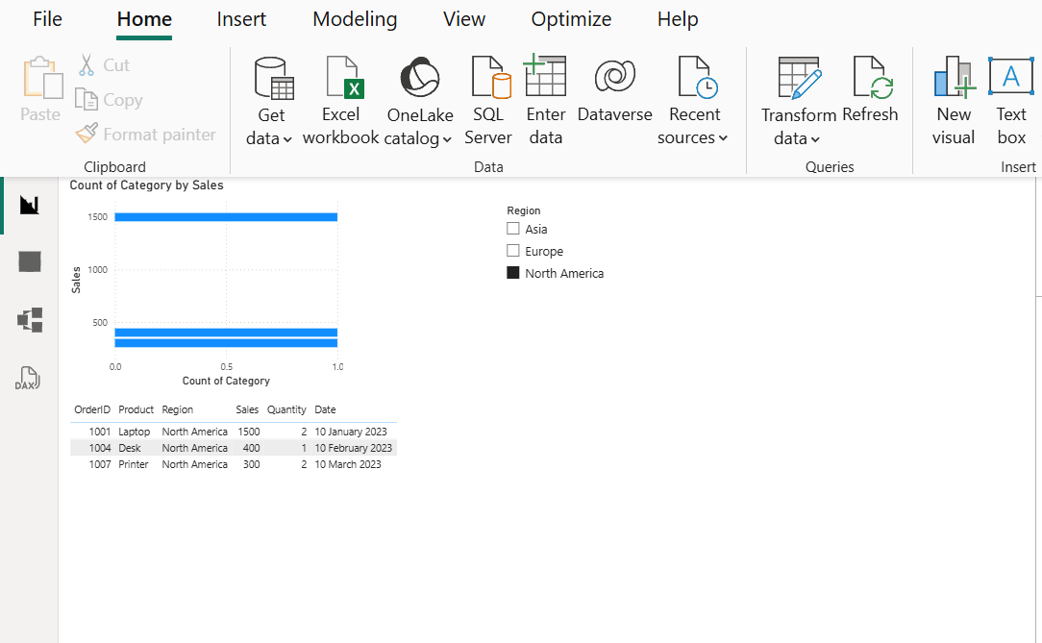
Slicers in Power BI

Slide 33
Filters in Power BI
Types of Filters:
Power BI offers various filter types to cater to different data types and analytical needs:
• Basic filtering: Allows you to select specific values from a list.
• Advanced filtering: Enables you to create more complex filtering conditions using operators like "contains," "starts with," "is blank," etc.
• Top N filtering: Displays only the top or bottom N values based on a specified measure.
• Relative date filtering: Filters data based on a relative date range, such as "last month," "this year," or "next quarter."

Slide 34
Filters in Power BI
Example of Applying Filters:
Let's say you have a dataset containing sales data for different products across various regions. You want to analyze the sales performance of a specific product category in a particular region.
1. Visual-level filter: Select the visual displaying sales data. In the "Filters" pane, locate the "Product Category" field and apply a basic filter to select the desired category (e.g., "Electronics").
2. Page-level filter: To filter all visuals on the page to show only data for a specific region, drag the "Region" field to the "Filters on this page" section and select the desired region (e.g., "North America").
3. Report-level filter: If you want to analyze the data for a specific year across the entire report, drag the "Year" field to the "Filters on all pages" section and select the desired year (e.g., "2023").

Slide 35
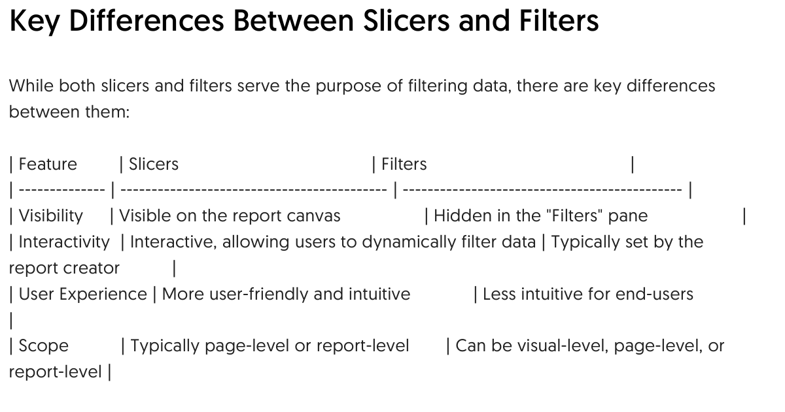
Slicers and Filters in Power BI

Slide 36
Unit 5

