Slide 1

Advanced Tricks with Buttons/Bookmarks in Power BI
Pragati Jain

Slide 2


Thank You to our Sponsors!
Gold:

Slide 3
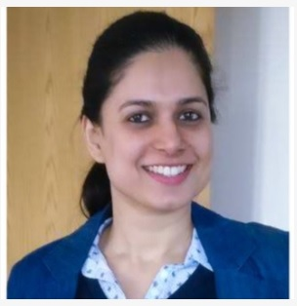



Pragati Jain
Microsoft Data Platform MVP
Superuser at Microsoft Power BI Community
10+ years of industry experience
Senior Data Analyst at Trustpilot, London
Fun Fact About Me:
I am a painter and proudly call myself ‘TechieArtist’ 😊

Slide 4
Agenda (One Slide, All Demo)
The agenda for today’s session covers different scenarios in Power BI using button/bookmarks and make report interaction better from user perspective.
We will use Button/Bookmark to achieve the following functionality in Power BI Desktop:
Toggle between type of charts
Dynamically modify the axis of the chart
Interactive drill-through functionality using buttons
Conditional drill-through functionality using user input
Creating simple Page Navigation using buttons
Conditional page-navigation using user input
Bookmarks Slide-show feature
Modern Visual tooltips (if time permits)

Slide 5
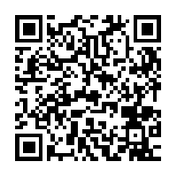






Thank you and Happy to answer any questions!
Scan Me for Feedback

