Slide 1

Credit Card Churn Prediction
Pragati Agrawal
Trainer – Arun Kumar Ganiger
Github - https://github.com/Pragati1200/Credit-Card_Churn_Prediction

Slide 2
Problem Statement
EXL's Credit Card Analytics team is facing declining retention in certain customer segments. To address this, we aim to build a machine learning–based proof of concept that:
Predicts customer churn using behavioral and demographic data
Identifies early warning signs through visual and statistical analysis
Supports proactive retention strategies

Slide 3
Flow
Data Cleaning
EDA
Feature Engineering
ML Models
Evaluation Metrics

Slide 4
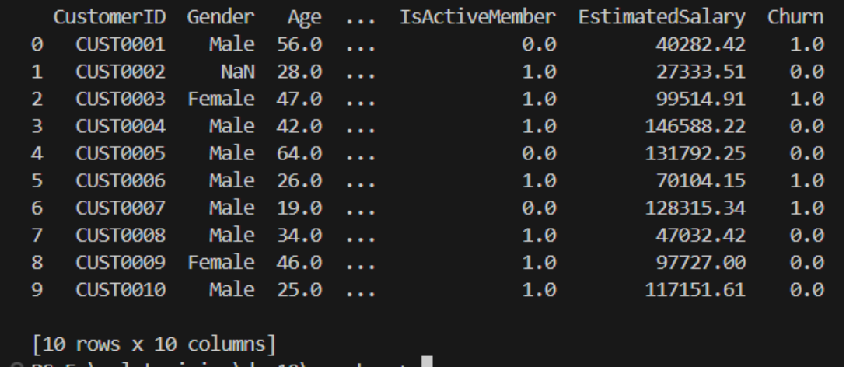
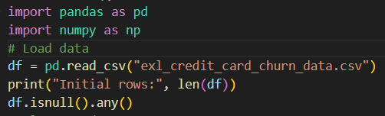
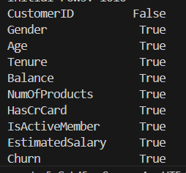
Understanding Data
Initial rows:
Load the data:
NULL Attributes:

Slide 5
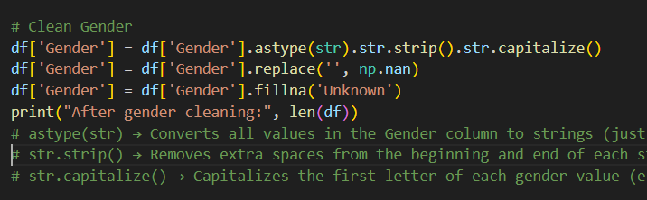
Data Cleaning:
Missing values in Gender, Age, Balance, Churn
Inconsistent case/format in Gender (e.g., "male ", "FEMALE")

Slide 6
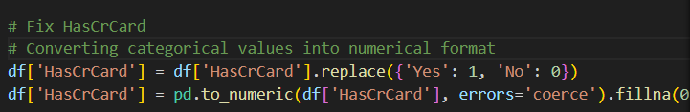
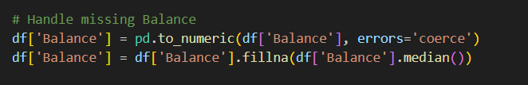
Data Cleaning
Invalid values:
HasCrCard: non-binary like "Yes"
Handling Missing Value

Slide 7
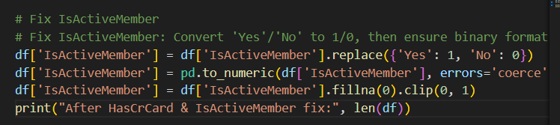
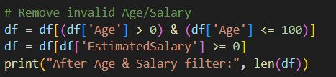
Data Cleaning
IsActiveMember: unexpected values like -1
EstimatedSalary: negative and extreme values

Slide 8
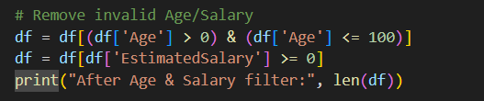
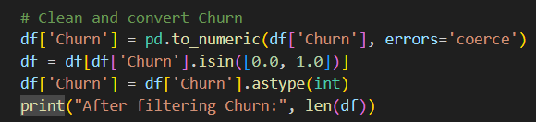
Data Cleaning
Age: negative and excessively high values
Churn: non-binary value "Maybe"

Slide 9



Cleaned Data

Slide 10
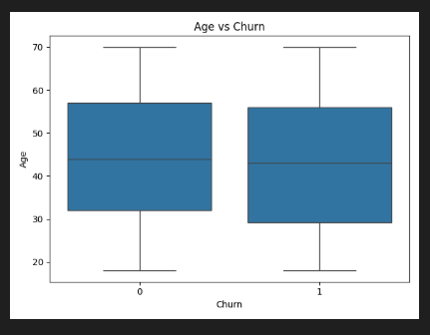
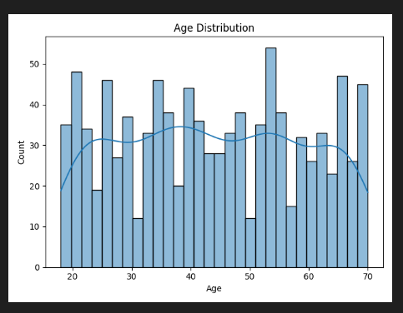
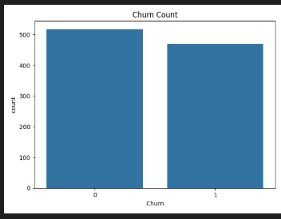
Key Visualisations
Age v/s Churn
Age Distribution
Churn Count

Slide 11
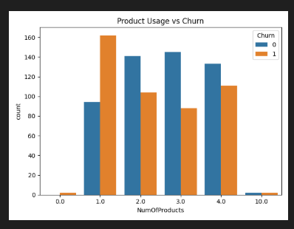
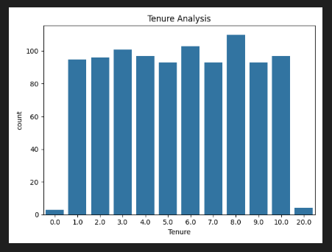
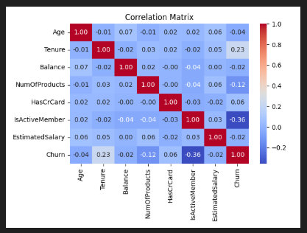
Key Visualisations
Product Usage v/s Churn
Tenure Analysis
Correlation Matrix

Slide 12
Key Insights
Median age is similar for both churners and non-churners.
Churners show a slightly wider spread in age.
Most customers fall between ages 25–65.
Slightly more non-churners (label 0) than churners (label 1).
Indicates moderate churn in the dataset.
Customers with 2 products are the most common churners.
Churn rate declines as number of products increases.
Tenure is mostly evenly distributed, with slight peaks at 5–8 years.
Very few customers at 0 and 20 years.
Churn has moderate positive correlation with Tenure.
Negative correlation with “IsActiveMember” – Inactive members are more likely to churn.

Slide 13
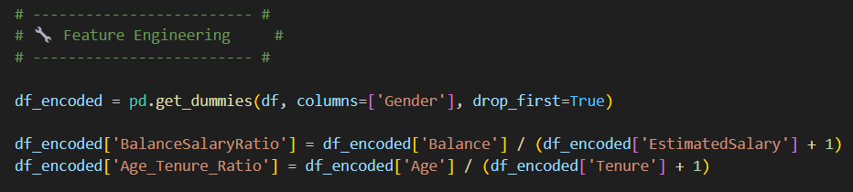
Feature Engineering

Slide 14
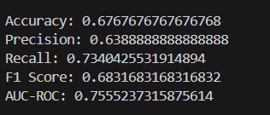
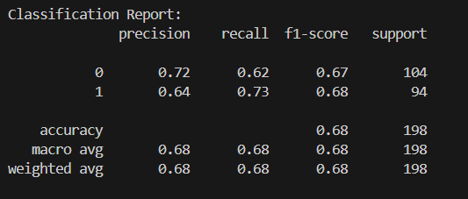
ML Model & Evaluation
Using Random Forest

Slide 15
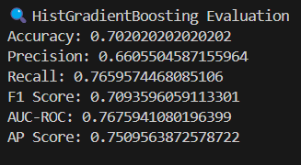
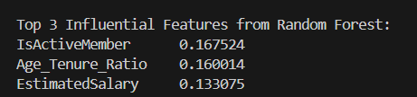
ML Model & Evaluation
HistGradientBoosting

Slide 16
Future Scope
Feedback Loop for Model Retraining
Anomaly Detection for Suspicious Behaviour
Privacy Preserving ML Techniques

Slide 17
THANK YOU !!
Any Questions??

