Slide 1

Chinook Project
By Pragati Kabra

Slide 2

Agenda
Problem Statement
Data Description
Objective Key Metrics and Visualizations
Subjective Question for Insights

Slide 3

PROJECT DESCRIPTION
To analyse music record sales data to gain insights and make recommendations for the company's strategy in the physical music market.

Slide 4
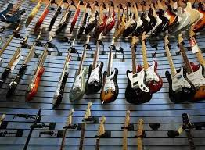


Chinook Music Store
Chinook Music simulates a digital music store where users can easily browse and purchase tracks and albums.
It offers a diverse music library spanning multiple genres, helping users discover both mainstream and niche tracks.
With personalized recommendations tailored to user preferences, Chinook enhances music discovery and builds customer loyalty.

Slide 5
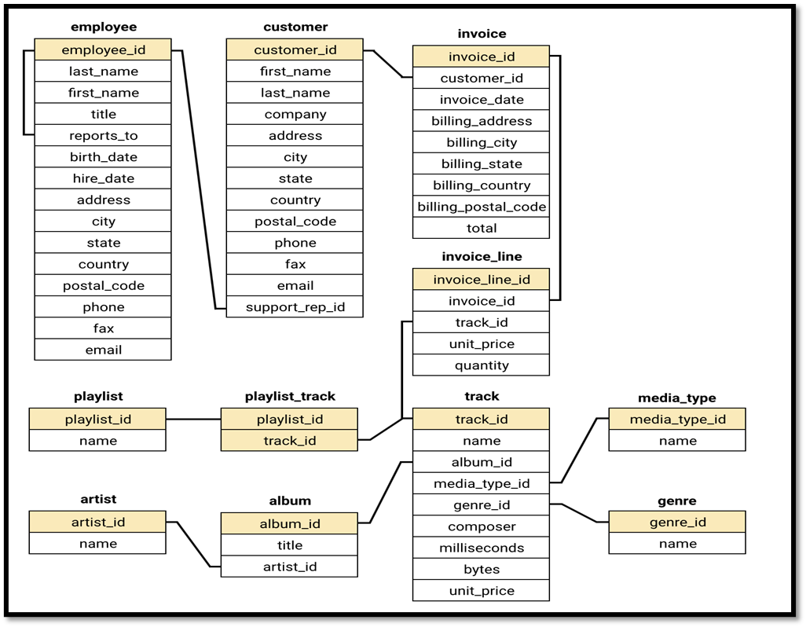
Database Schema

Slide 6
DATA OVERVIEW
customer
customer_id: Unique identifier assigned to each customer.
first_name: The given name or first name of a customer.
last_name: The surname or family name of a customer.
company: The name of the company associated with a customer.
address: The street address of a customer's location.
city: The city where a customer is located.
state: The state or province where a customer is located.
country: The country where a customer is located.
postal_code: The postal or zip code of a customer's address.
phone: The phone number of a customer.
fax: The fax number associated with a customer.
email: The email address of a customer.
support_rep_id: The employee ID of the support representative assigned to a customer.
invoice
invoice_id: Unique identifier assigned to each invoice.
customer_id: The customer ID associated with the invoice.
invoice_date: The date when the invoice was generated or issued.
billing_address: The street address used for billing purposes.
billing_city: The city used for billing purposes.
billing_state: The state or province used for billing purposes.
billing_country: The country used for billing purposes.
billing_postal_code: The postal or zip code used for billing purposes.
total: The total amount due on the invoice.

Slide 7
invoice
invoice_id: Unique identifier assigned to each invoice.
customer_id: The customer ID associated with the invoice.
invoice_date: The date when the invoice was generated or issued.
billing_address: The street address used for billing purposes.
billing_city: The city used for billing purposes.
billing_state: The state or province used for billing purposes.
billing_country: The country used for billing purposes.
billing_postal_code: The postal or zip code used for billing purposes.
total: The total amount due on the invoice.
invoice_line
invoice_line_id: Unique identifier assigned to each line item on an invoice.
invoice_id: The invoice ID to which the line item belongs.
track_id: The ID of the track or product included in the line item.
unit_price: The price per unit for the line item.
quantity: The quantity of units for the line item.
playlist
playlist_id: Unique identifier assigned to each playlist.
name: The name or title of the playlist.
playlist_track
playlist_id: The ID of the playlist to which the track belongs.
track_id: The ID of the track included in the playlist.
unit_price: The price per unit for the track.

Slide 8
album
album_id: Unique identifier assigned to each album.
title: The title or name of the album.
artist_id: The ID of the artist associated with the album.
artist
artist_id: Unique identifier assigned to each artist.
name: The name of the artist.
track
track_id: Unique identifier assigned to each track or song.
name: The title or name of the track.
album_id: The ID of the album to which the track belongs.
media_type_id: The ID of the media type associated with the track.
genre_id: The ID of the genre associated with the track.
composer: The name of the composer or artist who composed the track.
milliseconds: The duration of the track in milliseconds.
bytes: The file size of the track in bytes.
unit_price: The price per unit for the track.
media_type
media_type_id: Unique identifier assigned to each media type.
name: The name or description of the media type (e.g., MPEG audio file, AAC audio file).
genre
genre_id: Unique identifier assigned to each genre.
name: The name or description of the genre (e.g., rock, pop, classical).

Slide 9

DATA CLEANING AND PROCESSING
Null check implementation: Conducted targeted SQL queries on core tables (employee, customer, and track) to identify missing data in essential fields.
Default value substitution: Applied the COALESCE function to replace nulls with relevant defaults such as "N/A" for company and "Unknown" for state, promoting data completeness in the customer table.
Ensuring data integrity: Reviewed all tables for duplicate records in primary key columns to uphold the reliability and uniqueness of the data.
Enhancing dataset quality: Addressed missing values without modifying original records, preserving the dataset’s structure and improving its usability for future analysis.

Slide 10
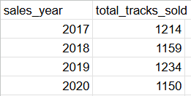
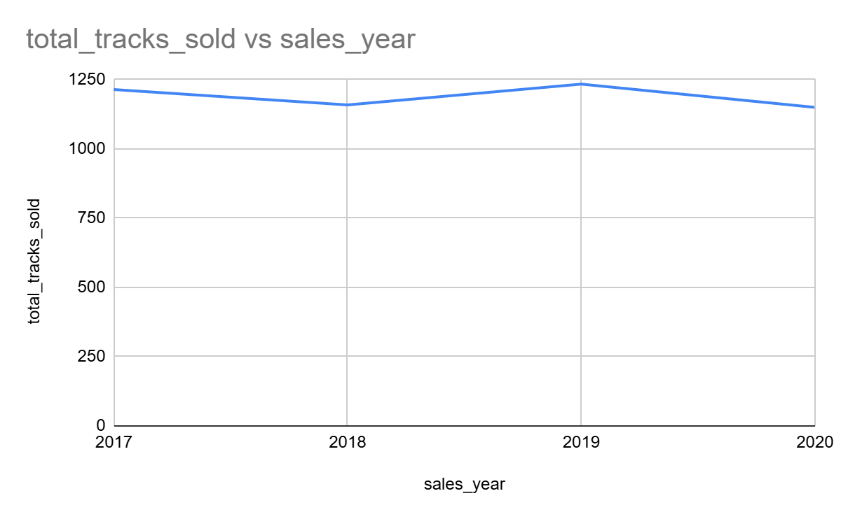
Yearly track sales analysis
Stable Demand Across Years Track sales remained relatively stable from 2017 to 2020, fluctuating between 1150 and 1234 units annually, indicating a consistent customer base and sustained interest in music purchases.
2019 Peak in Sales The highest track sales occurred in 2019 with 1234 units, suggesting a successful year possibly driven by popular releases, effective promotions, or increased customer activity.
Sales Dip in 2020 There was a drop to 1150 units in 2020, the lowest in four years. This could point to external disruptions (e.g., global events), a shift to streaming platforms, or reduced marketing efforts during that period.

Slide 11
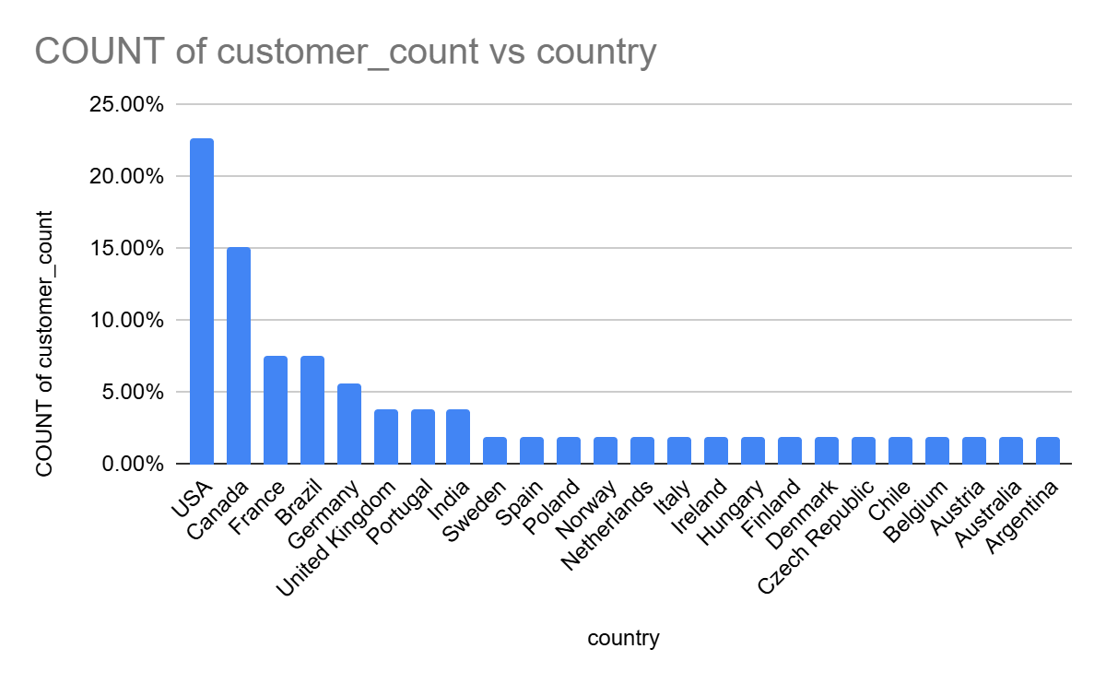
Percentage of customers across countries
USA dominates the customer base, contributing over 22% of all customers, followed by Canada (15%) and France & Brazil (7.5% each), indicating strong North and South American presence.
Europe is highly diversified, with many countries (Germany, UK, Portugal, etc.) each contributing between 1.8% to 5.6%, showing a broad but shallow European market.
The long tail of countries with low individual percentages suggests potential for global growth but indicates that marketing efforts may need to be more localized to convert scattered audiences

Slide 12
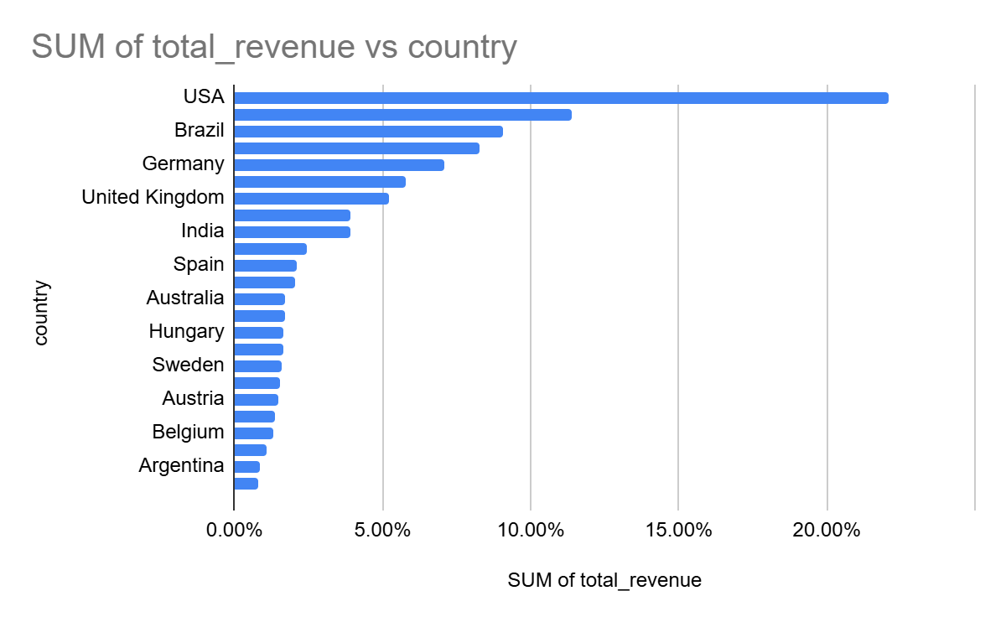
Percentage of total revenue across countries
USA leads in revenue, contributing over 22% of total sales, followed by Canada (11%) and Brazil (9%), showing strong North and South American markets.
European countries like France, Germany, and the Czech Republic collectively contribute a significant share, highlighting a diverse but valuable European customer base.
The revenue share gradually tapers off beyond the top 10 countries, indicating a long tail of countries generating smaller individual revenues but offering potential for targeted growth.

Slide 13
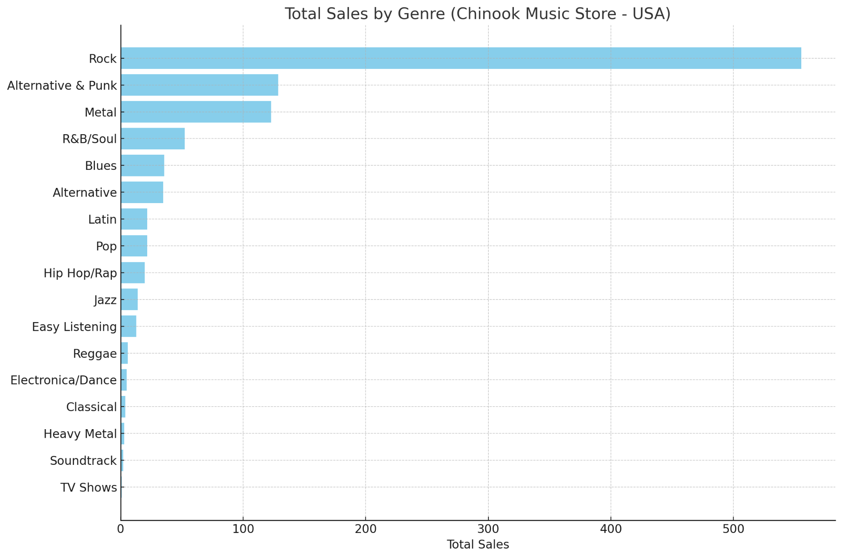
TOTAL SALES BY GENRE
Rock dominates sales, contributing the highest amount with a total of $555.39—far exceeding all other genres.
Alternative & Punk and Metal follow, but their combined sales are still less than half of Rock's total.
Genres like TV Shows, Soundtrack, and Heavy Metal have minimal sales, indicating low customer interest or limited inventory in those categories.

Slide 14
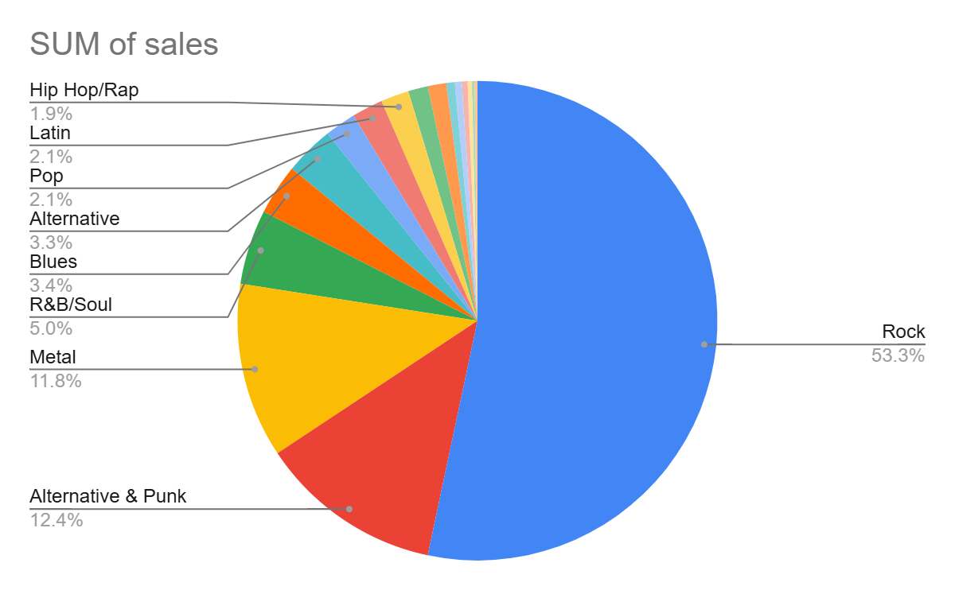
GENRE SALE PERCENTAGE
Rock dominates the U.S. market, contributing over 53% of total music sales, which is significantly higher than any other genre—indicating strong consumer preference.
Alternative & Punk and Metal follow distantly, making up around 12% and 11.8% respectively, showing that heavier and alternative music styles have solid but niche audiences.
Genres like Classical, Heavy Metal, and Soundtrack contribute less than 1% each, suggesting low demand or limited catalog availability in those segments.

Slide 15
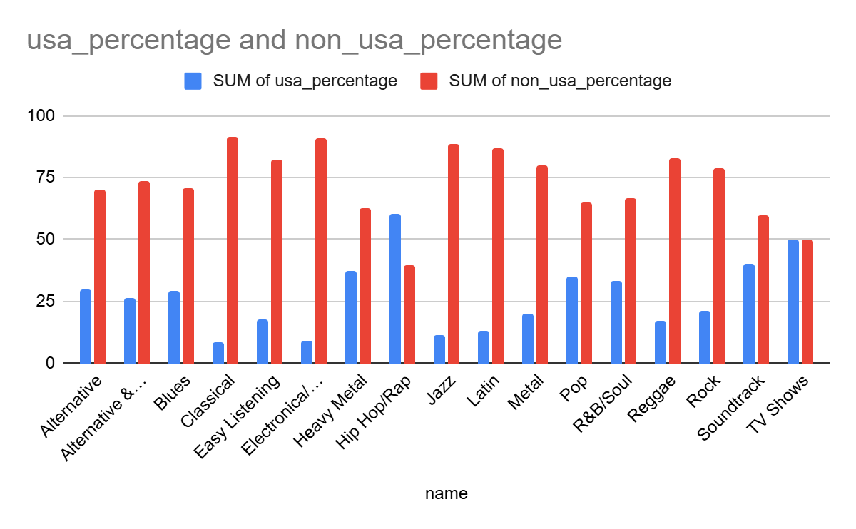
TOP SELLING GENRES PERCENTAGE IN USA AND OTHER COUNTRIES
Strong Presence of Non-USA Sales: Genres like "Classical" (91.49%), "Electronica/Dance" (90.91%), and "Jazz" (88.43%) show a much higher percentage of sales outside the USA. This suggests these genres might have a more global fanbase and are particularly popular in countries other than the USA.
Genres with Balanced Sales: Some genres, such as "Soundtrack" (50%) and "TV Shows" (50%), have an equal split between USA and non-USA sales. This indicates that these genres may appeal equally to both domestic and international markets.
USA-Dominated Genres: On the other hand, genres like "Hip Hop/Rap" (60.61%) and "Heavy Metal" (37.5%) have a significant share of sales from the USA, highlighting that these genres are particularly popular among American listeners compared to other regions.

Slide 16
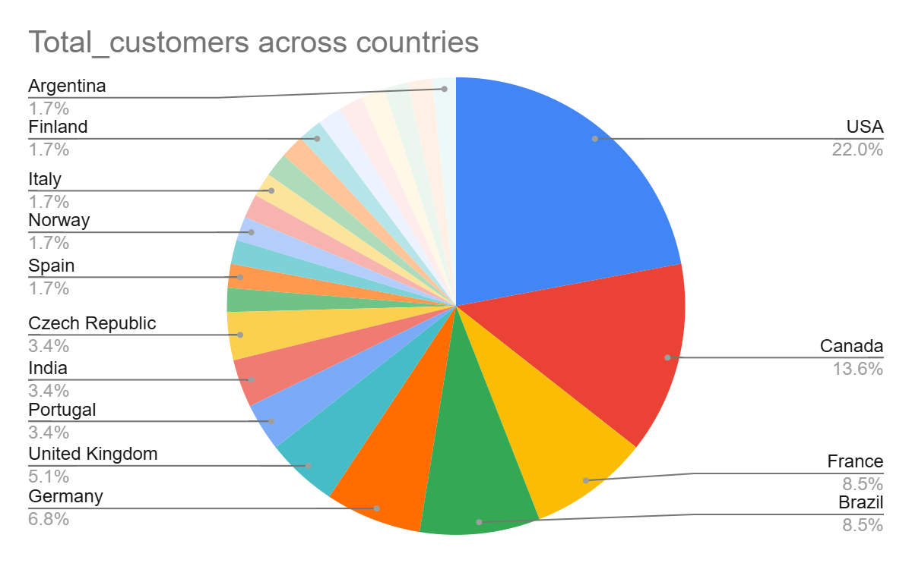
PERCENTAGE OF CUSTOMER ACROSS COUNTRIES
Top Markets: The USA, Canada, France, Brazil, and Germany collectively account for 58.91% of the total customer base. These regions are key markets, and focusing marketing and sales efforts here could yield significant returns.
Emerging Markets: Countries like India, Portugal, and the Czech Republic, while smaller in terms of customer share (around 3.39% each), may show growth potential. It might be worth considering local strategies to capture a higher share in these emerging markets.
Niche or Low-Share Markets: A large number of countries (such as Sweden, Spain, Poland, and others) each represent 1.69% of the customer base. While these markets individually have lower customer shares, collectively they represent a diverse customer segment that may offer valuable insights for regional diversification or tailored offerings.

Slide 17
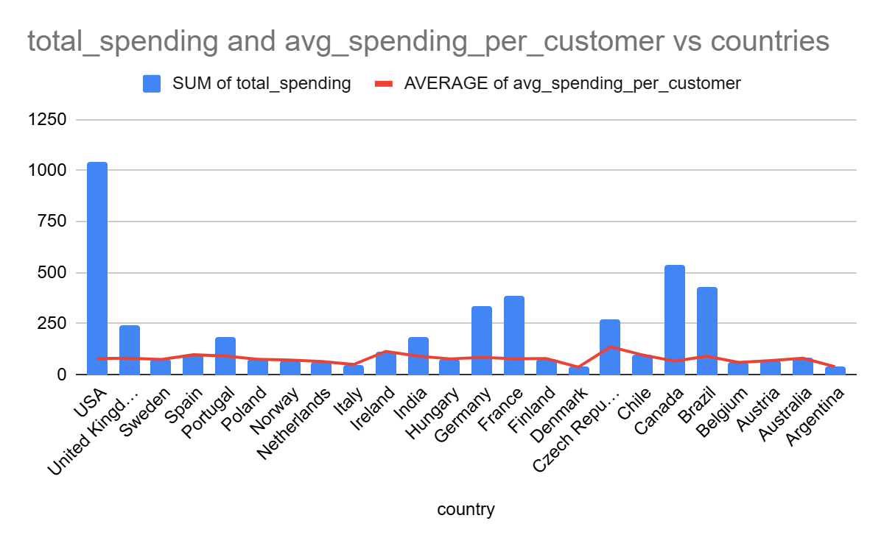
TOTAL SPENDING AND AVERAGE SPENDING VS COUNTRY
High-Value Markets: The USA, United Kingdom, Germany, and France stand out with the highest total spending, particularly the USA, which has a significant lead ($1040.49). These markets not only have large customer bases but also exhibit high total spending, indicating a strong purchasing power and potential for future growth.
Efficient Spend in Smaller Markets: Countries like the Czech Republic, Ireland, and Portugal show high average spending per customer (e.g., Czech Republic at $136.62 and Ireland at $114.84), despite having a smaller customer base. This suggests that while these markets are smaller, customers are willing to spend more on average, making them potentially lucrative for targeted marketing.
Lower Spending in Some Countries: Countries like Denmark, Austria, and Argentina show lower total spending and average spend per customer. These markets might require tailored strategies to increase customer engagement and boost spending, possibly through promotions or expanding product offerings.

Slide 18
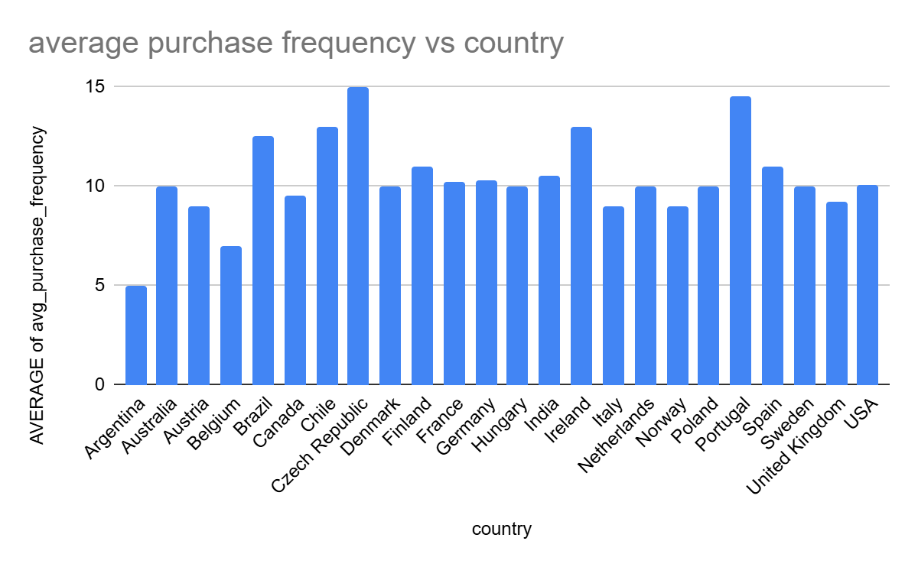
AVERAGE PURCHASE FREQUENCY VS COUNTRY
High-Value Markets: The USA, United Kingdom, Germany, and France stand out with the highest total spending, particularly the USA, which has a significant lead ($1040.49). These markets not only have large customer bases but also exhibit high total spending, indicating a strong purchasing power and potential for future growth.
Efficient Spend in Smaller Markets: Countries like the Czech Republic, Ireland, and Portugal show high average spending per customer (e.g., Czech Republic at $136.62 and Ireland at $114.84), despite having a smaller customer base. This suggests that while these markets are smaller, customers are willing to spend more on average, making them potentially lucrative for targeted marketing.
Lower Spending in Some Countries: Countries like Denmark, Austria, and Argentina show lower total spending and average spend per customer. These markets might require tailored strategies to increase customer engagement and boost spending, possibly through promotions or expanding product offerings.

Slide 19
AVERAGE PURCHASE FREQUENCY VS COUNTRY
High-Value Markets: The USA, United Kingdom, Germany, and France stand out with the highest total spending, particularly the USA, which has a significant lead ($1040.49). These markets not only have large customer bases but also exhibit high total spending, indicating a strong purchasing power and potential for future growth.
Efficient Spend in Smaller Markets: Countries like the Czech Republic, Ireland, and Portugal show high average spending per customer (e.g., Czech Republic at $136.62 and Ireland at $114.84), despite having a smaller customer base. This suggests that while these markets are smaller, customers are willing to spend more on average, making them potentially lucrative for targeted marketing.
Lower Spending in Some Countries: Countries like Denmark, Austria, and Argentina show lower total spending and average spend per customer. These markets might require tailored strategies to increase customer engagement and boost spending, possibly through promotions or expanding product offerings.

Slide 20
INSIGHTS ON INCREASING SALES
1. 2019 Sales Peak- Sales peaked in 2019 (1,234 tracks), indicating successful campaigns. Similar tactics can be reused for future boosts.
2. Rock Genre Focus- Rock dominates with 53% of sales. Prioritize promoting rock albums and artists to maximize returns.
3. Artist Opportunity- Jimi Hendrix leads with 2,624 sales. Re-releases or exclusive content could drive more engagement.
4. Key Regional Markets- USA, Canada, and Brazil are top-performing markets. Localized promotions can further strengthen sales.
5. Format Demand- MPEG files lead with 42,934 sales. Focus on this format while exploring why video/protected formats lag.
6. Untapped Regions- Explore opportunities in underperforming European and Asian markets through targeted campaigns.
7. Seasonal Campaigns- Review monthly/seasonal sales trends to time promotions when purchase activity peaks.
8. Bundle Offers & Discounts- Test bundle pricing and discount strategies during slow periods to increase volume.
9. Customer Segmentation- Use buying patterns to segment users (e.g., genre or artist loyalty) and tailor marketing.
10. Data-Driven Releases- Base release timing and pricing on historical sales data to optimize launch performance.

Slide 21

CONCLUSION
In conclusion, the music sales data reveals key opportunities for growth through genre focus, artist promotion, and market-specific strategies. Rock and MPEG formats show the strongest demand, while 2019 marks a benchmark year for campaign success. Targeted efforts in high-performing regions like the USA and emerging ones like Europe can enhance reach. Leveraging data-driven insights and seasonal trends will help optimize future sales strategies.

Slide 22


