Slide 1

IBM University Engagement Project Submission
“Exploring the Power of Agentic AI with IBM Cloud”

Slide 2


AI-POWERED RECIPE PREPARATION AGENT
Domain of Project – [Food & Healthcare ]
Student Name | Recent Passport Photo | Email ID | Mobile number [WhatsApp]
Pragati Choudhary |  | pragatichoudhary2005@gmail.com | 6202913263

Slide 3
Problem Statement -
Problem Statement : Recipe Preparation Agent
The Challenge
Many people find it difficult to decide what to cook using the ingredients they already have. Beginners often need clear cooking instructions, and people with dietary restrictions struggle to find suitable recipes. Searching multiple websites is time-consuming and often gives inconsistent information.
The Objective
Develop an AI-powered Recipe Preparation Agent that helps users prepare meals by providing personalized recipe suggestions, ingredient substitutions, step-by-step cooking instructions, cooking tips, and nutritional information.
The solution should:
Suggest recipes based on available ingredients.
Provide step-by-step cooking instructions.
Recommend ingredient substitutes.
Generate recipes according to dietary preferences (vegetarian, vegan, diabetic, gluten-free, etc.).
Estimate cooking time.
Provide nutritional information.
Generate a shopping list for missing ingredients.

Slide 4

Proposed Solution -
The proposed solution is an AI-powered Recipe Preparation Agent developed using IBM Granite Models, and watsonx.ai.
The system uses Retrieval-Augmented Generation (RAG) to retrieve reliable recipe information from trusted cooking databases.
The Recipe Agent contains four intelligent agents:
1. Recipe Recommendation Agent
Suggests recipes based on ingredients available with the user.
2. Cooking Instruction Agent
Provides detailed step-by-step cooking instructions.
3. Ingredient Substitute Agent
Suggests suitable alternatives for unavailable ingredients.
4. Nutrition & Health Agent
Calculates calories and recommends healthier recipe options.
The system can also generate shopping lists and personalize recipes according to user preferences.

Slide 5

Technology Used
IBM watsonx.ai
IBM Granite 3.2 / Granite 4.0
Retrieval Augmented Generation (RAG)
IBM Cloud
Python

Slide 6
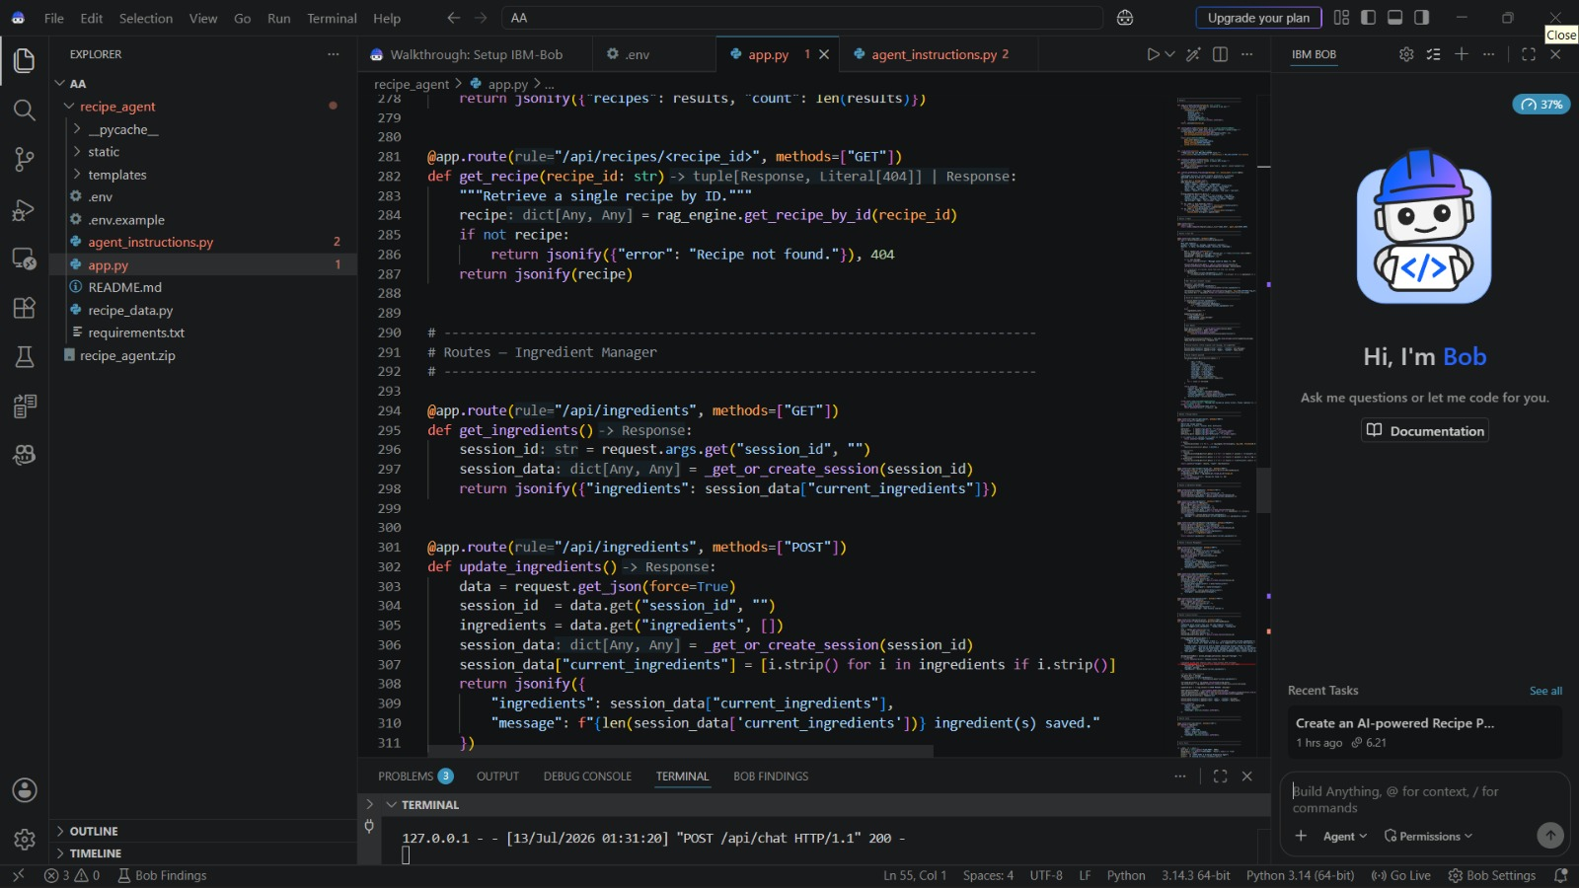
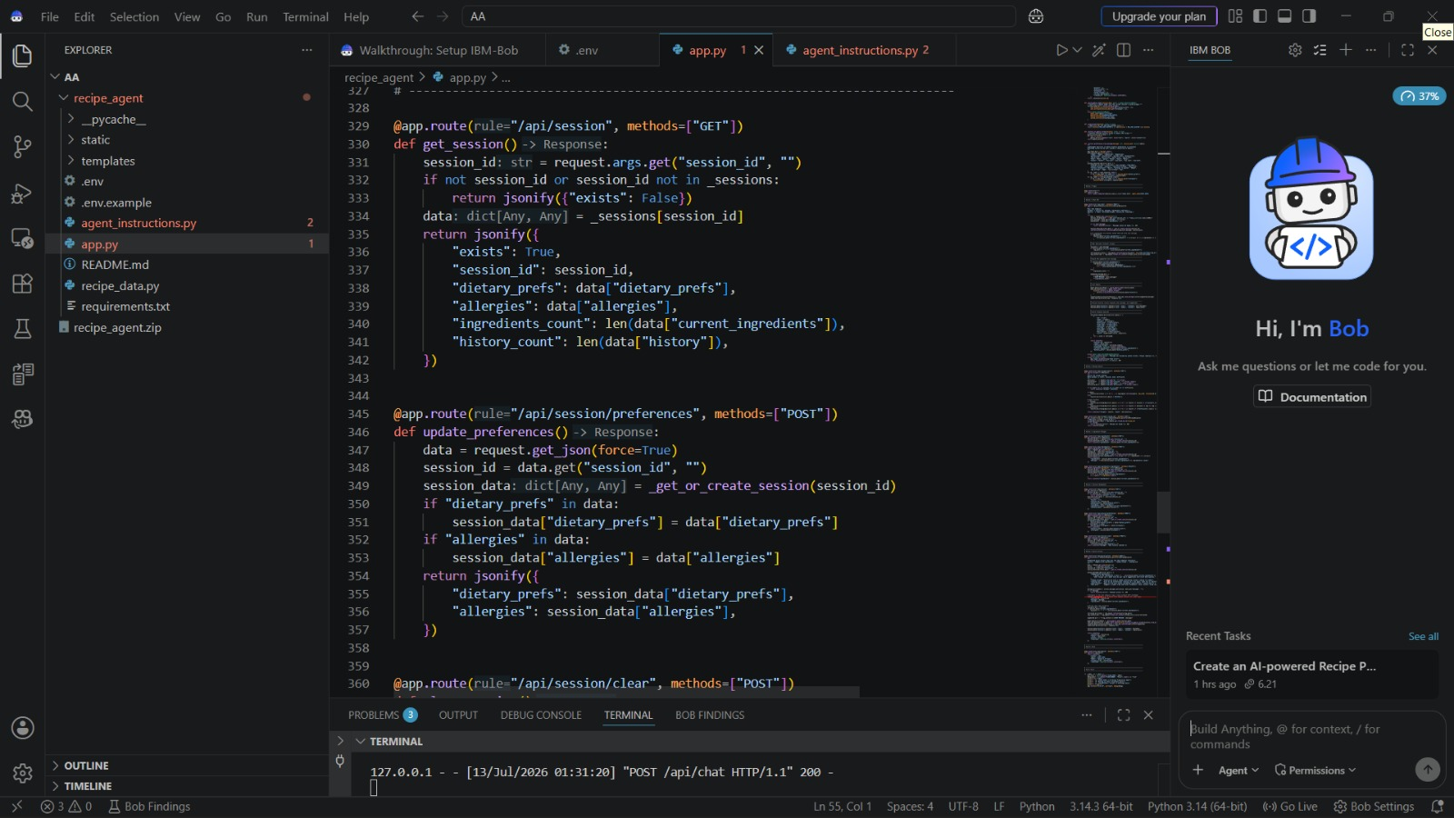
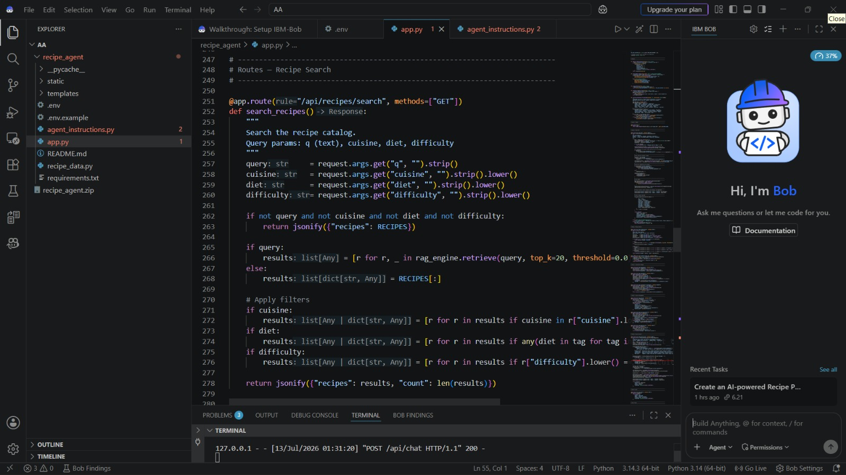
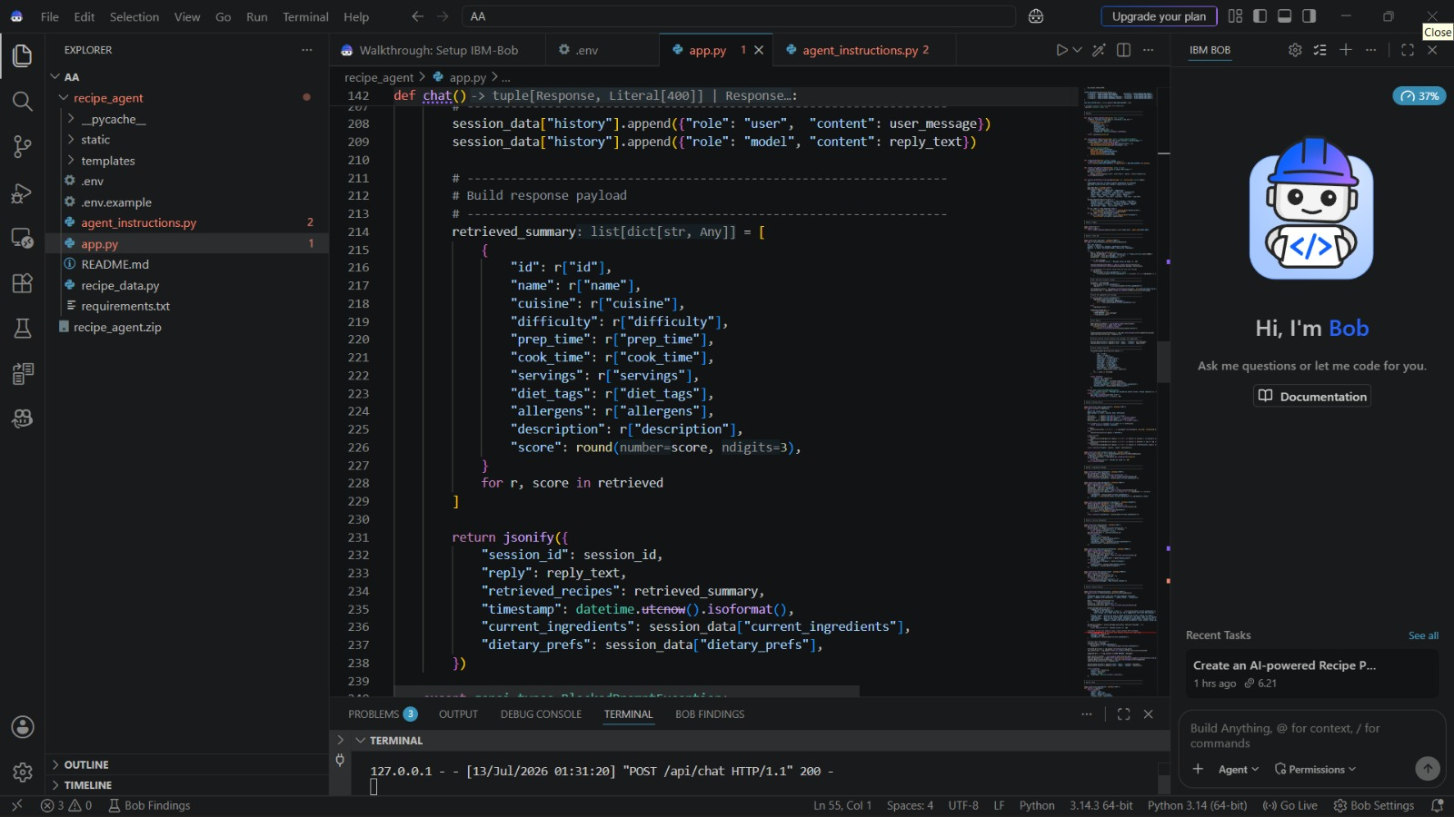

Slide 7
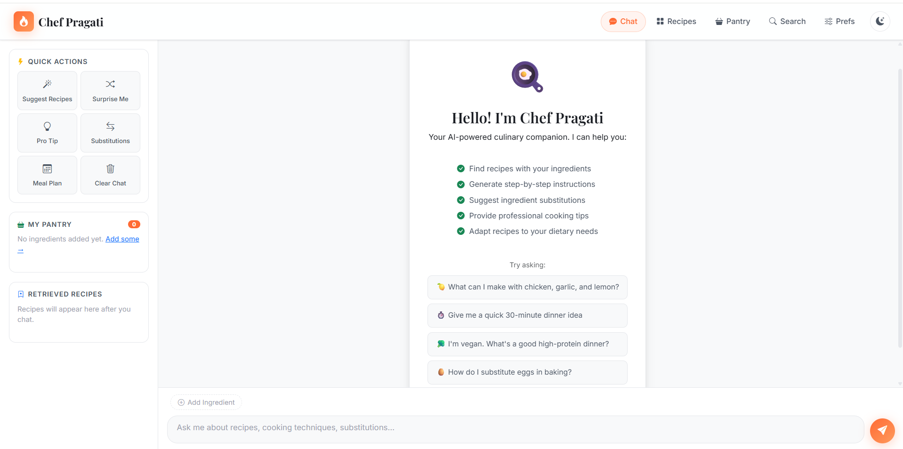
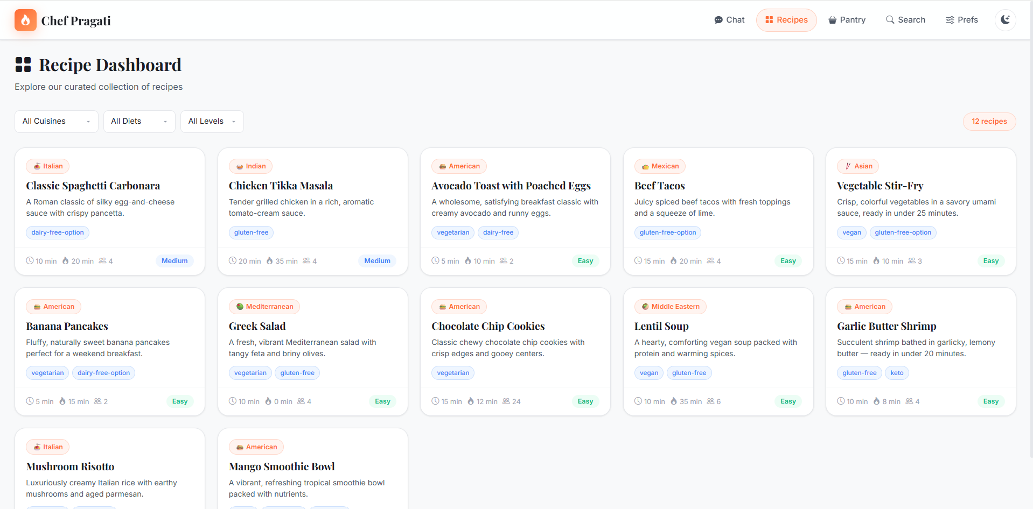
OUTPUT:-

Slide 8
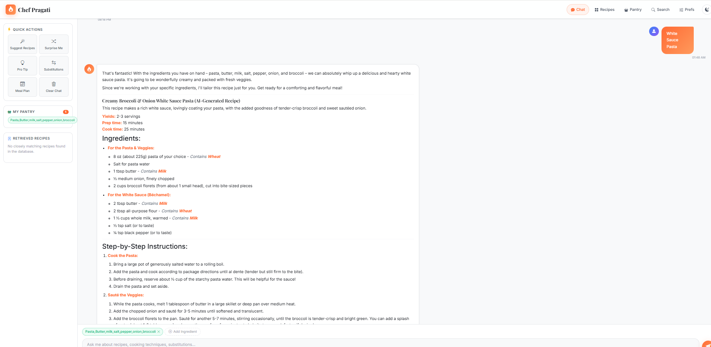
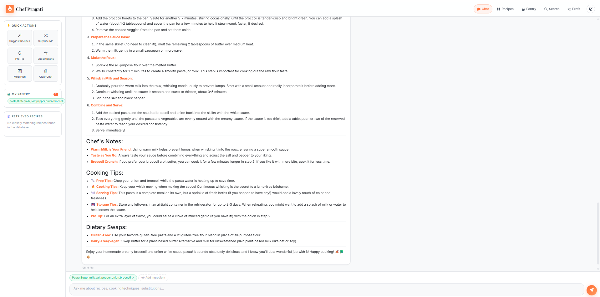

Slide 9

Role of Agentic AI in the solution
Agentic AI enables the Recipe Preparation Agent to function as an autonomous and intelligent cooking assistant. Instead of relying on a single AI model, it uses multiple specialized agents that work together to solve different aspects of the user's request.
Each agent is responsible for a specific task:
Recipe Recommendation Agent – Suggests recipes based on available ingredients, cuisine, and dietary preferences.
Cooking Guidance Agent – Provides clear, step-by-step cooking instructions and helpful cooking tips.
Ingredient Substitution Agent – Recommends suitable alternatives when certain ingredients are unavailable.
Nutrition Analysis Agent – Calculates nutritional values, calorie information, and suggests healthier meal options.
Shopping List Agent – Generates a list of missing ingredients required for the selected recipe.
By collaborating and sharing information, these agents deliver accurate, personalized, context-aware, and efficient cooking assistance, making meal preparation easier, faster, and more convenient for users of all skill levels.

Slide 10

Novelty and Uniqueness
Multi-Agent AI Architecture – Multiple AI agents work together to perform specialized tasks.
Personalized Recipe Generation – Suggests recipes based on user preferences and available ingredients.
Ingredient Substitution – Recommends suitable alternatives for missing ingredients.
RAG-Based Recipe Retrieval – Retrieves accurate recipes from a trusted knowledge base.
Shopping List Generation – Creates a list of missing ingredients automatically.
Nutrition Analysis – Provides calorie and nutritional information for recipes.
Diet-Specific Recipes – Supports vegetarian, vegan, gluten-free, and other dietary needs.
Beginner-Friendly Cooking Guidance – Offers simple, step-by-step cooking instructions.

Slide 11
Git Hub Link
GIT HUB LINK FOR RECIPE-PREPARATION-AGENT
·
·
·

Slide 12
Future Scope
Voice-enabled cooking assistant
Image-based ingredient recognition
Smart kitchen integration (IoT)
Regional language support
Recipe generation from refrigerator images
Meal planning for a week Integration with food delivery apps
·
·
·

Slide 13

Certificates Earned:
Journey To Cloud Certificate-

Slide 14

Certificate of Artificial Intelligence-

Slide 15
CyberSecurity Certificate-

Slide 16

Cybersecurity with Generative AI Certificate-

Slide 17
Certificates Earned:​
IBM BOB Certificate

Slide 18
Exploring Quantum Computing Certificate-

Slide 19



