Slide 1


Ministry Name: Ministry of Petroleum and Natural Gas Problem Statement: Technological advances for Retail Outlets Team Name: IoCrazoN Team Leader: Ms Pragati Chauhan College Code: 1-3512790486
Problem Category: Software
PS Number: AJ129
Problem Category: Hardware
PS Number: #AJ130

Slide 2

Problem Statement:
A software has to be developed for Dispensing Unit of petrol pump, which convey the customer about the actual quantity of product delivered after fuelling. Similarly about the quality of product.
Tagged under Software
but requires hardware

Slide 3
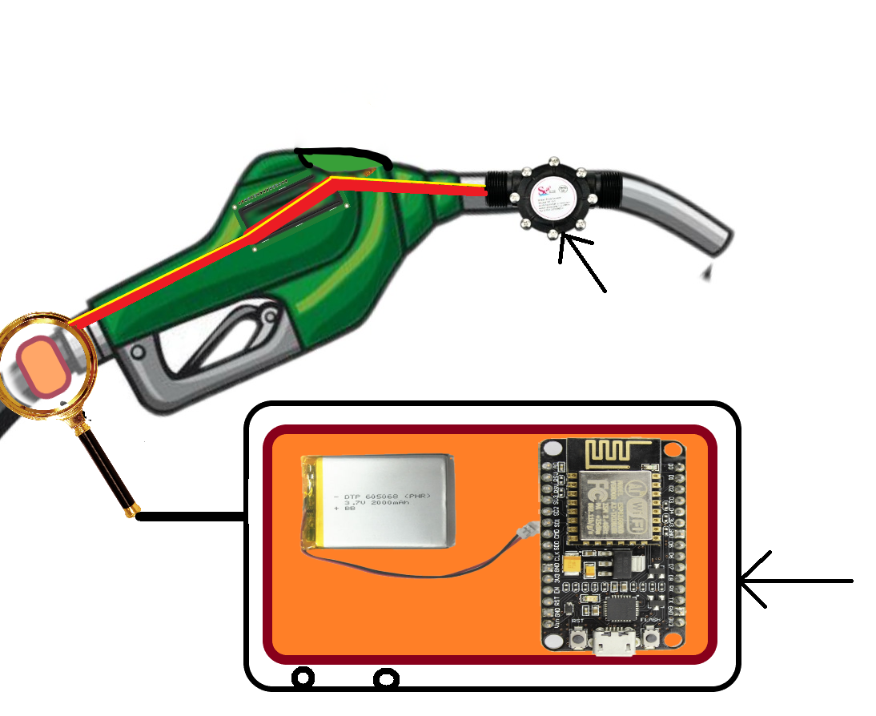
For Quantity Measurement
Flow Rate Sensor
NodeMCU+
Battery

Slide 4
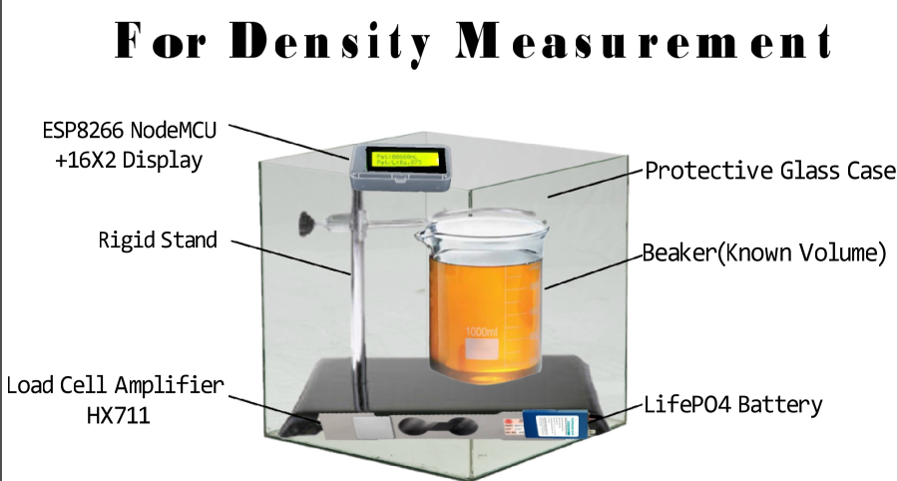

Slide 5


Slide 6
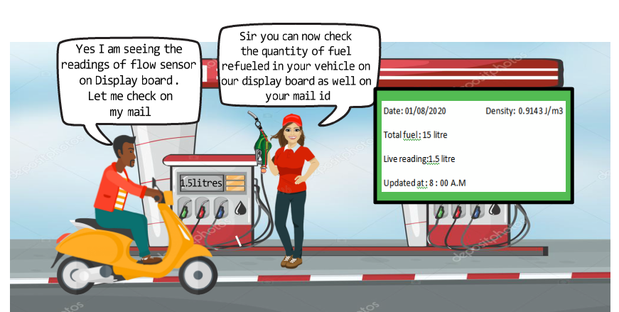

Slide 7
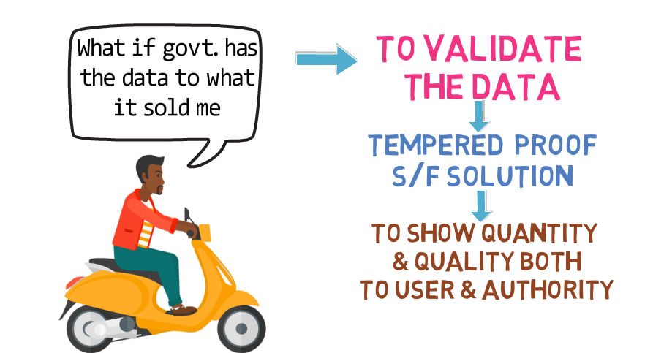

Slide 8
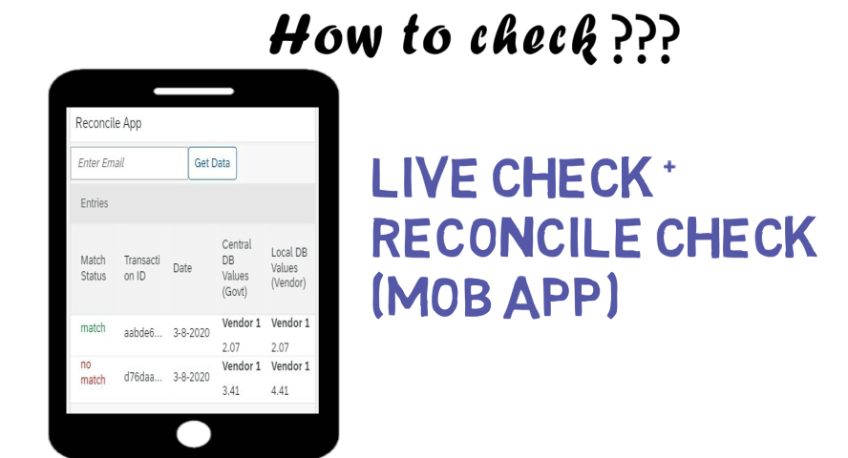

Slide 9
POC aRCHITECTURE
Hardware Setup Output
Transaction Id
Once Confirmation
Local Server
Python {App Runtime}
SMTP
Local DB
Server of Central Authority-
Dynamo db
Customer Email Id
Real time data processing & Display

