Slide 1



URBAN SMART LOGISTICS
AND
DELIVERY SYSTEM
PROJECT FOR DAMG6210 - DATA MANAGEMENT AND DATABASE DESIGN
UNDER THE GUIDANCE OF PROF. MANUEL D MONTROND
GROUP 3:
PRAGATI NAROTE
RUTUJA DHATRAK
DEEPIKA VADDADI
SAMRUDDHI SAWANT
TAPAS DESAI

Slide 2


INTRODUCTION
The project implements a centralized database-driven platform designed to optimize urban logistics by managing customers, delivery schedules, smart lockers, and prescriptions with secure authentication and route efficiency.
Featuring normalized database structures, advanced encryption for sensitive data, and optimized indexing, the system ensures secure, scalable, and real-time management of urban deliveries, reducing congestion and enhancing user convenience.

Slide 3

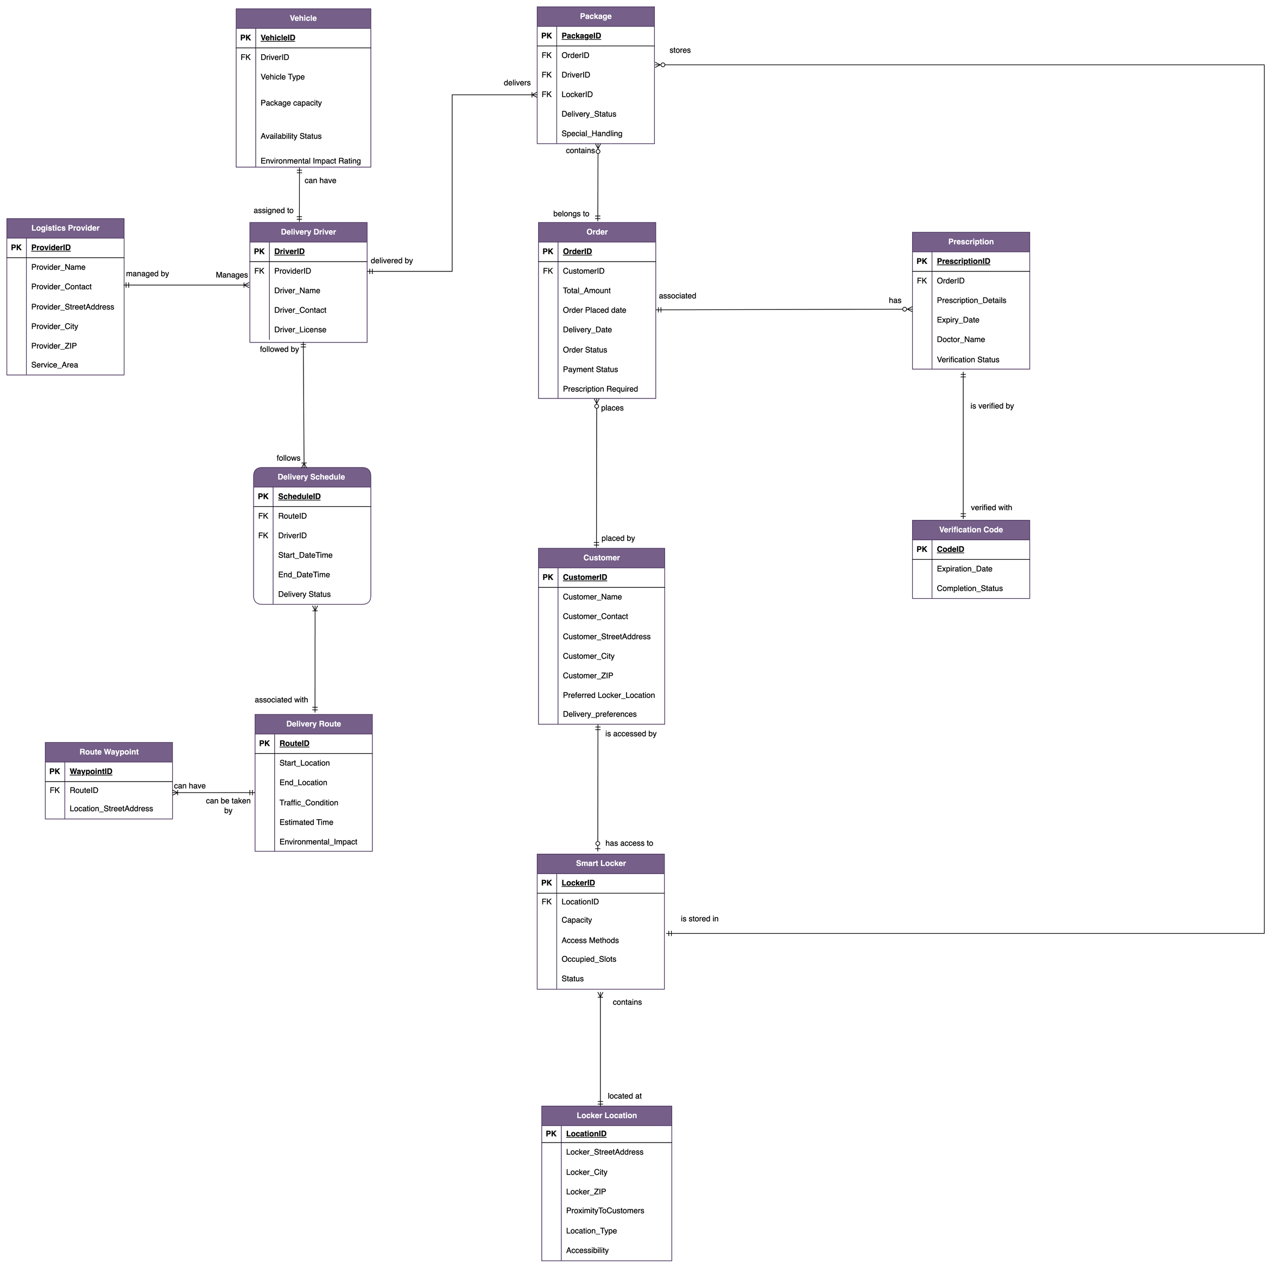
ENTITY RELATIONSHIP
DIAGRAM

Slide 4

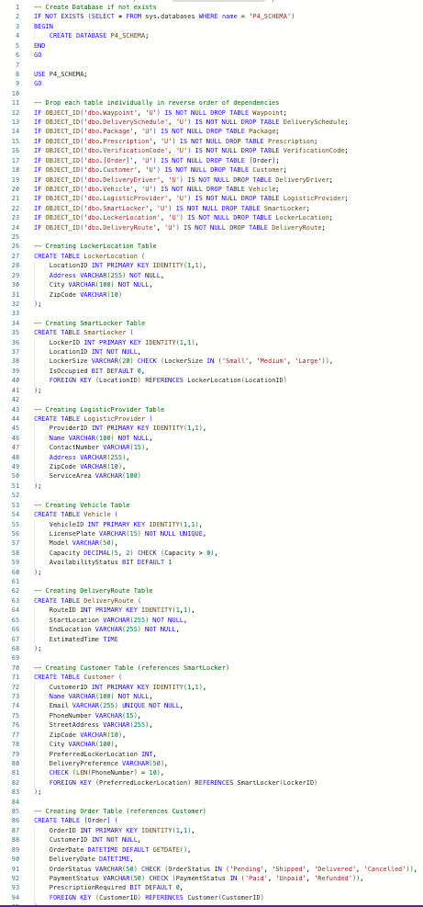
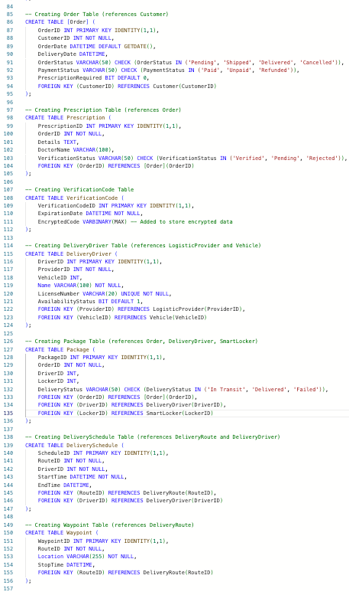
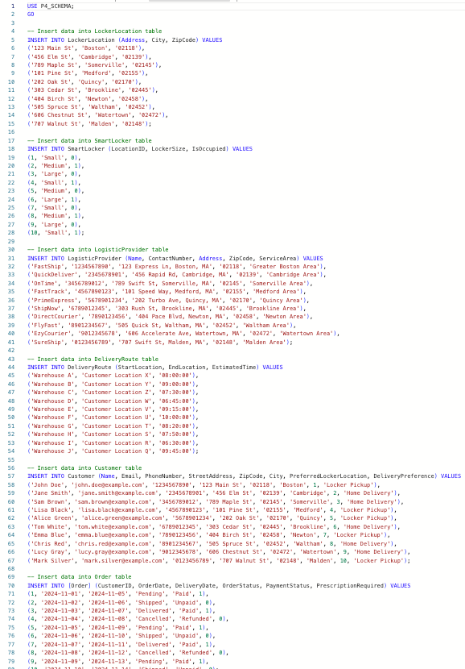
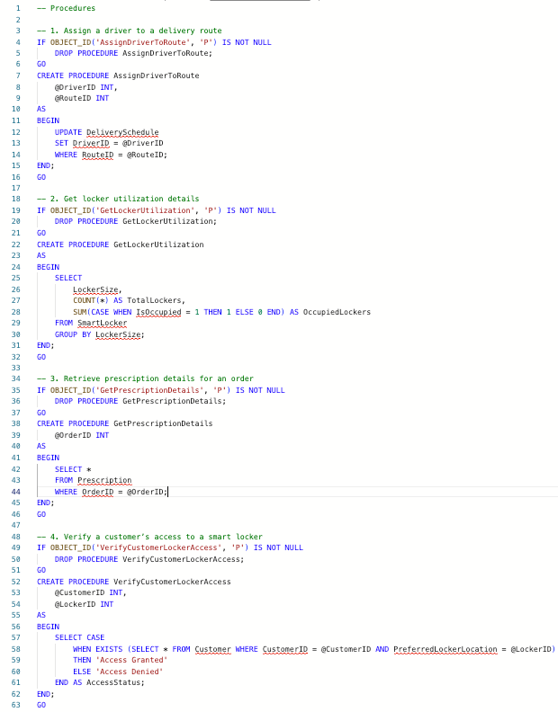
DDL, DML, STORED PROCEDURES

Slide 5
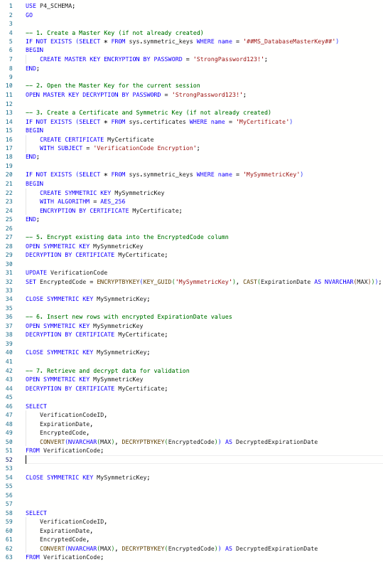
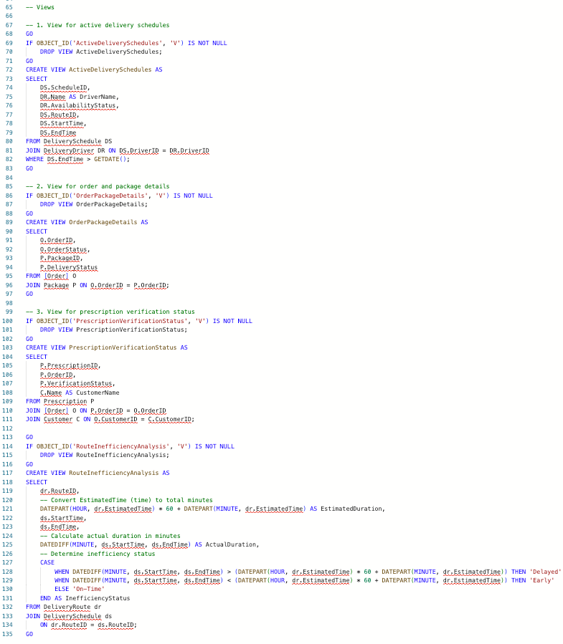
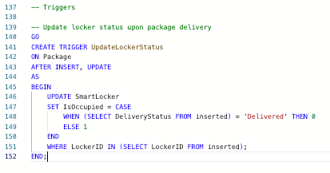
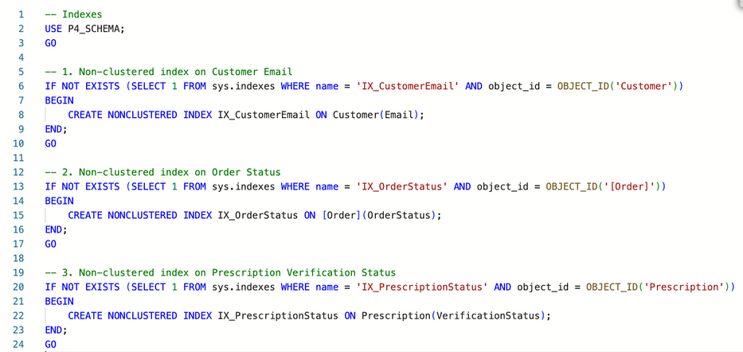
VIEWS, TRIGGERS, ENCRYPTION

Slide 6
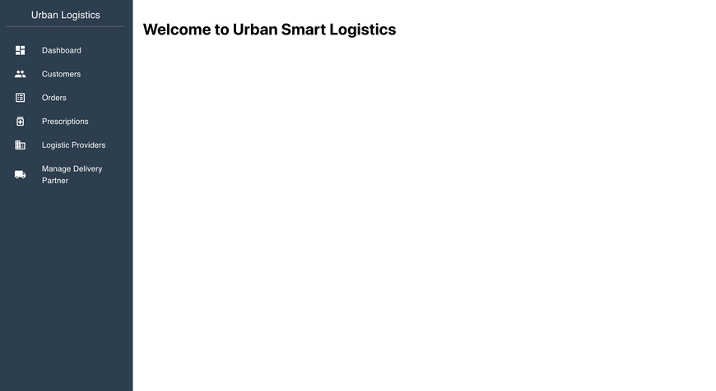
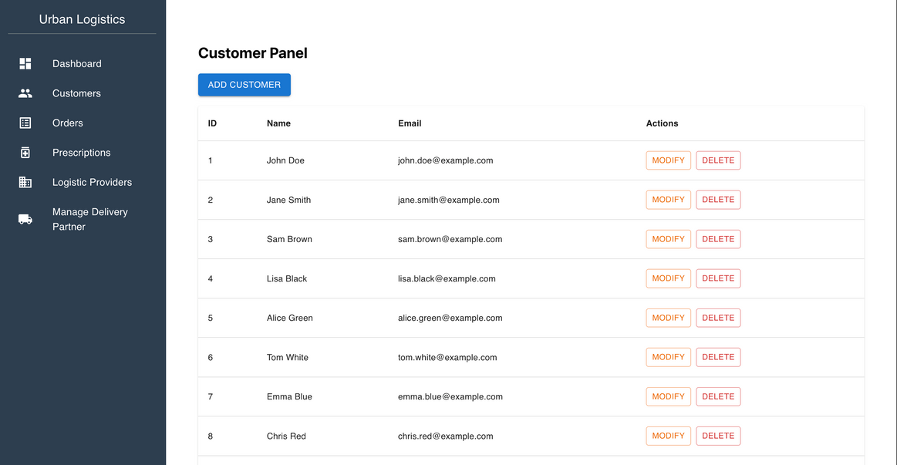
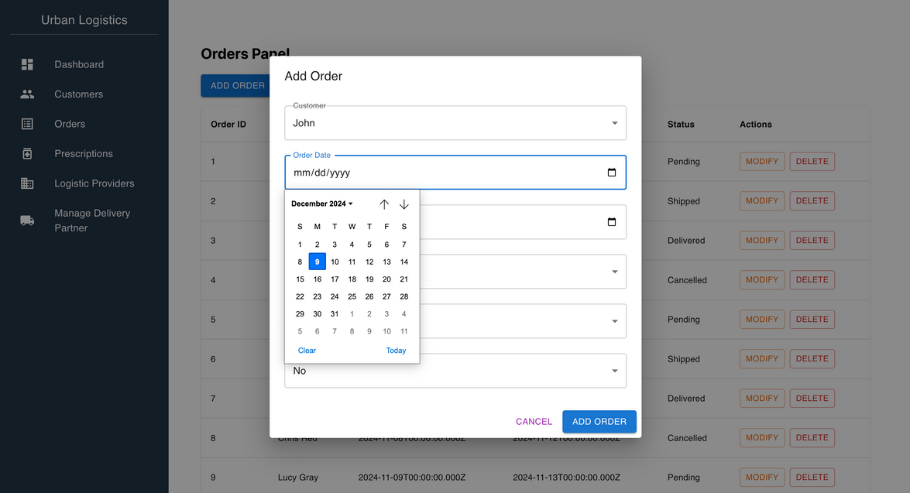
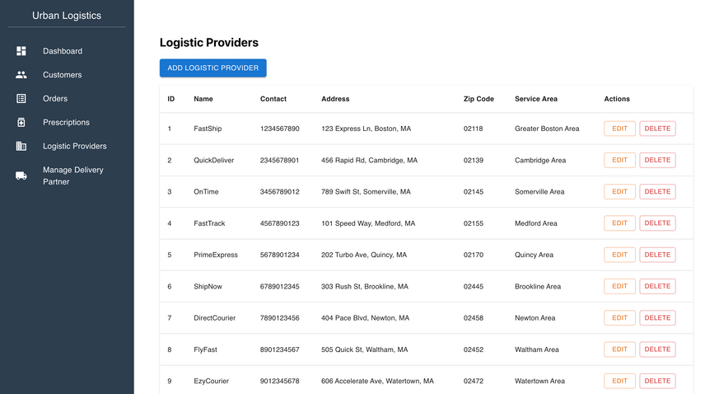
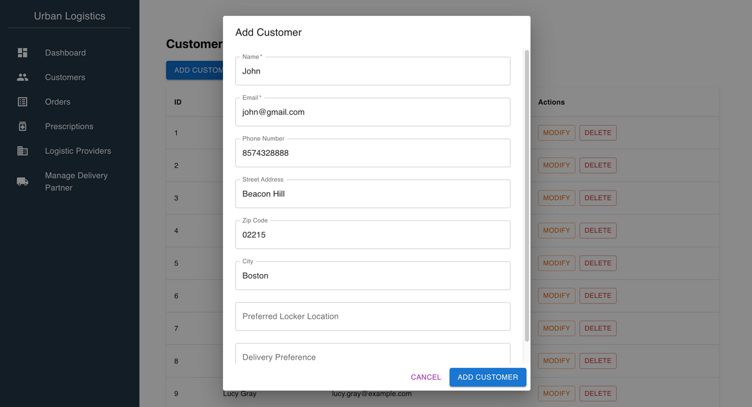
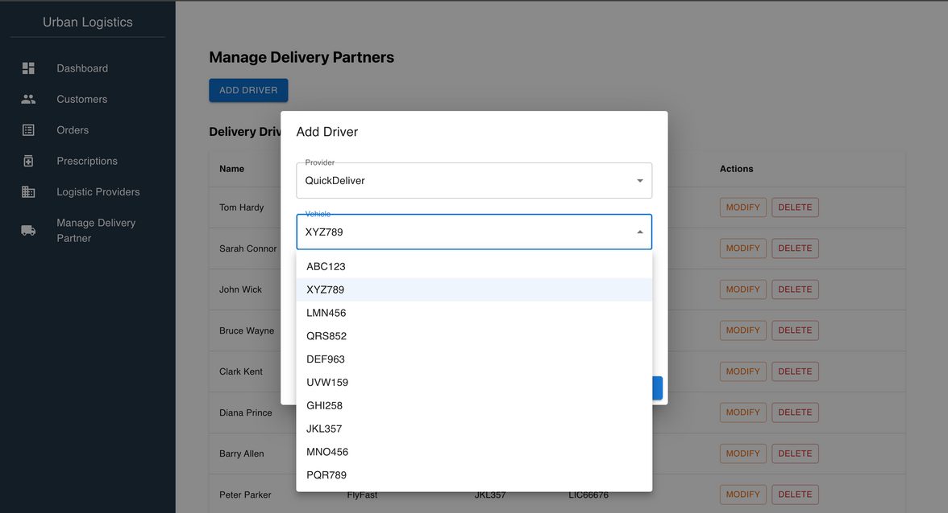
USER INTERFACE AND APPLICATION DEMO

Slide 7
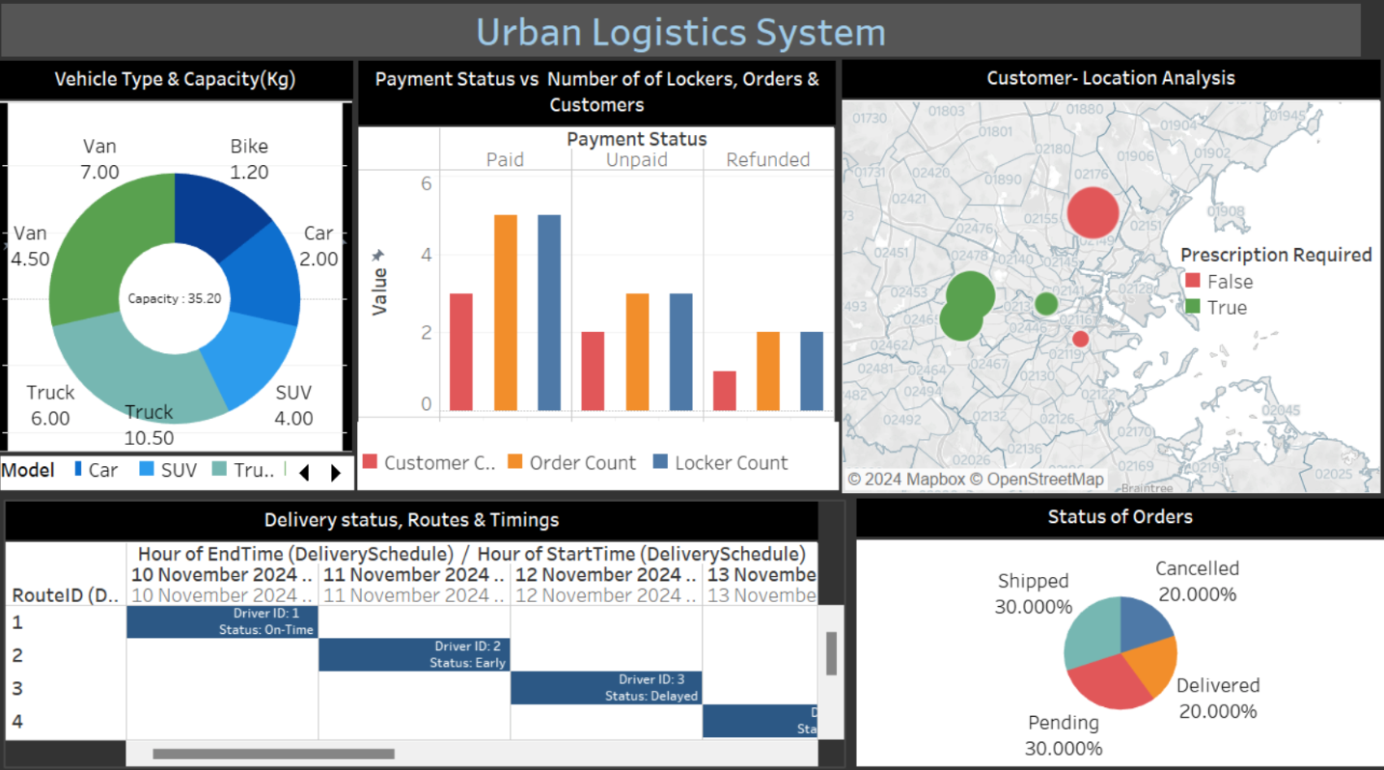
VISUALIZATION

Slide 8
CONCLUSION
Normalized database ensures scalability and efficient data management.
Advanced encryption secures sensitive customer and delivery data.
Effective solution for modern logistics challenges.
Enhanced convenience with smart lockers and centralized data handling.

Slide 9

THANK YOU
Group 3
Pragati Narote
Rutuja Dhatrak
Deepika Vaddadi
Samruddhi Sawant
Tapas Desai

