Slide 1
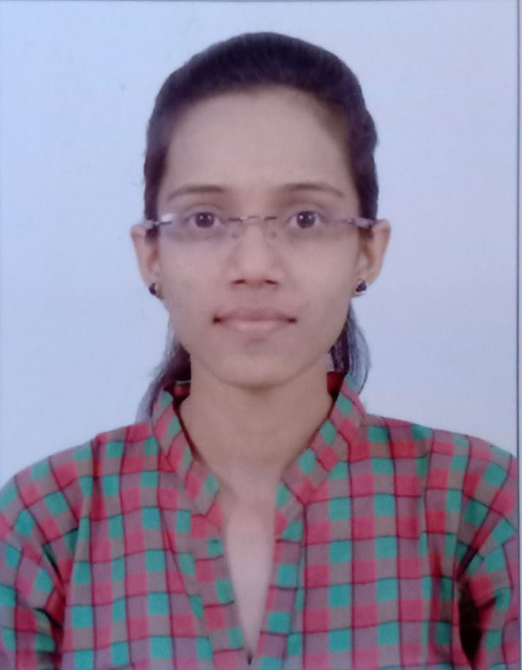


PRAGATI BORSE
Analyst/Software Engineer
M.sc(computer science)
2019-2021
Skills Java
Spring Boot
Microservice
MERN Stack
MongoDB
Database
No SQL database – MongoDB
Web Technologies
HTML5
CSS3
Javascript
AddOns
Github
postman
Additional skills
Quick Learner
Team management
Mumbai
PRAGATI-PUNJARAM.BORSE@CAPGEMINI.COM
+91 9049241874
A4
Eager to work in a team of dedicated people and serve a key role in the enhancement and development of the project.
Software Engineer who is Strong in design and integration with intuitive problem-solving skills. Passionate about implementing and launching new projects.
Ready to learn new technologies and implement them to further improve my knowledge.
Has working knowledge on Angular and Java Microservice Development using Spring framework on an intermediate level.
Hotel Management System
Completed end to end case study of Hotel Management System along with JWT authentication, Swagger and payment testing. Material-UI and Angular Bootstrap used for user interface.

