Slide 1
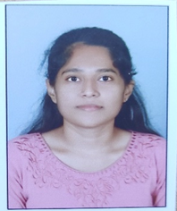


Pragati Ghanekar
Bachelor of Engineering
Civil: 2016 – 2020
Skills:
Dot NET Core
ASP MVC
ASP WEB API
Azure
Backend:
Asp Dot NET Core
REST API
MySQL
Database:
SQL database- MySQL
Web Technologies:
HTML5
CSS3
JavaScript
Add-Ons:
GitHub
Swagger
Postman
Additional Details:
Team Player
Adaptable
Optimistic
Analyst/Software Engineer
Mumbai
pragati-parmeshwar.ghanekar@capgemini.com
8888528271
A4
Software Engineer who is Strong in design and integration with intuitive problem-solving skills. Passionate about implementing and launching new projects.
Ready to learn new technologies and implement them to further improve my knowledge.
Eager to work in a team of dedicated people and serve a key role in the enhancement and development of the project.
I have working knowledge on ASP Dot NET Core, ASP MVC, SQL, Dot NET Framework on an intermediate level and Azure Technologies on basic level
Local Bus Pass Generation system Application:
Completed end to end case study of Local Bus Pass Generation system using JWT Authentication, swagger and Postman.
Coded and designed Static Web Pages:
Developed website with HTML5 and CSS3 along with Framework like ASP Dot NET to make website more interactive and dynamic.
Coded website for Resources used in Front-End Development:
Resources used for making website such as buttons and forms to make modern website:
Link: https://getbootstrap.com/
Check out my work in GitHub profile

