Slide 1
Data Visualization Techniques

Slide 2
Group: 09 Members: Om Govekar Devansh Goyanka Pragati Gupta Vaibhav Hade Anvay Hande Hari Jadhav

Slide 3
Introduction
What Is Data Visualization ?
Data visualization transforms raw data into visual formats like charts and graphs, making it easier to analyze and communicate insights.
Purpose:
To simplify complex data and uncover patterns or insights and enhances the experience.

Slide 4
Objectives:
Explore various data visualization techniques.
Understand how different techniques are used in various contexts.
Demonstrate the benefits of effective visualizations.

Slide 5
Key Elements of Data Visualization
Clarity : Clear and easy to interpret.
Accuracy: Free from distortions or misleading information.
Relevance: Aligns with the purpose of the analysis.

Slide 6
Tools for Data Visualisation:
1. Manual Methods:
Manual Methods in data visualization refer to traditional, non-digital techniques used to create visual representations of data.
Example: Graph Papers , Rulers , Compass , Pencil , etc.
2. Digital Methods:
→Excel
→Tableau
→Python(Matplotlib)
→Google Sheets

Slide 7
Types of Data Visualizations
Line Chart: Displays trends over time or continuous data.
Bar Chart: Compares quantities across categories.
Histogram: Shows the distribution of data.
Pie Chart: Represents proportions within a whole.
Box Plot: Represents data spread and outliers.

Slide 8
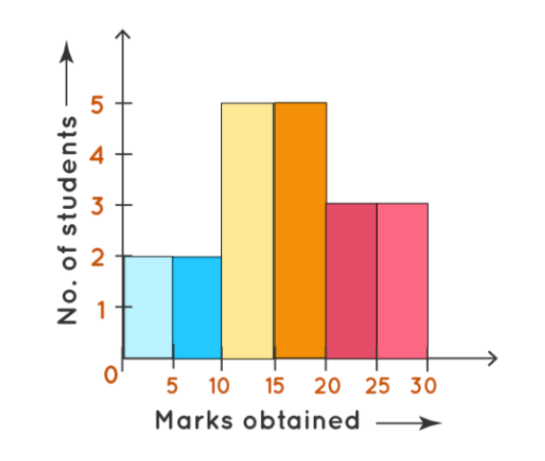
HISTOGRAM
Definition:
A histogram is a type of bar chart that visualizes the distribution of a set of continuous data. It is commonly used to show how data is distributed across different intervals or bins.
Purpose:
Helps in understanding data patterns, such as central tendency, spread, and variations in frequency distribution.

Slide 9
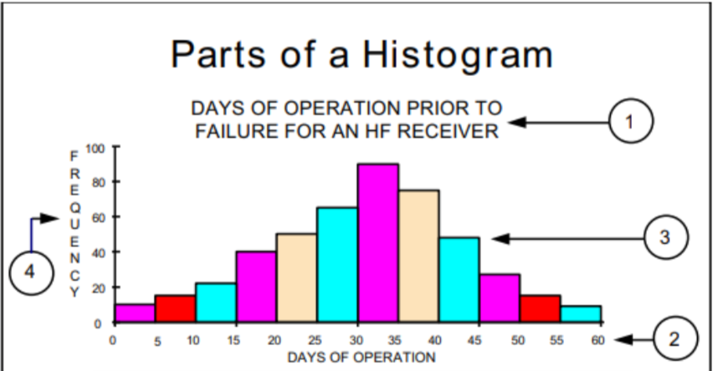
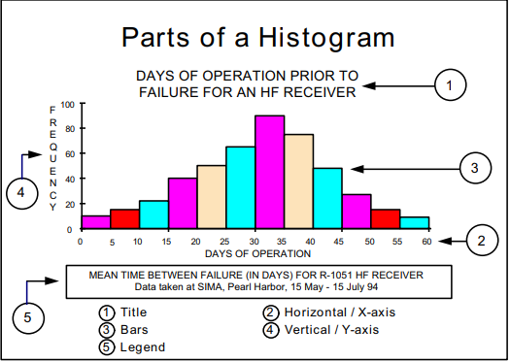
Components of a Histogram
Bins (Intervals): Represent the range of data values, divided into intervals of equal size.
Bars: Rectangles whose heights indicate the frequency or count of data within each bin.
X-Axis (Horizontal Axis): Represents the data range or the bins.
Y-Axis (Vertical Axis): Represents the frequency or count of data values in each bin.
Title: Describes what the histogram represents.
Labels: Provide context for the x-axis and y-axis, such as units or categories.

Slide 10
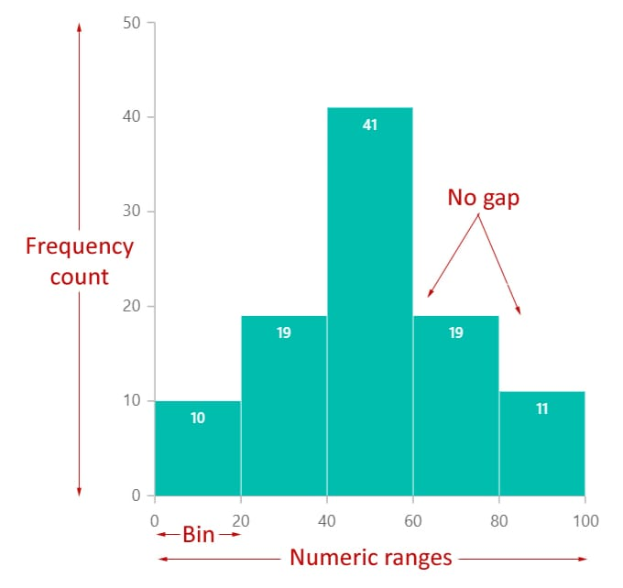
Key Features
Bars Represent Data: Each bar represents a specific range of data, called a class interval.
Continuous Data Representation: Suitable for continuous data, such as height, weight, or test scores
No Gaps Between Bars: In contrast to bar charts, histograms do not have gaps between bars since the data is continuous.
Shape of Distribution: The shape of the histogram indicates the distribution's pattern (normal, skewed, etc.).

Slide 11
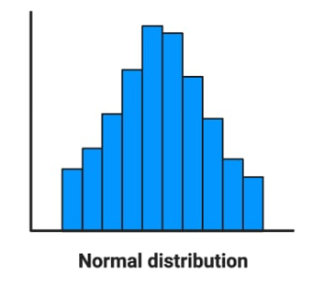
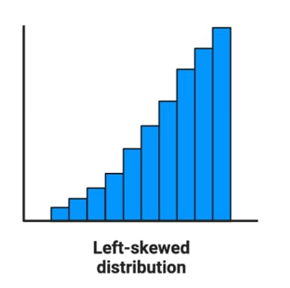
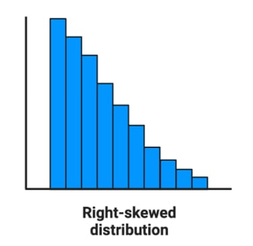
Types of Histogram
1. Normal Distribution Symmetric: Bell-shaped curve; most data around the mean.
2. Left-Skewed Distribution: Tail extends to the left; most data concentrated on the right.
3.Right-Skewed Distribution: Tail extends to the right; most data concentrated on the left.

Slide 12
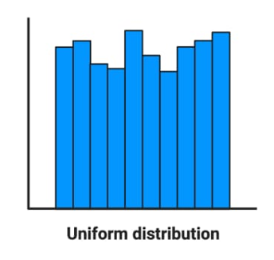
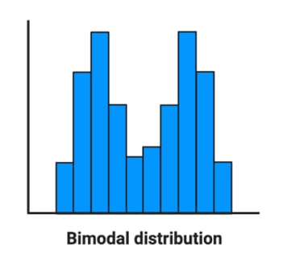
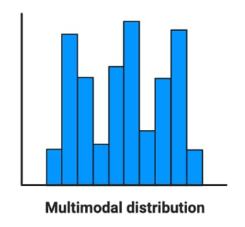
Types of Histogram
4. Uniform Distribution: Bars are approximately the same height; data is evenly distributed.
5. Bimodal Distribution:
Two distinct peaks; indicates two dominant groups in data.
6. Multimodal Distribution: More than two peaks; shows several clusters in data.

Slide 13
Advantages and Limitation of Histogram
Advantages:
Simple to create and interpret.
Provides a clear visual representation of data distribution.
Summarization of Large Datasets
Easy Identification of Patterns
Limitations:
Not suitable for categorical data (use bar charts instead).
Requires careful selection of class intervals (too many or too few intervals can distort the analysis).

Slide 14
Real-Life Applications of Histograms
1. In Education: Analyse test scores or performance distribution of students over time.
Dataset: Students' Test Scores Over Time
55, 67, 78, 45, 89, 92, 58, 64, 73, 81, 77, 69, 71, 87, 85, 74, 68, 90, 93, 62, 50, 79, 88, 76, 59, 66, 80, 72, 95, 61
Step 1: Define the Data
Arrange the data in it ascending order.
Step 2: Define the Bins and Count the Scores in Each Bin
We'll calculate how many scores fall into each range.
Bins | Frequency
40-50 | 2
51-60 | 3
61-70 | 7
71-80 | 9
81-90 | 5
91-100 | 3

Slide 15
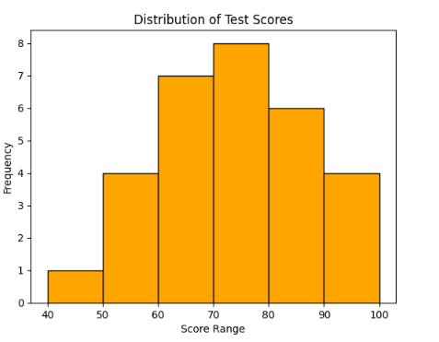
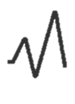
Step 3 : Explanation of the Output:
X-Axis: Represents the score ranges (bins).
Y-Axis: Represents the frequency of students scoring within each range.
Step 4: Interpretation:
The histogram will show how scores are distributed across bins.
Peaks in the histogram indicate where most students' scores lie (e.g., in the 70-80 range).

Slide 16
Real-Life Applications of Histograms
2. In Business: Retailers use histograms to track sales across different price ranges or over different periods.
Dataset: Product Prices of Sold Items
12, 20, 22, 30, 35, 40, 42, 45, 50, 52, 55, 60, 62, 65, 70, 72, 75, 80, 82, 85, 90, 92, 95, 100, 105, 110, 112, 115, 120, 125
Step 1: Define the Data
Arrange the data in it ascending order.
Step 2: Define the Bins and Count the Scores in Each Bin
We'll calculate how many scores fall into each range.
Bins | Frequency
10-30 | 3
31-50 | 4
51-70 | 4
71-90 | 4
91-110 | 6
111-130 | 9

Slide 17
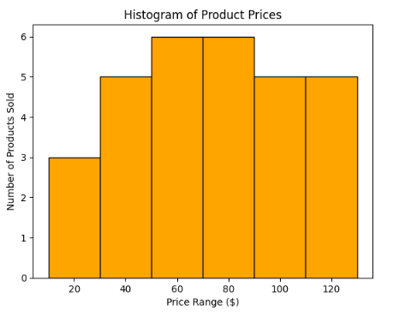
Step 3 : Explanation of the Output:
Bin 1 (10-30): Few products were sold in this price range (lower-cost items).
Bin 2 to Bin 4 (31-90): Moderate sales for mid-priced products.
Bin 5 and Bin 6 (91-130): Higher sales for more expensive items, indicating a trend toward premium product purchases.

Slide 18
Limitation of Histogram
Limitations:
Not suitable for categorical data.
Requires careful selection of class intervals.
Loss of Detailed Information
Limited to One Variable

Slide 19
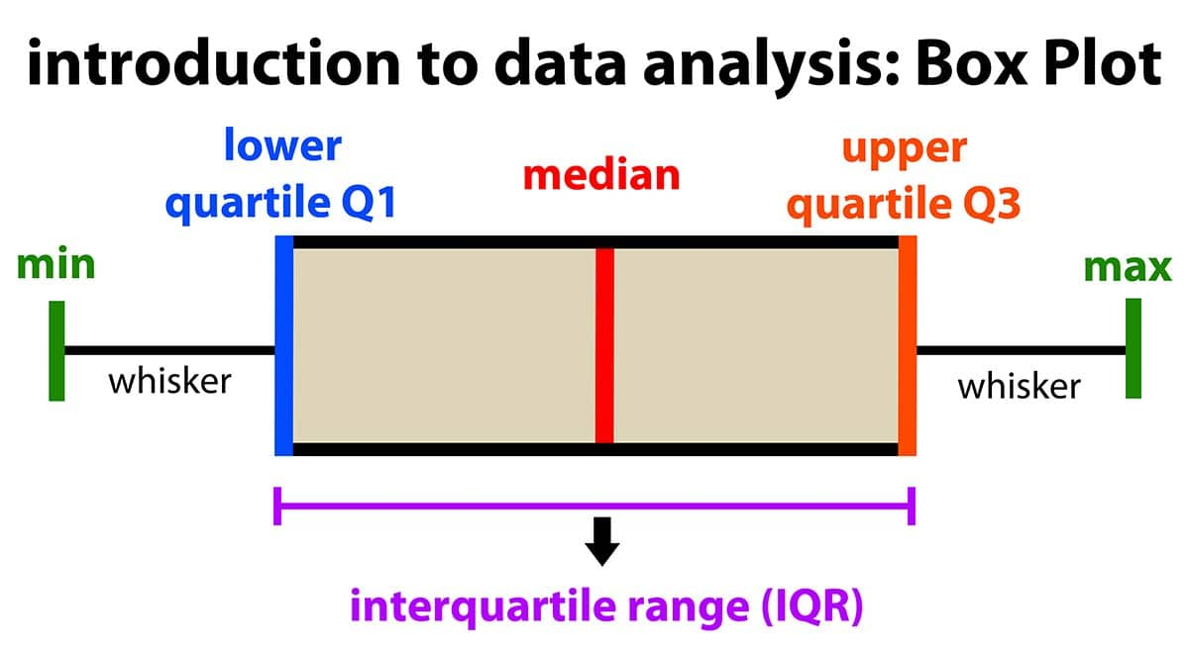
BOX PLOT
Definition:
A Box Plot (also known as a box-and-whisker plot) is a graphical representation of a dataset that displays the distribution and variability of the data. It shows the median, quartiles, and potential outliers, making it easier to identify patterns, central tendency, and spread.
.
Purpose:
The purpose of a box plot is to summarize the data's distribution in a way that is easy to interpret, allowing you to quickly identify the spread, skewness, and any outliers within the database.

Slide 20
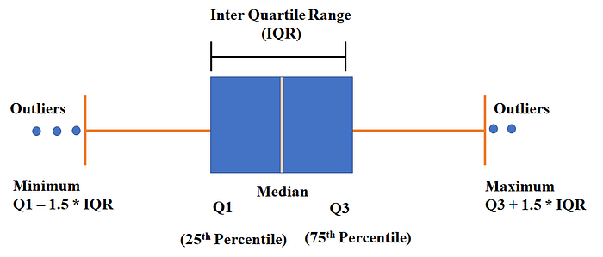
Components of a Box Plot
Whiskers: The lines extending from the box, representing the range of the data. They stretch from the first quartile and third quartile to the minimum and maximum values within a specified range (usually 1.5 times the interquartile range).
Quartiles:
The data is divided into four equal parts:
Q1 (First Quartile)
Q2 (Second Quartile/Median)
Q3 (Third Quartile)
Outliers: Data points that fall outside the whiskers' range and are usually defined as points that are more than 1.5 times the interquartile range (IQR) away from Q1 or Q3

Slide 21
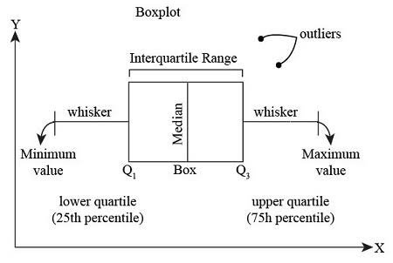
Key Features
The Box: The interquartile range (IQR), representing the middle 50% of the data (from Q1 to Q3), is shown as a box.
The length of the box indicates the variability of the data (larger box = higher variability).
The Whiskers: The lines extending from the box represent the spread of data points beyond the quartiles. The length of the whiskers gives insight into how spread out the data is.
The Median Line: A line inside the box represents the median (Q2), which divides the data into two equal halves.

Slide 22
Advantages of Box Plot
Quick Overview: Box plots provide a clear summary of the data distribution.
Comparison: They allow easy side-by-side comparison of multiple datasets or groups.
Outlier Detection: Box plots make it easy to identify outliers.
Robust: They are not affected by extreme values or skewed distributions, as they focus on quartiles.

Slide 23
Real-Life Applications of Box Plot
1. In Business: To analyze the distribution of total sales across stores and identify any outliers.
Dataset: 220, 250, 280, 300, 330, 340, 360, 400, 420, 450, 460, 500, 520, 550, 560, 600, 620, 640, 660, 680, 700, 750, 800, 820, 850, 880, 900, 950, 1000, 1200
Step 1: Arrange the Data
Arrange the data in it ascending order.
Step 2: Calculate Key Statistics for the Box Plot
Minimum (Q0): 220
First Quartile (Q1): 340
Median (Q2): 560
Third Quartile (Q3): 800
Maximum (Q4): 1200

Slide 24
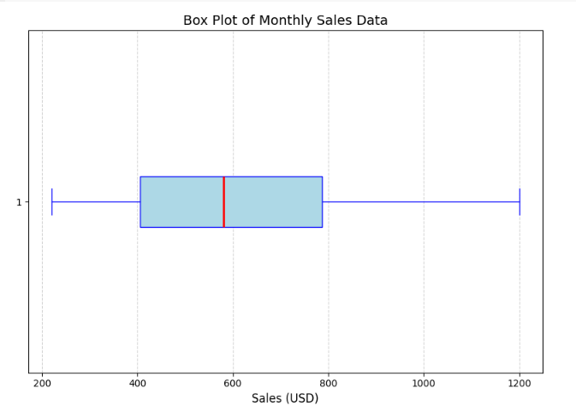
Real-Life Applications of Box Plot
Step 3: Plot the Box Plot
The box plot will include:
Minimum: 220
Q1: 340
Median : 560
Q3: 800
Maximum: 1200

Slide 25
Real-Life Applications of Box Plot
2. In Finance: Monthly Returns of an Investment Portfolio (in percentage)
Dataset: -3.5, -2.8, -1.2, 0.0, 1.5, 2.3, 3.1, 3.8, 4.2, 4.5, 5.0, 5.3, 5.8, 6.1, 6.5, 6.9, 7.0, 7.3, 8.0, 8.5, 9.0, 9.2, 9.8, 10.0, 10.5
Step 1: Define the Data
The data is already in ascending order.
Step 2: Calculate Summary Statistics for the Box Plot
Minimum value (Q0) = -3.5
First Quartile (Q1) = 3.1 Median (Q2) = 5.8 Third Quartile (Q3) = 7.3 Maximum value (Q4) = 10.5

Slide 26
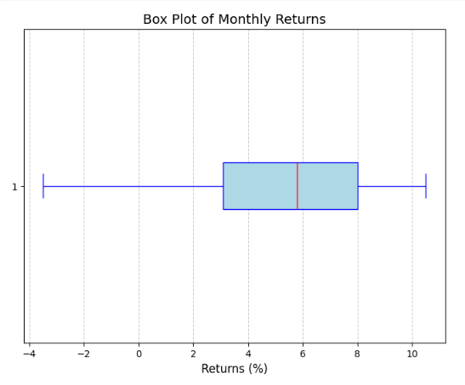
Real-Life Applications of Box Plot
Step 3: Plot the Box Plot
The box plot will include:
Minimum value = -3.5
First Quartile = 3.1 Median = 5.8 Third Quartile = 7.3 Maximum value = 10.5

Slide 27
Limitation of Box Plot
Limited Detail: Box plots don't provide information about the shape of the distribution beyond the quartiles (e.g., normal distribution vs. skewed).
Misleading with Small Samples: For small datasets, box plots can misrepresent the distribution because the calculation of quartiles might not be as precise.
Outlier Definition: The definition of outliers is based on a rule (1.5 * IQR), which may not always suit the context of the data.

Slide 28
Comparison
Feature | Histogram | Box Plot
Purpose | Visualizes the distribution of data by dividing it into bins (ranges). | Summarizes the spread and key statistics of data in a compact form.
Shape Analysis | Reveals the shape of the data (e.g., normal, skewed, bimodal). | Does not show the shape but highlights spread and outliers.
Key Components | - Bars represent frequency. - X-axis: Data ranges. - Y-axis: Frequency. | - Box: Middle 50% of data - Median: Central line. - Whiskers: Spread. - Outliers: Points outside 1.5 × IQR.
Data Size Suitability | Effective for large datasets with continuous data. | Suitable for medium-sized datasets or when focusing on summaries.

Slide 29
Summary
The presentation emphasizes the importance of histograms and box plots for data visualization. Histograms display patterns like central tendency and spread, while box plots summarize data distribution using quartiles, the interquartile range, and outliers. These tools are useful for comparing datasets and identifying outliers, and are widely used in fields like education, business, and health.

Slide 30
THANK YOU

