Slide 1
Automated Data Migration tool
from On Premise/Cloud to AWS
Author :: Pragyan Banerjee
Aug-2020

Slide 2
Agenda
Purpose/Background
Different Migration Strategies
Architecture for Rehost
Architecture for Re Factor
Architecture for Re Platform
Architecture for Disaster Recovery
How this POC will benefit Client/End Users
Challenges Faced
Technical Capabilities/Tools Used

Slide 3
Objective:
To understand the different migration strategies in AWS.
To map business requirements to the proper migration strategy.
To showcase how data can be migrated in cloud in few clicks.
Try to resolve client pain points with an innovative, flexible and automated solution.

Slide 4


1. RPO/RTO
Story Line:
2. Maintainability
3. Performance
4. Cost
1
2
3
4

Slide 5
Story Line Continued:
Rehost - Lift and shift
Reduce Cost of on-premise, database keeps running without disruption or modification, less downtime, less RTO, Homogeneous data migration, customer managed database.
Re-platform - Lift, Tinker and Shift
Organization ready for minor changes, AWS Managed database, automated process of backup/recovery, more scalable database platform
Re-factor
Organization looking AMS modernize database, ready for restructuring and modernize existing system, Heterogeneous database migration

Slide 6
Story Line Continued:
Rehost - Lift and shift
Reduce Cost of on-premise, database keeps running without disruption or modification, less downtime, less RTO, Homogeneous data migration, customer managed database.
Re-platform - Lift, Tinker and Shift
Organization ready for minor changes, AWS Managed database, automated process of backup/recovery, more scalable database platform
Re-factor
Organization looking AMS modernize database, ready for restructuring and modernize existing system, Heterogeneous database migration

Slide 7
Story Line Continued:
Rehost - Lift and shift
Reduce Cost of on-premise, database keeps running without disruption or modification, less downtime, less RTO, Homogeneous data migration, customer managed database.
Re-platform - Lift, Tinker and Shift
Organization ready for minor changes, AWS Managed database, automated process of backup/recovery, more scalable database platform
Re-factor
Organization looking AMS modernize database, ready for restructuring and modernize existing system, Heterogeneous database migration

Slide 8
How this asset will benefit Client/End Users:
01
03
02
04
Innovation/Automation
There are total 4 strategies I have covered, out of which the re host and re platform are completely automated with few manual steps required for parameter file updation . Also I have brought small innovation by automating one manual step in CloudEndure.
Reusability
All 4 strategies follow the best practises, and also this can be customized/modified based on different business scenarios.
Flexibility
Optimum cost required to customize based on an user’s requirement. Here we have created API’s through python.
Future Enhancements
This POC has various aspects , here I have used MYSQL as a source and all the strategies we have shown considering MySQL as source, now using this same concept a fully automated solution can be implemented for any database.

Slide 9




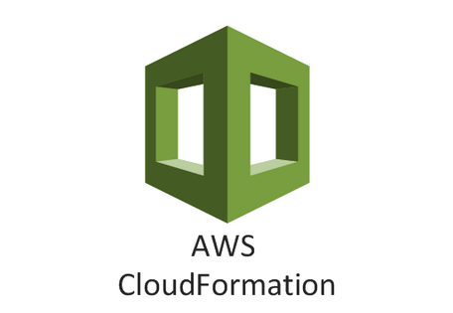





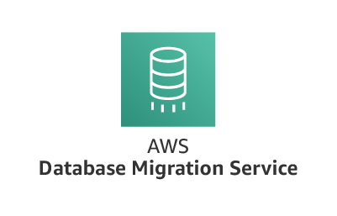
Technical Capabilities /Tools used
For this POC, I have used below AWS Services and also Python as the scripting language
Knowledge of AWS 3 tier architecture with below mentioned services are important for this poc. Also python scripting is one of the major pillar of this poc, so knowledge of python also immensely required.

Slide 10
Major challenges Faced
For Rehost migration , in cloudendure for replication instance a port 443 needs to be added as the ingress rule in the security group of the replication instance.
Compatibility of different database version is very important when re factor and re platform strategy is considered.
In the cloudendure API script the to get the machine id always refer the source IP than source machine name.
AWS RDS “pg_hba.conf rejects connection for host”
due to that DMS target endpoint getting failed.
The resource DB Cluster Parameter Group change rds.force_ssl=0 to overcome this

Slide 11
Thank you

