Slide 1
Welcome to my presentation
Presented By: Pragga Paromita Das
Department: Soil and Environmental Sciences
University of Barisal

Slide 2
Title: Microplastic pollution in River water in Bangladesh
Introduction
Current Status of Microplastic pollution in Bangladesh
Impact on River ecosystem and Human Health
Challenges in Monitoring and Assessment
Factors behind microplastic pollution in river
Conclusion

Slide 3
Introduction
Microplastics have been established as one of the most concerning problem in todays world.
Microplastics can act as a medium for environmental toxic substances.
Microplastic pollution is mainly caused by land base resources, industrial waste, sewage disposal, solid waste.
There are 12 categories of Microplastics in river water in Bangladesh. The common types were disposable plastic table cloths, old plastic cassette rees, pieces of plastic ropes and electric wire, beverage bottles. single-use products(glass, plates, straws, spoons, cups, medicine packets, pots), toothpaste covers, shampoo bottles, polythene bag, large polythene bags, large plastic sacks, food and fruit wrappers of different sizes.
Microplastics in river water damage the food chain of river and also harms human health.
Lack of awareness among the community, continuous reduction of water flow causes microplastic pollution in river water in Bangladesh.

Slide 4
Current status of Microplastic pollution in river
Rivers such as the Padma, Meghna, and Jamuna, which are vital for agriculture, transportation, and sustaining diverse ecosystems, are facing increasing threats from microplastic pollution.
Microplastics presents in various forms, including fibers, fragments, and microbeads, with sources ranging from urban runoff, industrial discharges, and inadequate waste management practices.
Microplastics contain in Bangladeshi rivers fish. Rui-35%,Catla-25%,Mrigal-22%, Hilsha-24%.

Slide 5
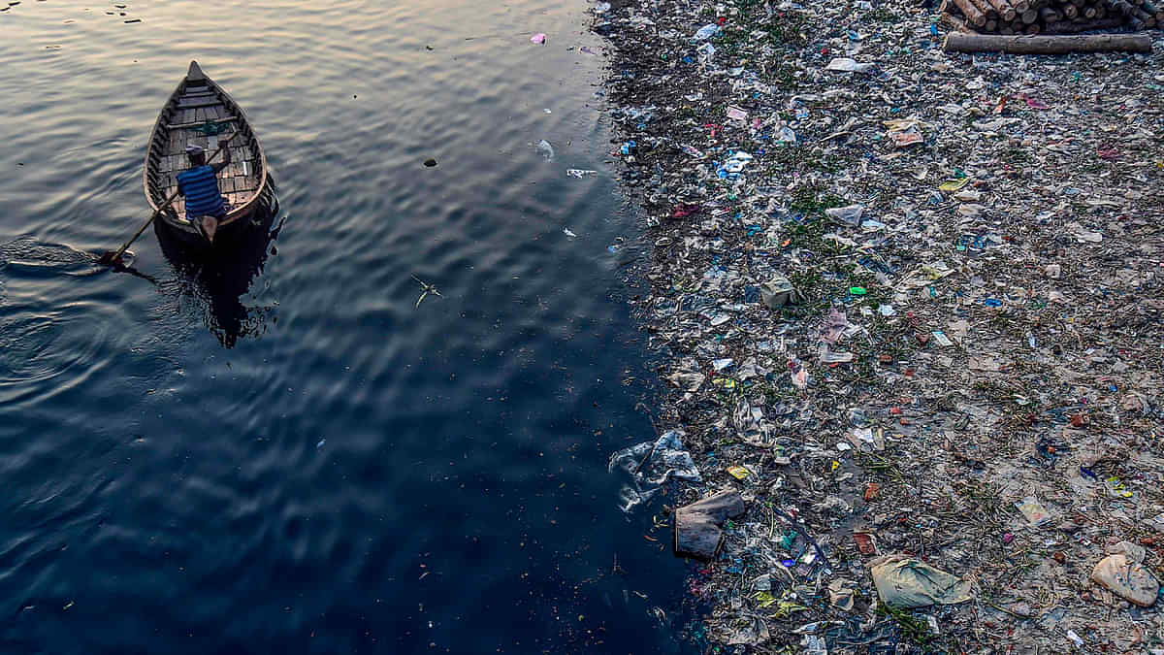

Slide 6
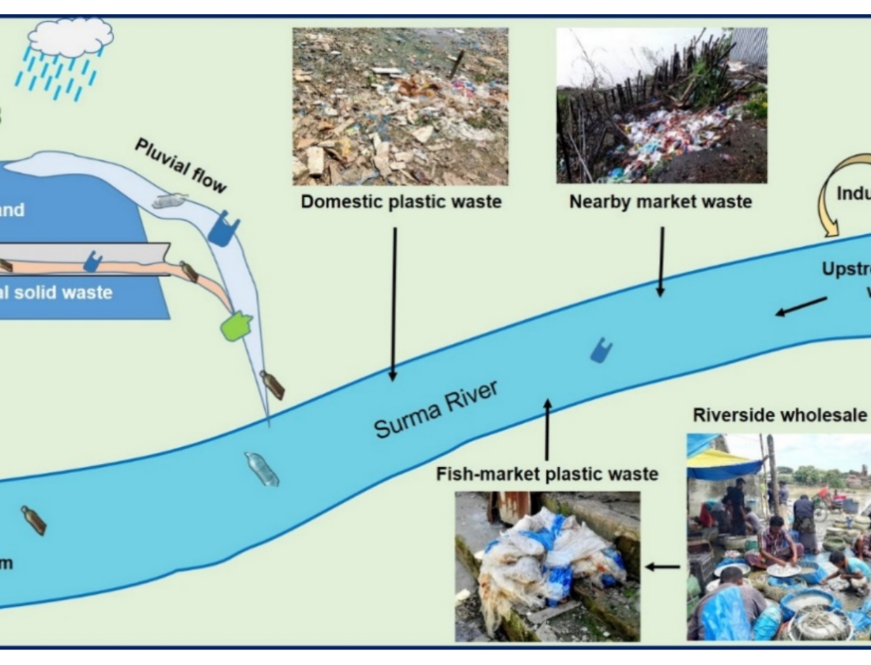
Impacts on aquatic system and human health:
These impacts include the ingestion of microplastics by aquatic organisms, leading to bioaccumulation and biomagnification along the food chain. Moreover, the physical and chemical properties of microplastic contribute to degradation, altered nutrient cycling, and the potential release of harmful additives. Furthermore, concerns about the transfer of microplastics through the food web raise questions about potential human health risks, demanding further investigation into the extent of exposure and associated health implications

Slide 7
Challenges Monitoring system and assessment
Obstacles :
Poor management of the municipal drainage system, Poor waste management, lack of awareness, people arrogance increase microplastic pollution in Bangladeshi river water.
Initiatives:
There are some initiatives that properly organize plastic disposal systems and places. Separation disposal of plastic and other waste, figuring out the alternatives to substitute plastics, raising public awareness, and implementing rules strictly.

Slide 8
Factors behind microplastic pollution in river
Some factors behind microplastic pollution in the river water of Bangladesh are-
1. Industrial Discharges: An important source of pollution in rivers is the uncontrolled release of industrial waste containing microplastics.
2. Urban Runoff: When plastic trash from urban areas is not properly managed, it can eventually find its way into rivers and break down into microplastics.
3. Incorrect Waste Disposal: Microplastics can build up in river systems as a result of inadequate waste disposal procedures, such as littering and incorrect disposal of plastic trash.
4. Agricultural Practices: When plastic-based products break down or fragment over time, such as mulching films, they can introduce microplastic pollution into the environment.
5. Efficiencies of Wastewater Treatment: Ineffective wastewater treatment facilities might not be able to eliminate microplastics, which would allow them to get into rivers through treated wastewater.

Slide 9
Conclusion
Rivers in the country are significantly contaminated with microplastics, posing potential threats to both the environment and human health. The diverse sources of microplastics, ranging from industrial discharges to inadequate waste management practices, contribute to the widespread contamination observed in various river systems.
The impacts of microplastic pollution on aquatic ecosystems, biodiversity, and ultimately human health cannot be ignored. The ingestion of microplastics by aquatic organisms can lead to bioaccumulation in the food chain, potentially affecting human consumers. Moreover, the persistence of microplastics in the environment exacerbates their adverse effects, requiring urgent attention and effective mitigation strategies.

Slide 10
Thank You

