Slide 1
Pacing In the RTB Space
A summary of research advances

Slide 2
Papers
Budget Pacing for Targeted Online Advertisements at LinkedIn by Deepak Agarwal et al. KDD 2014.
Smart Pacing for Effective Online Ad Campaign Optimization by Jian Xu et al. KDD 2015.
Real Time Bid Optimization with Smooth Budget Delivery in Online Advertising by Kuang-Chih Lee, Ali Jalali, Ali Dasdan. ADKDD 2013.
From 0.5 Million to 2.5 Million: Efficiently Scaling up Real-Time Bidding by Jianqian Shen et al. ICDM 2015.

Slide 3
A brief Overview
Why pacing is hard
Pacing techniques
Traffic vs KPI based pacing
Slow start; Early finish
Controller
How to pace: probabilistic throttling vs bid modification
Naïve control system
Priority control system
Evaluation
Spend error

Slide 4
Why PACING IS HARD

Slide 5
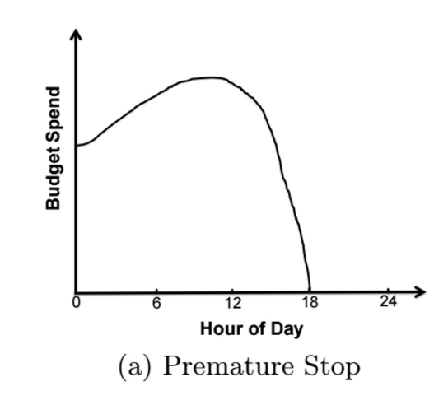
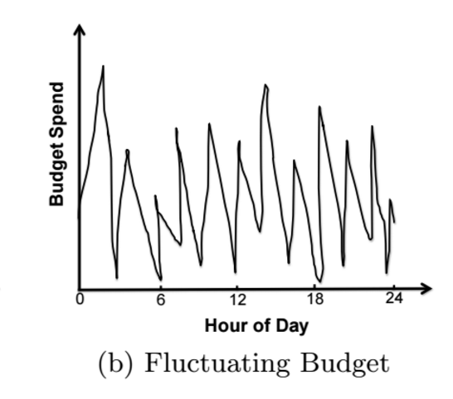
Why Pacing is hard
Advertisers prefer a smooth delivery of budget
Hard to implement in the real world

Slide 6
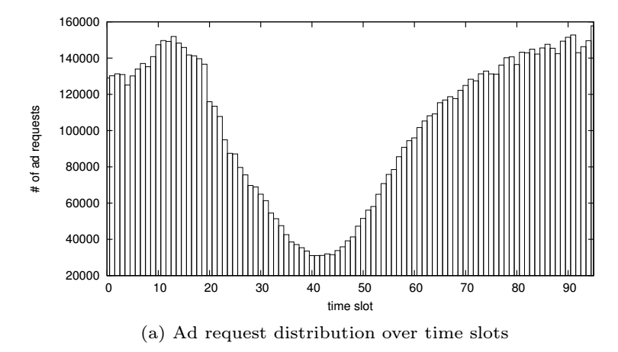
Why Pacing is hard
Traffic is not uniform
Traffic is even more erratic on a per campaign basis

Slide 7
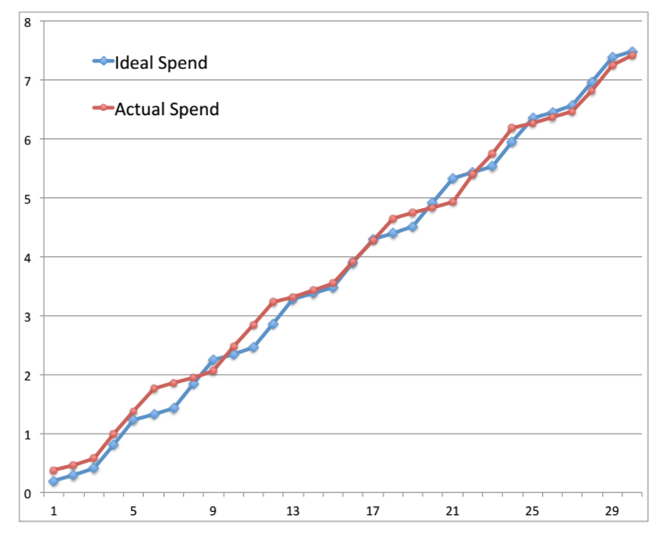
Why Pacing is hard: ideal performance

Slide 8
Pacing Techniques

Slide 9

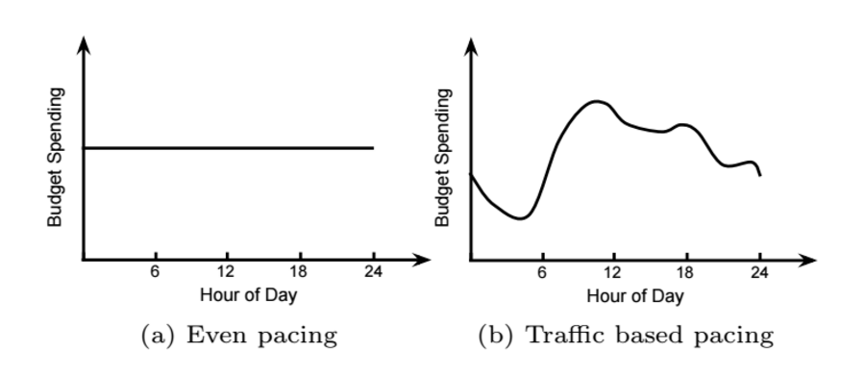
Pacing Techniques: How do we pace?
Come up with a spend plan
Divide up day into time slots and allocate budget B per time slot

Slide 10
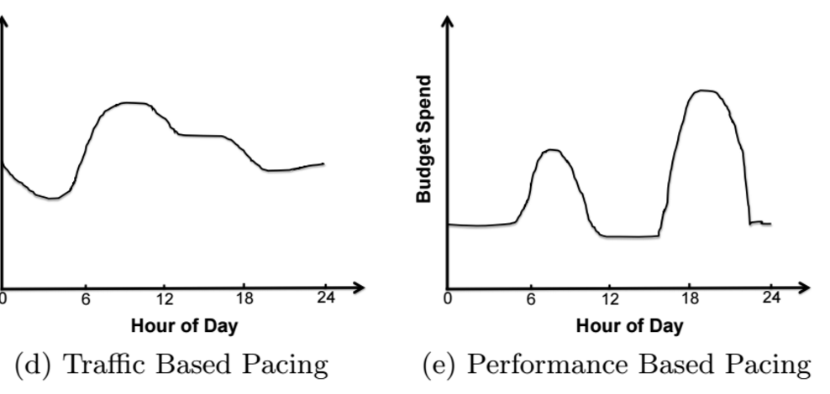
Traffic vs KPI BASED PACING
Traffic based pacing tries to control how many auctions a campaign sees
KPI based pacing tries to get the cheapest KPIs (clicks, completions…etc.)

Slide 11
Combining Traffic and KPI PATTERNS
Allocate B(k) based on KPI patterns (e.g. a lot more clicks in the evening than morning)
Clicks are cheapest when there’re an abundance of clicks
Calculate pacing rates for each time slot based on traffic
Need to spend B(k)
Estimate how many auctions, N(k), an ad needs to see
Figure out the % of traffic to show the ad to get N(k) auctions

Slide 12
Slow start
Start out the day by being selective
Prevents overspending / spending more than allocated
Encourages optimizing for KPIs
Let ad see 100% of auctions
Start out low
Hour

Slide 13
Fast finish
Finish spending budget a few hours before the 24 hour mark
A DSP would rather overspend then underspend
Try to finish by hour 22
End of day
Hour

Slide 14
Controller

Slide 15
Probabilistic throttling vs Bid modification
We want to spend exactly B(k) for time slot k
There are 2 ways to control spending
Probabilistic throttling
Show an ad an auction with p percent of the time
0 means stop showing auctions to ad
1 means show every auction to ad
Bid modification
Assume each campaign bids c on each auction
Lower the bid to βc, where 0 <= β <= 1
Change β to control spending

Slide 16
Probabilistic throttling vs Bid modification
Advantages with probabilistic throttling:
Directly influences budget spend (*)
Bid modification does not work all the time because of the reserve price established by the publisher
Decouples pacing from bid evaluation
From this point on, we will use probabilistic throttling or p the pacing rate as the actuator in our controllers.
(*) Changing β for bid modification does not directly change spend, because win rate does not change linearly with bid multiplier

Slide 17
Naïve Controller
LinkedIn uses a simple water wheel controller
Start the day with p = 0.1
Every 1 minute, update p:
If over pacing, p = p * 1.1
If under pacing, p = p * 0.9
Problems:
Needs the system to update very often
p oscillates needlessly

Slide 18
Priority Controller
Group similarly performing auctions together by KPI into layers
Tries to prioritize auctions that generate the best KPI (e.g. clicks)
In time slot k, each layer is given a budget and a pacing rate p
Rank layers by expected KPI (highest to lowest)
Layer 1, response rate: 0.002
Layer 2, response rate: 0.0002
Layer 3, response rate: 0.00002 …etc.
If campaign is overspending, lower pacing rate from bottom up
If campaign is underspending, raise pacing rate from top down

Slide 19
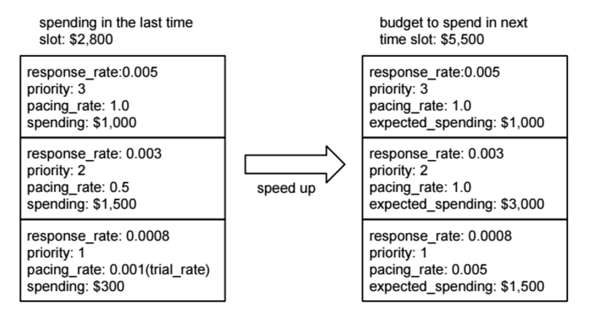
Priority Controller

Slide 20
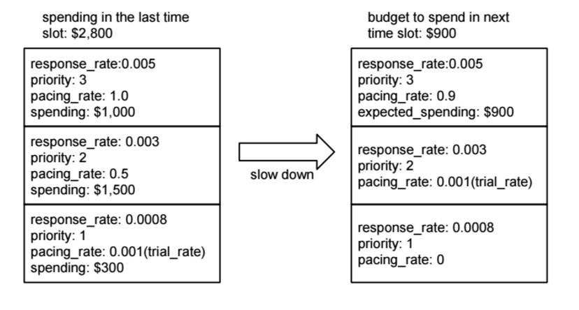
Priority Controller

Slide 21
Evaluation

Slide 22
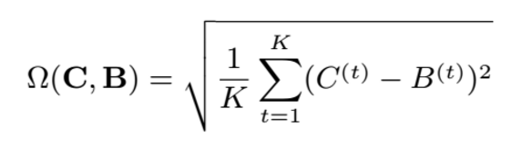
Evaluation by SPEND
Evaluate system by how closely it followed the budget
RMSE penalizes large errors more than small errors
B(k) is the spend plan, C(k) is the actual spend

Slide 23
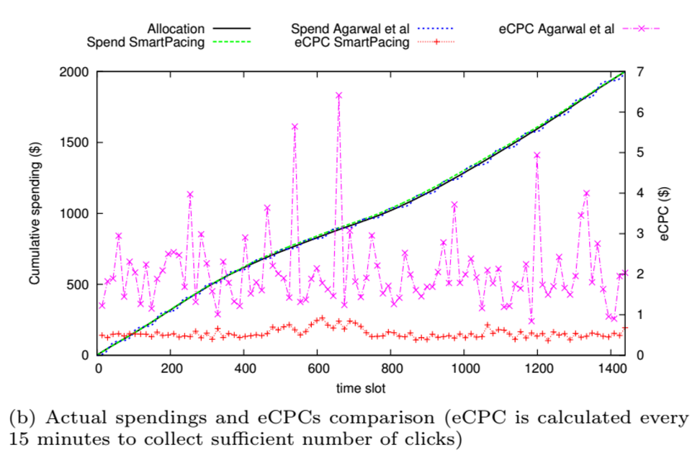
Evaluation by EPEC
If budget is allocated well, the eCPC of campaign will remain stable

