Slide 1
Pacing In the RTB Space
The state of AD TECH research

Slide 2
Papers
Budget Pacing for Targeted Online Advertisements at LinkedIn by Deepak Agarwal et al. KDD 2014.
Smart Pacing for Effective Online Ad Campaign Optimization by Jian Xu et al. KDD 2015.
Real Time Bid Optimization with Smooth Budget Delivery in Online Advertising by Kuang-Chih Lee, Ali Jalali, Ali Dasdan. ADKDD 2013.
From 0.5 Million to 2.5 Million: Efficiently Scaling up Real-Time Bidding by Jianqian Shen et al. ICDM 2015.

Slide 3
A brief Overview
Why pacing is hard
Pacing techniques
Traffic vs KPI
Slow start; Early finish
Control Systems Engineering
How to pace: probabilistic throttling vs bid modification
Naïve control system
Priority control system
Evaluation metrics

Slide 4
Challenges With Pacing

Slide 5
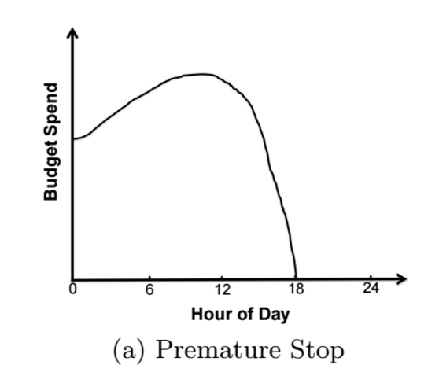
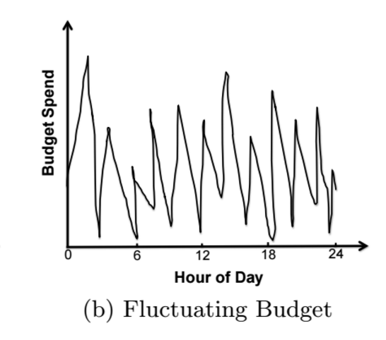
Challenges WITH PACING
Advertisers prefer campaign budgets to be spent smoothly
Hard to execute in the real world

Slide 6
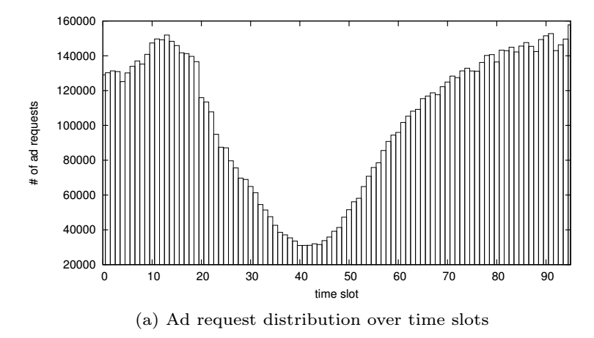
Challenges WITH PACING
Traffic is highly variable
Even more erratic on a per campaign basis (i.e. site list, geo filter)

Slide 7
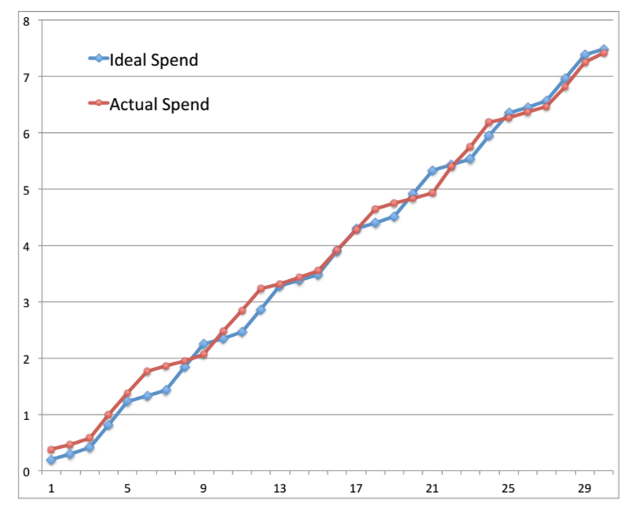
Challenges WITH PACING: ideal

Slide 8
Pacing Techniques

Slide 9

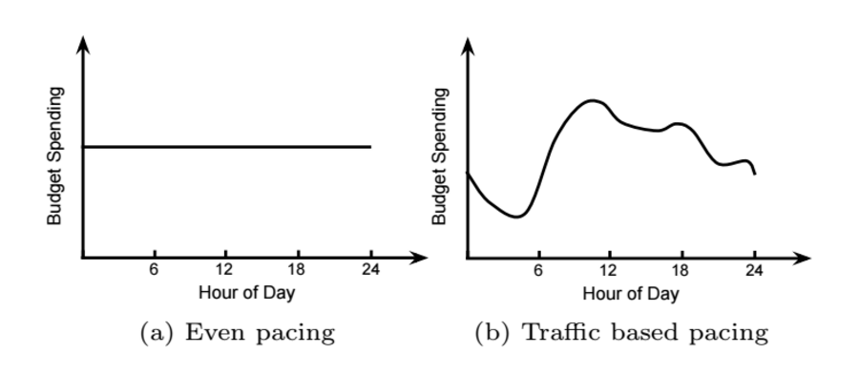
Pacing Techniques: How do we pace?
Come up with a spend plan
Divide up day into time slots and allocate budget B per time slot

Slide 10
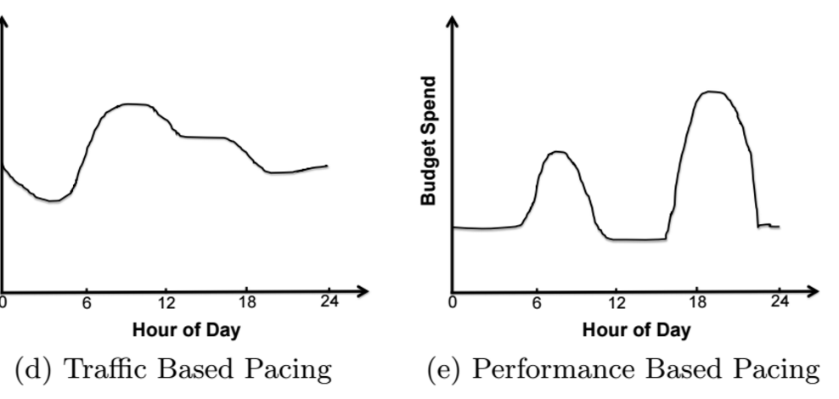
Traffic vs KPI BASED PACING
Traffic based pacing tries to control how many auctions a campaign sees
KPI based pacing tries to get the cheapest KPIs (clicks, completions…etc.)

Slide 11
Combining Traffic and KPI PATTERNS
Allocate B(k) based on KPI patterns (e.g. a lot more clicks in the evening than morning)
Clicks are cheapest when there’re an abundance of clicks
Calculate pacing rates for each time slot based on traffic
Need to spend B(k)
Estimate how many auctions, N(k), an ad needs to see
Figure out the % of traffic to show the ad to get N(k) auctions

Slide 12
Slow start
Start out the day by being selective
Prevents overspending / spending more than allocated
Encourages optimizing for KPIs
100% of eligible auctions
Start out low
Hour

Slide 13
Fast finish
Finish spending budget a few hours before the 24 hour mark
A DSP would rather overspend then underspend
Finish majority of spend
End of day
Hour

Slide 14
Control SystemS

Slide 15
Probabilistic throttling vs Bid modification
Want to spend exactly B(k) for time slot k
There are 2 ways to control spending
Probabilistic throttling
Show an ad an auction with p percent of the time
0 means stop showing auctions to ad
1 means show every auction to ad
Bid modification
Assume each campaign bids c on each auction
Lower the bid to βc, where 0 <= β <= 1
Change β to control spending

Slide 16
Probabilistic throttling vs Bid modification
Advantages with probabilistic throttling:
Directly influences spend (*)
Bid modification must take account of business rules in the auction space such as the reserve price established by the publisher
Decouples pacing from bid evaluation
From this point on, we will use probabilistic throttling (p, the pacing rate) as the actuator in our controllers.
(*) Changing β for bid modification does not directly change spend, sincewin rate does not change linearly with bid multiplier

Slide 17
Naïve Controller
LinkedIn uses a simple water wheel controller
Start the day with p = 0.1
Every 1 minute, update p:
If over pacing, p = p * 1.1
If under pacing, p = p * 0.9
Problems:
Needs the system to update very often
p oscillates needlessly

Slide 18
Priority Controller
Group similarly performing auctions together by KPI into layers
Prioritize auctions that generate the best KPI (e.g. clicks)
In time slot k, each layer is given a budget and a pacing rate p
Rank layers by expected KPI (highest to lowest)
Layer 1, response rate: 0.002
Layer 2, response rate: 0.0002
Layer 3, response rate: 0.00002 …etc.
If campaign is overspending, lower pacing rate from bottom up
If campaign is under spending, raise pacing rate from top down

Slide 19
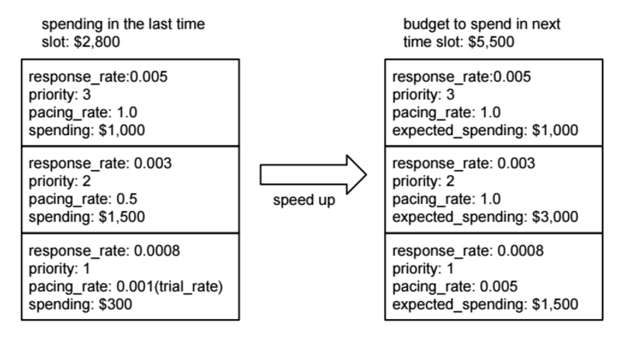
Priority Controller

Slide 20
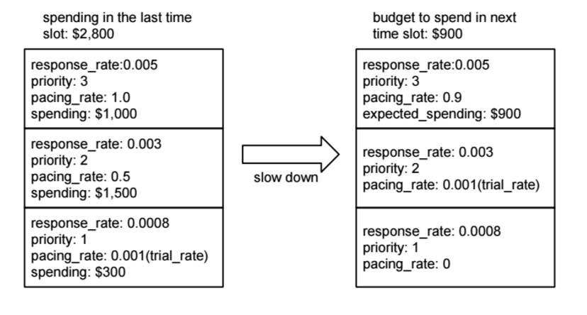
Priority Controller

Slide 21
Evaluation Metrics

Slide 22
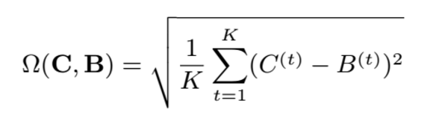
Evaluation Metric: RMSE
Evaluate system by how closely it followed the budget
RMSE penalizes large errors more than small errors
B(k) is the spend plan, C(k) is the actual spend

Slide 23
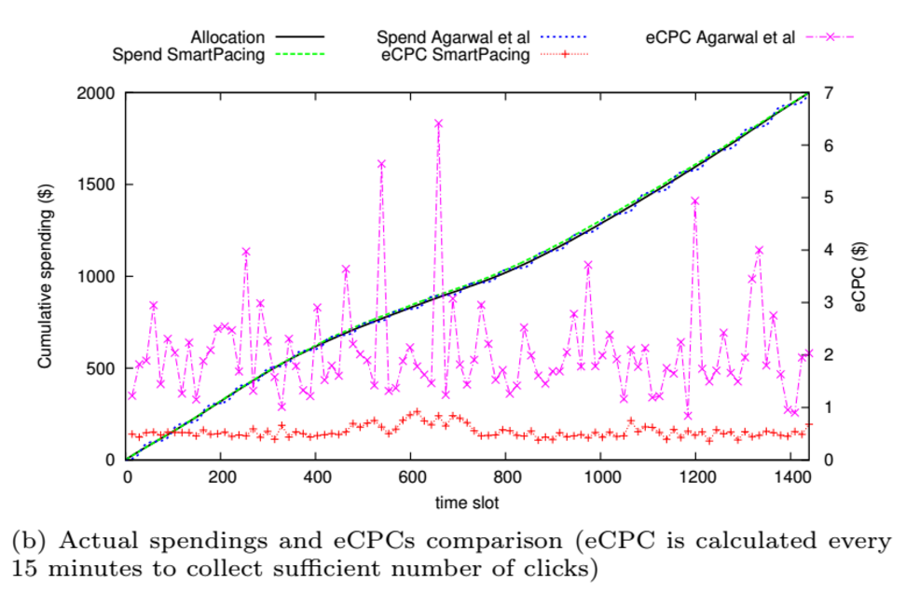
Evaluation METRIC: KPI
If budget is allocated well, the eCPC of campaign will remain stable

