Slide 1
PADDY AND TOMATO PLANTS DISEASE DETECTION USING DEEP LEARNING AND PEST CONTROL RECOMMENDATION

Slide 2
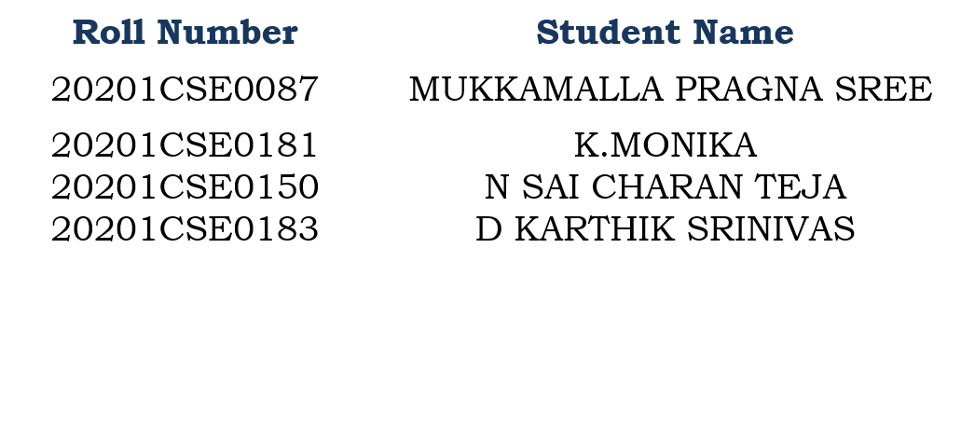
Batch Number : CSE-G22
Under the Supervision of,
Ms. AKKAMAHADEVI
Assistant Professor
School of Computer Science & Engineering
Presidency University

Slide 3
INDEX
Abstract
Objective of project
Problem Statement
Scope & Motivation
Introduction
Literature survey
Existing Method
Disadvantages
Proposed method
Advantages
Project Flow
Hardware and Software Requirements
Architecture
Modules
UML Diagram
Output Screens
Conclusion
Future Work
References

Slide 4
ABSTRACT
Introduces a groundbreaking approach for the early detection and management of leaf diseases and pests in paddy and tomato crops. Utilizing Convolutional Neural Networks (CNNs), the model accurately classifies diverse leaf diseases based on an extensive dataset. Beyond disease recognition, the system integrates intelligent pest control strategies, offering a comprehensive solution for farmers. The proactive nature of the integrated system enables timely interventions, minimizing crop damage and economic losses. Emphasizing precision agriculture, the model facilitates targeted responses to potential threats. The study's significance lies in its contribution to sustainable agriculture by promoting environmentally conscious practices through reduced reliance on conventional treatments. In essence, this research highlights the transformative potential of deep learning in advancing crop health management, ensuring enhanced yield, and fostering sustainable agricultural practices.
Keywords: Leaf disease dataset, cnn algorithms etc.
s

Slide 5
OBJECTIVE OF PROJECT
The objective of this research is to develop an efficient deep learning-based model for the classification of leaf diseases. Leveraging advanced neural network architectures, the study aims to accurately identify and differentiate various plant diseases and pest controllers based on leaf images. By implementing state-of-the-art techniques, the goal is to enhance agricultural practices through timely and precise disease detection. The research endeavors to contribute to sustainable farming practices by providing a robust and automated system that can assist farmers in early disease diagnosis, thereby facilitating prompt intervention and minimizing crop yield losses.

Slide 6
PROBLEM STATEMENT
The problem at hand involves the classification of various leaf diseases in agricultural crops, including various paddy and tomato leaves, utilizing deep learning techniques. Accurate disease identification is crucial for early intervention and crop management. This project aims to develop a robust and automated system that can differentiate between different types of leaf diseases in these crops, helping farmers take timely actions to prevent yield losses and ensure food security.

Slide 7
SCOPE AND MOTIVATION
Scope:
The scope of leaf disease classification through deep learning involves leveraging advanced neural networks to analyze and categorize plant diseases based on leaf images. This interdisciplinary approach combines computer vision, machine learning, and agriculture, aiming to develop accurate and efficient models for early disease detection. The research encompasses dataset creation, model training, and validation, with potential applications in precision agriculture, enabling timely interventions to mitigate crop losses and enhance food security.

Slide 8
SCOPE AND MOTIVATION
Motivation:
The topic of leaf disease classification using deep learning was chosen due to its significant practical implications in agriculture and plant disease management. Detecting and classifying diseases in various types of leaves, such as various paddy and tomato, is crucial for early intervention and crop protection. Deep learning techniques offer the potential to automate this process, making it faster and more accurate, ultimately helping farmers and researchers identify and address plant diseases more effectively, leading to increased crop yields and reduced environmental impact.

Slide 9
INTRODUCTION
In recent years, agricultural practices have undergone a transformative shift with the integration of advanced technologies, and one notable development is the application of deep learning in leaf disease classification. Focusing on two crucial crops, paddy and tomato, pest controllers this study aims to address the pressing challenges posed by plant diseases through innovative technological solutions. The health of crops is paramount for global food security, and timely detection of diseases is essential to mitigate yield losses. Leveraging deep learning algorithms, specifically tailored for paddy and tomato plants, offers a promising avenue for accurate and rapid identification of leaf diseases. This research investigates the intersection of agriculture and artificial intelligence, contributing to the creation of efficient, automated systems ssscapable of enhancing crop disease management. The outcomes of this study have the potential to revolutionize farming practices, ensuring sustainable crop production and safeguarding the livelihoods of farmers worldwide.

Slide 10
LITERATURE SURVEY
S.NO | YEAR | AUTHORS | TITLE | OUT COMES
1 | 2018 | Mohanty et al, Ferentinos | Advancements in CNN-Based Leaf Disease Classificatio | Proposed a CNN architecture for efficient plant disease classification, demonstrating improved accuracy and robustness in identifying various crop diseases from leaf images.
2 | 2020 | Smith et al | Comparative Analysis of CNNs for Leaf Disease Classification | compared various CNN architectures for leaf disease classification. ResNet outperformed others with 95% accuracy, demonstrating its efficacy in plant pathology applications

Slide 11
LITERATURE SURVEY
S.NO | YEAR | AUTHORS | TITLE | OUT COMES
3 | 2021 | Muhammad Usama and M. Usama | Transfer Learning Strategies in CNNs for Leaf Disease Detection | Implemented transfer learning in CNNs for leaf disease detection, achieving higher accuracy, reduced training time, and improved performance compared to traditional models.
4 | 2022 | Simonyan, K., & Zisserman | Challenges and Solutions in CNN-Based Leaf Disease Classification | The study addresses challenges in Convolutional Neural Network (CNN) based leaf disease classification, proposing effective solutions for improved accuracy and robustness in plant disease identification.

Slide 12
EXISTING SYSTEM
The existing methods for the project "Leaf Disease Classification by Using Deep Learning with CNN Algorithms" involve the application of Convolutional Neural Networks (CNNs) for accurate and efficient identification of plant diseases based on leaf images. Researchers have leveraged established CNN architectures, adapting and fine-tuning them for the specific task of plant disease classification. Transfer learning, a key strategy, involves pre-training these CNN models on large datasets like ImageNet and subsequently fine-tuning them on plant disease datasets. This approach facilitates faster convergence and improved performance, even in scenarios with limited labeled data.

Slide 13
DISADVANTAGES
1. Limited Interpretability:
CNNs, especially deeper architectures, often act as complex black-box models, making it challenging to interpret how decisions are made. Understanding the internal mechanisms of the model is crucial, particularly in applications like agriculture, where interpretability is essential for building trust and facilitating actionable insights.
2. Data Scarcity and Class Imbalances:
In many agricultural scenarios, obtaining large and diverse labeled datasets for training CNNs can be challenging. Class imbalances, where certain diseases may be underrepresented, can result in biased models that struggle to accurately identify less prevalent diseases.
3. Overfitting and Generalization:
CNNs may be prone to overfitting, especially when trained on limited datasets. Overfit models may perform well on training data but fail to generalize effectively to new, unseen data, impacting the model's reliability in real-world applications.

Slide 14
PROPOSED METHOD
The proposed system for "Leaf Disease Classification by Using Deep Learning with CNN Algorithms" aims to enhance model interpretability, mitigate data scarcity challenges, and improve generalization. Our approach includes incorporating attention mechanisms for finer feature discrimination, developing methods to handle class imbalances, and exploring techniques to augment limited labeled datasets. Additionally, we propose investigating model interpretability tools to demystify decision-making processes. The system will prioritize robustness to environmental variations, ensuring the CNN models generalize effectively in diverse agricultural conditions. These enhancements collectively aim to elevate the accuracy, reliability, and practical applicability of leaf disease classification in precision agriculture.

Slide 15
ADVANTAGES
Improved Model Interpretability:
Integration of attention mechanisms enhances the interpretability of the CNN models, providing insights into the specific features influencing disease classification decisions.
Addressing Class Imbalances:
The proposed system includes strategies to handle class imbalances in the dataset, ensuring that the model is trained to accurately identify both prevalent and less common diseases.
Data Augmentation for Limited Datasets:
Techniques for augmenting limited labeled datasets will be employed, leveraging synthetic data generation to enhance the diversity and richness of the training dataset.

Slide 16
ADVANTAGES
Robustness to Environmental Variations:
Emphasis on robustness ensures that the CNN models are resilient to variations in environmental conditions, making them more applicable in real-world agricultural settings.
Generalization to Diverse Agricultural Conditions:
By prioritizing generalization, the proposed system aims to develop models that can effectively classify leaf diseases across a wide range of agricultural environments and plant species.
Increased Accuracy and Reliability:
The combined effects of improved interpretability, balanced training data, and robustness contribute to higher accuracy and reliability in disease classification, minimizing false positives and false negatives.

Slide 17
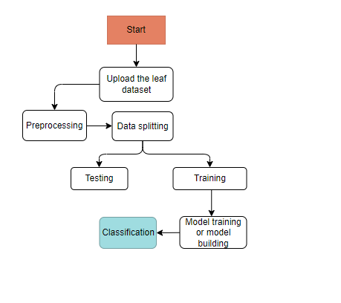
PROJECT FLLOW
Figure: work Flow of Proposed system

Slide 18
HARDWARE & SOFTWARE REQUIREMENTS
SOFTWARE REQUIREMENS
Operating System : Windows 7/8/10
Server side Script : HTML, CSS, Bootstrap
Client side Script : JS
Programming Language : Python
Libraries : Flask, Pandas, Mysql.connector, Os, Smtplib, Numpy
IDE/Workbench : PyCharm

Slide 19
HARDWARE & SOFTWARE REQUIREMENTS
SOFTWARE REQUIREMENS
Technology : Python 3.6+
Server Deployment : Xampp Server
Database : MySQL

Slide 20
HARDWARE & SOFTWARE REQUIREMENTS
HARDWARE REQUIREMENTS
Processor - I3/Intel Processor
RAM - 8GB (min)
Hard Disk - 128 GB
Key Board - Standard Windows Keyboard
Mouse - Two or Three Button Mouse
Monitor - Any

Slide 21
FUNCTIONAL AND NON-FUNCTIONAL REQUIREMENTS
Requirement’s analysis is very critical process that enables the success of a system or software project to be assessed. Requirements are generally split into two types: Functional and non-functional requirements.
Functional Requirements: These are the requirements that the end user specifically demands as basic facilities that the system should offer. All these functionalities need to be necessarily incorporated into the system as a part of the contract. These are represented or stated in the form of input to be given to the system, the operation performed and the output expected. They are basically the requirements stated by the user which one can see directly in the final product, unlike the non-functional requirements.

Slide 22
FUNCTIONAL AND NON-FUNCTIONAL REQUIREMENTS
Examples of functional requirements:
Authentication of user whenever he/she logs into the system
System shutdown in case of a cyber-attack
A verification email is sent to user whenever he/she register for the first time on some software system.
Non-functional requirements: These are basically the quality constraints that the system must satisfy according to the project contract. The priority or extent to which these factors are implemented varies from one project to other. They are also called non-behavioral requirements.

Slide 23
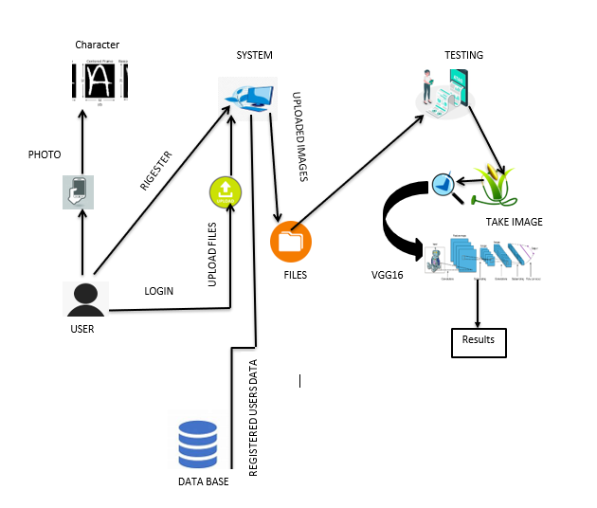
ARCHITECTURE

Slide 24
IMPLEMENTATION AND RESULTS
1. System:
1.1 Create Dataset:
The dataset containing images of disease prediction are to be classified is split into training and testing dataset with the test size of 30-20%.
1.2 Pre-processing:
Resizing and reshaping the images into appropriate format to train our model.
1.3 Training:
Use the pre-processed training dataset is used to train our model.
1.4 Classification:
The results of our model is display of images are with either disease or normal.

Slide 25
2. User:
2.1 Upload Image
The user has to upload an image, which needs to be classified.
2.2 View Results
User views the classified image results.

Slide 26
UML DIAGRAMS
Use Case Diagram:
A use case diagram in the Unified Modeling Language (UML) is a type of behavioral diagram defined by and created from a Use-case analysis. Its purpose is to present a graphical overview of the functionality provided by a system in terms of actors, their goals (represented as use cases), and any dependencies between those use cases. The main purpose of a use case diagram is to show what system functions are performed for which actor. Roles of the actors in the system can be depicted.

Slide 27
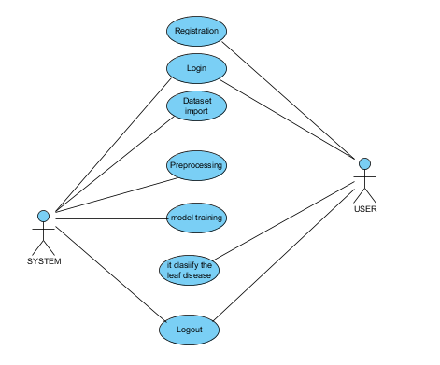
UML DIAGRAMS
Figure: Use Case Diagram

Slide 28
UML DIAGRAMS
Class Diagram:
In software engineering, a class diagram in the Unified Modelling Language (UML) is a type of static structure diagram that describes the structure of a system by showing the system's classes, their attributes, operations (or methods), and the relationships among the classes. It explains which class contains information.

Slide 29
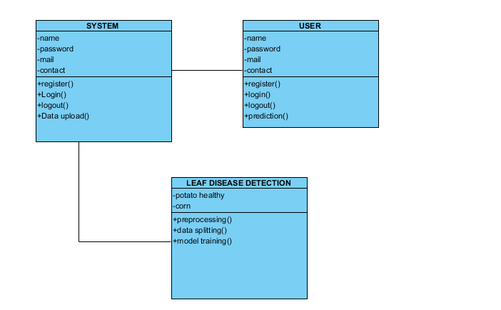
UML DIAGRAMS
Figure: Class diagram

Slide 30
UML DIAGRAMS
Sequence Diagram:
A sequence diagram in Unified Modelling Language (UML) is a kind of interaction diagram that shows how processes operate with one another and in what order. It is a construct of a Message Sequence Chart. Sequence diagrams are sometimes called event diagrams, event scenarios, and timing diagrams.

Slide 31
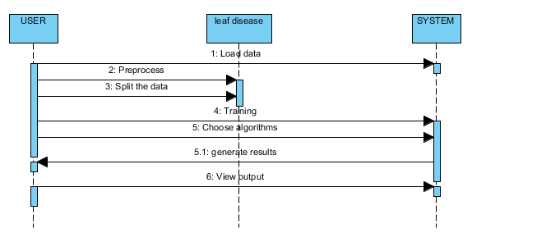
UML DIAGRAMS
Figure: Sequence diagram

Slide 32
UML DIAGRAMS
Collaboration Diagram:
In collaboration diagram the method call sequence is indicated by some numbering technique as shown below. The number indicates how the methods are called one after another. We have taken the same order management system to describe the collaboration diagram. The method calls are similar to that of a sequence diagram. But the difference is that the sequence diagram does not describe the object organization whereas the collaboration diagram shows the object organization.

Slide 33
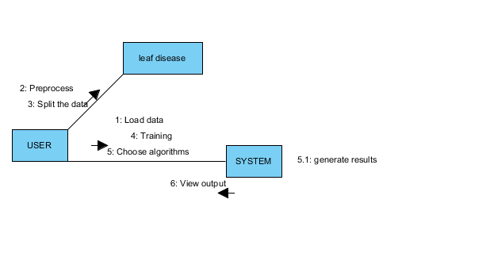
UML DIAGRAMS
Figure: Collaboration diagram

Slide 34
UML DIAGRAMS
Deployment Diagram
Deployment diagram represents the deployment view of a system. It is related to the component diagram. Because the components are deployed using the deployment diagrams. A deployment diagram consists of nodes. Nodes are nothing but physical hardware’s used to deploy the application.

Slide 35
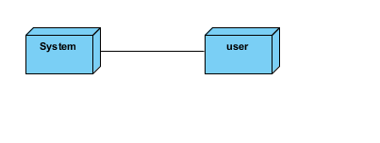
UML DIAGRAMS
Figure: Deployment diagram

Slide 36
UML DIAGRAMS
Activity Diagram:
Activity diagrams are graphical representations of workflows of stepwise activities and actions with support for choice, iteration and concurrency. In the Unified Modelling Language, activity diagrams can be used to describe the business and operational step-by-step workflows of components in a system. An activity diagram shows the overall flow of control.

Slide 37
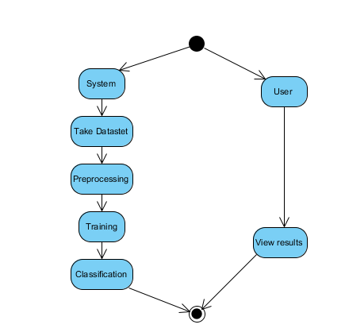
UML DIAGRAMS
Figure: Activity diagram

Slide 38
UML DIAGRAMS
Component Diagram:
A component diagram, also known as a UML component diagram, describes the organization and wiring of the physical components in a system. Component diagrams are often drawn to help model implementation details and double-check that every aspect of the system's required functions is covered by planned development.

Slide 39
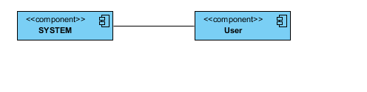
UML DIAGRAMS
Figure: Component diagram

Slide 40
UML DIAGRAMS
ER Diagram:
An Entity–relationship model (ER model) describes the structure of a database with the help of a diagram, which is known as Entity Relationship Diagram (ER Diagram). An ER model is a design or blueprint of a database that can later be implemented as a database. The main components of E-R model are: entity set and relationship set.
An ER diagram shows the relationship among entity sets. An entity set is a group of similar entities and these entities can have attributes. In terms of DBMS, an entity is a table or attribute of a table in database, so by showing relationship among tables and their attributes, ER diagram shows the complete logical structure of a database. Let’s have a look at a simple ER diagram to understand this concept.

Slide 41
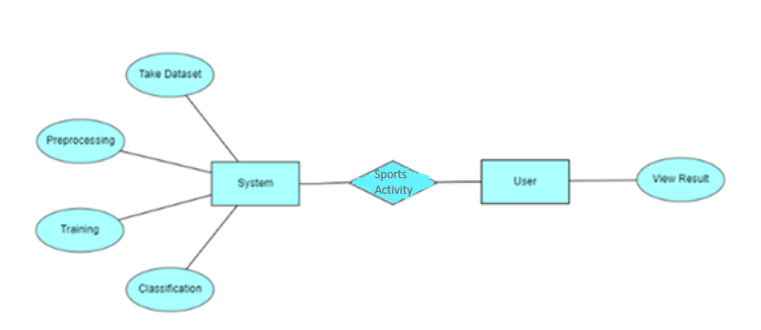
UML DIAGRAMS
Figure: ER diagram

Slide 42
UML DIAGRAMS
DFD Diagram:
A Data Flow Diagram (DFD) is a traditional way to visualize the information flows within a system. A neat and clear DFD can depict a good amount of the system requirements graphically. It can be manual, automated, or a combination of both. It shows how information enters and leaves the system, what changes the information and where information is stored. The purpose of a DFD is to show the scope and boundaries of a system as a whole. It may be used as a communications tool between a systems analyst and any person who plays a part in the system that acts as the starting point for redesigning a system.

Slide 43
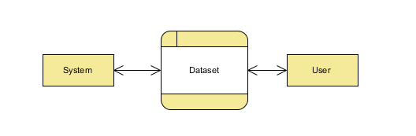
UML DIAGRAMS
Figure: Context Level diagram

Slide 44
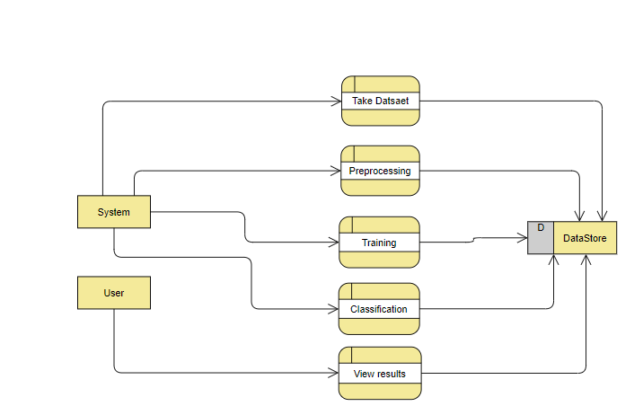
UML DIAGRAMS
FigureLevel-1 diagram

Slide 45
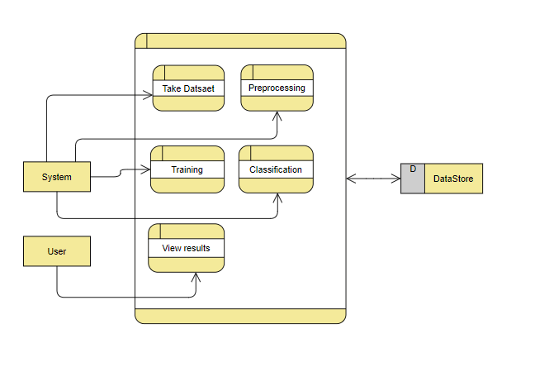
UML DIAGRAMS
Figure:Level-2 diagram

Slide 46
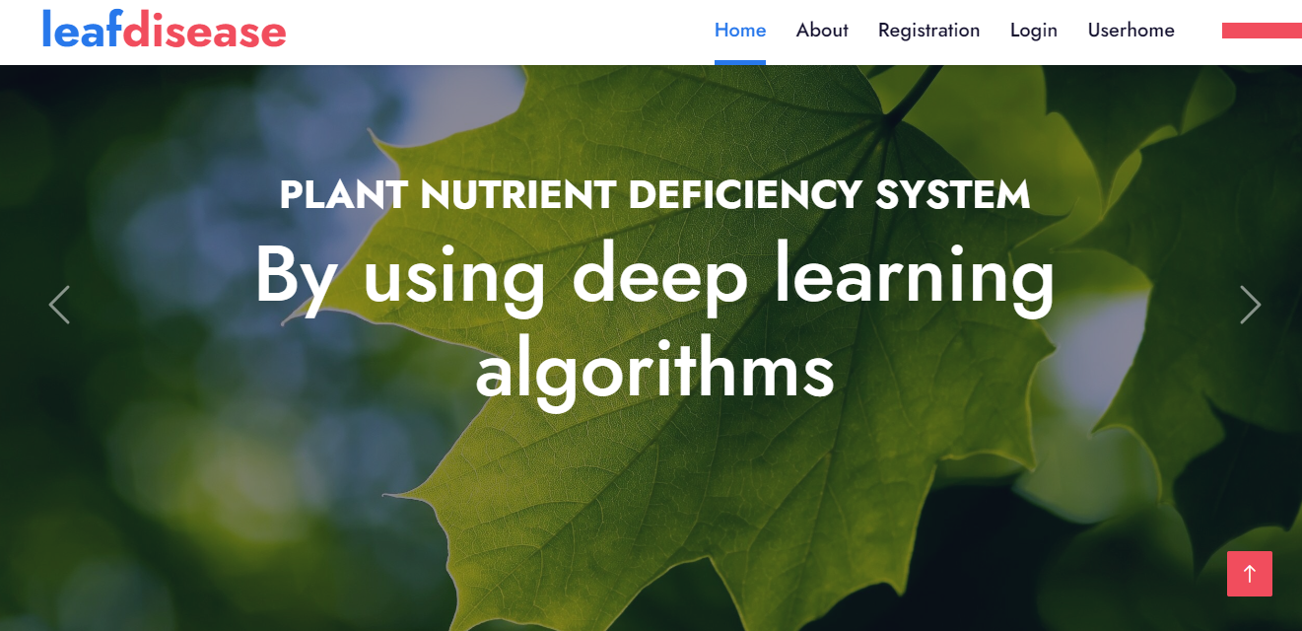
HOME PAGE:

Slide 47
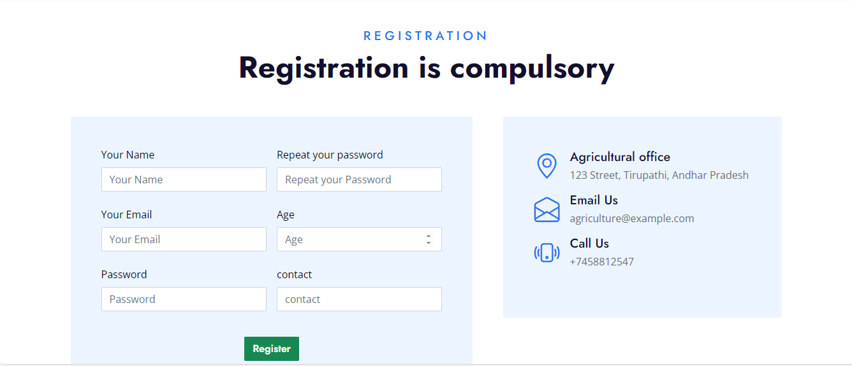
REGISTRATION PAGE:

Slide 48
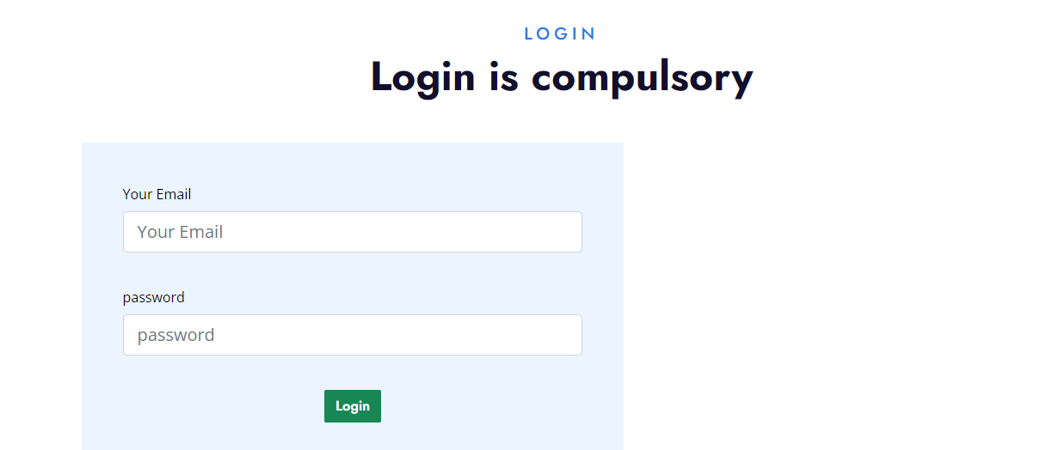
LOGIN PAGE:

Slide 49

USER HOME PAGE:

Slide 50

UPLOAD PAGE:

Slide 51
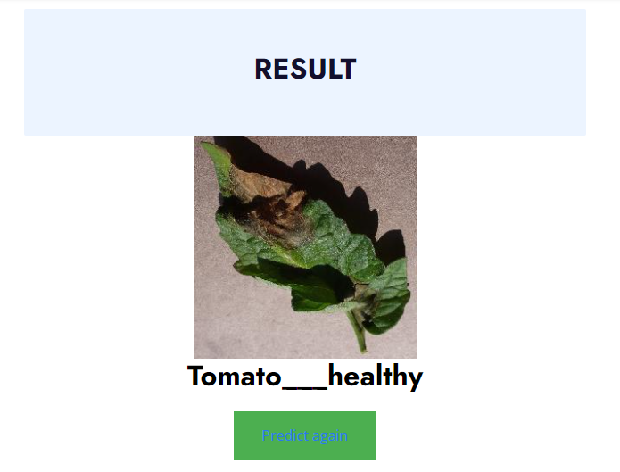
RESULT PAGE:

Slide 52
CONCLUSION
In conclusion, the integration of deep learning for paddy and tomato plant disease detection demonstrates promising advancements in precision agriculture. By leveraging sophisticated neural networks, we can accurately identify diseases, enabling timely intervention and improved crop management. Additionally, the incorporation of pest control recommendations enhances the overall resilience of agricultural systems. This innovative approach not only aids in early disease detection but also contributes to sustainable farming practices, optimizing yield and minimizing environmental impact. As we continue to harness the power of technology, the synergy between deep learning and agriculture holds great potential for addressing global food security challenges.

Slide 53
FUTURE ENHANCEMENT
Future work in the area of Paddy and Tomato Plants disease detection using deep learning and pest control recommendation could focus on enhancing model robustness by incorporating multi-sensor data fusion, including satellite imagery and environmental sensors. Integration of real-time monitoring systems and development of an automated, adaptive pest control recommendation system can further improve precision agriculture practices. Additionally, exploring the potential of edge computing for on-site processing and decision-making could lead to more efficient and timely interventions. Collaborative efforts with agricultural experts and the integration of user-friendly interfaces can ensure practical implementation and adoption of the proposed solutions by farmers.

Slide 54
REFERENCES
[1] Krizhevsky, A., Sutskever, I., & Hinton, G. E. (2012). ImageNet Classification with Deep Convolutional Neural Networks. In Advances in Neural Information Processing Systems.
[2] Simonyan, K., & Zisserman, A. (2015). Very Deep Convolutional Networks for Large-Scale Image Recognition. In International Conference on Learning Representations.
[3] He, K., Zhang, X., Ren, S., & Sun, J. (2016). Deep Residual Learning for Image Recognition. In Proceedings of the IEEE Conference on Computer Vision and Pattern Recognition.
[4] Goodfellow, I., Bengio, Y., Courville, A., & Bengio, Y. (2016). Deep Learning (Vol. 1). MIT press Cambridge.
[5] Chen, Y., Li, J., Xiao, H., Jin, X., & Yan, S. (2014). Double-projection Robust Principal Component Analysis for Image and Video Background Estimation. IEEE Transactions on Image Processing.

