Slide 1


BCA • ARTIFICIAL INTELLIGENCE & MACHINE LEARNING
The Future of
Artificial Intelligence
How AI Will Transform Our World
●
Your Name
Department of BCA — AI & ML

Slide 2
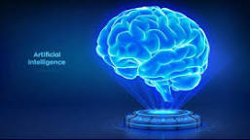





UNDERSTANDING THE BASICS
What is Artificial
Intelligence?
Definition
The ability of machines to learn, reason, and solve problems the way humans do.
EXAMPLES YOU USE TODAY
ChatGPT
Google Maps
Siri
Face Unlock
Netflix Picks
THE FUTURE OF AI
02 / 12

Slide 3






THE SHIFT
AI Today vs. AI Tomorrow
AI TODAY
AI TOMORROW
Voice Assistants
Personal AI Companions
Face Unlock
Emotion Recognition
Chatbots
AI Teachers
Smart Cars
Fully Autonomous Cities
AI is evolving from helping us to working alongside us.
THE FUTURE OF AI
03 / 12

Slide 4
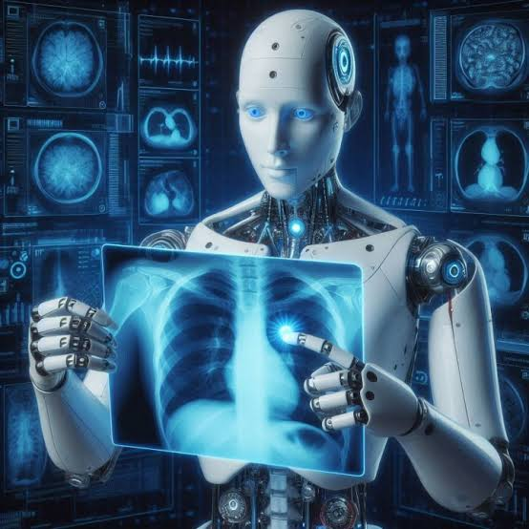




DOMAIN 01 — HEALTHCARE
Future of AI in
Healthcare
Early disease prediction
AI-assisted surgeries
Personalized medicines
AI health monitoring
Robotic nurses
EXAMPLE
AI may detect diseases like cancer at very early stages, helping doctors begin treatment sooner.
THE FUTURE OF AI
04 / 12

Slide 5
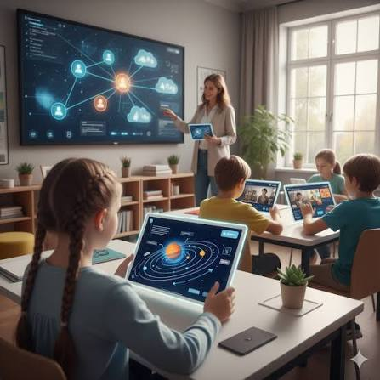




DOMAIN 02 — EDUCATION
Future of AI in
Education
AI tutors
Personalized learning
Automatic grading
Virtual classrooms
Learning in any language
THE FUTURE OF AI
05 / 12

Slide 6




DOMAIN 03 — URBAN LIFE
Future Smart Cities
AI-powered infrastructure reshaping how cities move, breathe, and grow.
Self-driving vehicles
Smart traffic signals
Energy-efficient buildings
Autonomous transport reduces accidents and congestion.
AI-timed signals cut wait times and emissions.
Smart grids optimize power use in real time.
Smart waste management
Better public safety
Sensors route collection only when needed.
Predictive systems help prevent incidents early.
THE FUTURE OF AI
06 / 12

Slide 7





DOMAIN 04 — BEYOND EARTH
AI in Space Exploration
Exploring Mars
Assisting astronauts
Autonomous space robots
Finding habitable planets
Satellite monitoring
THE FUTURE OF AI
07 / 12

Slide 8










A BALANCED VIEW
Benefits & Challenges
BENEFITS
CHALLENGES
Better healthcare
Privacy concerns
Faster work
Job changes
Smarter education
AI bias
Safer transportation
Cybersecurity
Scientific discoveries
Ethical issues
THE FUTURE OF AI
08 / 12

Slide 9




NEW OPPORTUNITIES
What Jobs Will AI Create?
AI Engineer
Data Scientist
Robotics Engineer
Prompt Engineer
AI Ethics Specialist
Machine Learning Engineer
AI won’t just automate jobs — it will also create many new careers.
THE FUTURE OF AI
09 / 12

Slide 10


KEY TAKEAWAYS
Conclusion
AI will improve healthcare, education, transportation, and space exploration.
AI should be developed responsibly and ethically.
Humans and AI will work together to solve future challenges.
THE FUTURE OF AI
10 / 12

Slide 11

The future belongs not to AI alone, but to people who know how to work with AI.
THE FUTURE OF AI
11 / 12

Slide 12

Thank You
Questions & Discussion Welcome
BCA — AI & ML | The Future of Artificial Intelligence

