Slide 1
CSE 575 Class Project Presentation
TEAM PERFORMANCE PREDICTOR
Team Members
Aditya Prasad Mishra (1211165121)(amishr28@asu.edu) (16.66%)
Manikandan Anandan (1210414345) (manandan@asu.edu)) (16.66%)
Piyush (1211198375) (ppapreja@asu.edu) (16.66%)
Pragna Munagala (1211111639) (pmunagal@asu.edu) (16.66%)
Rohit B Menon (1212386823) (rmenon9@asu.edu) (16.66%)
Shalmali Bhoir (1209395067) (sbhoir@asu.edu) (16.66%)

Slide 2
Introduction
Fundamental challenge lies in forming a high-performance team.
Individual skills and past collaboration efforts are considered to predict the future collaboration.
MovieLens dataset is used to analyze the network of actors and directors.
Classifiers used:
Gaussian Naive Bayes
Single layer Neural Network
Multi-layer layer Neural Networks
Notes:
speed...

Slide 3
Problem Statement
Given the movie actors and directors
Predict the performance of the movie.
Performance represented by the Movie Rating class
Higher the Movie Rating → Higher the Performance of the team
Considers Individual Skills and Past Collaboration Efforts
Apply Gaussian Naive Bayes, Single Layer Perceptron and Multi-layer Perceptron Back Propagation Algorithms. Study and compare the results obtained with other classifiers

Slide 4
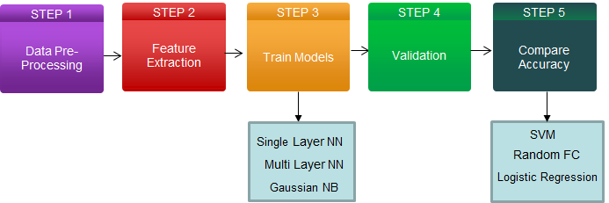
Process Flow
Notes:
explanation

Slide 5
Data Pre-processing
Dataset: Movielens 2K Dataset
Data Source: https://grouplens.org/datasets/hetrec-2011/
Dataset Statistics:
No. of Movies: 10197
No. of Actors: 95321
No. of Directors: 4060
No. of Genres: 20
Data is cleaned for missing values and invalid entries
Eliminated duplicate and outlier records and checked for data uniformity and integrity.
Notes:
2 3 datasets
2K users

Slide 6

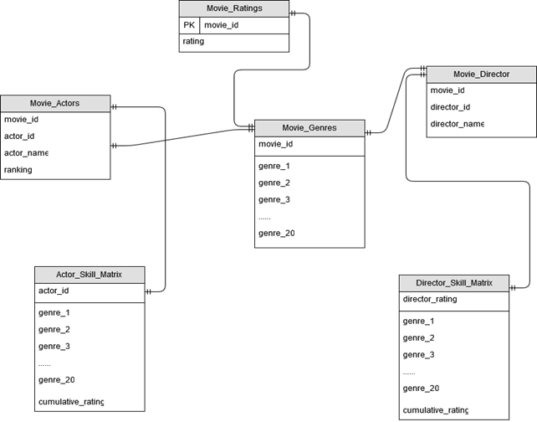
Data Pre-processing
Design database schema with required database objects.
Used MySQL loader to load data into the required tables from the flat files.

Slide 7
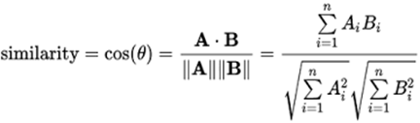
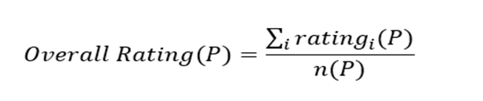
Feature Extraction I
Similarity matrix
Similarity between top 5 actors and director of a movie (Cosine distance)
Overall Quality:
Cumulative rating of each actor of a movie:
Notes:
Cosine similarity

Slide 8
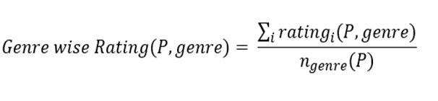
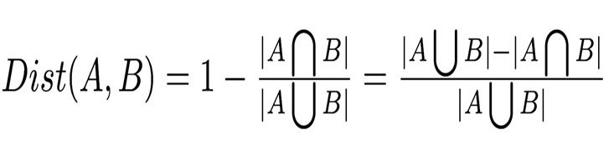
Feature Extraction II
Individual Quality:
Genre wise rating of an individual of a movie:
Collaboration Distance
Number of collaboration between each pair of individual (Jaccard distance)
Notes:
Script ?

Slide 9
Gaussian Naive Bayes
Algorithm
Features are assumed to be conditionally independent (on class) of each other.
Find probability of each class. P(y) = count of samples of that class / total samples
Find mean and variance of each feature for each class. P(X_{i} | y = C_{i})
Final probability is given by:
P(y=C_{i} | X_{i}) = (Σlog2(N(x_{i},𝜇_{ij},𝛔_{ij}))) + log2(P(y))
Where 𝜇_{ij},𝛔_{ij} are the mean and variance of a feature i given class j.
Finally, assign a class label whose probability is maximum in the above formula.
Notes:
Class labels ? Formula ?

Slide 10



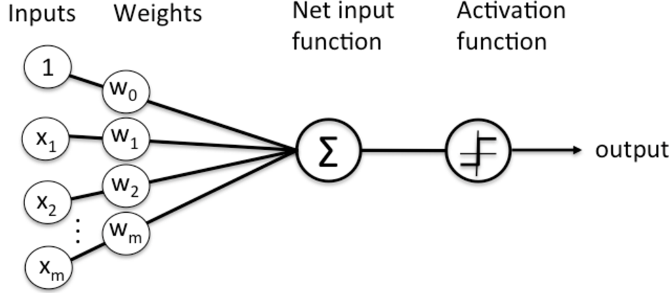
Single Layer Neural Network
Algorithm:
Initialize weights.
Calculate the class label.
Calculate mean squared error.
Update the weights using Gradient
Descent.
Repeat steps 2 to 5 until the error
Threshold or for specified number
of iterations.
Notes:
Iterations learning rate Weights Local optima , global optima

Slide 11
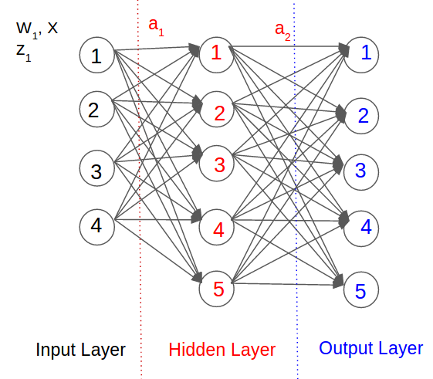
Multi Layer Neural Network
Basic Layers of MNN:
Input Layer - 4 Input features
Hidden Layer - 5 nodes
Output Layer - 5 class labels
Types of Activation Function
Sigmoid
Tanh (used)
Rectified Linear
Steps
Feed forward algorithm
Backward propagation algorithm

Slide 12
Multi Layer Neural Network
Algorithm
Forward Propagation - Predicting the class label
z₁ = w₁x + b
a₁ = tanh(z₁) - Input to hidden layer - Non linear transformation to hidden layer
a₂ = (w₂a₁ + b) - predicted class label - y’ - linear transformation to output layer
Backward Propagation - Updating the weights
E = 0.5 * (y’ - y)² - calculating the error
dw₂ = dE/dw₂ - partial derivative w.r.t w₂
W₂ = epsilon*(dw₂ + Lambda * w₂) - updating w₂
dw₁ = dE/dw₁ - partial derivative w.r.t w₁
W₁ = epsilon*(dw₁ + Lambda * w₁) - updating w₁
Notes:
Not sure

Slide 13
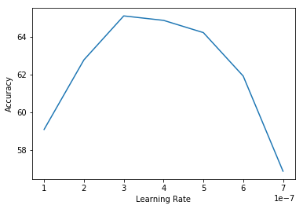
Results
10 Fold Cross Validation to get the accuracy
Notes:
Script ? To the point… Large values effect

Slide 14
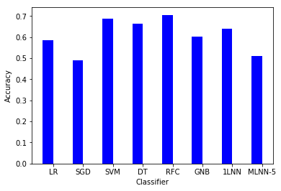
Validation Results
Notes:
Name classifiers ?

Slide 15
Conclusion
SVM and Random Forests performed the best among the classifiers tested on, with about 70% accuracy.
Our implemented models performed fairly well in predicting the performance of a given team with around 60% accuracy.
By varying the learning rate in single layer neural network, it is observed that learning rate used in the Gradient Descent plays an essential role in deciding the learning speed of the algorithm.
Future Work
We will try to improve Multi-Layer Perceptron by changing activation functions and changing initial weights.
Our implementation can be used for any Team Prediction Problem.

Slide 16
References
[1] Lowd, Daniel, and Pedro Domingos. "Naive Bayes models for probability estimation." Proceedings of the 22nd international conference on Machine learning. ACM, 2005
[2] Kuo, Ren Jie, C. H. Chen, and Y. C. Hwang. "An intelligent stock trading decision support system through integration of genetic algorithm based fuzzy neural network and artificial neural network." Fuzzy sets and systems 118.1 (2001): 21-45.
[3] Anirban Majumder , Samik Datta , K.V.M. Naidu, (2012), Capacitated team formation problem on social networks, Proceedings of the 18th ACM SIGKDD international conference on Knowledge discovery and data mining, DOI: 10.1145/2339530.2339690

Slide 17
Team Members
Aditya Prasad Mishra(1211165121)(amishr28@asu.edu) (Feature Engineering, Classifier Comparison, Analysis of Results) (16.66%)
Manikandan Anandan (1210414345) (manandan@asu.edu) (Feature Engineering, Data Pre-processing) (16.66%)
Piyush Nolastname (1211198375) (ppaprejal@asu.edu) (Feature Engineering, Cross Validation Code, Analysis of Results) (16.66%)
Pragna Munagala (1211111639) (pmunagal@asu.edu) (Multi layer NN and Gaussian Naive Bayes Implementation) (16.66%)
Rohit B Menon (1212386823) (rmenon9@asu.edu) (Feature Engineering, Data Pre-processing) (16.66%)
Shalmali Bhoir (1209395067) (sbhoir@asu.edu) (Single layer NN implementation, Analysis of Results) (16.66%)
‘All the team members agree on the team members’ contributions in terms of both what s/he did and the percentage’
’

Slide 18
Questions ?

