Slide 1

CVR COLLEGE OF ENGINEERING DEPARTMENT OF COMPUTER SCIENCE AND ENGINEERING
A Project seminar-I
on
< Timetable >
by
M. Ashritha (22B81A05D7)
SK. Ayesha(22B81A05D8)
T. Pragna (22B81A05G1)
Under guidance of
Dr. D. Sandhya Rani

Slide 2
Contents
Abstract
Motivation
Literature review
Limitations of the existing models
Proposed problem statement
Proposed approach of the work
User/Stakeholder requirement analysis
Software requirement/Technology stack
Hardware requirements
Data sets requirement
11. Innovation in the project
12. Plan of action to complete the project
References

Slide 3
Abstract
The project focuses on developing an automated system for generating faculty timetables by comparing and integrating student timetables.
This solution addresses the challenge of creating conflict-free schedules that optimize faculty availability and meet student course requirements.
Utilizing advanced scheduling algorithms, the system ensures that each faculty member's timetable aligns with student schedules, minimizing overlaps and maximizing resource utilization.
Key features of the system include real-time conflict detection and resolution, user-friendly input interfaces, and robust data validation mechanisms. The system also incorporates secure authentication and authorization protocols to protect sensitive information and ensure that only authorized users can modify timetables. Comprehensive testing was conducted to validate the system's functionality, performance, and security.
The results demonstrate the system's effectiveness in generating accurate and efficient timetables, significantly reducing the administrative burden associated with manual scheduling. Future enhancements are proposed, such as integrating real-time updates, enhancing mobile accessibility, and leveraging AI for predictive scheduling. This project represents a significant advancement in educational scheduling, providing a scalable and adaptable tool for institutions to manage their academic timetables more effectively.

Slide 4
Motivation
The motivation for developing an automated timetable generation system arises from the need to streamline the scheduling process within educational institutions, eliminating the inefficiencies and conflicts inherent in manual scheduling methods.
By offering a user-friendly interface where students can effortlessly view their class timetables by selecting their year and section, and faculty can instantly access their personalized schedules by entering their faculty ID, the system ensures accurate, up-to-date timetables without requiring manual updates or reports.
This enhances operational efficiency, reduces administrative burdens, and significantly improves the overall scheduling experience for both students and faculty members.

Slide 5
Literature review
At present, there is no website or app which is used for Generation of faculty timetable by taking student timetable as input
Since ages, it is manually done where the id or name of particular faculty is needed to be compared with all sections of the particular year student time table.
Wherever the data matches, Sec name of that particular timetable has to be written manually in faculty`s timetable. This is a very time consuming process.

Slide 6
Limitations of the existing Applications/ Models
1.Read Only Content: This project output supports read only content. The time table of the faculty can only be viewed, it can neither be downloaded nor shared through social media.
2.Input Dependency: Generating faculty timetable completely depends on the student time table when it is provided as input to the project in the backend.
3.Static Input: As passage of time, if there are any modification in student time table or if the timetable for the particular section is changed, the changes is not updated in the input of the project. We need to again manually change the input.
4.Limited Generation: As of now our project helps to retrieve faculty timetable data of the faculty who only teach to 2nd year cse.

Slide 7
Proposed problem statement
The project addresses the challenge of creating an automated system for generating faculty timetables by comparing student timetables, aiming to streamline the scheduling process and eliminate conflicts.
The primary interface of the system offers two main options on the homepage: "Faculty" and "Student." When selecting "Student," users can choose the year and section to view the corresponding timetable.
For "Faculty," users enter the faculty ID to automatically generate and display the personal timetable for the specified faculty member.
This system does not include features for updates or reports from faculty or students, focusing solely on providing accurate and conflict-free timetables based on the initial input data.
This approach intends to reduce administrative workload, enhance schedule accuracy, and improve overall efficiency in timetable management.

Slide 8
Proposed approach of the work
Home Page Design:
Create a user-friendly home page with two primary options: "Faculty" and "Student."
Student Timetable Access:
Upon selecting "Student," prompt the user to choose the year and section they are studying.
Display Student Timetable:
Automatically generate and display the timetable for the selected year and section.
Faculty Timetable Access:
Upon selecting "Faculty," prompt the user to enter the faculty ID.
Generate Faculty Timetable:
Automatically generate and display the personal timetable for the entered faculty ID.
Centralized Data Management:
Use a centralized database to store all student and faculty scheduling data.
Conflict-Free Scheduling Algorithm:
Implement an advanced algorithm to ensure conflict-free schedules for both students and faculty.
Real-Time Faculty Timetable Generation:
Ensure that the timetables generated are up-to-date and reflect any recent changes in course schedules or faculty availability.
User Authentication:
Implement a secure login system to ensure that only authorized users can access the timetables.

Slide 9
User/Stakeholder requirement analysis
1.Faculty
Personal Timetable Generation
Conflict Resolution.
Real-time Updates
User-friendly Interface
Mobile Access
Data Privacy
2.Student Requirements
Section Timetable Viewing
Accurate Information
User-friendly Interface
Mobile Access.
3.Administrative Staff Requirements
Timetable Management

Slide 10
Software requirement/Technology stack
1.Operating Systems: Windows, Linux.
2.IDE: JDK.
3.Database Management System: MYSQL.
4.Programming Languages: JavaScript, HTML, CSS, Express, JS

Slide 11
Hardware requirements
1.RAM: Atmost 1GB.
2.Storage: Sufficient storage space for the application.
3.Processor: Intel core i3 or equivalent.

Slide 12
Data sets requirement
1. Student Information Data Set
Attributes:
Course
Year
Branch
Section
2. Faculty Information Data Set
Attributes:
Faculty ID
Department(Student)
Courses Taught

Slide 13
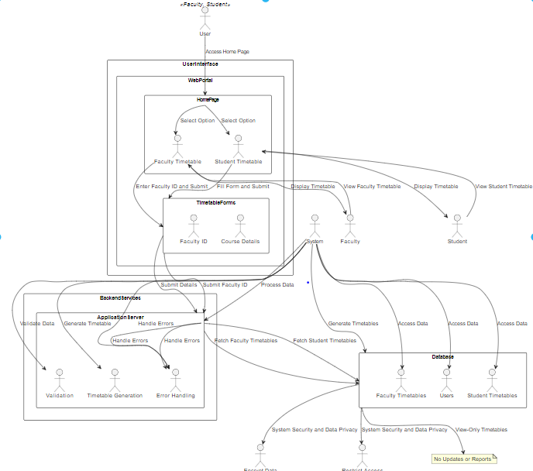
Architecture of the Model

Slide 14
Innovation in the project
1.Automated Faculty Timetable Generation
2.User-Friendly Web Portal
3.Real-Time Validation
4.Scalable and Flexible Architecture
5.Enhanced Student and Faculty Experience

Slide 15
Plan of action to complete the project
Week 1: Project Setup and Component Design
Understand project requirements and gather necessary resources.
Set up development environment (VS Code, Node.js).
Create Next.js project structure and initial setup. Begin designing components (expense list, form, header).
Week 2: Styling with CSS
Implement CSS in the project and apply styles to components.
Refine styling, ensuring consistency and responsiveness across different screen sizes.
Week 3: Data Management
Set up data models
Define relationships between data models and implement CRUD operations.
Week 4: Integration of Clerk for Authentication
Research and integrate Clerk for user authentication and authorization.
Implement user registration, login, and logout functionalities.

Slide 16
Week 5: Testing and Debugging
Test the application for functionality and usability.
Address any bugs or issues identified during testing. Conduct further testing as needed.
Week 6: Refinement and Optimization
Optimize application performance and improve code quality.
Refactor codebase for better maintainability and scalability.
Week 7: Deployment Preparation
Prepare the application for deployment.
Set up deployment environment and configure deployment settings.
Week 8: Deployment and Documentation
Write documentation including setup instructions, usage guidelines, and project overview. Review and finalize documentation.

Slide 17
References
We have referred few sites those are:
1.GeeksforGeeks
2.W3Schools
3.StackOverflow
4.https://youtu.be/A01KtJTv1oc?si=WX0ybCfx7ge10zbY
5.https://youtube.com/clip/UgkxDEuG_R5IIqFVCBLPDsilwVGkkhCwL27g?si=axoH6Buu_n80RppA

