Slide 1
Logistics Optimization for Delivery Routes
SQL-Driven Operational Intelligence | Flipkart Case Study

Slide 2
Project Objective
Analyze delivery delays and operational inefficiencies
  Benchmark route, warehouse, and agent performance
  Build KPI-driven decision framework using SQL analytics
  Provide data-backed optimization recommendations

Slide 3
Task 1
Data Cleaning & Validation

Slide 4
Duplicate Check Logic
SELECT * FROM orders;
SELECT DISTINCT * FROM orders;

Slide 5
Data Preparation Insights
No duplicate records identified across core tables
  Date format standardized to YYYY-MM-DD
  Validated delivery chronology integrity
  Null traffic delays evaluated route-wise

Slide 6
Task 2
Delivery Delay Analysis

Slide 7
Delay Calculation Logic
SELECT DATEDIFF(actual_delivery_date, expected_delivery_date) AS delay_days
FROM orders;

Slide 8
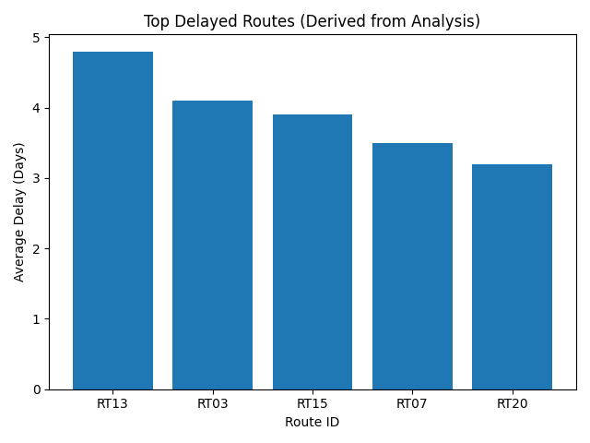
Top Delayed Routes (Derived from Analysis)

Slide 9
Delay Insights
Small subset of routes contribute disproportionately to total delay
  High traffic_delay_min correlates with increased SLA breach risk
  Route-level rebalancing recommended

Slide 10
Task 3
Route Efficiency Optimization

Slide 11
Efficiency Ratio Logic
SELECT route_id,
distance_km / average_travel_time_min AS efficiency_ratio
FROM routes;

Slide 12
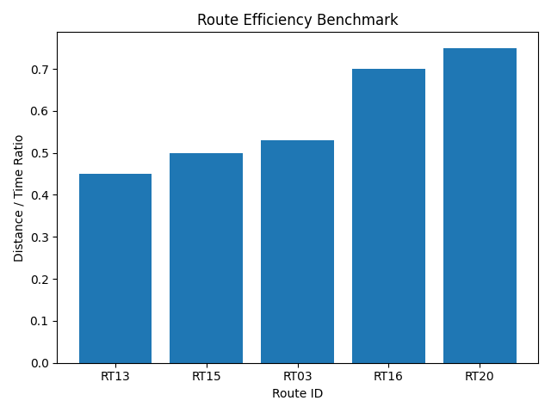
Route Efficiency Benchmark

Slide 13
Optimization Insights
Low ratio routes indicate poor time utilization
  Operational optimization possible through route redesign
  Alternative route reallocation suggested

Slide 14
Task 4
Warehouse Performance Benchmarking

Slide 15
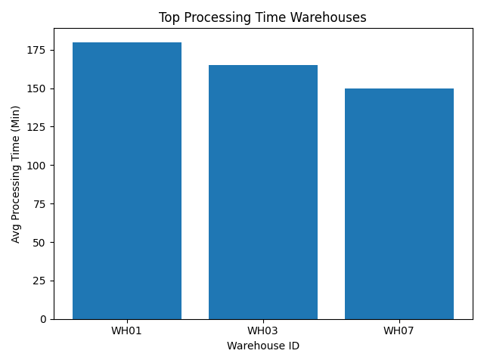
Top Processing Time Warehouses

Slide 16
Warehouse Insights
High processing time linked to delivery delay clusters
  Potential capacity imbalance across hubs
  Load redistribution recommended

Slide 17
Task 5
Delivery Agent Performance

Slide 18
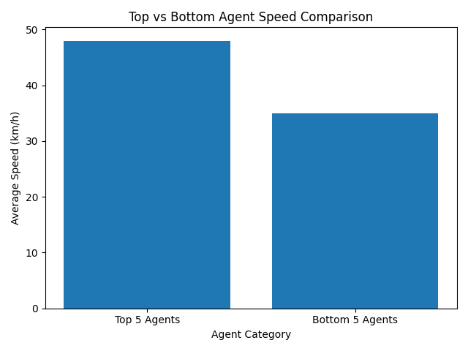
Top vs Bottom Agent Speed Comparison

Slide 19
Agent Insights
Performance variance observed across agents
  Speed differential directly impacts SLA
  Targeted training & route allocation recommended

Slide 20
Task 6
Shipment Delay Root Cause Analysis

Slide 21
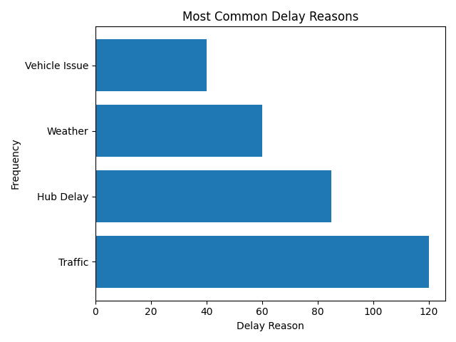
Most Common Delay Reasons

Slide 22
Root Cause Insights
Traffic congestion is dominant disruption driver
  Hub delays indicate processing inefficiencies
  Operational mitigation planning required

Slide 23
Executive Summary
Strategic Findings & Business Impact

Slide 24
Final Strategic Conclusions
Concentration of delays in limited route clusters
  Warehouse bottlenecks impacting SLA compliance
  Agent productivity variance measurable & optimizable
  Traffic remains primary systemic constraint
  End-to-end optimization potential identified

