Slide 1
Foreign Direct Investment Analytics
Project Report By
PRAGNYA

Slide 2
Project Details
Project Title | Foreign Direct Investment Analytics
Technologies | Data Science
Domain | Finance
Project Difficulties level | Intermediate
Objective
The objective of this project is to analyse Foreign Direct Investment (FDI) in India from 2000-01 to 2016-17, identifying key trends, sectoral performance, and growth patterns to provide actionable insights for investors and policymakers.

Slide 3
Problem Statement
Investment is a game of understanding historic data of investment objects under
different events but it is still a game of chances to minimize the risk we apply analytics
to find the equilibrium investment.
To understand the Foreign direct investment in India for the last 17 years from 2000-01
to 2016-17. This dataset contains sector and financial year-wise data of FDI in India
Sector-wise investment analysis Year-wise investment analysis.
Find key metrics and factors and show the meaningful relationships between
attributes. Do your own research and come up with your findings.

Slide 4
Dataset Information
The dataset covers Foreign Direct Investment (FDI) in India from 2000-01 to 2016-17.
The dataset includes sector-wise and year-wise Foreign Direct Investment (FDI) data, detailing investment amounts across various sectors and financial years. This comprehensive dataset allows for in-depth analysis of sectoral performance and investment trends over the 17-year period.

Slide 5
Architecture
Raw Data Collection
Importing Libraries In Jupyter Notebook
Load Dataset
Missing Values Imputation
Data Pre-Processing
Report
Data Cleaning
Handling Outliers
Insight
PowerBi
Desktop
Exploratory Data Analysis (EDA)

Slide 6
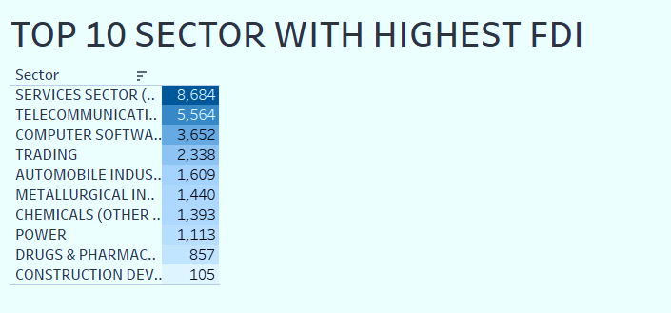
Top Sectors with Highest FDI:
The "Services Sector (Financial, Banking, Insurance, etc.)" received the highest FDI, amounting to 8,684 units.
Other top sectors include "Telecommunications" (5,564 units) and "Computer Software & Hardware" (3,652 units).
Sectors like "Trading" (2,338 units) and "Automobile Industry" (1,609 units) also attracted significant investments.

Slide 7
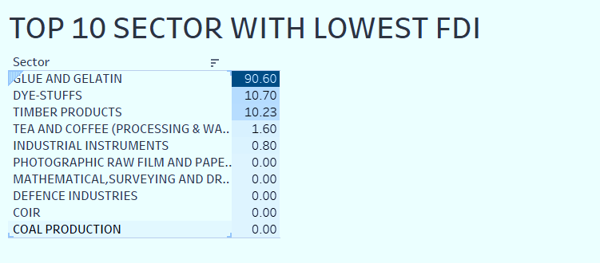
Top Sectors with Lowest FDI:
The "Glue and Gelatin" sector received the lowest FDI, with just 90.60 units.
Other sectors with minimal FDI include "Dye-Stuffs" (10.70 units) and "Timber Products" (10.23 units).
Several sectors like "Defence Industries," "Coir," and "Coal Production" received no FDI during this period.

Slide 8
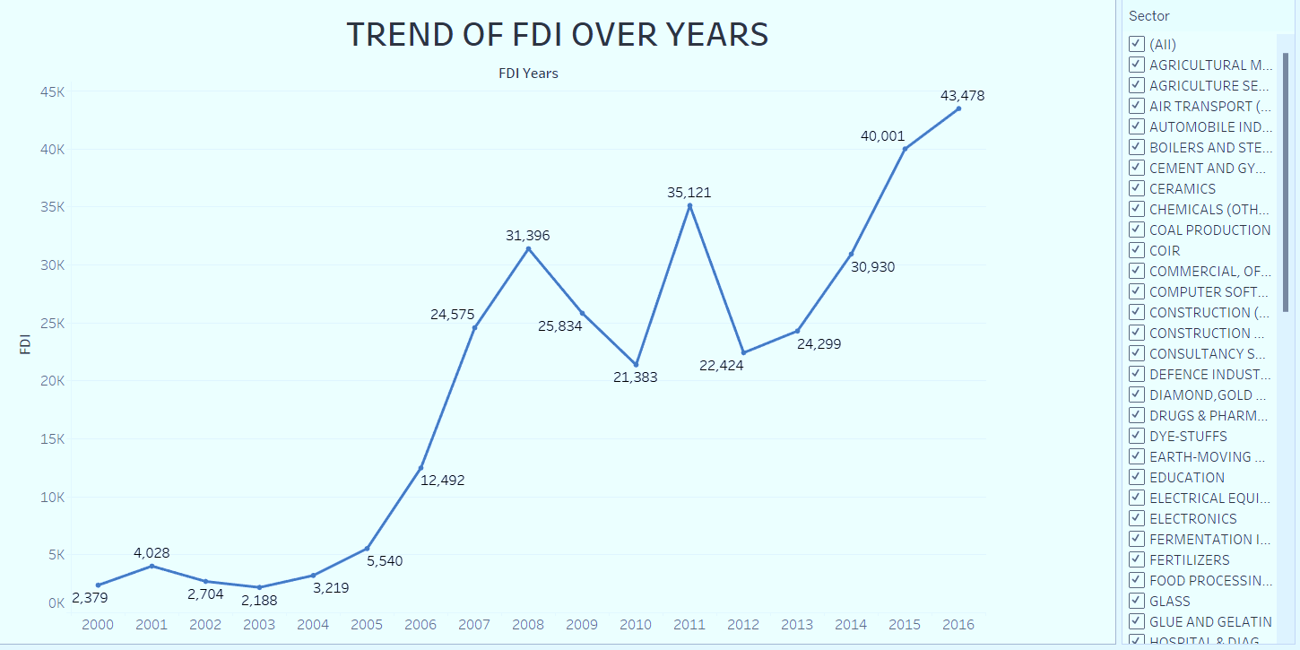
• Trend of FDI Over Years:
FDI in India has seen a significant upward trend from 2000-01 to 2016-17.
The investment started at 2,379 units in 2000-01 and showed fluctuations in the initial years.
A notable increase is observed from 2006-07 onwards, with FDI peaking at 43,478 units in 2016-17.
Key peaks include 31,396 units in 2008-09 and 40,001 units in 2015-16, indicating periods of high investment activity

Slide 9
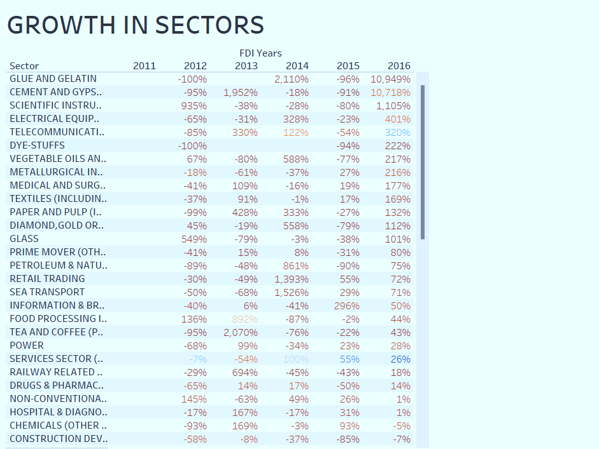
Growth in Sectors:
Volatile Growth Rates: Sectors like "Glue and Gelatin" and "Cement and Gypsum" show highly volatile growth rates, with significant fluctuations year over year.
Consistent Performers: Sectors such as "Scientific Instruments" and "Telecommunications" exhibit more stable growth trends, though still with notable variability.

Slide 10
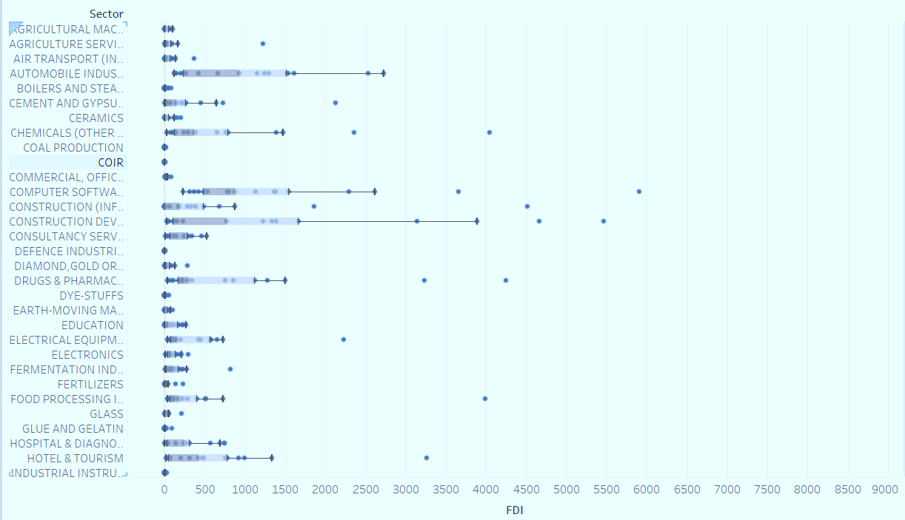
Variation Across Sectors:
There is a considerable variation in FDI across different sectors.
Some sectors like "Agricultural Machinery," "Automobile Industry," and "Chemicals" show a wide range of FDI values, indicating diverse levels of investment within these industries.
Other sectors, such as "Coal Production" and "Defence Industries," show little to no variation, highlighting the absence or uniformity of investments.

Slide 11
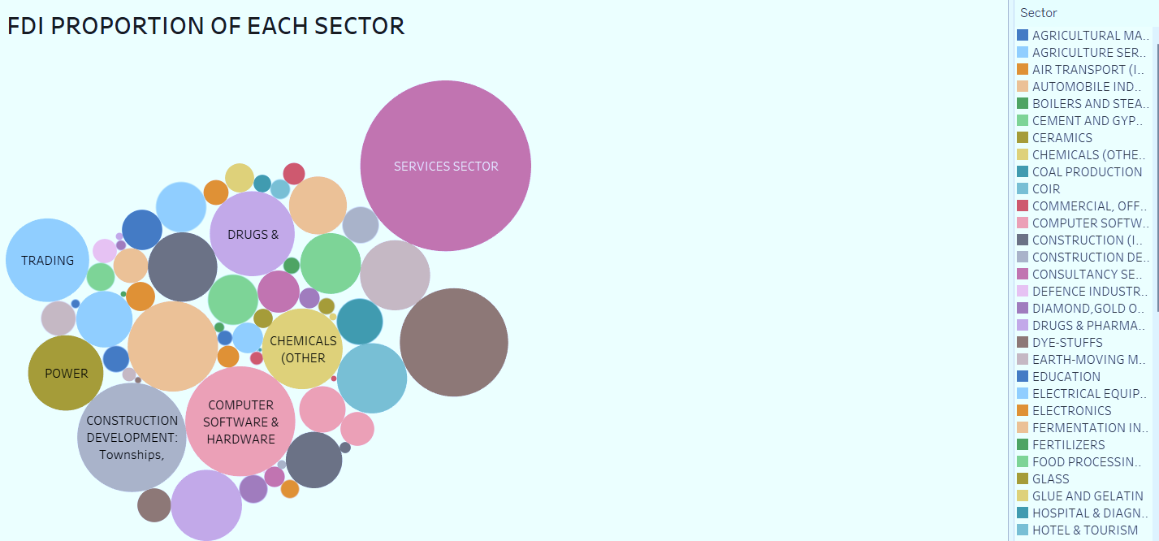
FDI by Sector Over Time:
Top Sectors by Investment: The "Services Sector" continues to dominate with consistent high FDI throughout the years. Similarly, "Telecommunications" and "Computer Software & Hardware" remain strong contenders.
Sector Growth Patterns: The growth in FDI for sectors like "Automobile Industry" and "Trading" indicates increasing investor confidence and interest in these areas. Conversely, sectors such as "Coir" and "Coal Production" show minimal to no investment growth over the years.

Slide 12
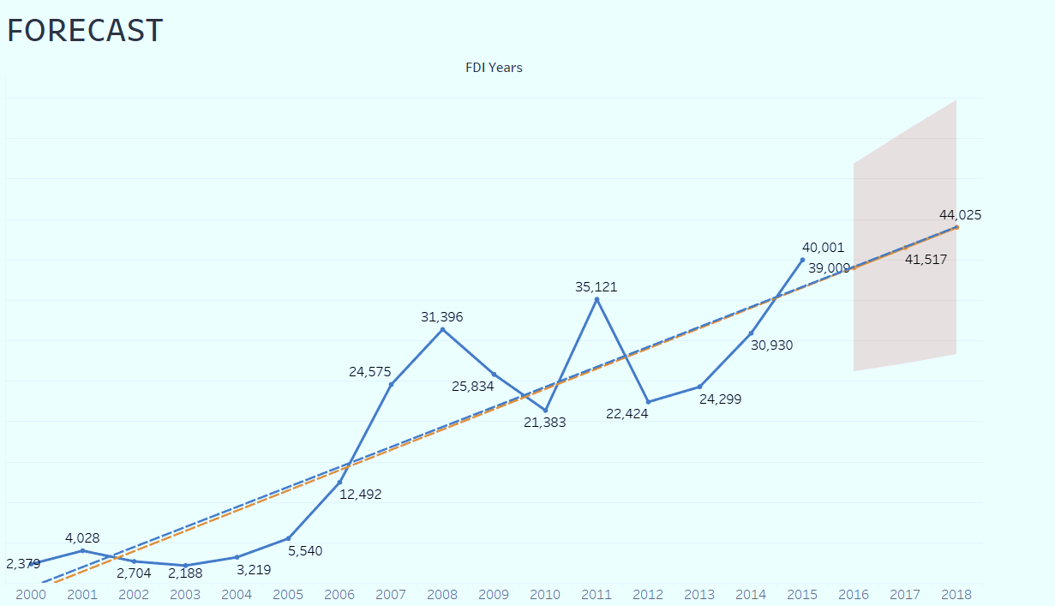
FDI Forecast Analysis:
Projected Growth: The forecast indicates a steady increase in FDI, with projections reaching around 44,025 in 2017 and 45,517 in 2018. This suggests a continued positive trend in foreign investments.
Confidence Intervals: The shaded area around the forecast line shows the confidence interval, indicating the range within which the actual FDI values are expected to fall. This provides a measure of uncertainty in the predictions.

Slide 13
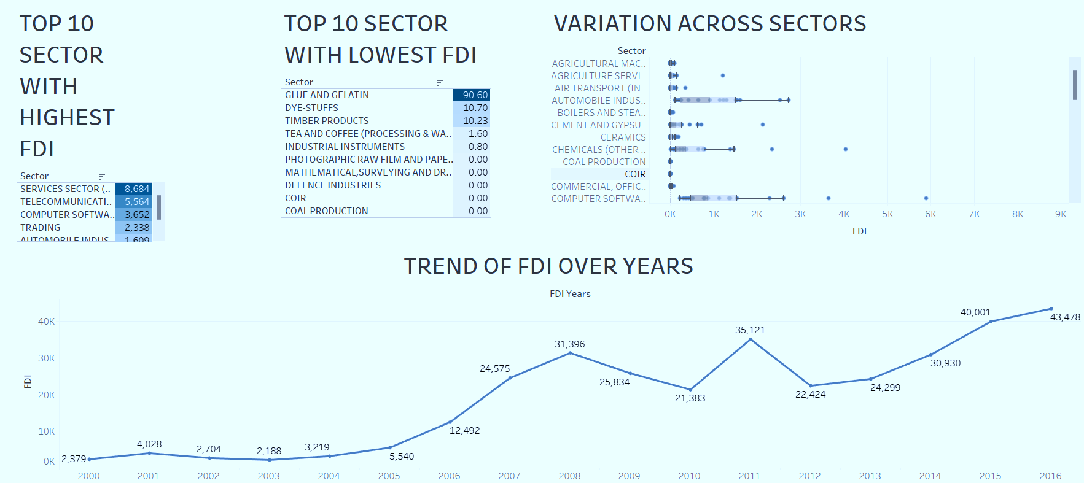
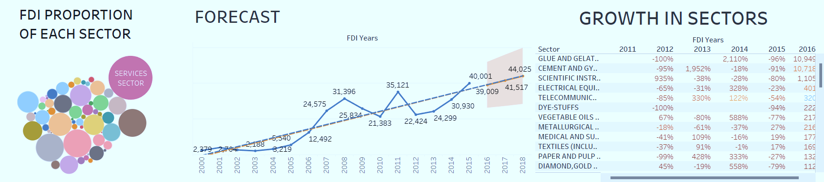

Slide 14
Conclusion
Sector-wise Analysis:
Top Performing Sectors: The Services, Telecommunications, and Computer Software & Hardware sectors received the highest FDI, indicating these areas are the most attractive to investors.
Underperforming Sectors: Glue and Gelatin, Dye-Stuffs, and Timber Products sectors saw minimal FDI, highlighting potential areas for policy improvement or targeted growth strategies.
Sectoral Volatility: Growth rates across sectors were highly variable, suggesting both significant opportunities and risks depending on the sector.
Year-wise Analysis:
Overall Upward Trend: FDI in India showed a strong upward trend from 2000-01 to 2016-17, with significant peaks in 2008-09 and 2015-16, reflecting increasing investor confidence over time.
Forecasted Growth: Projections indicate continued growth in FDI, suggesting a favourable investment climate and positive outlook for future investments.
Key Growth Periods: Specific years such as 2007-08, 2011-12, and 2015-16 saw notable spikes in FDI, driven by policy changes or economic events.

Slide 15
THANK YOU

